Slide 1
Titanic Survival Prediction
Najib Abdullahi
Baze University Abuja
Course: Titanic Survival Prediction

Slide 2
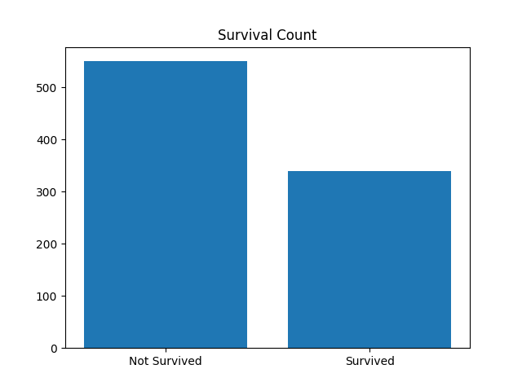
Survival Count

Slide 3
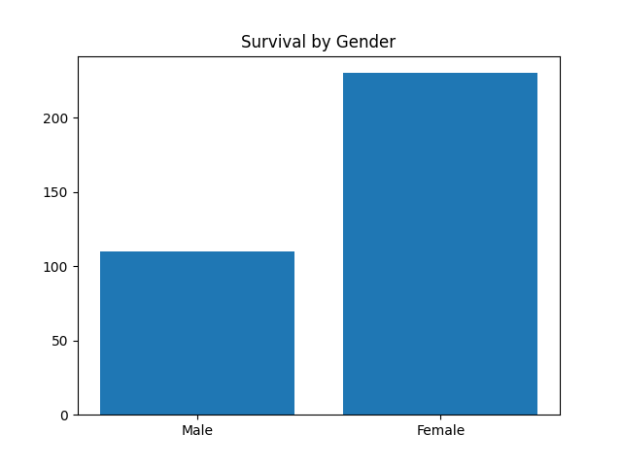
Survival by Gender

Slide 4
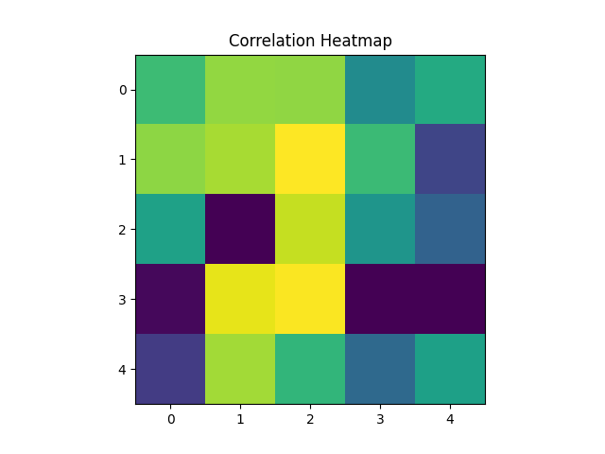
Heatmap

