Slide 1

Flexing game 100
Laser your friends
Grinding mode
Ludicrous upgrades

Slide 2
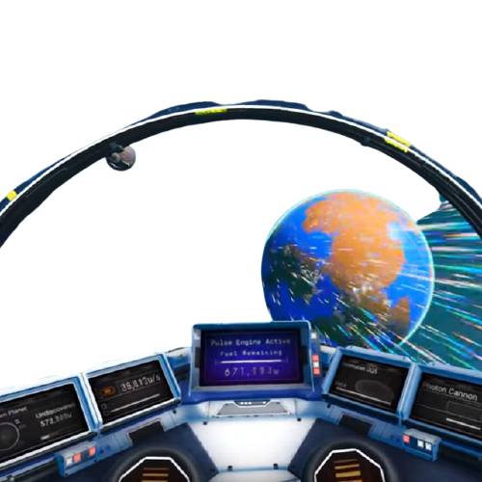
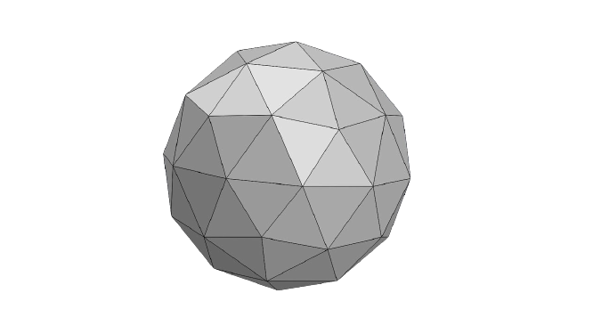

Slide 3


Slide 4
