Slide 1
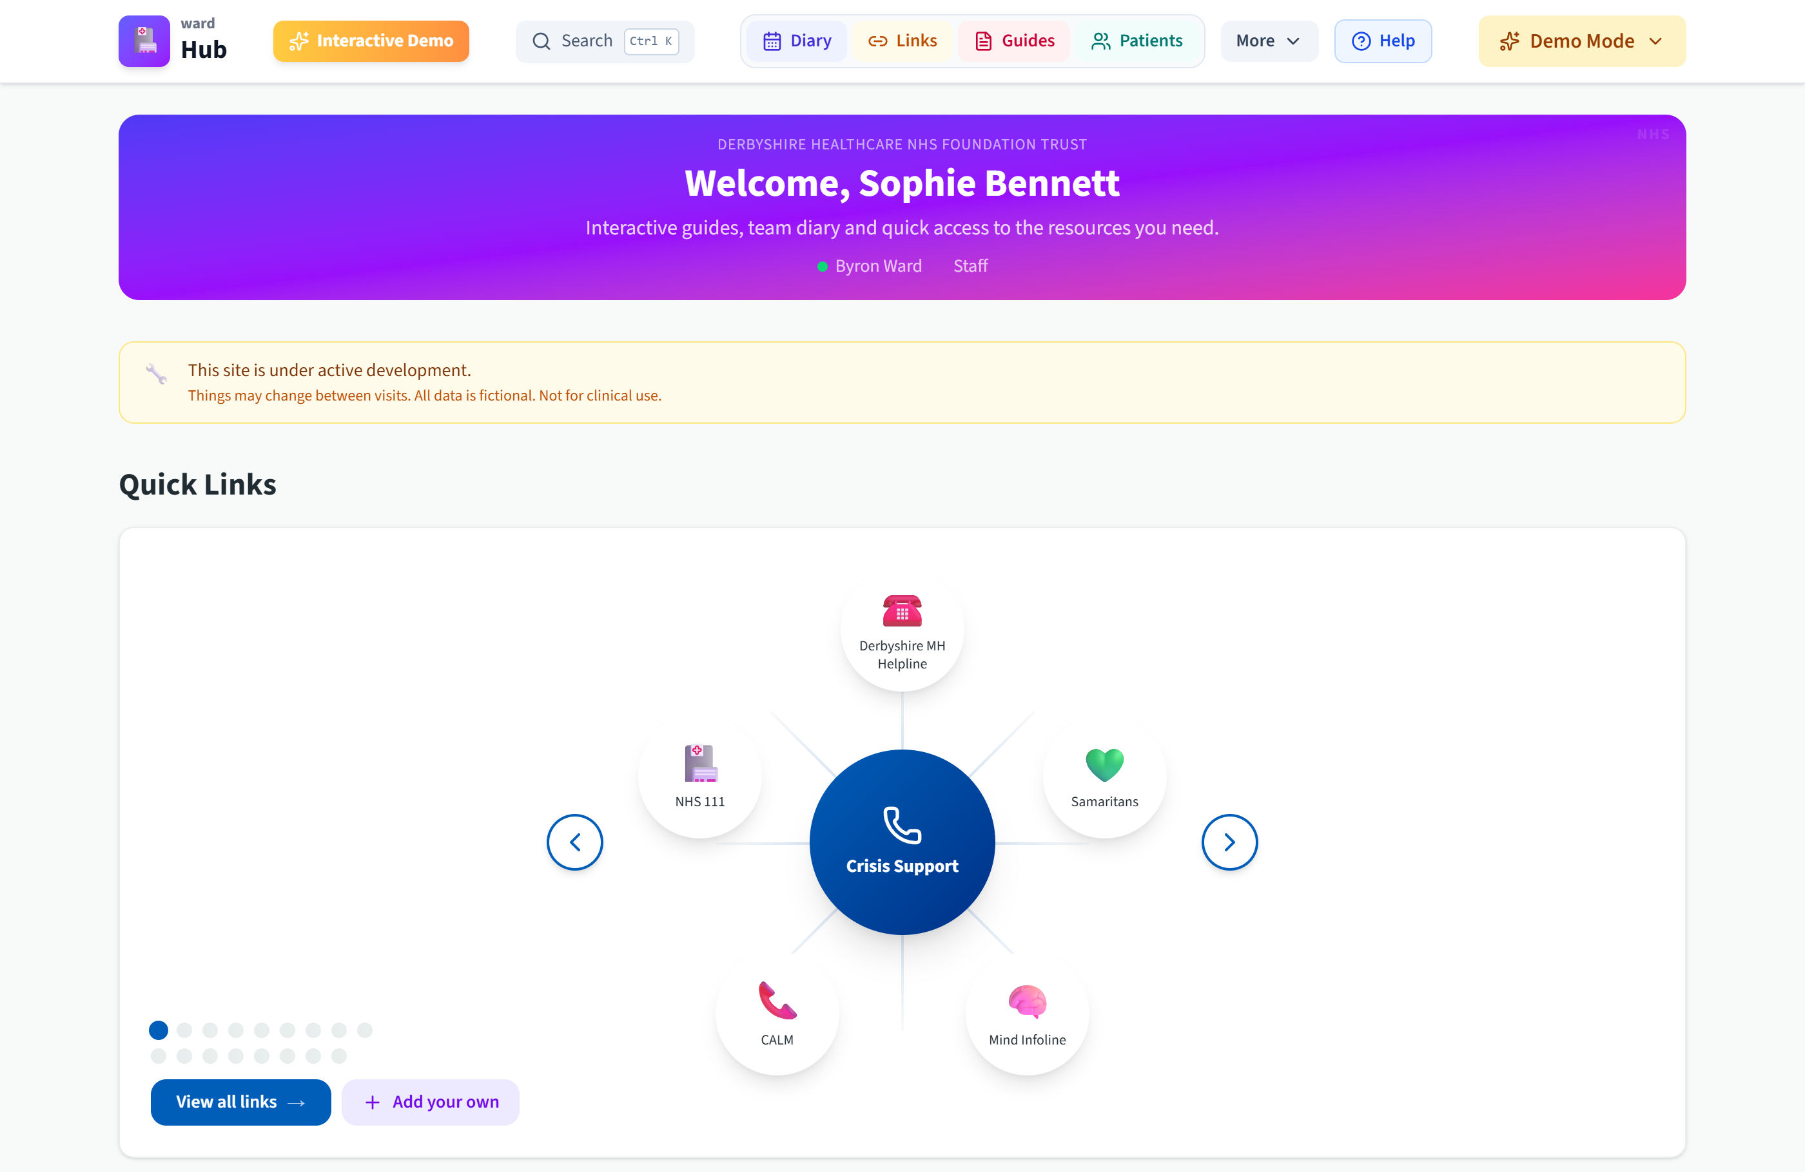
wardHub
One place for everything the ward needs.
Built by a nurse, for nurses.
Mike Sharpe · Ward nurse in charge
Derbyshire Healthcare NHS Foundation Trust
www.wardhub.live
Notes:
Evening everyone, I'm Mike. I run shifts as nurse in charge on one of our acute wards. wardHub is a tool I built in my own time, on the ward, because I was fed up watching good staff lose time hunting for things they need right now. Ten minutes from me, and at the end it's live on your own phone if you want a play.

Slide 2
Ten past three in the morning
A new starter needs the seclusion SOP. Now.
Is it on the intranet? In a red folder in the office? Does the nurse next to her know it by heart, and is her memory of it current?
That hunt happens on every shift, for every kind of task. Referral forms, section paperwork, service phone numbers, ward routines.
The intranet
Paper folders
Where is the seclusion SOP?
Someone's memory
The nurse next to you
Time lost hunting. Risk of acting on stale guidance.
Notes:
Picture a new starter, ten past three in the morning, patient in seclusion. She needs the SOP. Is it on the intranet? A red folder? Ask the nurse next to her, who is on a break? That hunt is real, it happens every shift, and the version she eventually finds might be three years out of date. That is the whole problem wardHub exists to fix.

Slide 3
One website, everything in it
64
clinical guides and referral walkthroughs
364
sourced quiz questions
113
ward links, checked and categorised
109
local services on an eligibility map
The home page: crisis numbers front and centre
Counts measured in the code, July 2026. Every patient and staff name in the demo is fictional.
Notes:
So wardHub is one website with everything on it. Sixty-four guides, a training quiz, all the links the ward actually uses, and a map of local services. Those numbers are real, we counted them in the code this month, not off a brochure. And everything you will see today runs on made-up patients on made-up wards.

Slide 4
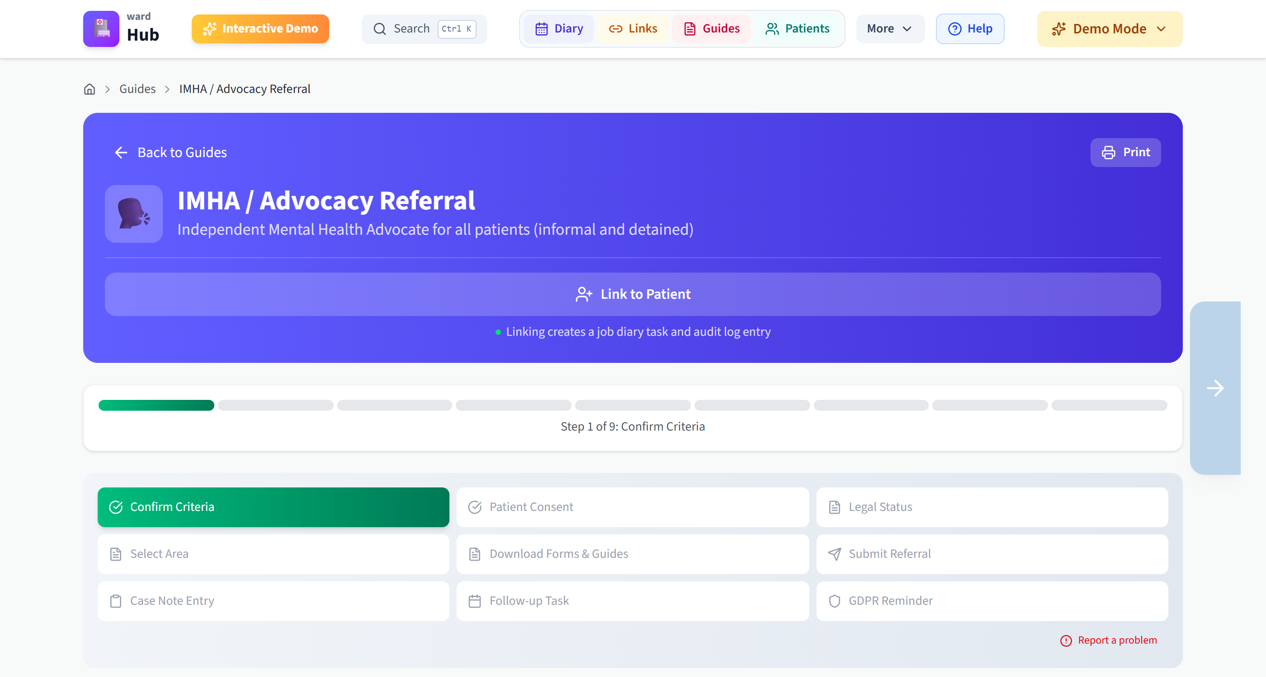
A referral that finishes itself
17
step-by-step referral walkthroughs
Criteria check first, so no wasted referrals
Branches for Derby City and Derbyshire County
Blank form, a worked example, and where to send it
Then it writes the case note. Copy, paste into SystmOne, done
Every guide prints for the ward folder
The advocacy referral: nine steps, one case note at the end
Notes:
This is the advocacy referral. It walks you through step by step. Checks the criteria first, branches for city or county because the providers differ, hands you the form and a worked example, tells you exactly where to send it. Then the bit staff love: it writes the case note for you. Copy, paste straight into SystmOne. The paperwork stops being the reason a referral does not happen.

Slide 5
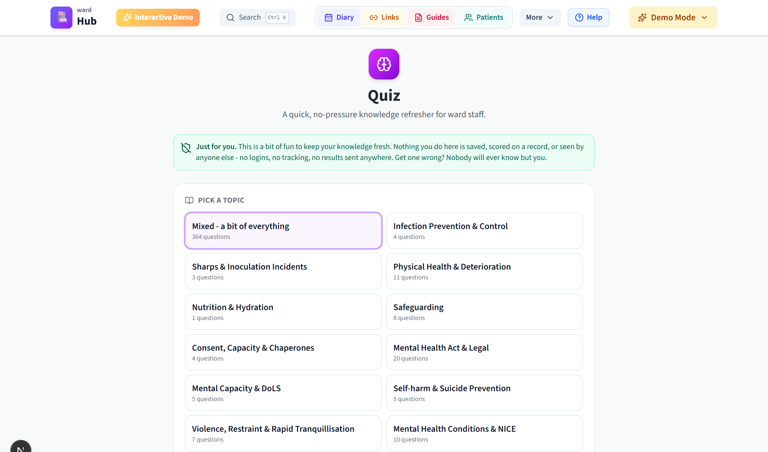
364 questions, every one sourced
Sourced from NICE, the BNF, NMC guidance and the MHA code of practice
26 topics, three difficulty levels
Every answer explains itself and cites its source
No logins, no scores kept, nothing sent anywhere
Made for quiet nights, not for mandatory training
Pick a topic, or take a bit of everything
Notes:
The quiz has 364 questions and every single one carries its source: NICE, the BNF, the Mental Health Act code, NMC guidance. Get one wrong and it tells you why, with the reference. There is no score kept and nobody watching, which is exactly why people use it on quiet nights. I am still proofreading the bank myself, so it is flagged as draft in the app, honestly labelled like everything else.

Slide 6
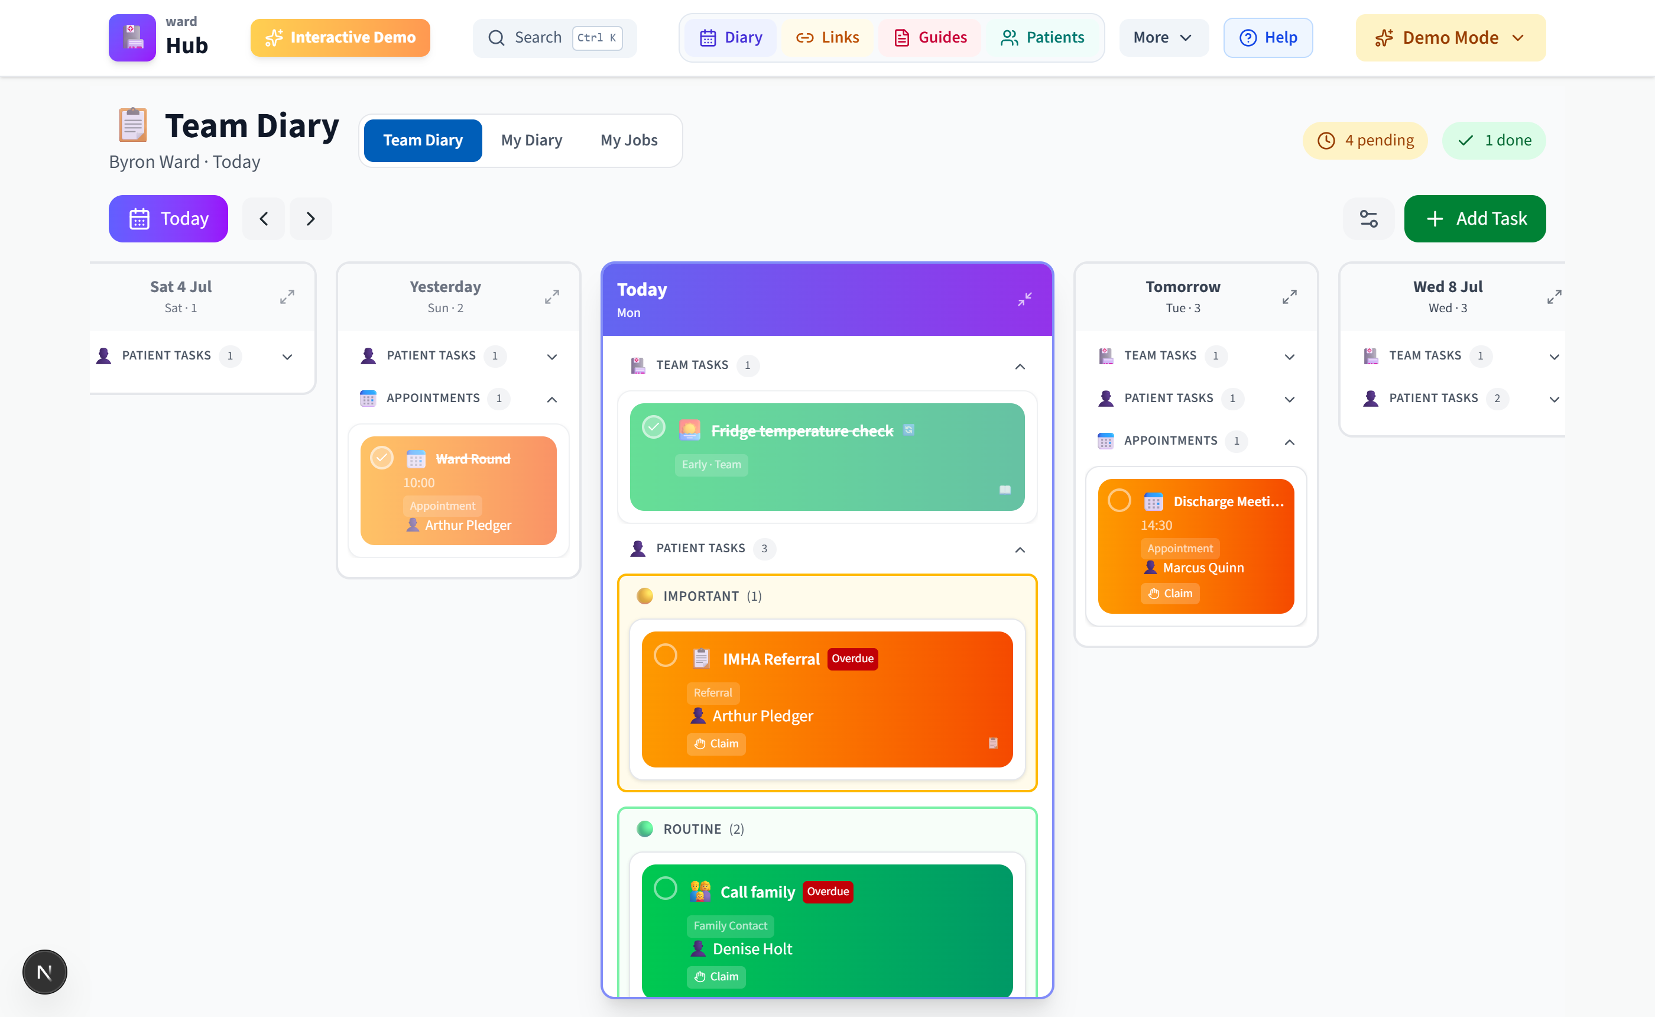
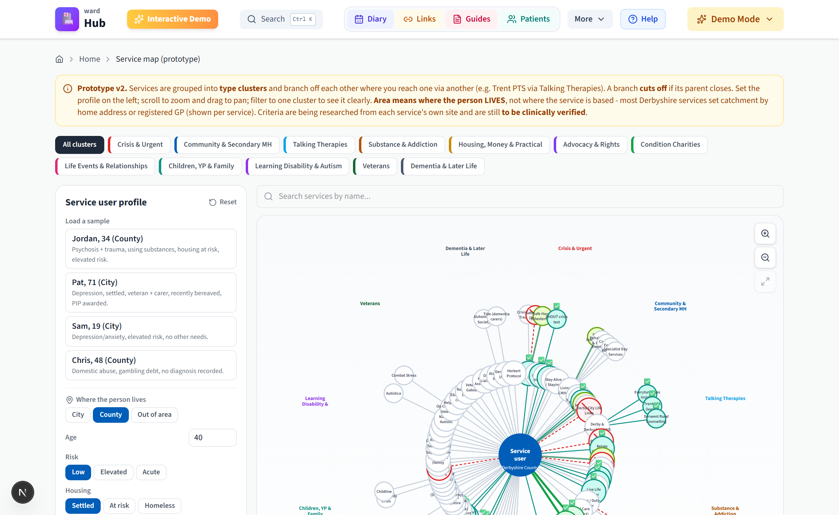
The team diary and the service map
Shared ward tasks that survive handover, and a live picture of which local services will actually take a person.
Team diary: claim it, hand it over, tick it off
Service map: 109 services, filtered by the person's circumstances
Notes:
Two more pieces. The diary is the ward's shared to-do list: anyone can claim a task, hand it over, and nothing falls down the gap between shifts. The service map answers 'who will actually take this person', filtered by where they live and their needs. Both run on fictional demo data today, and the map's criteria are marked as needing clinical verification. Again: labelled honestly.

Slide 7
Every guide wears its approval status
Passed
Awaiting approval
In development
Signed off. Safe to rely on.
The default for new content. Visible on the tile, treat with care.
A draft, and it says so before you open it.
Content review is a feature of the product, not a spreadsheet kept somewhere else. One editable file controls every light, and changing it is an audited edit.
Notes:
Every guide and every link carries a traffic light on its tile. Green means signed off. Amber means awaiting approval, and that is the default, nothing sneaks in as approved. Red means still in development and says so. Right now most of the content sits at amber or red, deliberately, because clinical sign-off is exactly what I am here to ask the trust to help with. The review process is on the page, in front of the staff using it.

Slide 8
No patient data. Nothing leaves the device.
The user's own browser
Any other server
Everything typed stays on the device
Demo diary wiped on refresh
One click clears the lot
X
Blocked by the Content Security Policy. The browser itself refuses to send data to any other host.
No patient data
No accounts
No tracking
Audited: the claim held
Notes:
This is the slide I want you to remember. There is no patient data in wardHub. Nothing anyone types ever leaves their own computer. No accounts, no tracking, no analytics, and the fonts are self-hosted so there is not even a font request going out. It is not a promise, it is enforced: the security policy means the browser physically refuses to talk to any other server. A line-by-line audit went through the code and the live site this week, and the claim held.

Slide 9
The homework is already written
DPIA draft
ICO structure. Covers today's demo and the proposed live build.
Clinical safety hazard log
DCB0129 set: hazard log, case report, management plan.
Security review
Zero high-severity findings. The one medium was fixed the same day.
Accessibility statement
WCAG 2.1 AA. Zero automated violations on every audited page.
Data governance audit
Twelve findings, eleven fixed within the week. One awaits a decision.
Data inventory and rebuild pack
Every content count measured. Hosting options costed and compared.
It needs trust review, not trust writing.
Notes:
I did not want to turn up asking the trust to do my paperwork. So it is written. A DPIA draft in the ICO's own structure, a clinical safety hazard log against DCB0129, a security review, an accessibility statement, a full data governance audit, and a rebuild pack that prices up the hosting options. All of it is honest about what is outstanding. It needs trust eyes and trust signatures. It does not need writing from scratch.

Slide 10
SystmOne stays the record
wardHub
The ward's guidance and capture layer. Guides, checklists, prompts, drafts.
SystmOne
The clinical record. Unchanged, untouched, still the single source of truth.
copy to notes,
one click
wardHub holds the know-how. It helps staff write a better entry into the record, and stores none of it.
Notes:
Worth saying plainly: wardHub does not compete with the clinical record and never will. SystmOne is the record. wardHub is the layer that helps staff do the job, then hands them a better-written entry to paste into SystmOne. Copy out, paste in. That is the whole relationship, and it is why this can be useful on day one without touching a single clinical system.

Slide 11
What it has cost the trust
£0
Built in my own time
Evenings, nights and days off. No trust hours used.
Hosting costs pennies
A static site. Trust hosting would cost about the same.
to date
The ask is time, not money
Review hours from IG and clinical safety, not budget.
Notes:
Cost so far to the trust: nothing. I built it in my own time and the hosting is pennies a month. I am not here asking for budget, and I am not selling anything. What I need is some people's time to review what is already written.

Slide 12
Three asks
A named contact
Someone from IG and clinical safety to review the prepared pack with me. The documents exist; they need trust review.
1
A pilot on one ward
The no-patient-data build, on my ward, so we learn what staff actually use before anything bigger.
2
A decision path for hosting
Agree the route to running wardHub inside the trust boundary, so the 'nothing leaves' claim becomes 'nothing leaves the trust'.
3
Notes:
Three asks, none of them expensive. One: a named IG or clinical safety contact to go through the pack with me, a few hours of someone's time. Two: a pilot on one ward, mine, with the version that holds no patient data at all. Three: a decision path for moving the hosting inside the trust. That is the whole ask.

Slide 13
If the trust says yes
1
2
3
4
Trust login
Single sign-on with trust accounts
Trust hosting
Data and logs inside the trust boundary
SystmOne link
Case notes and tasks, with full approval
Contacts directory
The numbers staff actually ring, kept current
In that order, each step behind its own sign-off. Nothing here starts without approval, and the product is useful from step zero.
Notes:
If the trust says yes, the sensible order is: trust logins first, then hosting inside the trust boundary, then the SystmOne link, then a proper contacts directory. Each step waits for its own sign-off. I would rather do this slowly and properly than quickly and badly, and the guides are useful to staff before any of it happens.

Slide 14
See it for yourself.
www.wardhub.live
Live now, on any device. Phones included. All data fictional.
Mike Sharpe · Ward nurse in charge · Derbyshire Healthcare NHS Foundation Trust
Notes:
That is the ten minutes. wardhub.live works right now on the phone in your pocket, all fictional data, so have a poke around tonight. I am happy to do a live walkthrough now, or come and demo it to any of your teams. Thank you.

