Slide 1
Cascading Style Sheet

Slide 2
CSS Cascading
Cascading - the process by which the browser determines which style rules to apply when multiple rules target the same element
Cascading order from highest priority to lowest priority:
!important: Highest priority, regardless of source.
Inline styles: Next in priority, unless overridden by !important.
Internal CSS: Styles within a <style> tag which apply only to that document.
External CSS: Styles from external CSS files linked to the HTML document, which apply globally across multiple pages.
Browser/User styles: Defaults or user-defined preferences.
!important > Inline CSS > Internal CSS > External CSS > Browser/User styles

Slide 3
Here's how it works?
Specificity: CSS rules with more specific selectors take priority over less specific ones. For example, an ID selector (#header) is more specific than a class selector (.header), so it will override it if both are applied to the same element.
Importance: Styles marked with !important take precedence over all other styles, even if they are less specific. However, overusing !important can lead to maintenance problems and should be avoided unless absolutely necessary.
Source Order: When two rules have the same specificity and importance, the order in which the rules are defined matters. The later rule (appearing further down the CSS file or in the later <style> block) will override the earlier one.

Slide 4

CSS Cascading – Example 1
<html>
<head>
<link rel="stylesheet" href="index.css">
<style>
h1 {
background-color: red;
}
</style>
</head>
<body>
<h1 style="background-color: blue;">Cascading in CSS</h1>
</body>
</html>
Index.css h1{ background-color: brown !important }

Slide 5
CSS Cascading – Alternate stylesheet
light.css
body{
background-color:lightyellow;
}
<html>
<head>
<link rel=" stylesheet" type="text/css" title="light theme" href="light.css" >
<link rel=" alternate stylesheet" type="text/css" title="lighter theme" href="lighter.css" >
<link rel="alternate stylesheet" type="text/css" title="dark theme" href="dark.css" >
<style>
p {font-size:20px;}
</style>
</head>
<body>
<h1 style="letter-spacing:normal">Hello World!</h1>
<p>Paragraph 1</p>
<p>Paragraph 2</p>
<p>Paragraph 3</p>
<p>Paragraph 4</p>
<p>Paragraph 5</p>
</body>
</html>
lighter.css
body{
background-color: lightpink;
color: white;
letter-spacing: 3px;
}
dark.css
body{
background-color: lightblue;
color: white;
}

Slide 6
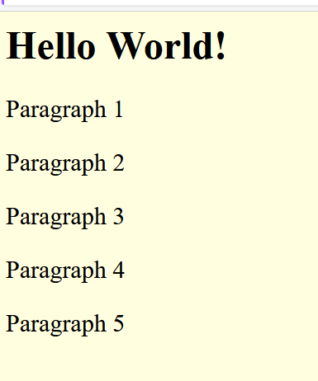
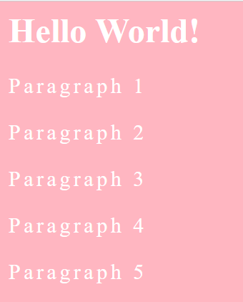
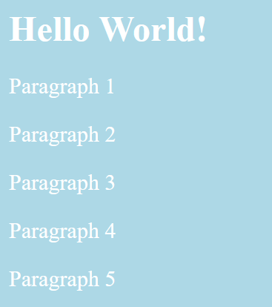
Lighter theme
CSS Cascading – Alternate stylesheet
Light theme
Dark theme
For checking alternate style sheet
→ Open html file with Firefox browser and press alt to get menu bar
→ in view menu bar --> under style --> we will be able to see the titles of the alternate style sheets
→ Choose style to view the application of styles

Slide 7
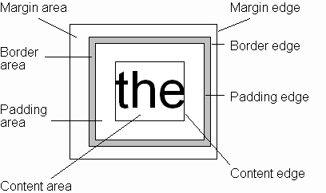
CSS Box model
Every rendered element occupies a box:
(or outer edge)
(or inner edge)

Slide 8
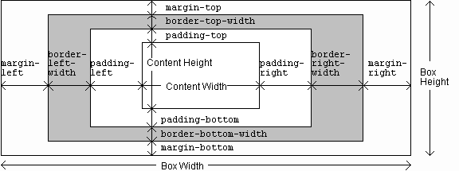
CSS Box model

Slide 9
CSS Box model

Slide 10
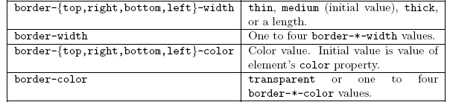
CSS Box model

Slide 11
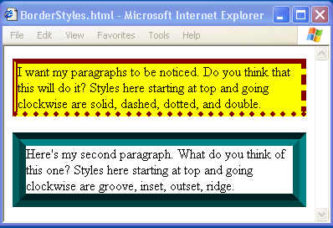
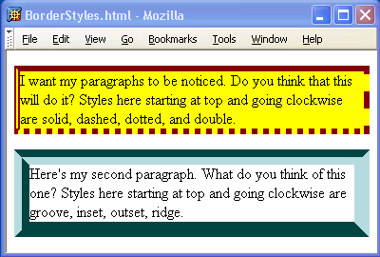
CSS Box model

Slide 12
CSS Box model

Slide 13
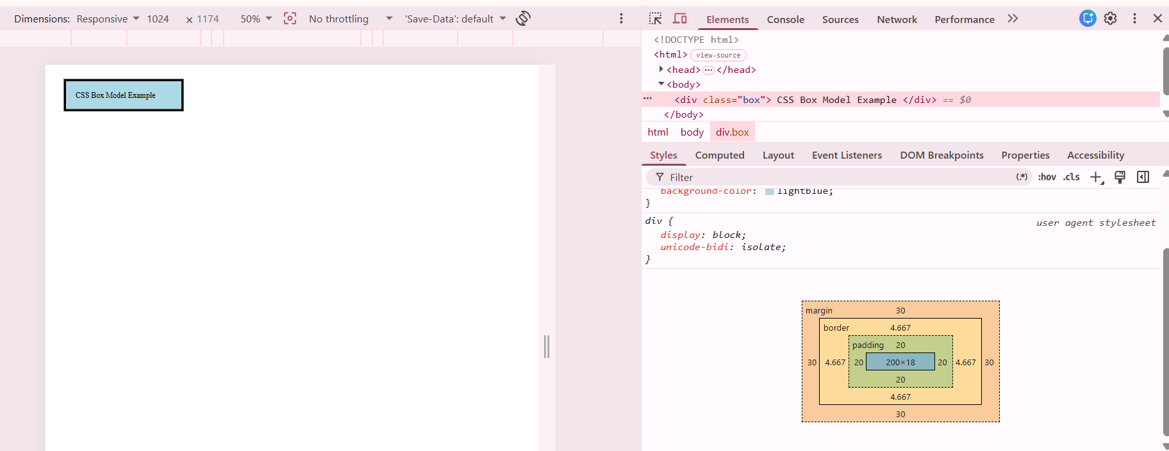
CSS Box model - Example
describes how every HTML element is represented as a rectangular box
determines the space an element occupies on a webpage

Slide 14
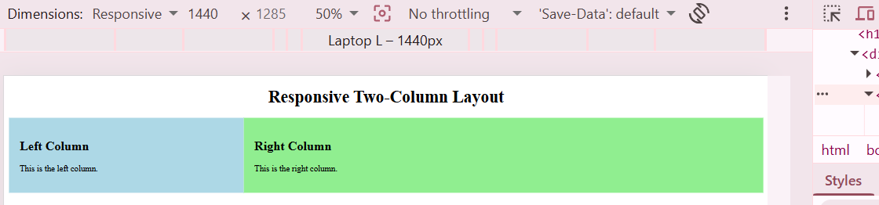
Responsive Layout – Two Columns
→ that automatically adjusts its structure, size, and arrangement to fit different screen sizes and devices, such as desktops, laptops, tablets, and mobile phones.

Slide 15
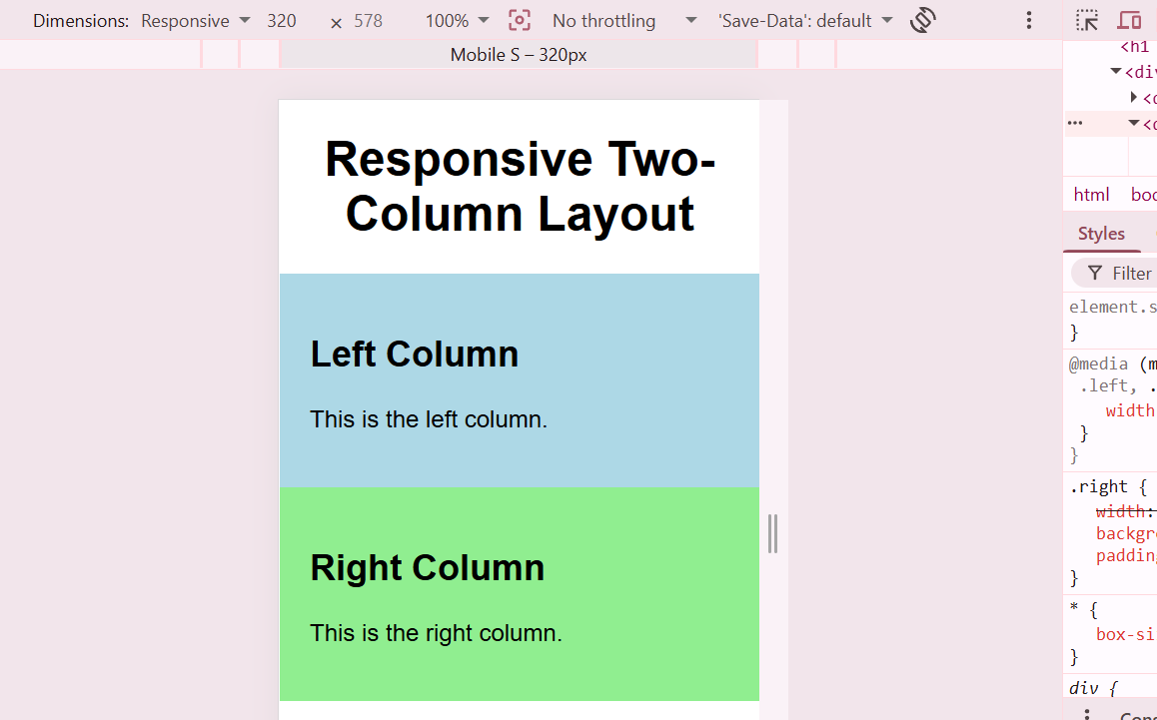
Responsive Layout - Two Columns

Slide 16
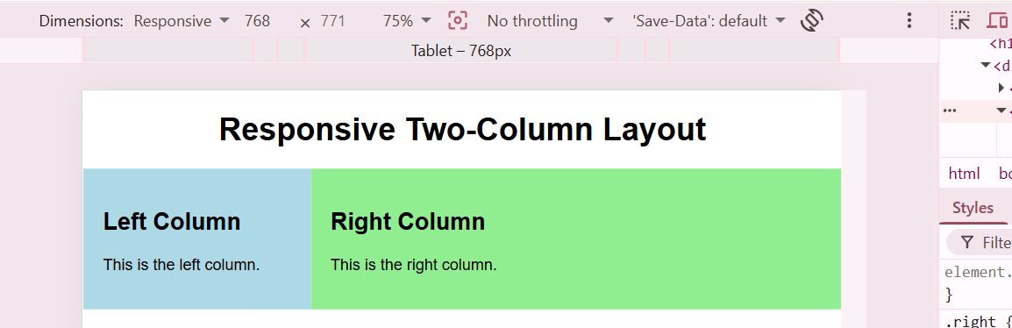
Responsive Layout - Two Columns

Slide 17
Responsive Layout - Example
<style>
.container { display: flex; }
.left {
width: 30%;
background-color: lightblue;
padding: 20px;
}
.right {
width: 70%;
background-color: lightgreen;
padding: 20px;
}
/* Responsive Layout */
@media (max-width: 600px) {
.container {
flex-direction: column;
}
.left,
.right {
width: 100%;
}
}
</style>
<body>
<h1 style="text-align:center;">Responsive Two-Column Layout</h1>
<div class="container">
<div class="left">
<h2>Left Column</h2>
<p>This is the left column.</p>
</div>
<div class="right">
<h2>Right Column</h2>
<p>This is the right column.</p>
</div>
</div>
</body>
<meta name="viewport" content="width=device-width, initial-scale=1.0">
initial-scale=1.0
Specifies the initial zoom level when the page first loads.
Display the page at 100% zoom (no zoom in or out).

Slide 18
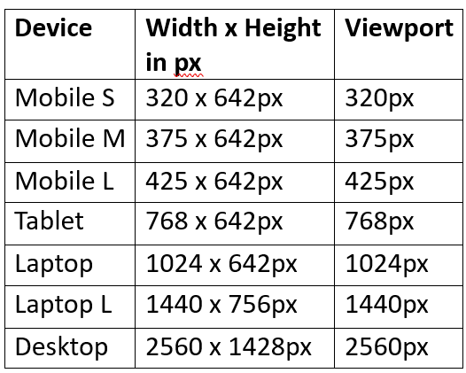
Various Device Width for Viewport - Details

Slide 19
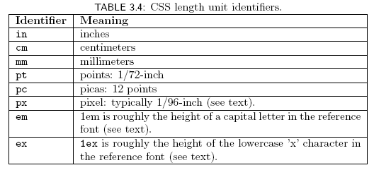
CSS Font Properties
Many properties, such as font-size, have a value that is a CSS length
All CSS length values except 0 need units

Slide 20
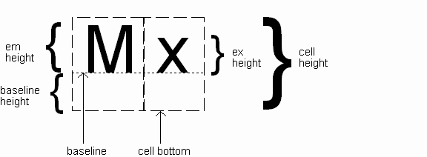
CSS Font Properties
Computed value
of font-size
property

Slide 21
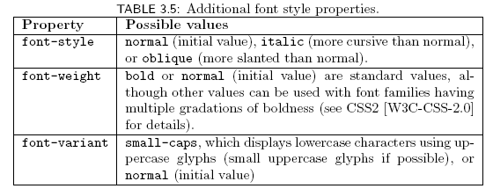
CSS Font Properties

Slide 22
CSS Text Formatting

Slide 23
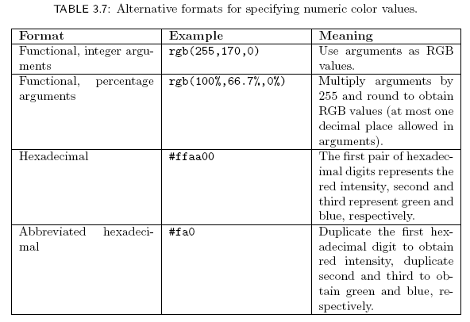
CSS Text Color

