Slide 1
HTTP Request & Response Message

Slide 2
Session Objectives
To learn the HTTP request & response messages
Notes:
Student Notes:
The objective of the session is to introduce the concept of services and how these are management. There are standards and frameworks that enable the organization to manage the services. These are also introduced in this session.

Slide 3
Session Outcomes
At the end of this session, participants will be able to
  Understand the communication of messages between web server and the web client

Slide 4
Agenda
  HTTP Request Message
  HTTP Response Message

Slide 5

HTTP Request and Response messages
Dr. B. Prabavathy
SSNCE

Slide 6
World Wide Web
The Web is the collection of machines (Web servers) on the Internet that provide information, particularly HTML documents, via HTTP
Machines that access information on the Web are known as Web clients. A Web browser is software used by an end user to access the Web

Slide 7
What a web client (web browser) will do?
Normally implemented over a TCP connection (80 is standard port number for HTTP)
Typical browser-server interaction:
  User enters Web address in browser
  Browser uses DNS to locate IP address
  Browser opens TCP connection to server
  Browser sends HTTP request over connection
  Server sends HTTP response to browser over connection
  Browser displays body of response in the client area of the browser window

Slide 8
What a web server will do?
Basic functionality:
  Receive HTTP request via TCP
  Map Host header to specific virtual host (one of many host names sharing an IP address)
  Map Request-URI to specific resource associated with the virtual host
    File: Return file in HTTP response
    Program: Run program and return output in HTTP response
  Map type of resource to appropriate MIME type and use to set Content-Type header in HTTP response
  Log information about the request and response

Slide 9
URI, URL and URN
Uniform Resource Identifier (URI)
  URI is the superset of both URL and URN
  URL, and URN are used to identify any resource or name on the internet
    URL – Uniform Resource Locator
    URN – Uniform Resource Name

Slide 10
Uniform Resource Name
URN just uniquely identifies the resource e.g. ISBN numbers which are a good example of URN is used to identify any book
URN Example
  urn:uuid:6e8bc430-9c3a-11d9-9669-0800200c9a66

Slide 11
URL Example
A URL usually consists of the following components:
Protocol, domain, path (or pathname), hash and query string.
Protocol is the technology that will be used to transfer the data, usually http or https
  Domain is the the domain name, tealium.com for example.
  Path relates to the section and page on the site
  Query string contains data that is being passed to the page
  Hash relates to a section within the page

Slide 12
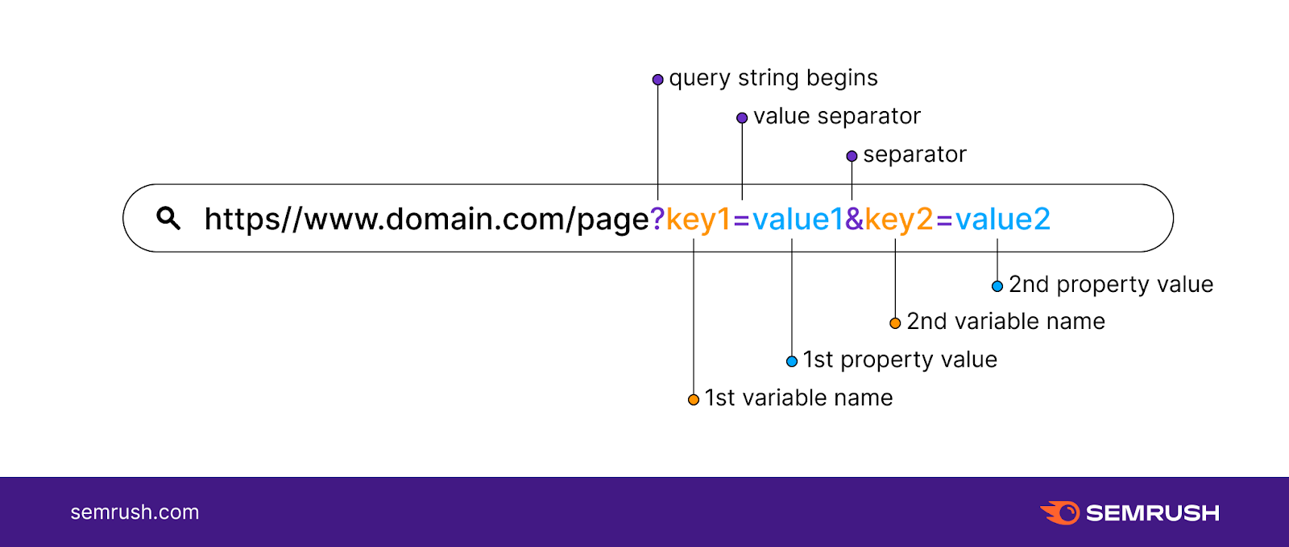
URL & URN Examples
URL Example
  http://tealium.com/solutions/?example=test&example2=test2
  domain: "tealium.com"
  pathname: "/solutions/"
  query_string: "example=test&example2=test2"

Slide 13
Hypertext Transfer Protocol
HTTP is based on the request-response communication model:
  Client sends a request
  Server sends a response
HTTP is a stateless protocol:
  The protocol does not require the server to remember anything about the client between requests.

Slide 14
HTTP Request
Every HTTP request message has the same basic structure:
  Start line
  Header field(s) (one or more)
  Blank line
  Message body (optional)

Slide 15
HTTP Request
Start line
  Example: GET / HTTP/1.1
Three space-separated parts:
  HTTP request method
  Request-URI
  HTTP version

Slide 16
HTTP Request
Common request methods:
  GET
    Used if link is clicked or address typed in browser
    No body in request with GET method
  POST
    Used when submit button is clicked on a form
    Form information contained in body of request
  HEAD
    Requests that only header fields (no body) be returned in the response

Slide 17
HTTP Request
Header field structure:
  field name : field value
Syntax
  Field name is not case sensitive
  Field value may continue on multiple lines by starting continuation lines with white space
  Field values may contain MIME types, quality values, and wildcard characters (*’s)

Slide 18
Multipurpose Internet Mail Extensions (MIME)
Convention for specifying content type of a message
  In HTTP, typically used to specify content type of the body of the response
MIME content type syntax:
  top-level type / subtype
Examples: text/html, image/jpeg

Slide 19
HTTP Quality Values and Wildcards
Example header field with quality values:
accept:
text/xml,text/html;q=0.9,
text/plain;q=0.8, image/jpeg,
image/gif;q=0.2,*/*;q=0.1
Quality value applies to all preceding items
Higher the value, higher the preference
Note use of wildcards to specify quality 0.1 for any MIME type not specified earlier

Slide 20
1. GET Used to retrieve data from the server. Example: GET /products HTTP/1.1 Host: www.example.com Response: [ {"id":1,"name":"Laptop"}, {"id":2,"name":"Phone"} ] Characteristics: Read-only Parameters sent in URL | 2. POST Used to create a new resource. Example: POST /users HTTP/1.1 Content-Type: application/json { "name":"John", "age":25 } Characteristics: Data sent in request body
3. PUT Used to replace or update an existing resource completely. Example: PUT /users/101 HTTP/1.1 { "name":"John", "age":30 } Characteristics: Entire resource is updated | 4. PATCH Used to update only specific fields. Example: PATCH /users/101 HTTP/1.1 { "age":30 } Only the age is modified.
5. DELETE Used to remove a resource. Example: DELETE /users/101 HTTP/1.1 Response: HTTP/1.1 204 No Content | 6. HEAD Similar to GET but returns headers only, not the body. Example: HEAD /index.html HTTP/1.1 Used to: Check file existence Get content length

Slide 21
Header Fields
Common header fields:
  Host: host name from URL (required)
  User-Agent: type of browser sending request
  Accept: MIME types of acceptable documents
  Connection: value close tells server to close connection after single request/response
  Content-Type: MIME type of (POST) body, normally application/x-www-form-urlencoded
  Content-Length: bytes in body
  Referer: URL of document containing link that supplied URI for this HTTP request

Slide 22
HTTP Response
Structure of the response:
  status line
  header field(s)
  blank line
  optional body

Slide 23
HTTP Response
Status line
  Example: HTTP/1.1 200 OK
Three space-separated parts:
  HTTP version
  status code
  reason phrase (intended for human use)

Slide 24
HTTP Response
Status code
  Three-digit number
  First digit is class of the status code:
    1=Informational
    2=Success
    3=Redirection (alternate URL is supplied)
    4=Client Error
    5=Server Error
  Other two digits provide additional information

Slide 25
Response Status code
Code | Meaning
200 OK | Request successful
201 Created | Resource created successfully
202 Accepted | Request accepted for processing
204 No Content | Success, but no content returned
Code | Meaning
301 Moved Permanently | Resource has moved permanently
302 Found | Temporary redirection
304 Not Modified | Use cached version

Slide 26
Response Status code
Code Meaning
400 Bad Request Invalid request syntax
401 Unauthorized Authentication required
403 Forbidden Access denied
404 Not Found Resource does not exist
405 Method Not Allowed HTTP method not supported
408 Request Timeout Client took too long
409 Conflict Conflict with current resource state
415 Unsupported Media Type Unsupported contenttype
429 Too Many Requests Rate limit exceeded
Code Meaning
500 Internal Server Error Generic server error
502 Bad Gateway Invalid response from upstream server
503 Service Unavailable Server temporarily unavailable
504 Gateway Timeout Upstream server timed out

Slide 27
HTTP Response
Common header fields:
  Connection, Content-Type, Content-Length
  Date: date and time at which response was generated (required)
  Location: alternate URI if status is redirection
  Last-Modified: date and time the requested resource was last modified on the server
  Expires: date and time after which the client’s copy of the resource will be out-of-date
  ETag: a unique identifier for this version of the requested resource (changes if resource changes)

Slide 28
Client caching
A cache is a local copy of information obtained from some other source
Most web browsers use cache to store requested resources so that subsequent requests to the same resource will not necessarily require an HTTP request/response
  Ex: icon appearing multiple times in a Web page

Slide 29
Client caching
Client
Server
Browser
1. HTTP request for image
Web
Server
2. HTTP response containing image
3. Store image
Cache

Slide 30
Client caching
Client
Server
Browser
Web
Server
I need that
image
again…
Cache

Slide 31
Client caching
Client
Server
Browser
Web
Server
This…
HTTP request for image
I need that
image
again…
HTTP response containing image
Cache

Slide 32
Client caching
Client
Server
Browser
Web
Server
I need that
image
again…
Get
image
… or this
Cache

Slide 33
Client caching
Cache advantages
  (Much) faster than HTTP request/response
  Less network traffic
  Less load on server
Cache disadvantage
  Cached copy of resource may be invalid (inconsistent with remote version)

Slide 34
Client caching
Validating cached resource:
  Send HTTP HEAD request and check Last-Modified or ETag header in response
  Compare current date/time with Expires header sent in response containing resource

Slide 35
Summary
Details of HTTP request message
Details of HTTP response message

