Slide 1

KEYLOGGER
Presented by
A.SHARUMITHA
B.E.COMPUTER SCIENCE
GRACE COLLEGE OF ENGINEERING

Slide 2
outline
Problem Statement
Proposed System/Solution
System Development Approach
Algorithm & Deployment
Result
Conclusion
Future Scope
Reference

Slide 3

Problem statement
Develop a discreet key logger software that secretly records all keystrokes on a computer, including letters, numbers, and symbols, while ensuring it operates invisibly and securely with optional remote access features. Use responsibly, following privacy laws and ethical considerations.

Slide 4

Proposed System/Solution
It will feature advanced encryption and timestamps for secure and organized data logging.
Additionally, an optional remote access feature will be available for authorized monitoring purposes, ensuring compliance with privacy laws and ethical standards.

Slide 5
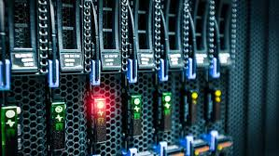
System Development Approach
Design & Coding: Develop a discreet key logger with features like encryption and timestamps for secure keystroke logging.
Testing & Compliance: Thoroughly test the key logger for bugs and security, ensuring it meets privacy laws and ethical standards.

Slide 6
Algorithm & Deployment
Algorithm for Keylogger:
Keystroke Capture Algorithm: Continuously monitor keyboard input to capture and record keystrokes.
Encryption Algorithm: Encrypt the logged data using strong encryption methods to secure sensitive information.
Timestamp Algorithm: Automatically add timestamps to each recorded keystroke for chronological tracking.
Stealth Mode Algorithm: Implement stealth techniques to run the keylogger discreetly without user detection.

Slide 7
Algorithm & Deployment
Deployment for Keylogger:
Packaging: Compile the keylogger software into executable files compatible with target operating systems.
Documentation: Prepare user guides and installation instructions to assist users during deployment.
Distribution: Distribute the keylogger through secure and authorized channels, ensuring proper consent and compliance.
Monitoring & Updates: Monitor the keylogger's performance post-deployment and provide regular updates to enhance functionality and address potential issues.

Slide 8
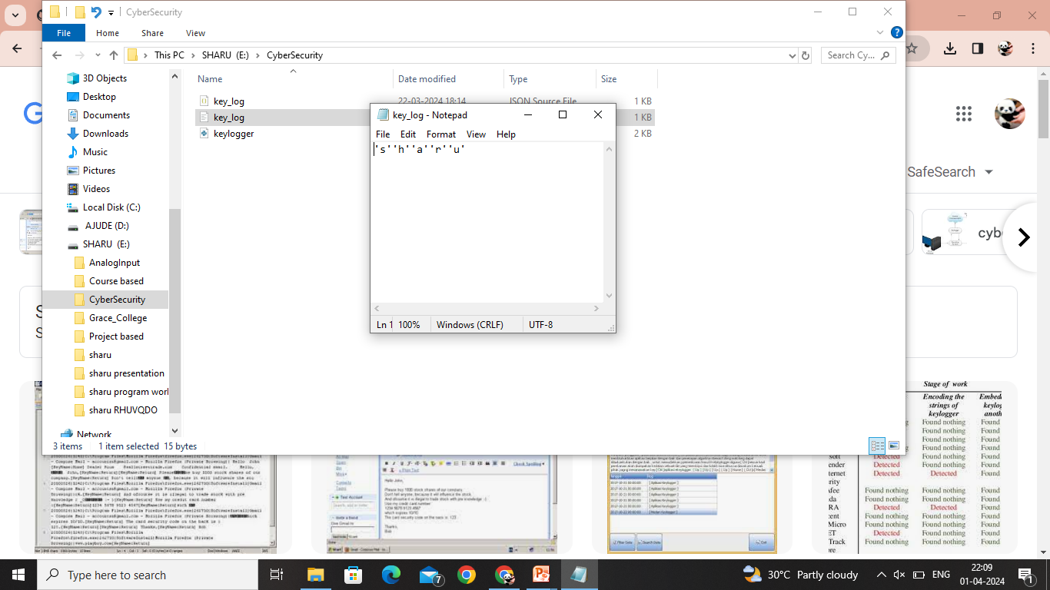
RESULT

Slide 9
cONCLUSION
The development of a keylogger offers monitoring benefits but raises ethical and legal concerns about privacy invasion. Proper encryption and responsible deployment are crucial to balance monitoring capabilities with individual privacy rights.

Slide 10

Future Scope
The future scope of keyloggers includes integration with advanced AI and machine learning for enhanced cyber threat detection and prevention.

Slide 11
REFERENCES
"Deep Learning for Demand Prediction: A Survey" by X. Liang, L. Zhao, X. Jiang, and Y. Dong. (IEEE Transactions on Industrial Informatics, 2020) "Time Series Forecasting with Deep Learning: A Survey" by Z. Zhang, Y. Zhao, and Y. Wang. (arXiv preprint arXiv:1809.04356, 2018) "A Comparative Study of Time Series Forecasting Methods for Predictive Maintenance" by A. Sharma, A. Mathur, and S. Tiwari. (2019 IEEE 16th India Council International Conference (INDICON), IEEE) "Machine Learning for Demand Forecasting: A Review" by C. McArdle, J. Vinué, and P. Mues. (International Journal of Forecasting, 2020) "Feature Engineering for Machine Learning: Principles and Techniques for Data Scientists" by A. Zheng and A. Casari. (O'Reilly Media, 2018) "Model Evaluation, Model Selection, and Algorithm Selection in Machine Learning" by C. Blake and C. J. Merz. (1998)
These sources cover a range of topics relevant to developing a solution for demand prediction, including deep learning, time series forecasting, machine learning techniques, data preprocessing, and model evaluation.

