Slide 1
DATA MINING ASSIGNMENT
ASSOCIATION SKILLS TRAITS
ASSIGNMENT NUMBER : 1
GROUP NO : 111
GROUP MEMBERS :
Sharath Vaidyanath – 2019HC04539
Ramachandran N – 2019HC04537
Pradeep Kumar Choudrey – 2019HC04538

Slide 2
CONTRIBUTION TABLE
NAME | ID | CONTRIBUTION (%)
SHARATH VAIDYANATH | 2019HC04539 | 100
PRADEEP KUMAR CHOUDREY | 2019HC04538 | 75
RAMACHANDRAN N | 2019HC04537 | 100

Slide 3
OBJECTIVES
To obtain insights about the employees skills through knowledge discovery process
To recognise patterns present at the data
To evaluate efficacy of the patterns obtained.

Slide 4
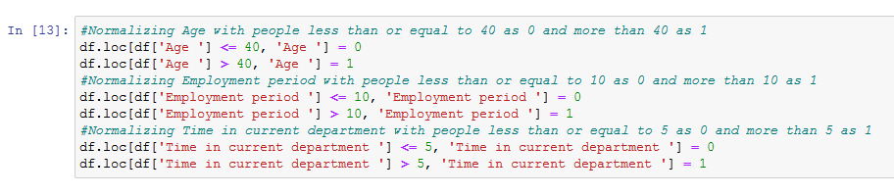
ASSUMPTIONS
An arbitrary assumption of the 3 columns was done
AGE (in years) (> 40 → 1 and <=40 → 0 )
EMPOLYMENT PERIOD (in years) (> 10 → 1, <=10 → 0)
TIME IN CURRENT DEPARTMENT (in years) (>5 → 1 , <=5 → 0)
REASON : To convert the values of these categorical variables for applying apriori and frequency pattern determination.

Slide 5
TOOLS AND LIBRARIES USED
Phyton programming in Jupyter Notebook was carried out on this KDD process.
LIBRARIES USED:
PANDAS
NUMPY
SEABORN
MATPLOTLIB
MLXTEND – contains apriori algorithm and frequent pattern association

Slide 6
THE APPROACH
Step 1 : Import the necessary libraries for calculation and visualizations
Step 2 : Import the data into a dataframe
Step 3 : Perform basic numpy operations to view the data and its columns
Step 4 : Data Cleaning
→ Check for any duplicates based on an unique ID and remove them
→ Check for any NaN values and remove them
Step 5 : Perform EDA
→ Visualise the cleansed and correlated data by a pairplot and heatmap to identity columns with similar characters
Step 6 : Data Conversion
Step 7 : Applying Apirori and frequent pattern algorithm to the refined data and iterating them over by various levels of minimum confidence and minimum threshold to identify patterns
Step 8 : Making inferences based on metrics such as support, confidence, lift and conviction.

Slide 7
FLOWCHART
IMPORT LIBRARIES AND DATA
PERFORMING EXPLORATORY DATA ANLYSIS
DATA CLEANING
DATA CONVERSION
DETERMING PATTERNS USING METRICS
APPLYING APIRORI ALGORITM

Slide 8
RESULTS AND DISCUSSIONS
The Employment period and Time at the current department has highest support of 0.316633 and hence, the time that the employee spends in the company is mainly the time spent at current department. Hence, the company should take these parameters as the key, for refining their resources
The Age and Time at the current department has least support of 0.219439 and hence, the time that the employee spends in the current department and age ,is least significant among the variables . Hence, the company can rule out this parameter for refining their resources
The maximum lift ratio of the dataset is 1.38 for the pair [Time in current department, Employment period]. Hence, 1.38 times the number of people staying at the current department also is the reason of employment period. This is needed to be studied in detail for further clarity.
The minimum lift ratio of the dataset is 1 for the pair [SQL Server, Fast working]. Hence, the entities of this pair are independent to each other of support offered.
The maximum conviction of X (Time in current department) ---> Y (Employment period) is 1.6, states that the probability of employees staying at current department is 1.6 times the ones present at employment period.
Hence, to conclude, the effect of time of an employee in current department and employment period, has a significant impact in various aspects of the company. Hence, We recommend the HR to encourage in work that can increase the time at current department, thereby to see an increase in overall performance and growth of the company

Slide 9
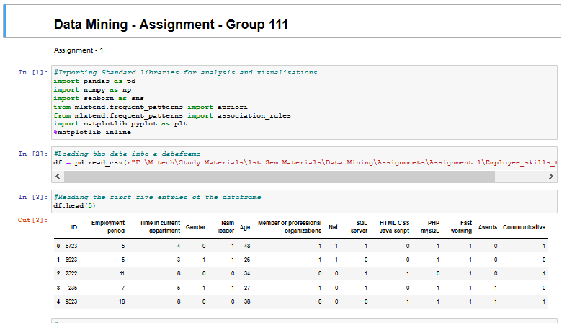
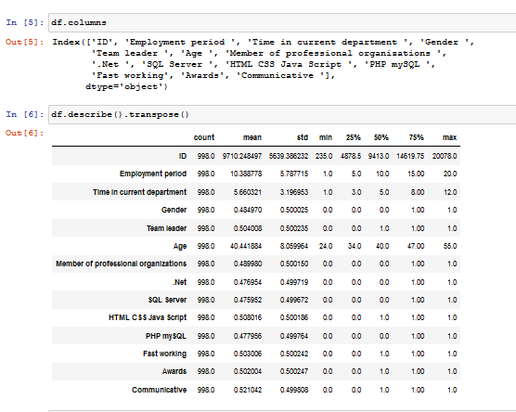
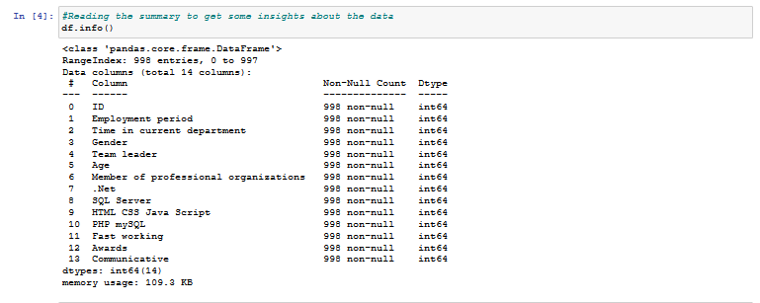
PYTHON CODE

Slide 10
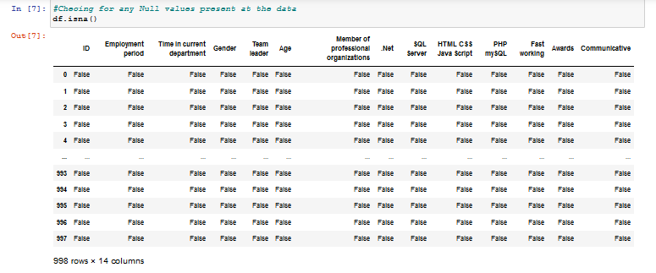
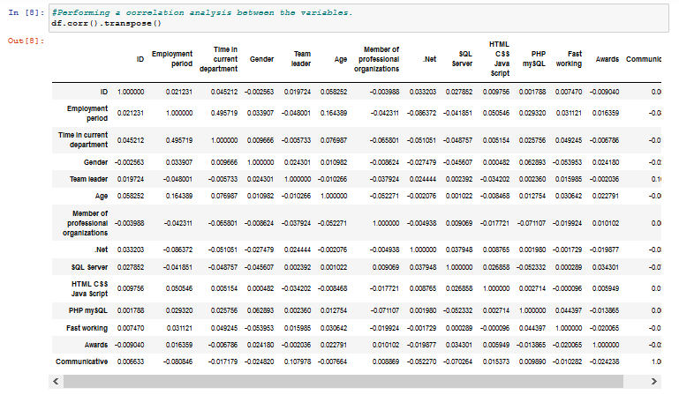

Slide 11
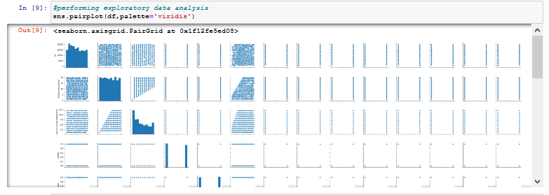
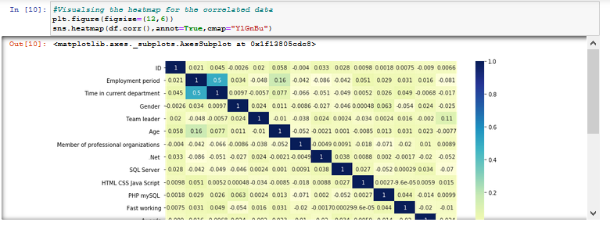

Slide 12
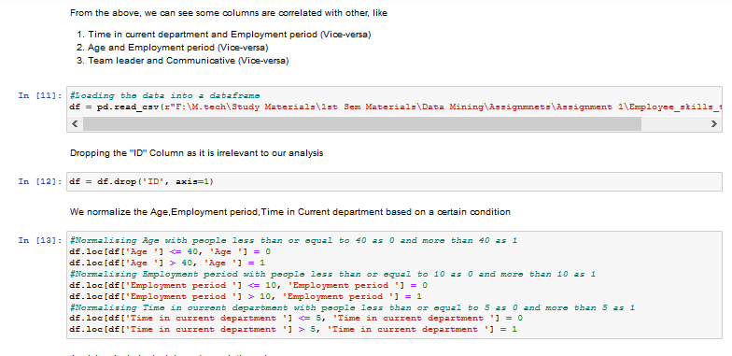
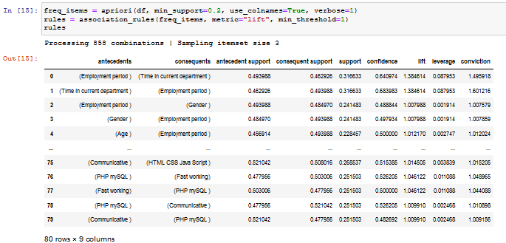
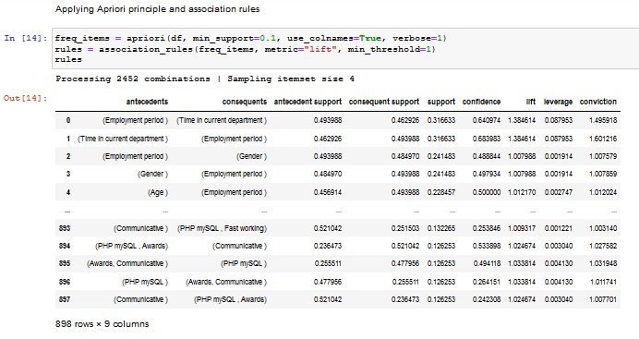

Slide 13
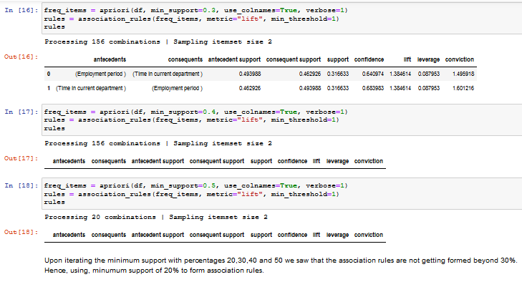
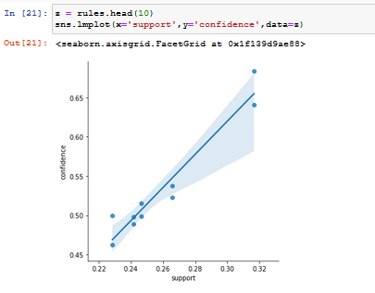
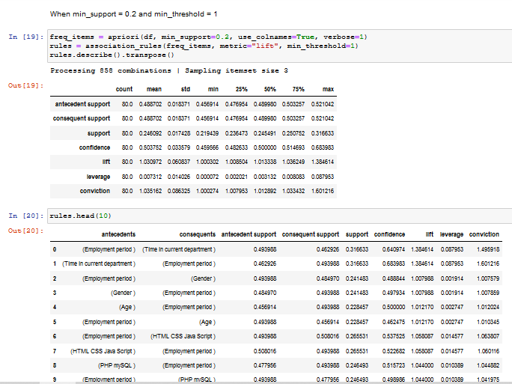

Slide 14
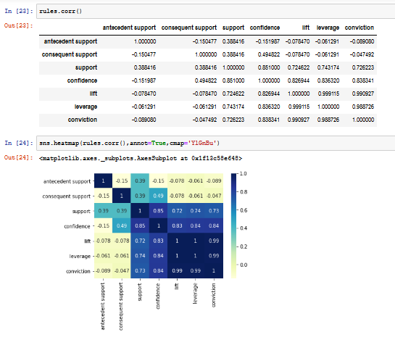
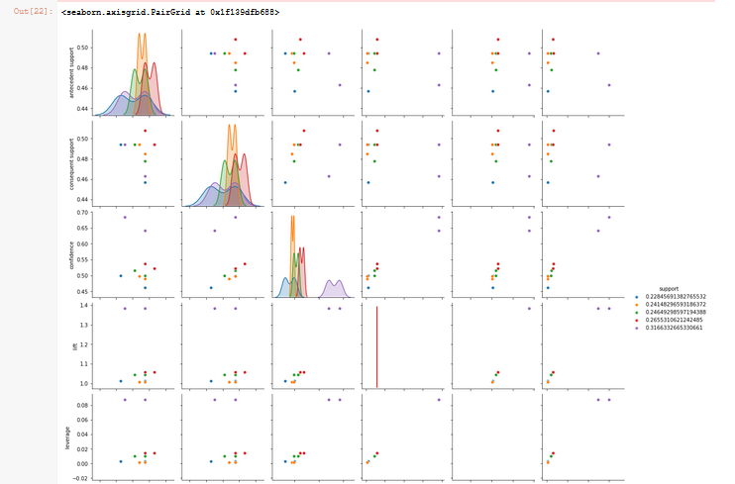

Slide 15
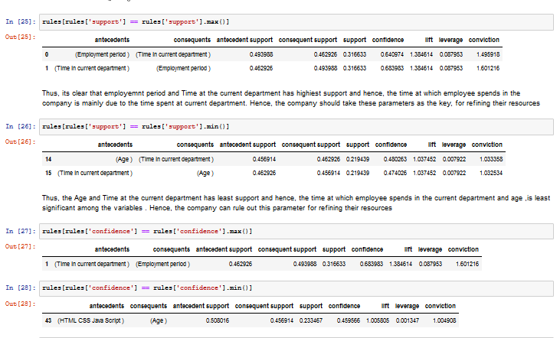

Slide 16
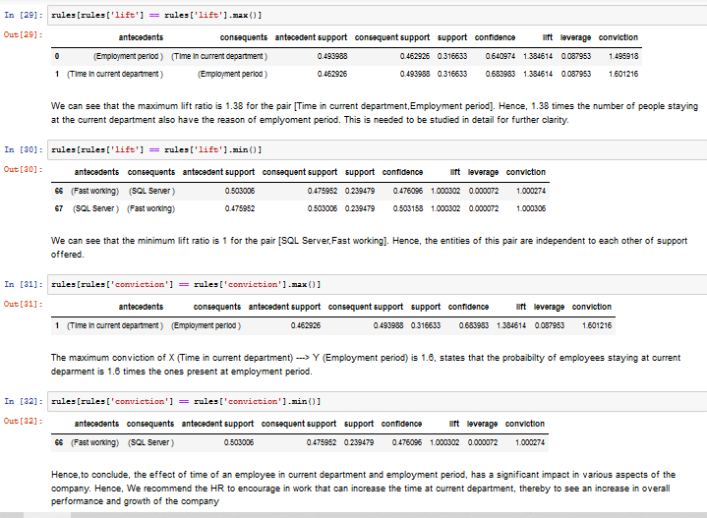

Slide 17
THANK YOU

