Slide 1
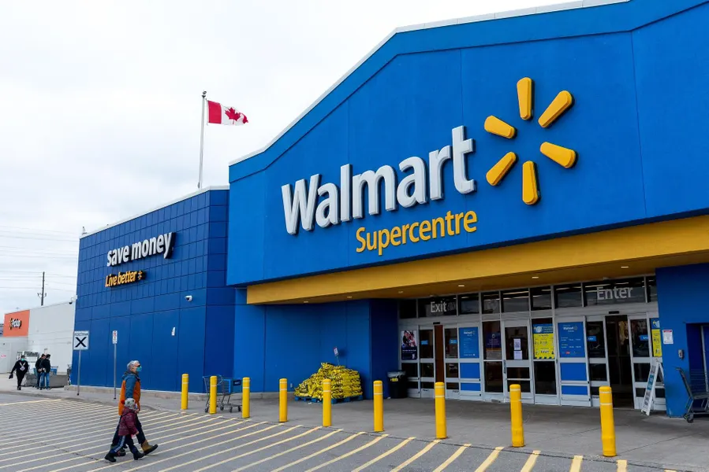
Walmart
Sharubaa Kirubakaran
Caroline Nkan
Viet Hoang Phan (Danny)

Slide 2
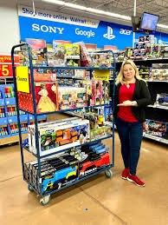
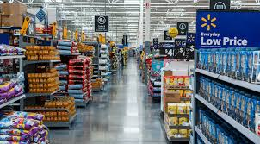
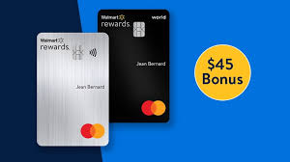
What Walmart does?
Multinational Retail Corp
Supply Chain
One stop shop that has Garden Center, PhotoCenter, Vision Center, Baker/Deli and All the home goods and needs
Offers Walmart MasterCard
Offers discounts and clearances
Has online ordering and pickup (where they groceries and everything you ordered and put it in your car)

Slide 3
Walmart is a….
Broad low cost leadership
Target variety of customers with their wide range of costs
Offer product at a lower price than competitors
Has brand names that people don’t associate with Walmart
Also has non-branded walmart owned brands that are cheaper versions of items people like

Slide 4
Why This Strategy Works?
Walmart’s Everyday Low Prices has created a strong customer base because the prices are affordable for all population compared to other stores like superstore, loblaws,e.t.c.
Walmart’s versatility in services has created a strong brand recognition . It is known as a one-stop shop for services like pharmacy, Electronic appliances, grocery , clothing,e.t.c.
Walmart also adds discounts to their pricing strategy through clearance sales, seasonal promotions,and bundled deals that help customers to save money enhancing their customer base.
Walmart also offers online services making it convenient for customers to shop from their homes.

