Slide 1
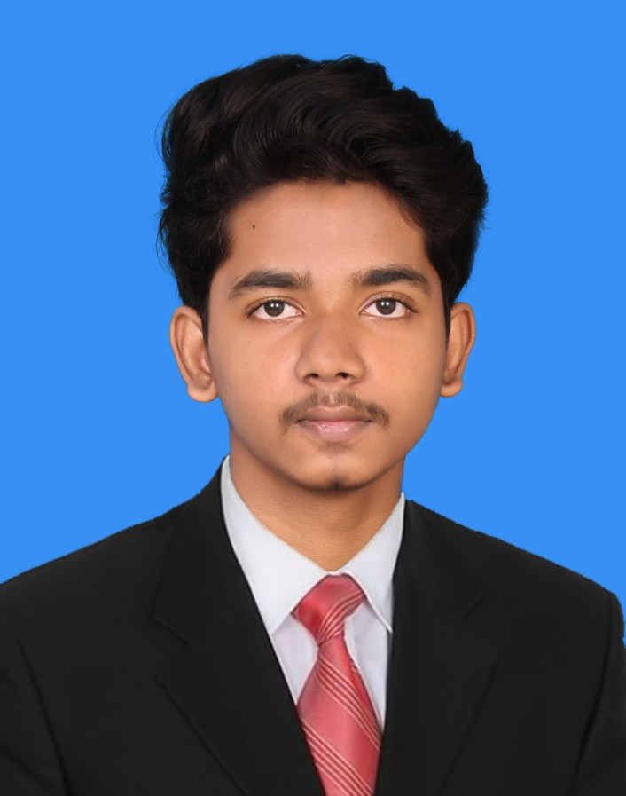
WHO AM I ?
SUBTITLE: SHARUKESH V

