Slide 1

GROUP NO: 1
01/06/2024
23CHY115: Introduction to Materials Informatics
PROJECT PRESENTATION
DEVARAJAN S
CB.AI.U4AID23006
M Sharukesh
CB.AI.U4AID23021
Pranav Sivakumar
CB.AI.U4AID23028
SHAYAN ATHIF CB.AI.U4AID23037

Slide 2
LARGE LANGUAGE MODEL
HYDROGEN STORAGE
TEXT SUMMARIZATION & QUESTION-ANSWERING

Slide 3
OVERVIEW
01
05
TEXT SUMMARIZATION FEATURE
PROBLEM STATEMENT
02
INTRODUCTION
06
QUESTION-ANSWERING FEATURE
03
LITERATURE REVIEW
07
RESULTS
04
METHODOLOGY
08
CONCLUSION

Slide 4

PROBLEM STATEMENT
Hydrogen storage research is challenged by the overwhelming volume of scientific literature, making it difficult for researchers to stay updated and find relevant information quickly. Our project addresses this by providing a tool that efficiently summarizes and retrieves key information, enhancing research productivity.
1

Slide 5

INTRODUCTION
To begin, let's discuss the importance of hydrogen storage in the context of renewable energy. Hydrogen is a promising energy carrier due to its high energy density and environmental benefits. However, effective hydrogen storage remains a significant challenge, requiring innovative materials and technologies.
Our project aims to address this challenge by using large language models to process and summarize vast amounts of scientific literature, providing researchers with quick access to relevant information
2

Slide 6
LITERATURE REVIEW
Hydrogen storage methods include physical, chemical, and materials-based approaches. Recent advancements and AI applications aim to enhance efficiency. We referenced various papers to gather information, using a large language model to support our research.
No. | Title | Summary
1. | A Review of Current Trends, Techniques, and Challenges in Large Language Models (LLMs) | This paper by Rajvardhan (2024) discusses advancements in large language models, focusing on interpretability, explainability, privacy preservation, and continual learning. It explores pretraining objectives like LTR, Prefix LM, and MoD, and transfer learning techniques such as adapter modules and centralization. The paper also emphasizes scalability, user-centric design, human feedback, and inclusivity.
2. | Building custom question-answering app using LangChain and Pinecone vector database | This paper by Talaviya (2023) describes a practical approach for constructing a question-answering application using LangChain, a framework for building NLP pipelines, and Pinecone, a cloud-native vector database. It provides a step-by-step guide for integrating these tools and demonstrates the effectiveness of vector databases for question answering.
3. | BART Model for Text Summarization: An Analytical Survey and Review: | This paper by Awasthi et al. (2022) offers a comprehensive review of the BART model, focusing on its application in text summarization. It discusses various fine-tuning techniques and highlights the strengths of BART for abstractive summarization tasks.
3

Slide 7
METHODOLOGY
Data Collection:
Extracted abstracts from research papers using the Scopus database.
Data Preprocessing:
Cleaned data by removing duplicates and irrelevant content.
Performed tokenization, stemming, and lemmatization for text normalization.
Model Fine-Tuning:
Trained the BART model on the preprocessed dataset for accurate summarization and question-answering.
Evaluation and Validation:
Tested model performance against benchmark abstracts.
Collected feedback from various sources for refinement.
Website Development:
Created a user-friendly website with two main features:
Summarization Tool: Generates concise summaries of scientific abstracts.
Question-Answering System: Provides accurate answers to specific questions based on the extracted literature.
4

Slide 8
TEXT SUMMARIZATION FEATURE
Core Feature: Summarization tool for scientific documents
Powered by BART Summarization Model
Allows users to input full research papers/articles
Generates concise summaries highlighting key points and findings
Benefits for Researchers:
Quickly grasp essence without reading full texts
Save time by focusing on critical information
Facilitate efficient literature reviews
Accurate & Useful Summaries:
Leverages advanced NLP capabilities
Captures insights, methods, conclusions
5

Slide 9
MODEL FRAMEWORK
DATASET PREPARARTION
(GEMINI API)
DATA PREPROCESSING
(CLEANING, TOKENIZIING, ETC)
DATA COLLECTION
(SCOPUS DATABASE)
TESTING AND EVALUATION
(ROUGE SCORES, HUMAN EVALUATION)
FINETUNING
(FOR SUMMARIZATION)
IMPORT MODEL
(PRE-TRAINED BART MODEL)
6

Slide 10
QUESTION-ANSWERING FEATURE
Core Feature: Question-Answering System
Powered by BART Text-to-Text Model
Utilizes vector database for hydrogen storage information
Retrieves relevant information based on user queries
A form of Retrieval-Augmented Generation (RAG) model
Benefits for Users:
Get specific answers to hydrogen storage questions
Access comprehensive knowledge from literature
Save time from manually searching through papers
Accurate & Insightful Responses:
Leverages BART's language understanding capabilities
Retrieves most relevant information from vector database
7

Slide 11
MODEL FRAMEWORK
DATA COLLECTION:
EXTRACT ABSTRACTS FROM PAPERS STORED IN THE SCOPUS & STORE INTO A VECTOR DATABASE.
VECTORIZATION:
CONVERT USER QUERY INTO A VECTOR REPRESENTATION.
VECTOR DATABASE LOOKUP:
RETRIEVE THE TOP 10 MOST SIMILAR VECTORS FROM THE DATABASE.
QUESTION-ANSWERING MODEL:
UTILIZE A QUESTION-ANSWERING MODEL (BART) TO PROCESS THE PREPARED INPUT AND GENERATE ANSWERS.
MODEL INPUT PREPARATION:
FORMAT THE QUESTION AND POTENTIAL CONTEXT INTO A SUITABLE QUESTION-CONTEXT FORMAT.
VECTOR TO WORDS:
DECODE THE RETRIEVED VECTORS INTO WORDS TO FORM POTENTIAL CONTEXT FOR THE QUERY.
8

Slide 12
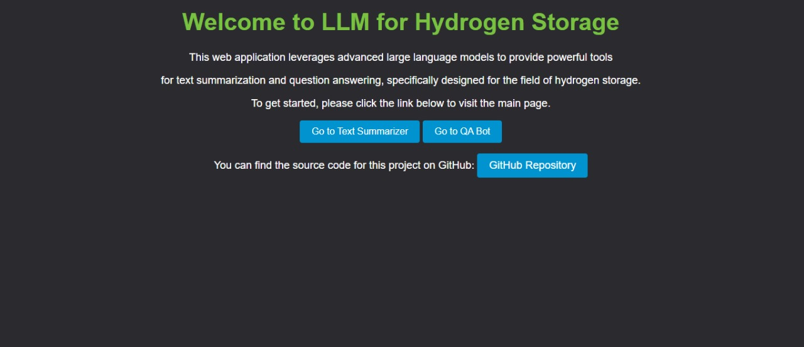
RESULTS
Let's take a look at the results. The overall quality of summaries generated and the answers provided by our model is quite good. Performance metrics indicate high accuracy and relevance in both tasks. Our model contributes to enhancing research efficiency by providing precise and relevant information.
HOME PAGE
9

Slide 13
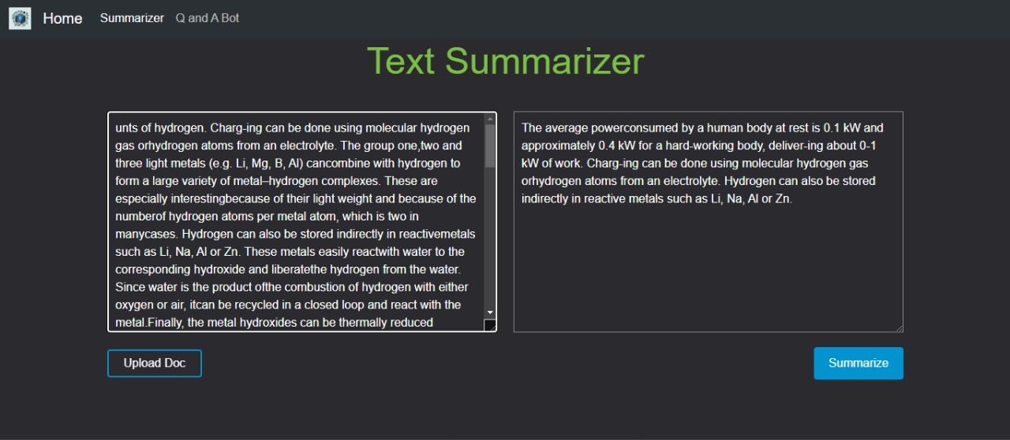
SUMMARIZATION TOOL
10

Slide 14
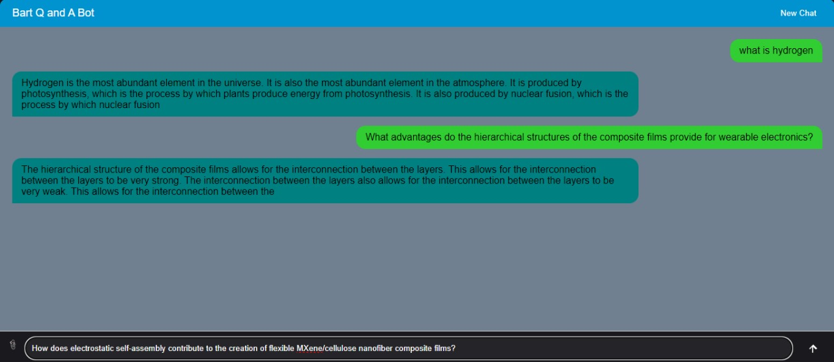
QUESTION-ANSWERING BOT
11

Slide 15
CONCLUSION
In conclusion, our project focused on developing a tool using the BART model to improve research efficiency in the field of hydrogen storage. We collected and preprocessed a comprehensive dataset of scientific abstracts from the Scopus database, fine-tuned the BART model, and developed a user-friendly website with summarization and question-answering features.
The final outcome is a robust tool that generates high-quality summaries and accurate answers to specific queries, significantly enhancing the accessibility and usability of hydrogen storage research. Our project demonstrates the potential of leveraging advanced language models to support and streamline scientific research efforts.
12

Slide 16
FUTURE OUTLOOK
Looking ahead, we have several exciting plans to enhance our project further. Our future enhancements include:
Incorporating Updated and Latest Information with the RAG Model: By integrating updated information into our RAG model, we can dynamically add new data to the vector database. This ensures our model always has access to the latest specialized information, enhancing its ability to provide accurate responses.
Faster and Better summary for a pdf input: Generating faster and more accurate summaries for PDF inputs would be highly beneficial, as it improves efficiency without compromising quality.
These enhancements will help us make the tool more powerful and user-centric, continuously improving the support we provide to researchers.
13

Slide 17
THANK YOU!
- BY TEAM A1

