Slide 1
TOPIC – 1 The Rise of Subscription Services
SHARUKKHAN

Slide 2
About the Model
These models are based on the idea of selling a product or service to receive a monthly or yearly recurring subscription revenue.
Customer retention is prefered over customer acquisition.
Companies are making a transition from business revenue model to subscription revenue model or recurring revenue model
Recurring revenue models also helps in creating stronger customer relationships.
Netflix is a good example for this model.
periodically
Product/
Service
🏬
Company
🏢
🕘
Customers
👥
$
$
$
Periodically payment

Slide 3
Evolution of Subscription Business Model
This model was initially pioneered by publishers of books, magazines and periodicals in 17th Century.
With the rise of technology, Electronic Gadgets like Mobiles, Tabs and Laptops were available in the affordable prices.
And many Companies are getting more benefits of the recurring basis in return for consistent access to the delivery of a good or service, which eventually makes many companies are moving from a Business Revenue Model to Subscription Revenue Model.
Industries that offer this model includes Cable television, Satellite television, Telephone companies, Mobile network operators, Health clubs as well as traditional Newspapers, Magazines and Academic Journals.
A subscription model will be beneficial for the software buyer if it forces the supplier to improve its product
Subscription pricing can make it easier to pay for expensive items, since it can often be paid for over a period of time and thus can make the product seem more affordable.
Both Sides of Business, Company as well as People getting Good Benefits of Subscription Revenue Model.

Slide 4

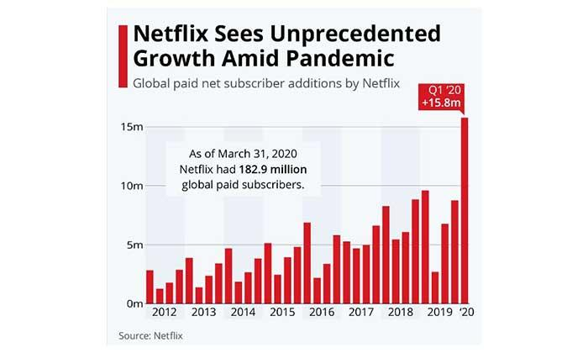
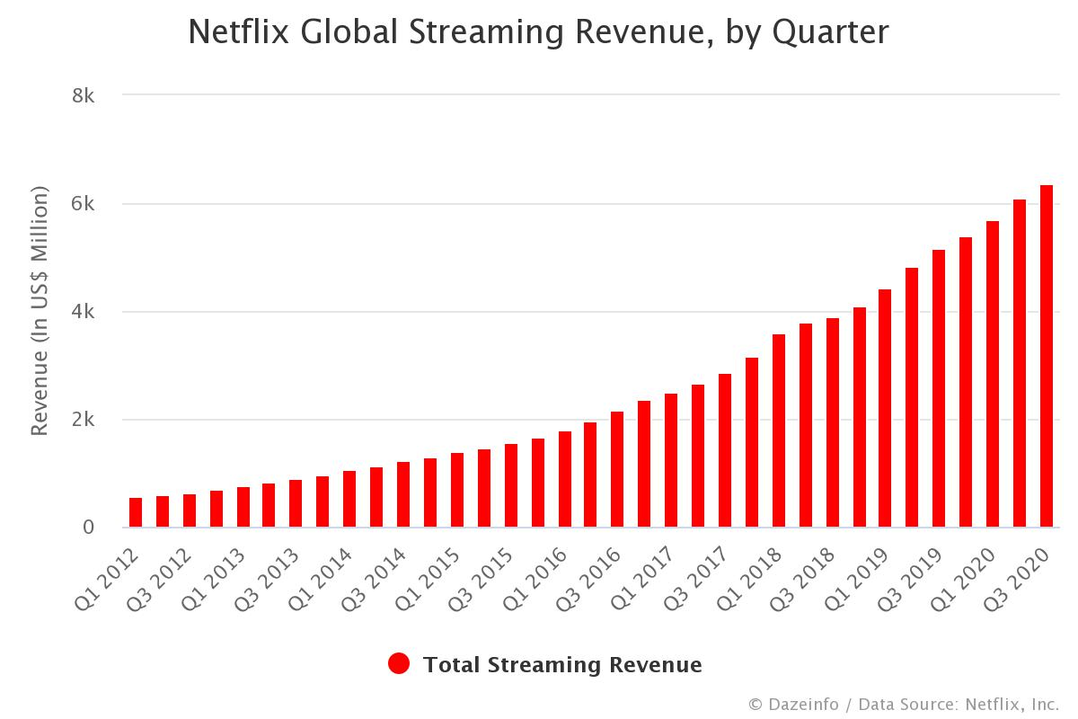
Netflix Example
Netflix is the best example of Subscription Revenue Model.
The company started as a small DVD rental Business, Now it became one of the main content video Creator and Distributors in the world.
When most of things were changing online, it would be a great idea to deliver a video directly online, in a Subscription Way.
Netflix became famous and Cross 180 million global paid subscribers on 2020, which makes the constant increase in revenue(See the diagram below)
Subscription 2012 - 2020
Revenue 2012 - 2020
Source: Netflix

Slide 5
Advantages of the Model:
Disadvantages of the Model:
Subscription based pricing attracts more customers
Recurring billing offers Predictable Revenue
Subscription billing increases return on customer acquisition costs
Revenue can be increased through up-and-cross selling
Easier to offer a proof of concept
Risk of high Churn / Cancellation or Cost risks
Singular Vs. Varied products
Difficulty in maintaining value (Loss of interest)
Raising issues of privacy when substantial information of customers are extracted

Slide 6
Based on my Latest Experience in Subscription Revenue Model.
I was working as a Data Analyst in an E-Magazine company that has Product Based Subscription Service, We have 12 different products(magazines and articles), with different subscription packs like SIP(Single Issue Payment), 1-month, 6-months, 1-year and Lifetime Subscription.
Based on their customer’s requirements they choose the subscription plans, Our focus is more on customer retention than acquisition.
To achieve our goals, we use data of customer's behavior, finding the patterns based on meaningful metrics, and provide good customer service by recommending the specific articles to the customers having a high probability of buying those articles. To generate revenue we move customers to the next phase of subscription like move from 1-month to 6-month subscription and Retention of the Customers by offering Good Services and Offers.
Technically, we have databases like MySQL, MongoDB where we used to retrieve and preprocess data using SQL, Python, R languages, Analyze based on the objective using Python, Excel, Machine Learning techniques like Regression, Classification, and Recommendations, Google Analytics, and finally present with graphs using Tableau, Google Data Studio, and PowerPoint.

Slide 7
Thank You BY SHARUKKHAN

