Slide 1
TOPIC – 2
Data Visualization
SHARUKKHAN

Slide 2
Data
For easy understanding and convenience, I have used a single dataset to explain all visualizations.
This Data above is Tip dataset for Three Days, has some features including Review Scores calculated by NLP(Machine Learning Technique for Text Analysis).
Day | tips | Gender | Time | Bad Review Score | Good review Score
Day1 | 10 | Male | Dinner | 90 | 4
Day1 | 20 | Female | Lunch | 40 | 32
Day1 | 20 | Male | Breakfast | 40 | 45
Day1 | 20 | Female | Breakfast | 43 | 45
Day2 | 10 | Female | Lunch | 98 | 10
Day2 | 20 | Male | Lunch | 32 | 43
Day2 | 40 | Female | Dinner | 20 | 67
Day2 | 80 | Male | Breakfast | 20 | 80
Day3 | 60 | Female | Dinner | 25 | 70
Day3 | 150 | Female | Dinner | 2 | 99
Day3 | 10 | Male | Breakfast | 23 | 3
Day3 | 40 | Female | Lunch | 16 | 70

Slide 3
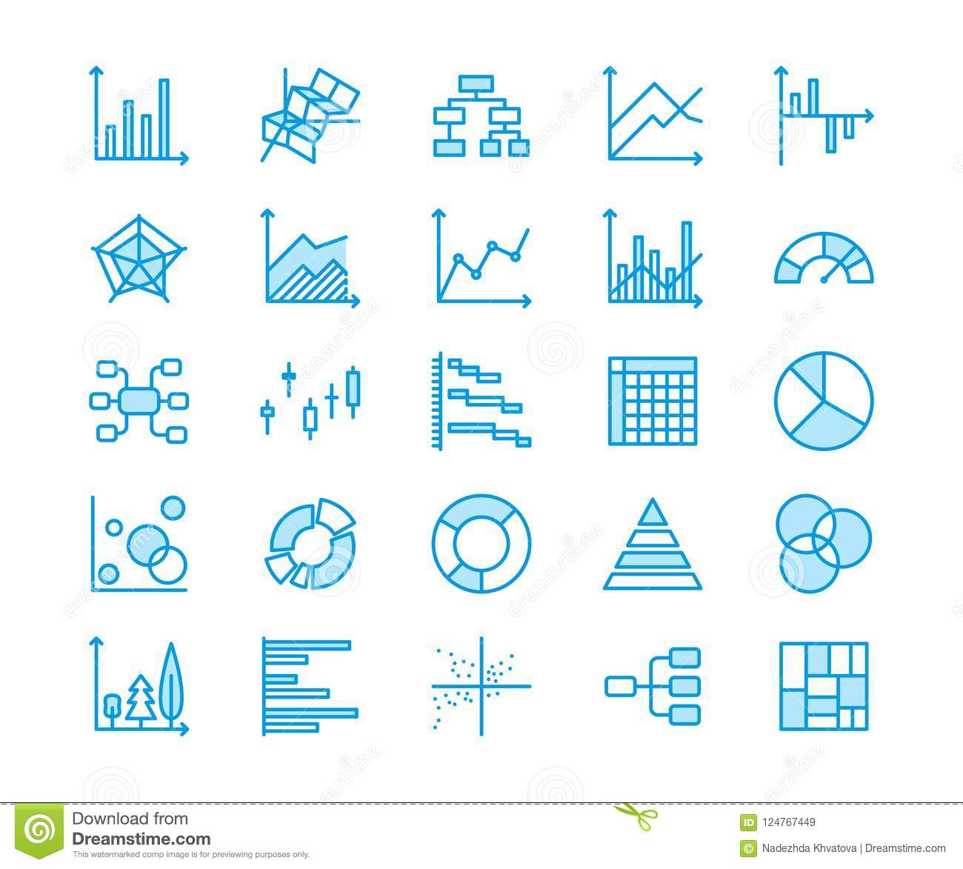
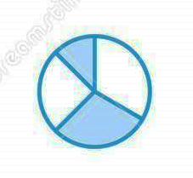
Data Visualization Techniques
Bar Chart
Pie Chart
Histogram
Box Plot
Scatter Plot

Slide 4
Bar Chart
What is it: A bar graph is a chart that plots data using rectangular bars that represent the total amount of observations in the data for that category.
What you need: For Simple Bar Chart, two main variables—one categorical and one numerical. You can also break this down further with another categorical variable if you wish.
Use Case:
1) Growth over the time of a Company (Simple Bar Chart),
2) In Stock Market, the trading volume of stocks goes up and down
(Deviation Bar Chart),
3) Simple comparison between 2 families in Budgets,
Budgets are composed of Food, Education, Expenditure and so on.
(Stacked Bar Chart).
Best Visualization for: Compared to the Histogram Plot, it can be best to see the frequency of the Nominal as well as Ordinal data in detail, Where Histogram fails to show bars in Nominal data. This is considered as the most basic chart like pie, It is self-explanatory and easily understandable by clients.

Slide 5
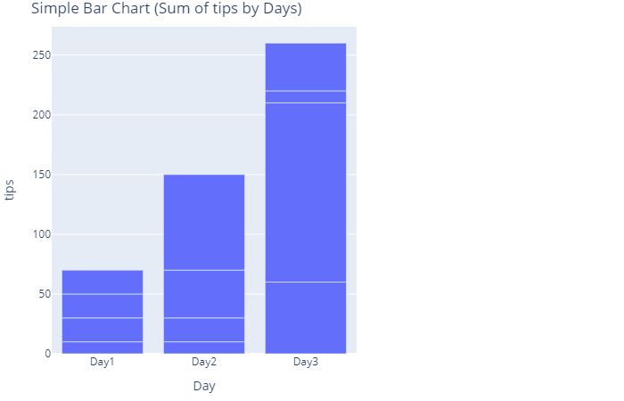
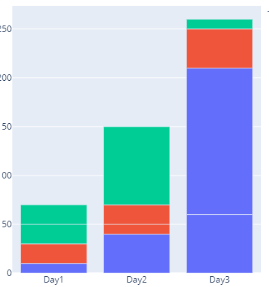
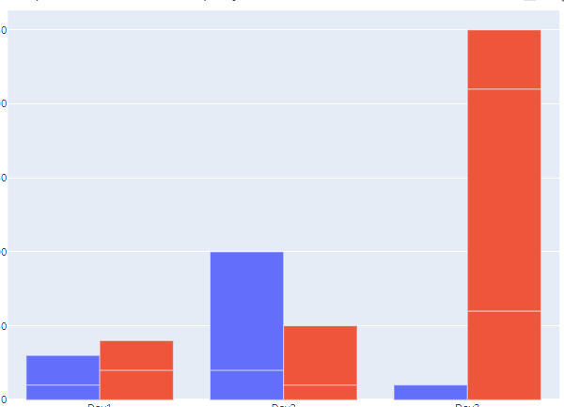
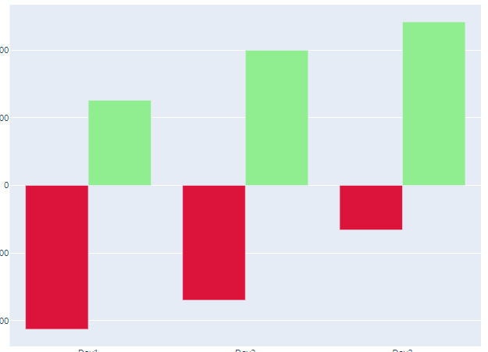
Examples of Bar Chart:
Simple Bar
Stacked Bar
Grouped Bar
Deviation Bar

Slide 6
Simple Bar Chart
Data : Tips Data Click Here
Variables :
One Categorical – Day,
One Numerical – tips.
About the Chart :
This Simple Bar Chart represents
the growth of tips over time(Day).
Here Day by Day its increasing.
Code : Types of Bar Chart.ipynb

Slide 7
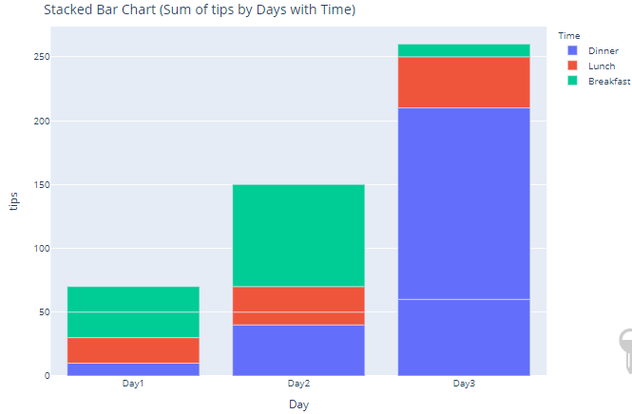
Stacked Bar Chart
Data : Tips Data Click Here
Variables :
Two Categorical – Day, Time.
One Numerical – tips.
About the Chart :
This Stacked Bar Chart represents
the growth of tips over time(Day).
By Time Composition(Breakfast, Lunch,
Dinner)
Code : Types of Bar Chart.ipynb

Slide 8
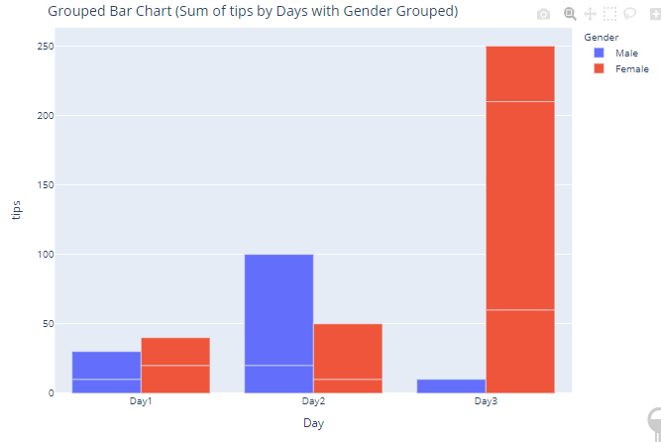
Grouped Bar Chart
Data : Tips Data Click Here
Variables :
Two Categorical – Day, Gender.
One Numerical – tips.
About the Chart :
This Grouped Bar Chart represents
the growth of tips over time(Day).
Grouped By Gender.
Code : Types of Bar Chart.ipynb

Slide 9
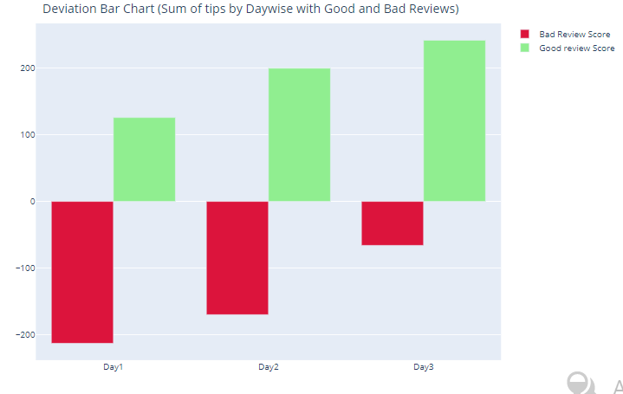
Deviation Bar Chart
Data : Tips Data Click Here
Variables :
One Categorical – Day.
Two Numerical – Bad Reviews Score,
Good Reviews Score.
About the Chart :
This Deviation Bar Chart represents
the Bad and Good Reviews Score changes
over the time (Day by Day).
Code : Types of Bar Chart.ipynb

Slide 10
Pie Chart
What is it: A pie graph is a chart in which a circle is divided into sectors that each represent a proportion of the whole.
What you need: For Simple Pie Chart, two main variables—one categorical and one numerical. You can also break this down further with another categorical variable if you wish.
Use Case:
1) Composition of Gases in air (Simple Pie Chart),
2) Composition of Nutrient in different Health Drink (Subplot Pie Chart),
3) Composition divided into some groups, in that group it divides again and so on
in a Hierarchy Manner(Sunburst Pie Chart).
Best Visualization for: The most preferable and easily understandable for simple analysis is the pie chart, we have some alternative charts like a bar chart that does the same job but with the height of bars, but whenever we want to see proportions or percentages the best chart to choose is pie chart.

Slide 11
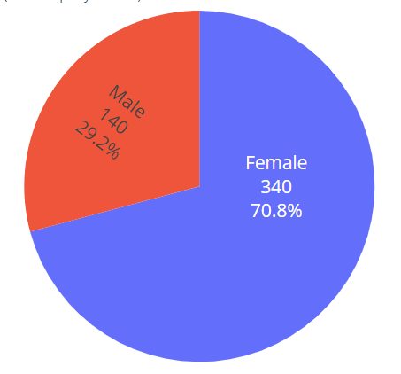
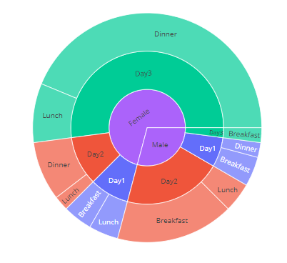
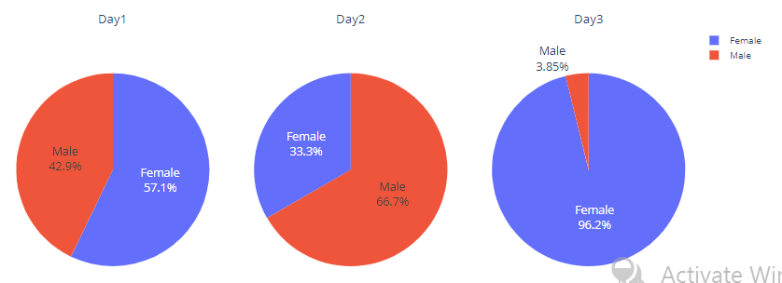
Examples of Pie Chart:
Simple Pie
Sunburst Pie
Subplot
Pie

Slide 12
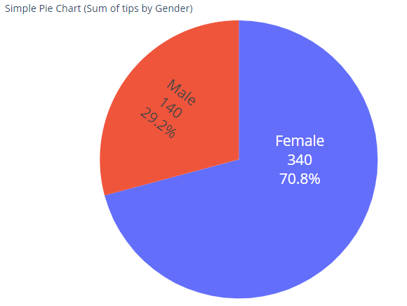
Simple Pie Chart
Data : Tips Data Click Here
Variables :
One Categorical – Gender.
One Numerical – tips.
About the Chart :
This Simple Pie Chart represents
the Proportion and Percentage of Gender
giving the tips.
Code : Types of Pie Chart.ipynb

Slide 13
Sunburst Pie Chart
Data : Tips Data Click Here
Variables :
Two or More Categorical – Gender, Day,
Time.
One Numerical – tips.
About the Chart :
This Sunburst Pie Chart represents
the Proportion or Percentage of Gender
in a Day in a Time (in a Hierarchy Fashion)
giving the tips.
Code : Types of Pie Chart.ipynb

Slide 14
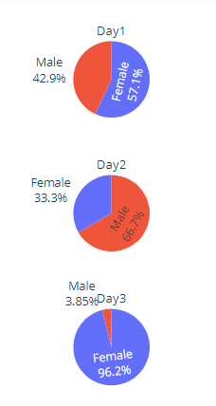
Subplot Pie Chart
Data : Tips Data Click Here
Variables :
Two Categorical – Gender, Day
One Numerical – tips.
About the Chart :
This Subplot Pie Chart represents
the Proportion or Percentage of Gender
in a Day giving the tips.
Code : Types of Pie Chart.ipynb

Slide 15
Histogram
What is it: A Histogram graph consisting of rectangles whose area is proportional to the frequency of a variable and whose width is equal to the class interval.
What you need: For Simple Histogram Chart, one numeric (Discrete or Continuous) variable is needed. You can also break this down further with another categorical variable if you wish.
Use Case:
1) Check the Distribution of the Score, Most Common Assumption of Statistical test is Bell Shape Curve (Normal Distribution) ,(Simple Histogram Chart),
2) Histogram is best way to represent continuous data like time than discrete, Frequency of App Using in Each Interval , So we can run campaign in optimize way (Simple Histogram Chart), If two app are comparing(Histogram Different Groups),
3) In Quality control ,they represent where it clustered, Example: If it is Normal Distribution, then In-Control or if it is Skewed, then, data clustered near to Out of Control Level(Distribution Histogram Plot or Simple Histogram).
Best Visualization for: Compared to Box Plot, it can be best to see the distribution in detail, Box plot gives the summary of the distribution for more groups at a time but if you want to see in detail of One or Two Distribution, Histograms are best way to carried out.

Slide 16
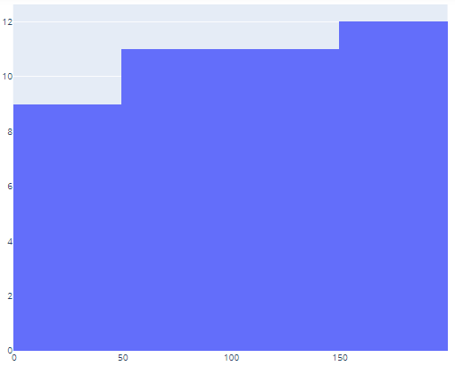
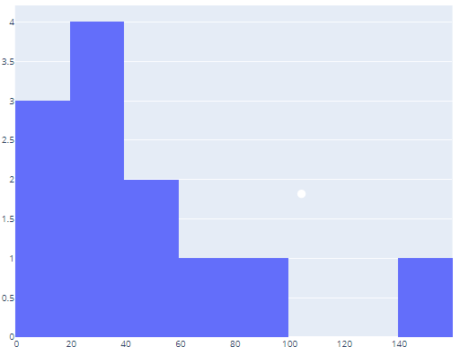
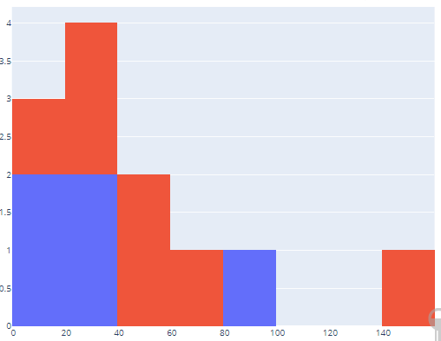
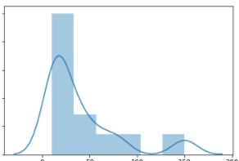
Examples of Histogram:
Simple
Histogram
Cumulative
Histogram
Histogram
Different
Groups
Distribution
Plot
Histogram

Slide 17
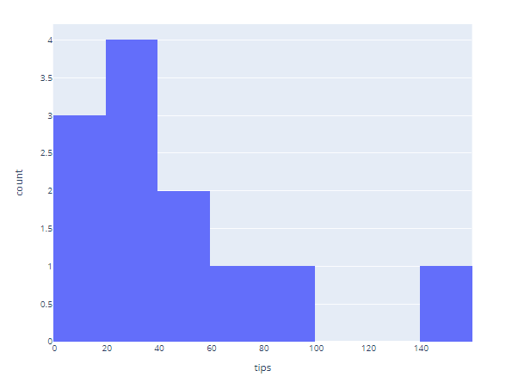
Simple Histogram Chart
Data : Tips Data Click Here
Variables :
One Numerical – tips.
About the Chart :
Simple Histogram Chart represents
Frequency of the tips in different
intervals.
Code : Types of Histogram.ipynb

Slide 18
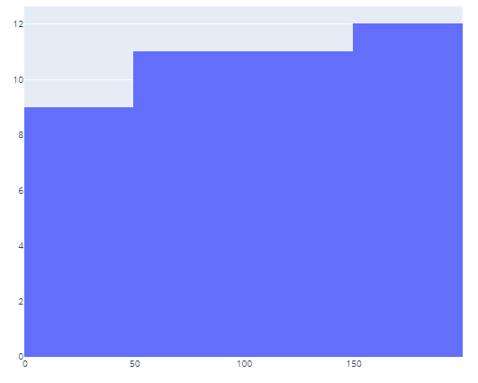
Cumulative Histogram Chart
Data : Tips Data Click Here
Variables :
One Numerical – tips.
About the Chart :
Cumulative Histogram Chart represents
Cumulative Frequency of the tips in different
intervals.
Specifically used to see the Total or Accumulate
value at specific time.
Code : Types of Histogram.ipynb

Slide 19
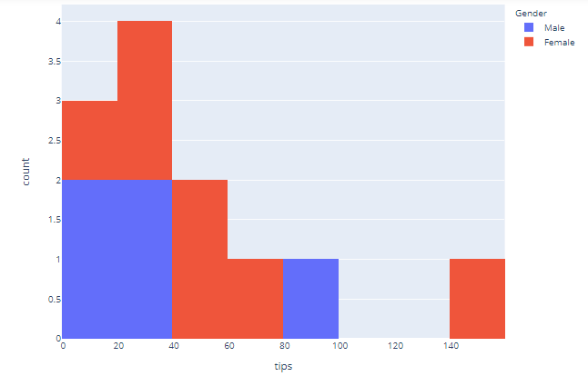
Histogram Different Groups
Data : Tips Data Click Here
Variables :
One Numerical – tips.
One Categorical – Gender.
About the Chart :
Histogram for Different Groups represents
Frequency of the tips in different
intervals in terms of Gender.
Code : Types of Histogram.ipynb

Slide 20
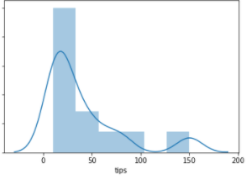
Distribution Plot Histogram
Data : Tips Data Click Here
Variables :
One Numerical – tips.
About the Chart :
Distribution Plot Histogram represents
Frequency of the tips in different
intervals with Distribution plot.
Many Application are there, commonly
used to see Normality Test.
Code : Types of Histogram.ipynb

Slide 21
Box Plot
What is it: Boxplots are useful when you wish to compare the distribution of scores on
variables. You can use them to explore the distribution of one continuous variable for the
whole sample or, alternatively, you can ask for scores to be broken down for different groups.
What you need: For Box Plot, One numeric (Continuous) variable is needed.
You can also break this down further with another categorical variable if you wish.
Use Case:
1) Check the Optimum Scale Distribution for Different Age Groups (Simple Box Chart),
2) In Meteorology, Seeing Distribution of Temperature Data for Different Countries, Outliers are considered as Extreme Temperatures like Too Cold and Hot.
Line with Scatter Chart for best representation (Box For Different Groups),
3) In Stock Market, it is using enormously, called as candles to see the distribution of Stock Price in Selected ticks(Day, Minute and Hour) to take decision. (Harami, Doji, candlestick ).
Best Visualization for: We can use a Histogram with a Colour Difference chart to see the Difference Between the Distribution of Groups, but for 10 or more Groups we can’t use histograms, The best approach is Box Plot. Secondly, the Box plot is well known for detecting Outliers Chart, and its extensively useful for Detecting Outliers compared to other Charts.

Slide 22
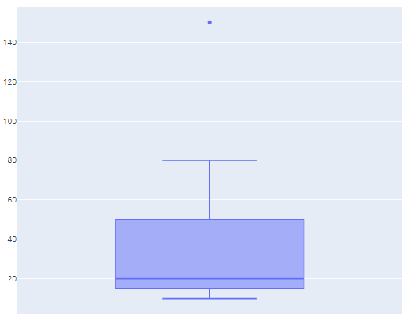
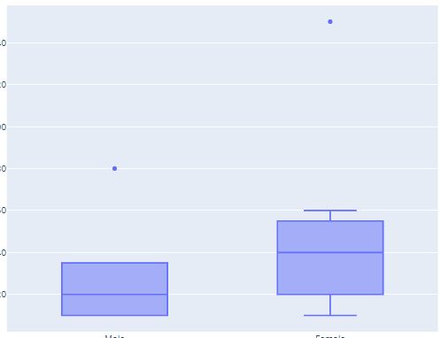
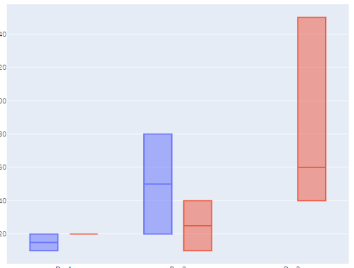
Examples of Box Plot:
Simple
Box
Box
Different
Groups
Box
Nested
Group

Slide 23
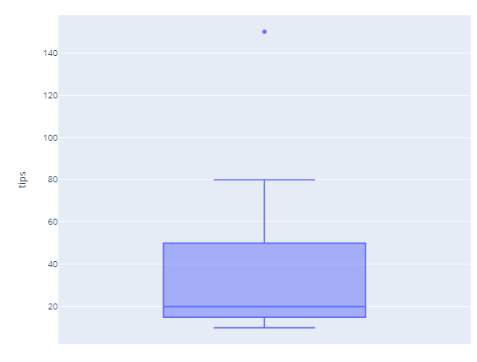
Simple Box Plot
Data : Tips Data Click Here
Variables :
One Numerical – tips
About the Chart :
Simple Box Plot depicts the distribution of
the tips data, with Outlier value 150.
Code : Type of Box Plot.ipynb

Slide 24
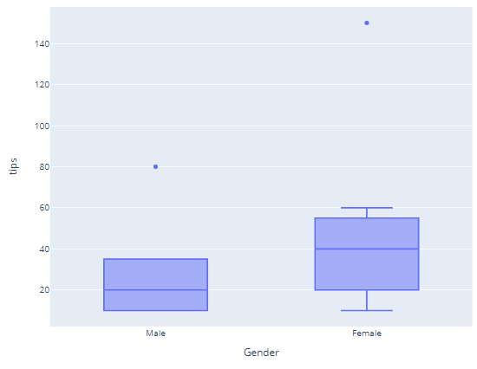
Box plot for Different Groups
Data : Tips Data Click Here
Variables :
One Numerical – tips
One Categorical - Gender
About the Chart :
Box Plot depicts the distribution of
the tips data in terms of Gender, with
Outlier value for Male is 80, Female is 150.
Code : Type of Box Plot.ipynb

Slide 25
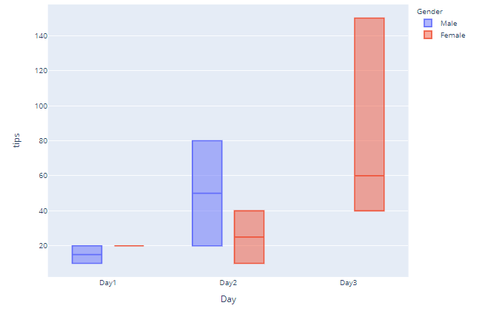
Box plot for Nested Groups
Data : Tips Data Click Here
Variables :
One Numerical – tips
Two Categorical – Gender, Day.
About the Chart :
Box Plot depicts the distribution of
the tips data in terms of Gender and Day.
Code : Type of Box Plot.ipynb

Slide 26
Scatter Plot
What is it: Scatterplots are typically used to explore the relationship between two continuous variables (e.g. age and height)
What you need: For Scatter Plot, Two numeric (Continuous) variable are needed.
3- dimensional scatter plot is also available, You can also break this down further
with another categorical variable if you wish.
Note: In some cases, categorical variable(only Ordinal data) can also be used.
Use Case:
1) Check the Relationship between two Scores of Age and height
(Simple Scatter Chart),
2) In Quality control, To see Points In-Out of Control, In some cases we use
Line with Scatter Chart for best representation (Scatter and Line Chart),
3) In Stock Market, To represent stock price, we use Scatter and Line Chart
for best representation.(Scatter and Line Chart).
Best Visualization for: When trying to find two variables are related, whether it is a positive, negative, or no relationship between two variables. Scatter with line has extensive applications, like in quality control and stock market price, We can use bar charts to see the trend in a company, but it fails to do a good job when we compare two or more companies in the same chart, so the best approach is Scatter Plot.

Slide 27
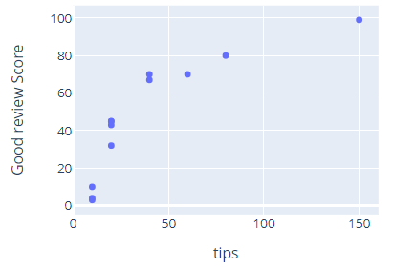
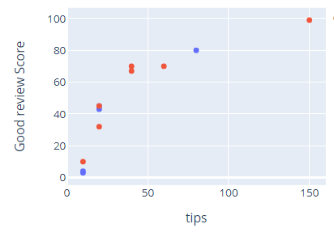
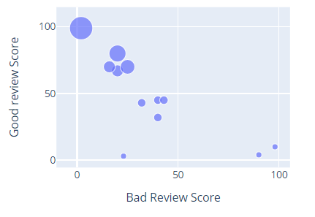
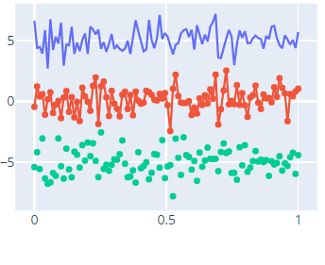
Examples of Scatter Plot:
Simple
Scatter
Scatter
Different
Groups
Bubble
Scatter
Scatter
Line

Slide 28
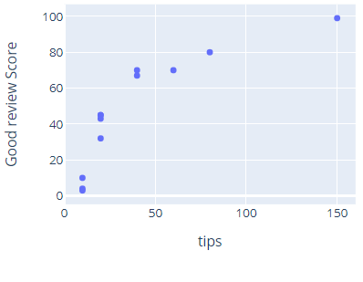
Simple Scatter Chart
Data : Tips Data Click Here
Variables :
Two Numerical – tips,
Good review Score
About the Chart :
Simple Scatter Chart represents the
Relationship between tips and
Good review Score.
Code : Types of Scatter Plot.ipynb

Slide 29
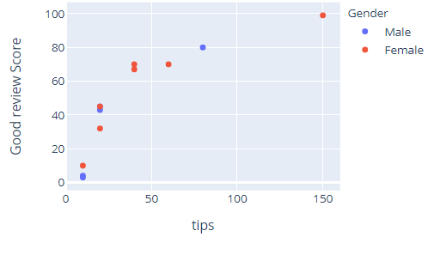
Scatter for Different Groups
Data : Tips Data Click Here
Variables :
Two Numerical – tips,
Good review Score
One Categorical – Gender.
About the Chart :
Scatter for Different Groups Chart
represents the Relationship between
tips and Good review Score in terms of
Gender.
Code : Types of Scatter Plot.ipynb

Slide 30
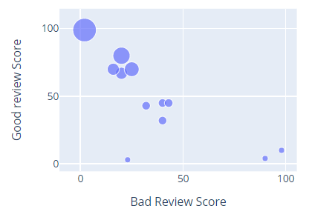
Bubble Scatter Chart
Data : Tips Data Click Here
Variables :
Two Numerical – tips,
Good review Score
One Numerical – Bad Review Score.
About the Chart :
Bubble Scatter Groups Chart
represents the Relationship between
Good review Score and Bad Review
Score in size of tips.
Code : Types of Scatter Plot.ipynb

Slide 31
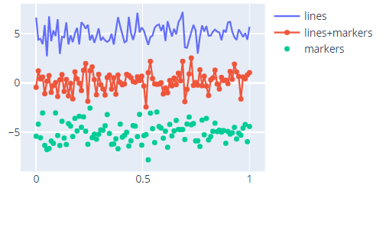
Scatter Line Chart
Data : Tips Data Click Here
Variables :
Two Numerical – time(Day by Day),
Stock Price.
About the Chart :
This Chart simply generates the random
number to represents how Scatter Line
Chart Works in Stock Market Analysis.
Code : Types of Scatter Plot.ipynb

Slide 32


Source:
I have done my visualization in python, the codes are available on the Github
Github Link: https://github.com/Sharukkhan777/Python/tree/master/Statistics/Plots/Assignment_Graphs
I have used my own android app called Mini Stat Analyser available on Play Store to analyse charts.
Google Play Store Link:
https://play.google.com/store/apps/details?id=com.sharukkhan.ministatanalyzer

Slide 33
Thank You BY SHARUKKHAN

