Slide 1
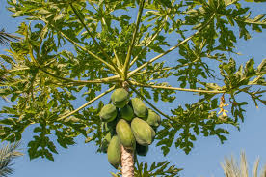
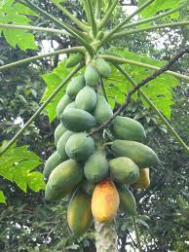
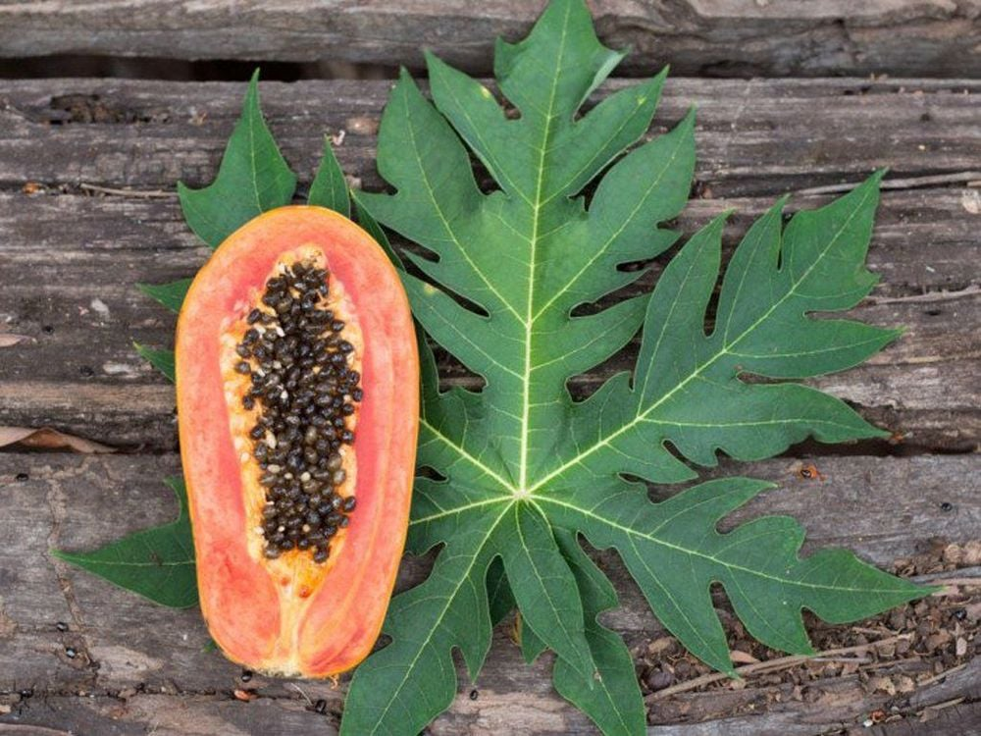
PAPAYA
Near gate no.2 AIS campus ,Wakad

Slide 2
Common name : Papaw, Melon Tree, Papaya etc.
Scientific name : Carica papaya
Family : Caricaceae
Habit : Carica papaya is dioecious. The leaves are arranged alternately, to 1 m in length, deeply (compound) lobed to palmatifid, with an acute leaf apex. Carica papaya grows as monopodial softwood tree with infrequent branching, to 10 m in height (usually smaller) and produces a slightly milky latex.
Distribution : Papaya is native to tropical America, specifically southern Mexico and Central America. India being the largest producer, accounting for 38% of the world’s supply in 20221. Papaya cultivation is now nearly pantropical

Slide 3
DESCRIPTION:
Height of the tree : 5-10 m / 16-33 ft tall.
Leaves : 20-40 cm in diameter, deeply lobed with 7 distinct lobes.
Flower : Papayas are dioecious. The flowers are five-parted and highly dimorphic; the male flowers have the stamens fused to the petals. There are two different types of papaya flowers. The female flowers have a superior ovary and five contorted petals loosely connected at the base.
Fruits : The fruit is a large berry about 15–45 cm (6–17+³⁄₄ in) long and 10–30 cm (4–11+³⁄₄ in) in diameter. It is ripe when it feels soft (as soft as a ripe avocado or softer), its skin has attained an amber to orange hue and along the walls of the large central cavity are attached numerous black seeds.
Seeds : Papaya seeds are edible and contain fiber

Slide 4
USES:
Green papaya is used in Southeast Asian cooking, both raw and cooked. In some parts of Asia, the young leaves of the papaya are steamed and eaten like spinach.
Papaya contain high levels of antioxidants such as vitamin A, vitamin C, and vitamin E.
Additionally, papaya's high fiber content may reduce the risk of heart disease. High-fiber diets lower cholesterol levels.
Papaya contain two enzymes, papain and chymopapain. Both enzymes digest proteins, meaning they can help with digestion and reduce inflammation.
Papain is an ingredient in some over-the-counter supplements to help with minor upset stomach.
papaya are good sources of lycopene which reduces the risk of prostate cancer.
In addition to ripe papaya fruit, a mixture made from papaya leaves is very beneficial in increasing the platelet count.

