Slide 1
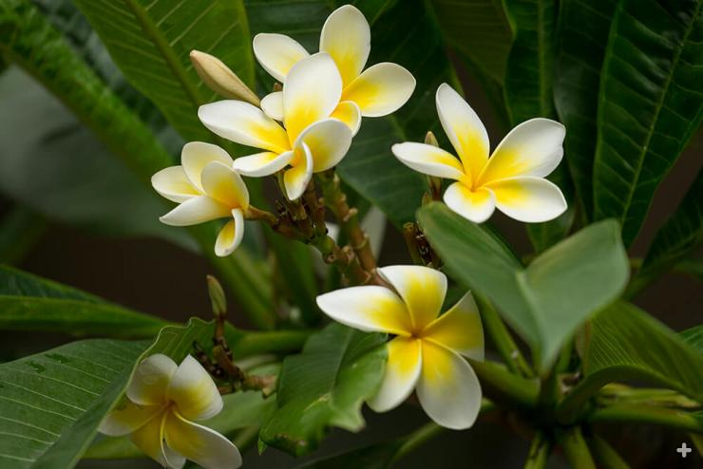
Plumeria (Indian Champa)
In between assembly point 2 and 3 at AIS campus Wakad

Slide 2
Common Name : Chaaffa , Champa
Scientific Name : Plumeria alba.
Family : Apocynaceae
Habit : Large shrub or small tree with an irregular or
rounded crown that grows up to 12 m. Evergreen
in the tropics, but deciduous in temperate climates.
Distribution : In eastern India and Bangladesh, plumeria is
traditionally considered as a variety of the champak flower

Slide 3
Description :
Trunk short with branching at about 1.5 - 2 m.
Bark is grey and smooth.
Branches: Highly branched with thick, but fragile branches. Branches knobby due to small, outgrowths of cork.
Foliage: Leaves glossy and obovate with blunt ends (15 - 25 cm long). They are arranged in a spiral cluster with most leaves concentrated at branch tips.
Flowers: Flowers have large, waxy petals that form a funnel shape (9 - 10 cm wide). Each inflorescence stalk consists of several flowers (18 - 30 cm long). These flowers come in many colours including pink, red, white and yellow, orange, or pastel. They have separate anthers.
The genus Plumeria includes about 18 accepted species, with over 100 regarded as synonyms. As of January 2024.

Slide 4
USES :
The flavonoids in the flowers make an excellent cure for rheumatism.
A paste of the flowers is effective in treating rheumatism gout and vertigo.
The buds of the flowers are used to treat diabetes and renal diseases.
An extract of the flowers are rich in antioxidant and antimicrobial activities.
Champak or Frangipani not only provides many health and holistic benefits, but it also has the potency to balance all the three doshas in the body specifically the Kapha dosh.
Essential oil made from its root, bark, and flower extracts soothes the mind, augments hair growth, and nourishes the skin.
he decoction of the bark is an antitoxic and diuretic agent that can expel worms and promote a regular flow of urine.
Using a diffuser, gentle spraying can be done with some water and a few drops of Champa flower oil to make the ambiance aromatic and blissful.

