Slide 1
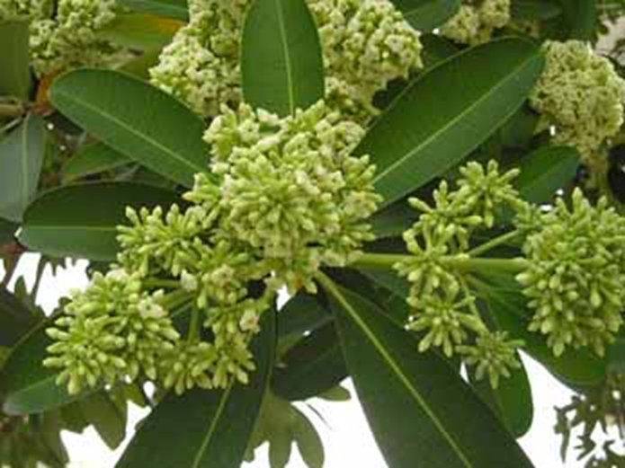

At Main gate -Near waiting lounge at AIS campus, Wakad
2. Saptaparni

Slide 2
Common Name: Saptaparni , Indian Devil tree, blackboard tree
Scientific name: Alstonia scholaris
Family : Apocynaceae
Habit : The tree is native to Asian subcontinent. It grows naturally in any
type of soil including arid regions.
Distribution : It is native to Indian Subcontinent .It has been extensively planted
in India and also seem to grow well in hot dry regions but can
not sand water logging. This tree recommended for planting in
parks ,garden and at roadside.

Slide 3
Description:
Saptaparna (Alstonia scholaris) which literally means seven leaves in a whorl, is an evergreen tree which grows up to height of 40 m. It is a glabrous tree, having green colored leaves, with glossy appearance on the upper side, while appear greyish colored on the underside of the leaves. Leaves are 4-6 inches in length, and 1-2 cm in diameter. The leaves are of uneven size but in clusters known by the name
- visama- cchada and ayuk cchada.
The bark of this tree is thick, brittle, white on the external surface and yellowish inside. When the bark is cut a milky liquid oozes out. Seeds are white in color with attached to it cotton like fibers at the end. The tree is a rich in alkaloids and flavonoids.

Slide 4
USES :
The twigs of Alstonia Scholaris tree is used for brushing the teeth due to its bactericidal property.
Herb is useful in skin diseases with secretions, allergic skin diseases
It is also found to be useful in thread worms and round worms.
It is very good supplement that helps to improves appetite and is given to women after delivery.
It is effective remedy to drop the fever, increases lactation and provides strength to women after delivery.
The paste of the bark is applied over inflamed joints in chronic arthritis which provides relief to the patient.
Saptaparna is a very efficient blood purifier which provides beneficial effects for the heart
It is very useful for malarial fever as it is a very good antipyretic and giving same effect as that of quinine on fever, but has no side effects.

