Slide 1

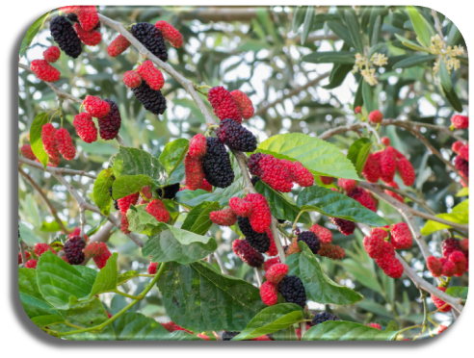
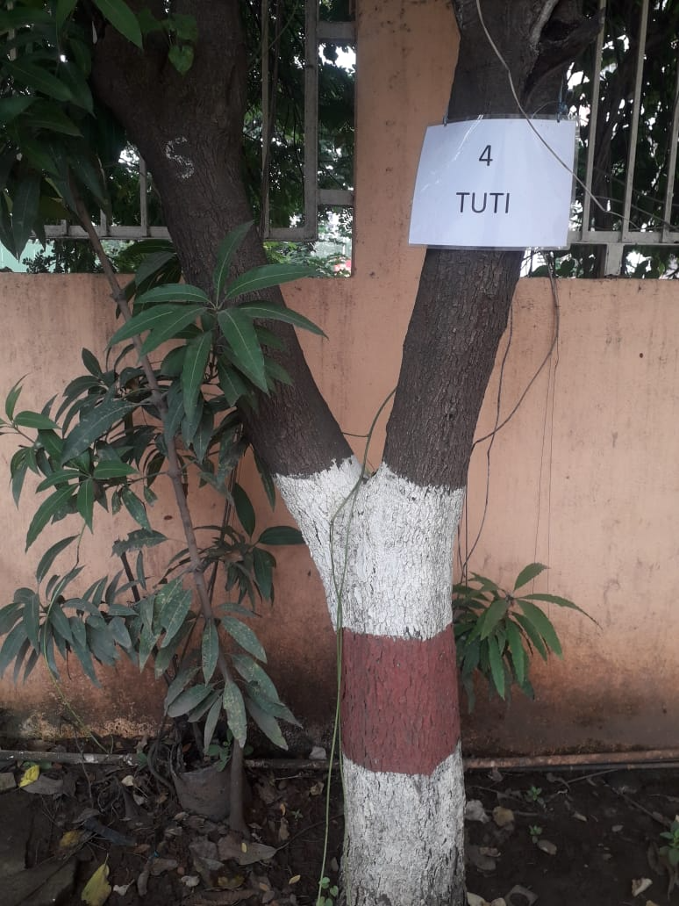
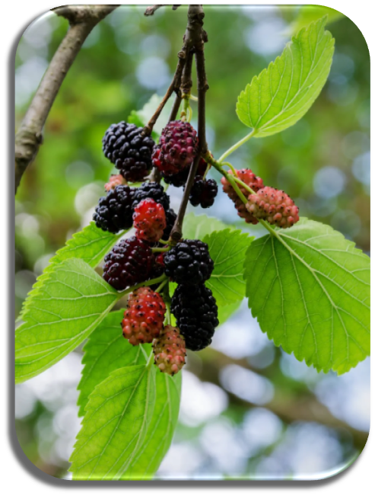
TUTI TREE
Between Gate no.1 and Gate no.2 AIS Campus, Wakad.

Slide 2
Common Name : Mulberry, Tuti
Scientific Name : Morus
Family : Moraceae.
Habit : Grown in temperate regions and as well as in subtropical and arid tropical
areas. It is also grown in flood plains in the southern half of its natural
range.
Distribution : It is found in China, Japan, Korea, USA, Mexico, Central America, India,
Southeast Asia.

Slide 3
Description :
Height of Tree : About 10-20 m (33-66 ft).
Leaves : The leaves are alternately arranged, simple, and often lobed and serrated on the margin.
On older trees, the leaves are generally 5–15 cm (2.0–5.9 in) long, unlobed, cordate at the
base and rounded to acuminate at the tip, and serrated on the margins.
Fruits: The mulberry fruit is a multiple, about 2–3 centimetres (0.5-1.5 inches) long. Immature fruits are
white, green, or pale yellow. The fruit turns from pink to red while ripening, then dark purple or
black, and has a sweet flavor when fully ripe.
Bark of the tree : The bark of branches and twigs is brown to orange-brown, smooth, with scattered
raised lenticels

Slide 4
Fruits: Mulberry contains various nutritional components that are given as follows. The fruits are rich in a variety of organic compounds, like: zea-xanthin, anthocyanins, phyto-nutrients, lutein, resveratrol and a wide range of other polyphenolic compounds. Mulberry can also be consumed in the form of juices and syrups for the effective management of various diseases.
Leaves: The leaves of mulberry may be used as an emollient that helps in softening or soothing the skin. The juice of the mulberry leaf may have a beneficial effect on throat infections, inflammation, and irritation.
Bark: The bark is used to make medicines. Black mulberry bark has blood sugar lowering effects.

