Slide 1
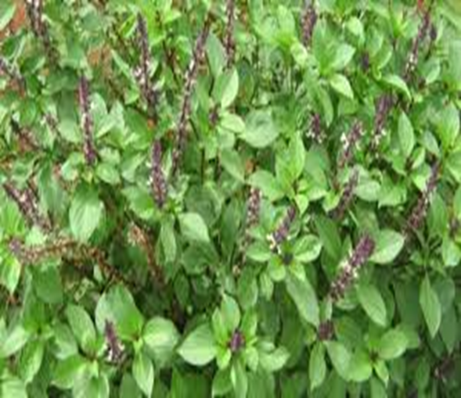
Basil
Infront of reception area AIS Campus, Wakad.

Slide 2
Basil
´Common name : sabja seeds
´Scientific name : Ocimum basilicum
´Family : mints
´Habitat : tropical regions of Africa and Asia.
´Distribution : Basil seeds are indigenous to the lower hills of Himachal Pradesh and Punjab, and are cultivated throughout India

Slide 3
Description
Hieght of the plant : between 30 and 150 centimetres (1 and 5 feet).
´Leaves :Basil leaves are oval-shaped, glossy, and arranged oppositely on square stems
´Flower :Basil flowers are small, edible blooms that grow on basil plants during their reproductive cycle.
´Seeds : Basil seeds germinate best when soil temperatures are 75-85°F and take about 10-14 days to sprout.

Slide 4
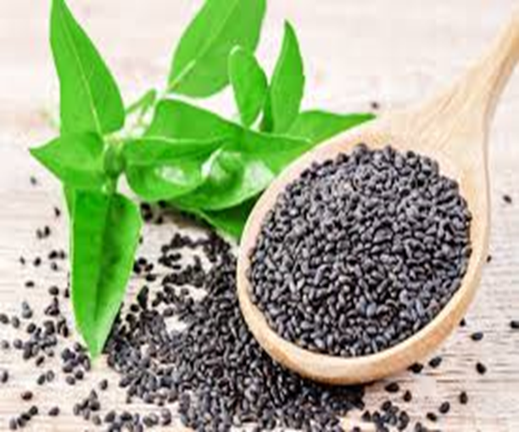
Uses of basil seeds

Slide 5
Uses of basil seeds
It is believed to possess several health benefits, such as aiding digestion, promoting weight loss, relieving constipation, improving skin health, and providing a cooling effect on the body.
Additionally, basil seeds are rich in fibre, antioxidants, minerals like iron and magnesium, and essential fatty acids.

