Slide 1
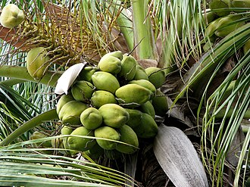
COCONUT

Slide 2
Common Name : Coconut
Scientific Name : Cocos nucifera
Family : Arecaceae
Habit : The coconut palm thrives on sandy soils and is
highly tolerant of salinity. It prefers areas
with bundant sunlight and regular rainfall with humid
conditions.
Distribution : Coconuts have a nearly cosmopolitan distribution
due to human cultivation and dispersal.
original distribution was in the Central IndoPacific,
in regions of Maritime Southeast Asia and Melanesia

Slide 3
Description :
Cocos nucifera is a large palm, growing up to 30 metres (100 feet) tall, with pinnate leaves 4–6 m.
coconut palms produce their first fruit in six to ten years, taking 15 to 20 years to reach peak production.
the coconut fruit is a drupe, not a true nut.
Wild coconuts feature an elongated triangular fruit with a thicker husk and a smaller amount of endosperm.
Domesticated Pacific coconuts, on the other hand, are rounded in shape with a thinner husk and a larger amount of endosperm.

Slide 4
USES :
Coconut oil is increasingly used in the food industry.
Coconut milk a widely used ingredient in the cuisines of regions where coconuts are native
grated coconut is often added to various desserts and savory dishes, as well as in curries and stews
Coconut oil extracted from coconut milk or copra is also used for frying, cooking, and making margarine,
Coconut water can be drunk fresh or used in cooking as in binakol.^{[143][144]} It can also be fermented to produce a jelly-like dessert
Coconut flour has also been developed for use in baking, to combat malnutrition.
Coconut vinegar, made from fermented coconut water or sap, is used extensively in Southeast Asian cuisine

