Slide 1
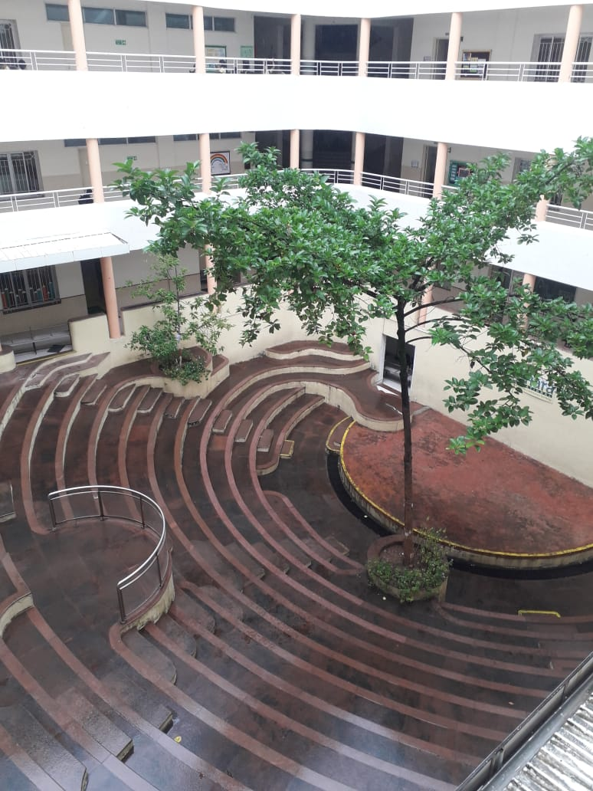
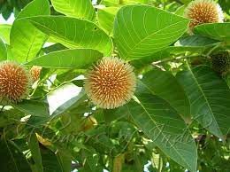
KADAMB
At Amphitheater - AIS campus, Wakad

Slide 2
Common Name : Kabamb
Scientific Name : Neolamarckia cadamba
Family : Rubiaceae
Habit : It is a fast-growing, evergreen tropical tree with unique
flowers native to South and Southeast Asia. It is also popular
in different regions of India.
Distribution : Native to South and Southeast Asia. It is also popular
in different regions of India, Bangladesh, Indonesia, Sri Lanka,
Cambodia, Laos, Nepal, Myanmar, Philippines, Malaysia, Papua
New Guinea, Australia

Slide 3
Description :
Plant size more than 12 meter. Bark Dark grey in colour, rough and frequently longitudinally fissured, exfoliating in thin scales.
Trunk diameter of 100-160 cm. This plant is one large tree that is quickly growing, with wide-spreading branches.
The Kadamba flower generally pops up between June to August.
Leaves of Kadamba have a glossy green color with the large, oblong, bushy, dark, and shining opposite. They are 30 cm long and 10-15 cm in size, almost ovate to elliptical, sessile to petiolate with prominent veins.
The Flower of Kadamba tree highly is fragrant, yellowish-green in colour, having a sweet and heady scent.
Fruits of the Kadamba tree are circular, like small balls, hard, having roughly 8000 seeds. The fruits, when young, appear green and yellow when they turn ripe. The seeds of plants are trigonal or random in shape.

Slide 4
The leaf of the Kadamba tree carries methanolic extracts that are an extraordinary asset in suppressing elevated blood sugar levels.
The plant decoction piques the wound contraction with shooting tensile strength.
Kadamba plant extracts have factors in fighting against bacteria. These are like proteus mirabilis, escherichia coli, and staphylococcus aureus. Not only bacteria, but it can also combat many kinds of fungi like trichophyton rubrum, candida Albicans, and other Aspergillus species.
Kadamba tree creates a sort of antitumor activity widely utilized in managing many forms of cancer.
Kadamba tree leaves are also helpful in treating diabetes.
The bark skin decoction of the Kadamba tree is a reliable medication for dysentery and colitis.

Slide 5
Several people use plant decoction to gargle and treat mouth ulcers or gum inflammation.
Generally, the Kadamba decoction is recommended to consume in a 30-40 ml dose for diarrhea treatment and irritable bowel syndrome.
The tree bark is powdered and further formulated with sugar candy in a proportionate dose of 5-6 gm for nausea treatment and vomiting.
The juice extracted from Kadamba fruit is recommended in a dosage of 40-50 ml for extreme sweating, thirst, or any burning sensation caused in the body.
The composed paste made from the bark of Kadamba can reduce black spots and pimples.

Slide 6
Leucorrhoea or hyper menstrual flow can be treated with fresh juice extracted from the plant leaf while taking a dose of 10-15 ml.
Also, this fresh juice extracted from the Kadam fruit enhances breast milk in lactating women.
The juice prepared from the bark skin of the Kadam plant, when combined with cumin seeds and sugar, relieves vomiting.
In Ayurvedic medicine, the bark of Kadam can be consumed for blood-related diseases.
Kadamba tree is usually depicted in Indian art and literature as a symbol of romantic love and is associated with the divine love between Radha and Krishna.

