Slide 1
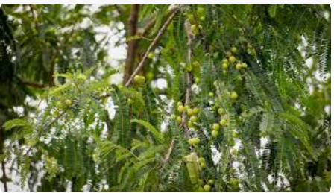
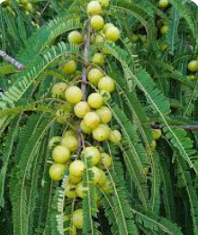
Amla

Slide 2
Common Name : Indian Gooseberry , Amla
Scientific Name : Phyllanthus emblica
Family : Phyllanthaceae
Habit : It is a medium-sized deciduous tree, reaching heights of up to 18m
thriving in a variety of soil types.
Distribution : Indian gooseberry is primarily found in South Asia, with
its natural range extending across the Indian subcontinent.
It can be found growing in various states of India, especially
in the hilly regions and along riverbank.as well as in plains
and coastal regions.

Slide 3
Description : The tree with crooked trunk and spreading branches. The leaves are very short, petiole, ovate or oblong, 7-10cm long. The flowers are greenish-yellow. The fruit is nearly spherical, light greenish yellow, quite smooth and hard on appearance, with 6 vertical stripes or furrows. The fruits ripen in autumn. Its taste is bitter-sour. Being more fibrous than most fruits, it cannot be consumed raw in vast quantity; indeed, it is taken with salt. A glass of water taken immediately after eating a large fruit makes the water seem sweeter.

Slide 4
USES :
Medicinal Uses: Emblica Officinalis is highly valued in Ayurvedic medicine for its numerous health benefits. It is used to treat various ailments such as diabetes, heart diseases, respiratory disorders, and digestive issues.
Amla's high concentration of Vitamin C helps your body produce norepinephrine, a neurotransmitter believed to improve brain function in people with dementia.
Cosmetics: The fruit extract of Emblica Officinalis is used in the production of hair oils, shampoos, and skincare products due to its antioxidant and anti-aging properties.
Food Industry: The fruit is rich in vitamin C and is used in the preparation of jams, pickles, and traditional Indian dishes. It is also consumed in the form of juice or dried powder.

Slide 5
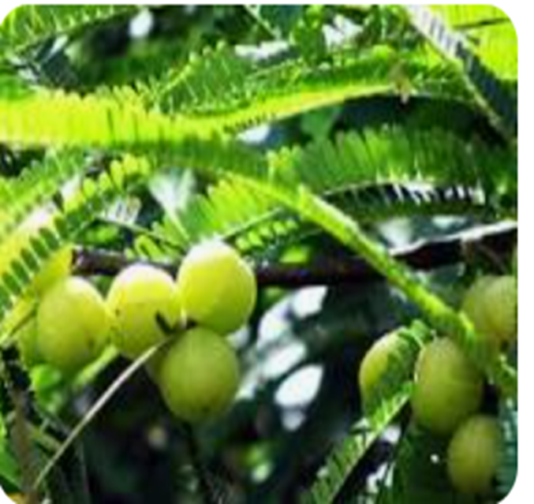
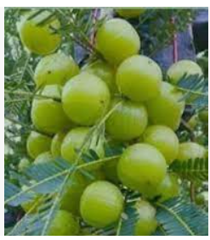
Social value
In Hinduism it is regarded as a sacred tree and worshipped as Mother Earth by Hindus.
Spiritual Value
It stimulates spiritual purity. Kartik Mahatma and Vrat Kaumudi order the worship of this tree. Its fruits and flowers are used in worship.

