Slide 1
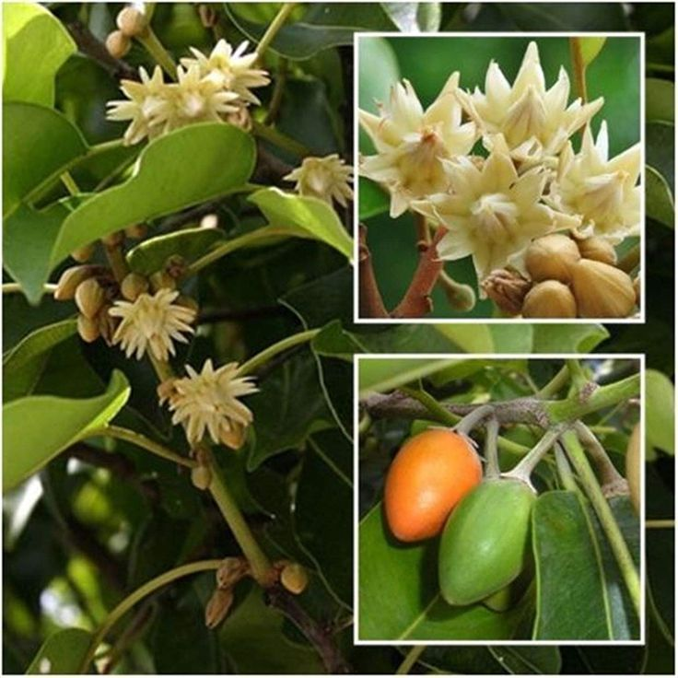
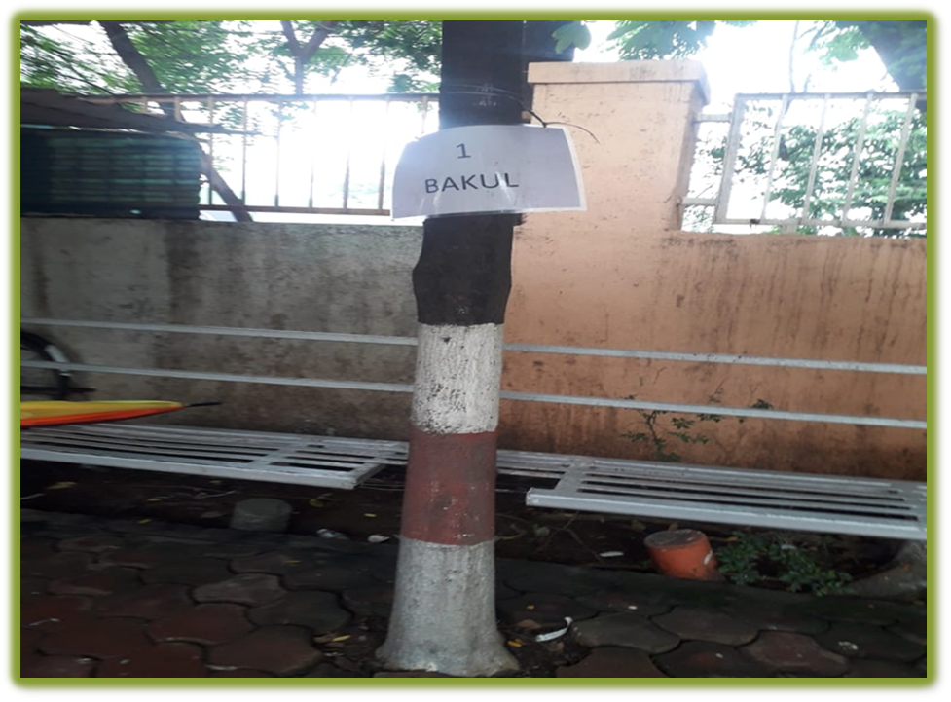
1. BAKUL
Main gate -Near waiting lounge at AIS Campus, Wakad.

Slide 2

Common Name : Bakul
Scientific Name : Mimusops elengi Linn.
Family : Sapotaceae.
Habit : Mimusops elengi is a medium-sized evergreen tree.
gives thick shade and small yellowish white flowers
emit fragrance. It is a prized collection of gardens.
Distribution : Its found in tropical forests in South Asia, Southeast Asia
and northern Australia. English common names include
Spanish cherry, medlar, and bullet wood.

Slide 3
Description :
Height of Tree : About 16 m (52 ft).
Leaves : The leaves are glossy, dark green, oval-shaped, 5–14 cm (2.0–5.5 in) long, and
2.5–6 cm (0.98–2.36 in) wide
Flower: The flowers are cream, hairy, and scented. It flowers in April.
Fruits: are fleshy, range in color between yellow and brown, and contain a large brown seed.
The pulp has a yellow color and it is edible. Fruiting occurs between June and October.
Bark of the tree : is thick and appears dark brownish black or grayish black in colour.
Seeds : are just like the seeds of custard apple. About 1 to 1.5 cm in length and have a brownish black hard coat. They are quite easy to germinate.

Slide 4
USES :
Fruits: The ripe fruits of Bakul are pressed into a pulp and used in the treatment of chronic dysentery. The seeds are also crushed and made into a paste with some ghee or butter to treat constipation in children.
Flowers: Dried Bakul flowers are used as snuff to give relief from headaches and acute pains. Both the flowers and fruits of this amazing plant are mixed with other astringents to create a lotion that treats ulcers and wounds.
Bark: Even the bark of the Bakul tree is an astringent and a febrifuge (used to treat fever). It is also said to increase the chances of conception in women. The decoction from the bark is used for the treatment of tooth diseases.
Oil from the seeds of Bakul is used for lighting and to make paint.
Its timber is valuable.
Fruits, flowers, seeds and bark of the Spanish cherry have a huge demand in the cosmetics industry.

