Slide 1
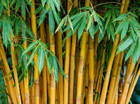
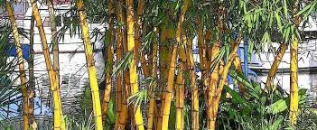
BAMBOO
In front of Front Assembly point 3

Slide 2
Common Name: Bamboos
Scientific Name: Bambusa vulgaris(Poaceae)
Family: Poaceae / Grasses
Habitat: Tropical , Sub -Troprical , Mild Temperate Regions. It can grow on ground up to 1,500 m (4,900 ft) above sea level. In extreme droughts, it may defoliate completely.
Distribution: Deciduous And Semi evergreen Forests Of The North Eastern Region Of India. Most bamboo species are native to warm and moist tropical and to warm temperate climates.

Slide 3
Description :
Bambusa vulgaris forms moderately loose clumps and has no thorns.
It has lemon-yellow culms (stems) with green stripes and dark green leaves.
Stems are not straight, not easy to split, inflexible, thick-walled, and initially strong.
Nodes are slightly inflated. Internodes are 20–45 cm
Several branches develop from mid-culm nodes and above.
Flowering is tiny and borne on compound inflorescences .
Fruits are rare, Pear shaped, avocado like green, fleshy, single seeded
Bamboos are some of the fastest growing plants in the world.

Slide 4
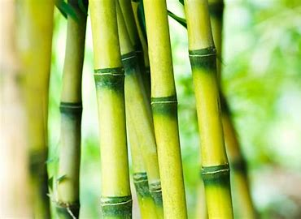
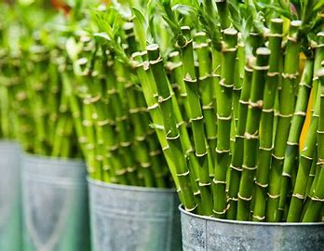
USES OF BAMBOO

Slide 5
USES:
The stems used as fuel and the leaves used as fodder.
It is also is used to make furniture, basketry, windbreakers, flutes, fishing rods, tool handles, stakes, weapons, bows for fishing nets, smoking pipes, irrigation pipes, distillation pipes etc.It is widely used as an ornamental plant.
It often is planted as fences and border hedges. It is also planted as a measure for erosion control.
It is used to make many parts of boats including masts, rudders, outriggers, and boating poles.
Young shoots of the plant, cooked or pickled
Water stored in golden bamboo tubes is used as a cure of various diseases.

