Slide 1

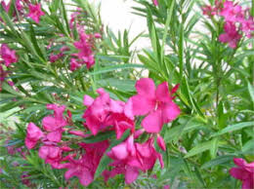
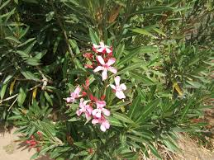
Nerium

Slide 2
Common Name : Oleander, rosebay
Scientific Name : Nerium oleander L
Family : Apocynaceae
Habit : Annual, perennial herb, shrub, tree, often vine; sap generally milky. Leaf: simple, alternate, opposite, subwhorled to whorledLeaves glossy and thick, with prominent mid-rib. Flowers fragrant, bright red and showy, 5 petals, in clusters, on the end of each branch.
Distribution : They are mostly found distributed in the dry tropical regions of India. The three commercially important species of Nerium are Nerium indicum, Nerium oleander and Nerium oleander. Native to the Mediterranean region, including northern Africa, southern Europe and South East Asia

Slide 3
Description :
Bark and Trunk: The Nerium oleander (kanhera) has grayish, rough bark and an erect trunk that can support its height of 2-6 meters.
Leaves: thick, leathery, and dark green
Flowers: The flowers of the Nerium oleander (kanhera) are white, pink, or red, and grow in clusters at the end of branches. They are five-lobed and typically 1-2 inches in diameter
Fruits: The fruits of the Nerium oleander (kanhera) are long, narrow pairs of follicles that can be up to 23 cm (9 inches) long.
Growth and Lifespan: The Nerium oleander (kanhera) is a rapidly growing shrub or small tree that can live for several decades. It typically reaches heights of 2-6 meters (7-20 feet) and can spread up to 4.5 meters (15 feet)

Slide 4
USES:
Nerium oleander (kanhera) is widely used for various purposes:
Ornamental Use: It is popular in landscaping due to its attractive, evergreen foliage and vibrant flowers. It is often planted in gardens, parks, and along roadsides1.
Medicinal Use: Despite its toxicity, oleander has been used in traditional medicine for treating conditions like heart disease, asthma, and skin ailments. However, its use is highly regulated due to the risk of poisoning2.
Environmental Use: Oleander is used for soil stabilization and as a windbreak in arid regions. Its ability to tolerate poor soil conditions makes it useful for preventing soil erosion2.
Cultural Significance: In some cultures, oleander is used in rituals and as a symbol of beauty and resilience

Slide 5
Wood (Trunk and Branches): structural use, cultural , ornamental etc.
Leaves: medical, skincare. The leaves and the flowers of Nerium are cardiotonic, diaphoretic, and diuretic, anticancer, antibacterial.
Root is powerful resolvable and is used in the form of plasters and is applied to tumours because of its poisonous nature it is only used externally.
Flowers: antibacterial, medical uses
Pods and Seeds: ornamental, limited medicinal use

