Slide 1

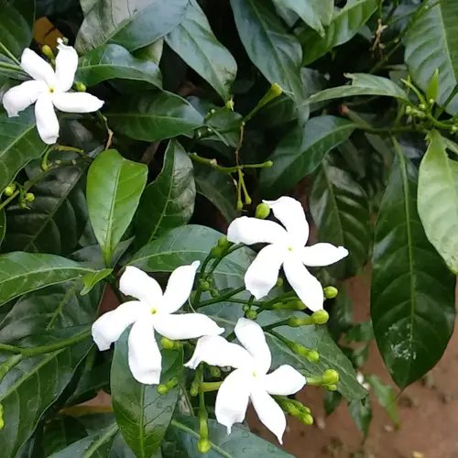
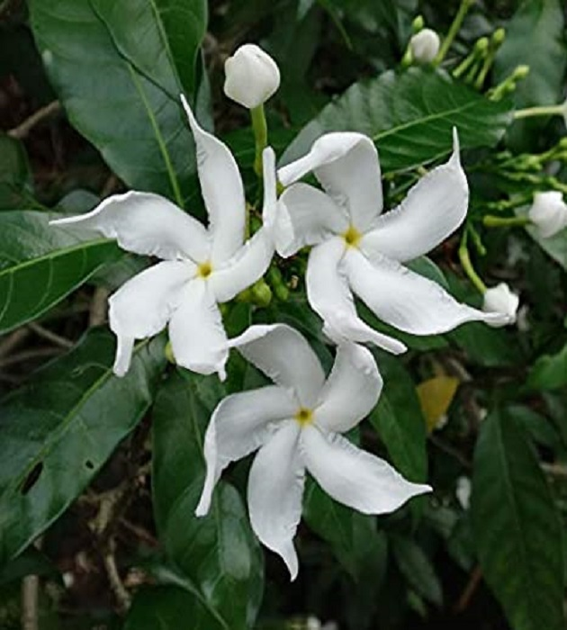
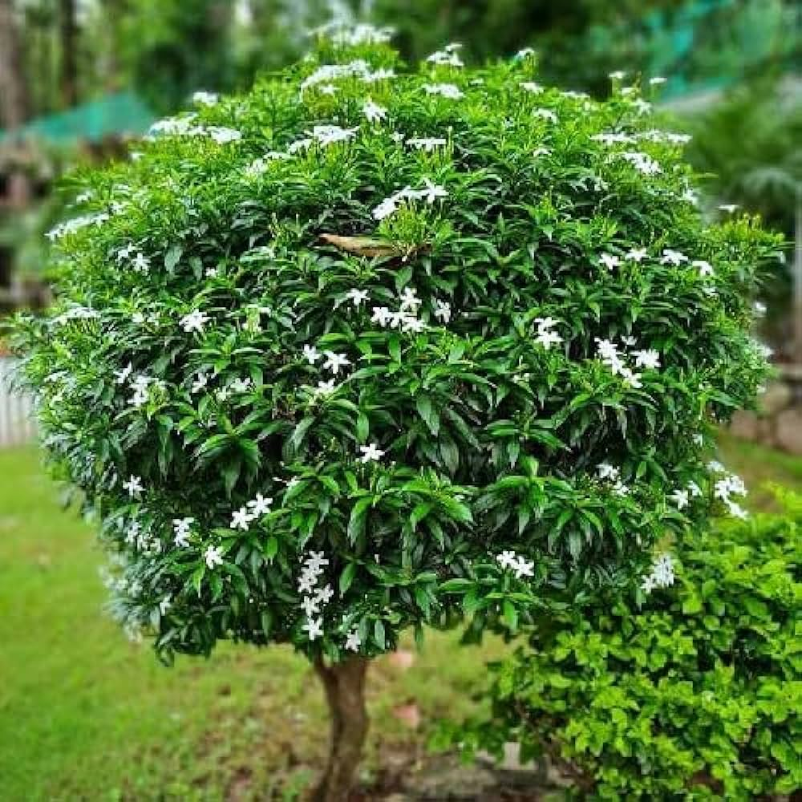
Crape Jasmine
In front of reception, AIS Campus, Wakad.

Slide 2
Common Name : Crape Jasmine, Pinwheel Flower
Scientific Name : Tabernaemontana divaricate
Family : Apocynaceae.
Habit : It grows in montane brushwoods and sparse forests.
Distribution : The plant is found in Asia, Australia, China, Japan, India and Myanmar.

Slide 3
Description :
Height of Tree : About 1.5 m (33-66 ft).
Leaves : The large shiny leaves are deep green and about 15 cm (6 in) in length and 5 cm (2 in) in
width.
Flowers: The waxy blossoms are found in small clusters on the stem tips. The (single) flowers have the
characteristic 'pinwheel' shape also seen in other genera in the family Apocynaceae such as
Vinca and Nerium. Both single and double-flowered forms are cultivated, the flowers of both
forms being white. The plant blooms in spring but flowers appear sporadically all year. The
flowers have a pleasing fragrance.

Slide 4
Flowers: The waxy blossoms are white five petaled pinwheels. The flowers are commonly used for poojas and worshipping gods in India. Nandyarvatam has a magical ability to cure eye disease and the milky juice of the leaves has anti inflammatory action and can be applied directly over the wounds. The juice of the flowers can also be made into eye drops. The petals are used in Kajals (Ayurvedic eye liners).

