Slide 1
ANTI-BIOTICS
CASE STUDY : Computing and Science (CS 103)
~ Sharvanee Sonawane (22B0943)

Slide 2
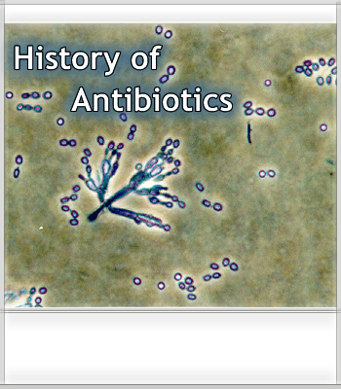
Development of Anti-biotics
Antibiotics are used to treat or prevent bacterial infections. The introduction of antibiotics into clinical use was arguably the greatest medical breakthrough of the 20th century.

Slide 3
Scientific milestones that contributed to the development of Anti-biotics-
Discovery of salvarsan
The first antibiotic, Salvarsan, was deployed in 1908. The search for chemicals that would adversely affect invading bacteria but not the host began in the nineteenth century. Paul Ehrlich, a German bacteriologist, investigated arsenic based structures in order to produce less toxic substances for the treatment of Syphilis. He developed the medicine, Arsphenamine, known as salvarsan and got Nobel prize for Medicine in 1908 for this discovery. It was the first effective treatment discovered for syphilis.

Slide 4
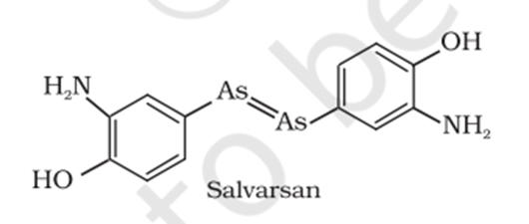
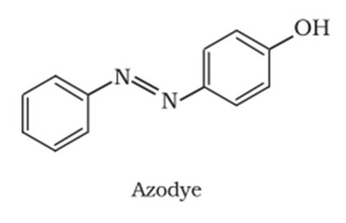
At the same time, Ehrlich was working on azo dyes also and he noted the similarity in structures of salvarsan and azo dyes as –As = As– linkage present in arsphenamine resembles the –N = N – linkage present in azo dyes.
In 1932, he succeeded in preparing the first effective antibacterial agent, Prontosil, which resembles in structure to the compound, Salvarsan. Soon it was discovered that in the body prontosil is converted to a compound called Sulphanilamide, which is the real active compound. Thus the Sulpha drugs were discovered. A large range of Sulphonamide analogues was synthesised. One of the most effective is Sulphapyridine.
Synthesis of Sulpha Drugs

Slide 5
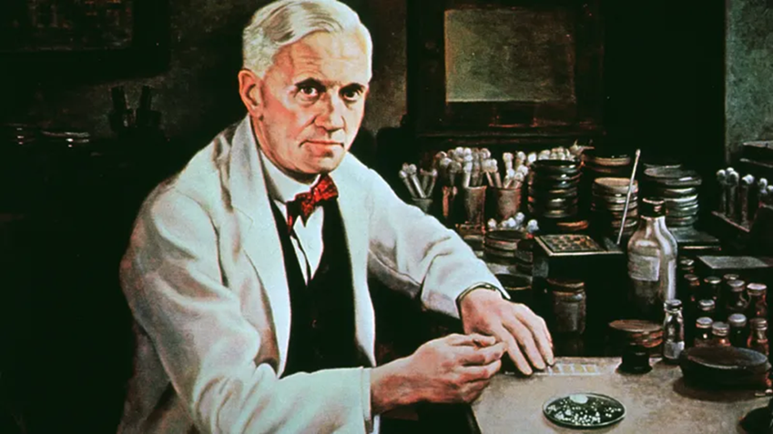
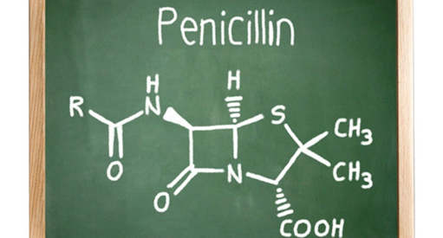
Despite the success of sulphonamides,
the real revolution in antibacterial
Therapy began with the discovery of
Alexander Fleming in 1929,
of the antibacterial properties of a
Penicillium fungus.
Isolation and purification of active
compound to accumulate sufficient material for clinical trials took thirteen years.
The discovery of penicillin in 1929 started the
golden age of natural product
antibiotic discovery
that peaked in mid-1950s.
Penicillin breakthrough

Slide 6
Penicillin was later purified by Norman Heatley, Howard Florey, Ernst Chain and colleagues at Oxford, who were instrumental in the development of penicillin as a drug.
Selman Waksman, in the late 1930s, defined an antibiotic as ‘a compound made by a microbe to destroy other microbes’ and was instrumental in identifying soil-dwelling filamentous Actinomycetales as prolific producers of antimicrobial compounds. Waksman’s work initiated the Golden Age of antibiotic discovery from the 1940s to the 1960s.
Identification of Actinomycetales

Slide 7
Societal factors that contributed to the development of Anti-biotics-
Fatal diseases having no cure
Serious diseases that once affected thousands of people each year caused medicines called antibiotics to be used in many countries in current times. So the discovery of antimicrobial drugs (antibiotics) was one of the most significant medical achievements of the 20th century. In the pre-antibiotic era of the early 1900s, people had no medicines against these common germs and as a result, human suffering was enormous.
Before antibiotics, 90% of children with bacterial meningitis died. Among those children who lived, most had severe and lasting disabilities, from deafness to mental retardation.

Slide 8
Strep throat was at times a fatal disease, and ear infections sometimes spread from the ear to the brain, causing severe problems. Other serious infections, from tuberculosis to pneumonia to whooping cough, were caused by aggressive bacteria that reproduced with extraordinary speed and led to serious illness and sometimes death.
Penicillin made a difference during the first half of the 20th century. The first patient was successfully treated for streptococcal septicemia in the United States in 1942. However, supply was limited and demand was high in the early days of penicillin.

Slide 9
World War II and British firms
Penicillin helped reduce the number of deaths and amputations of troops during World War II. According to records, there were only 400 million units of penicillin available during the first five months of 1943; by the time World War II ended, U.S. companies were making 650 billion units a month.
In 1940s, there were plans to make penicillin available for British troops on the battlefield.
The discovery of penicillin and the initial recognition of its therapeutic potential occurred in the United Kingdom, but, due to World War II, the United States played the major role in developing large-scale production of the drug, thus making a life-saving substance in limited supply into a widely available medicines.

Slide 10
War-time conditions made industrial production of penicillin difficult. A number of British companies, including Glaxo (now GlaxoSmithKline) and Kemball Bishop, a London firm later bought by Pfizer, took up the challenge.
Penicillin Production in the United States during and post WWII-
Howard Florey recognized that large-scale production of penicillin was probably out of the question in Britain, where the chemical industry was fully absorbed in the war effort. Florey and his colleague Norman Heatley traveled to the United States to interest the American pharmaceutical industry in the effort to produce penicillin on a large scale.
Role of United States post World War II

Slide 11
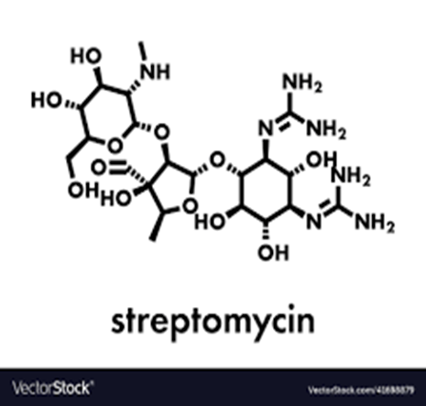
Orville May, Director of the NRRL, agreed to have the Laboratory undertake a vigorous program to increase production proved to be crucial to the success of the project, as the NRRL was a key contributor of innovations that made large-scale production of penicillin possible.
Another great milestone was the discovery of Streptomycin in 1943, the first useful drug for tuberculosis, or TB treatment.
Not only was streptomycin able to treat TB,
but it was useful to cure gram-negative
bacterial infections, which penicillin could not.
Selman Waksman received the Nobel prize in 1952
for his “discovery of streptomycin,
the first antibiotic effective against tuberculosis.”
People relying on first ever TB treatment

Slide 12
Sources used for reference-
https://ncert.nic.in/ncerts/l/lech207.pdf
https://www.healthychildren.org/English/health-issues/conditions/treatments/Pages/The-History-of-Antibiotics.aspx
https://en.wikipedia.org/wiki/Antibiotic
https://www.acs.org/content/acs/en/education/whatischemistry/landmarks/flemingpenicillin.html
https://www.youtube.com/watch?v=uRhkDN2WjzI&feature=emb_rel_end
https://www.sciencedirect.com/science/article/pii/S1369527419300190

