Slide 1


PREDICTION OF KAP
IN HYPOTHYROIDISM
GROUP NAME:
BINGE THINKERS

Slide 2

T1
SHARVANI-2103A54024
Coding & Literature survey
T2
SHIVANSH-2203A54L03 Coding
Team 01
T3
VARSHITHA-2103A54040 Data set Collection & Process
Part 02
TEAM MEMBERS
T4
SAHANA-2103A54022 Literature survey & Process
Part 03
T5
VYSHNAVI-2103A54043 Methodology & Data set collection
Part 04
T6
PARUSHURAM-2103A54019 Data Set Collection

Slide 3
DATASET :
We have Collected our data set by creating a google form.
We got total responses of 114, so dataset consist of 114 columns
Our Dataset includes attributes of:
Age
Gender
Knowledge: How familiar are you with the term "hypothyroidism" ?
common symptoms
Have you ever been diagnosed with hypothyroidism
How concerned are you about the impact of hypothyroidism on your overall health
Do you feel well-informed about the available treatment options for hypothyroidism
Are you comfortable discussing hypothyroidism with your healthcare provider
Practices: How regularly do you takeyour prescribed medication for hypothyroidism
Have you made any dietary or lifestyle changes to manage your hypothyroidism
How often do you attend follow-up appointments with your healthcare provider for hypothyroidism
experienced any challenges in managing hypothyroidism
Those are the details which help us out for our prediction
.

Slide 4
NLP TECHNIQUES
prerocessing
tokenization
lowercasing
an essential step in natural language processing (NLP) that involves cleaning and transforming unstructured text data to prepare it for analysis
the text is split into smaller units. We can use either sentence tokenization or word tokenization based on our problem statement.
It is one of the most common text preprocessing Python steps where the text is converted into the same case preferably lower case

Slide 5
stop word removal
stemming
lemmatization
Stop word removal is typically one of the initial steps in preprocessing text data for tasks such as text classification, sentiment analysis, information retrieval, and topic modeling. After stop word removal, the remaining words, often referred to as content words, carry more weight in representing the semantic content of the document.
stemming is a text processing approach that reduces words to their stem, or base form. By normalizing words, stemming helps to reduce the quantity of a vocabulary and increase the effectiveness of text analysis by treating multiple forms of the same word as equal.
.
Lemmatization is the process of determining a word's lemma based on its intended meaning and grammatical function within a phrase. Usually, this calls for having access to a lexicon or dictionary that lists words' basic forms and part-of-speech (POS) labels.

Slide 6
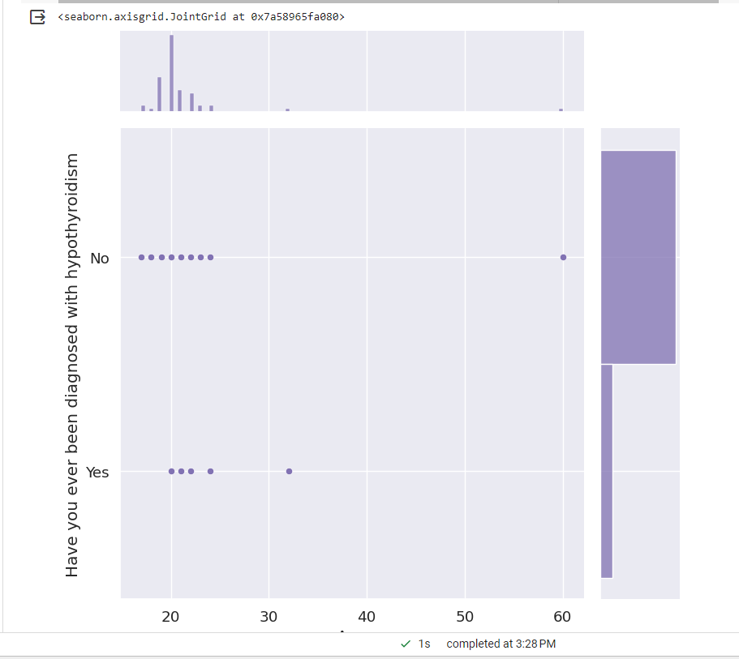
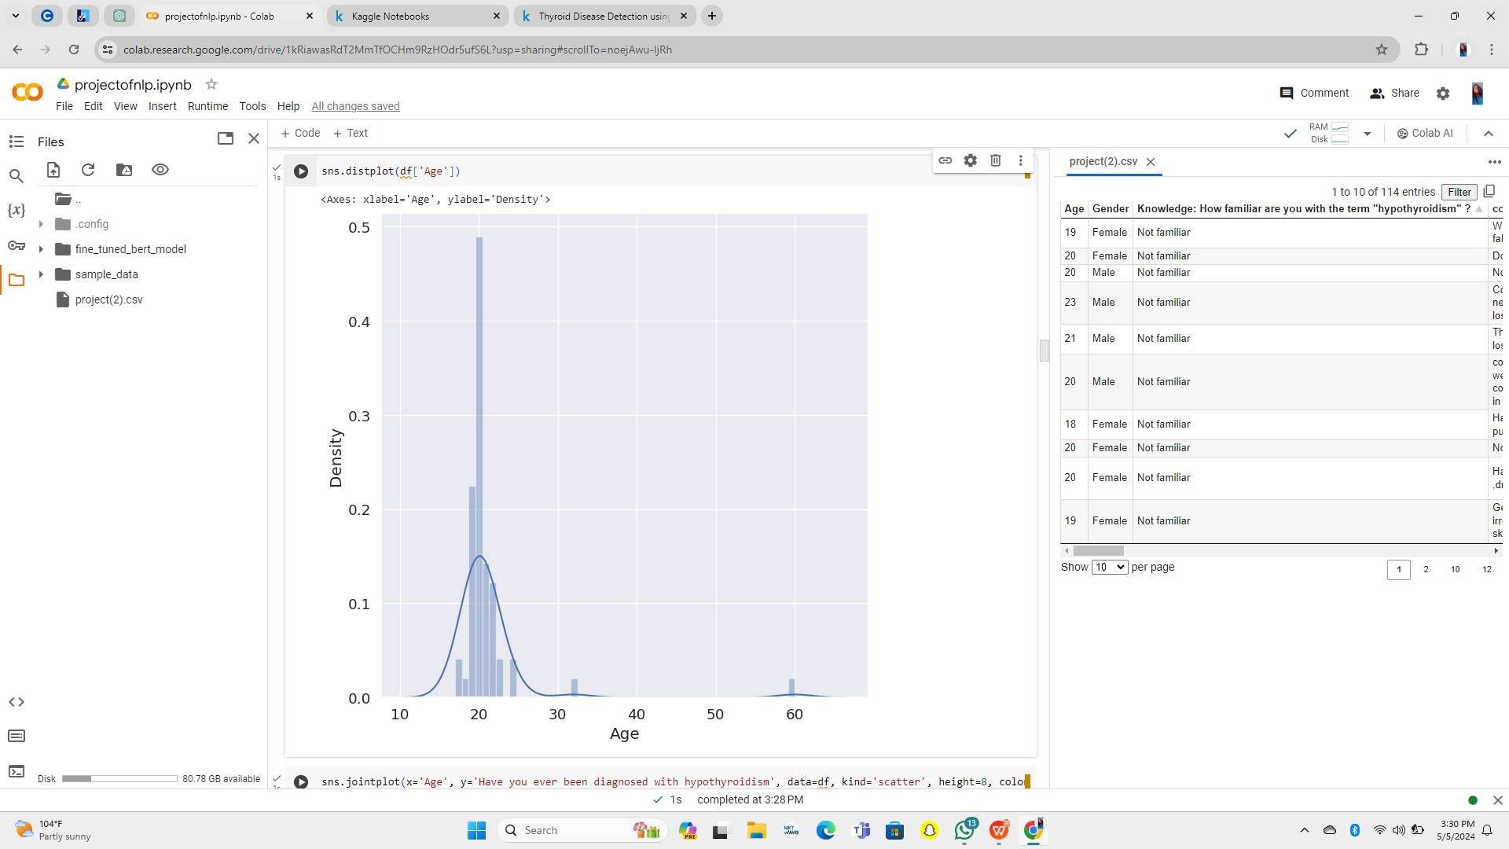
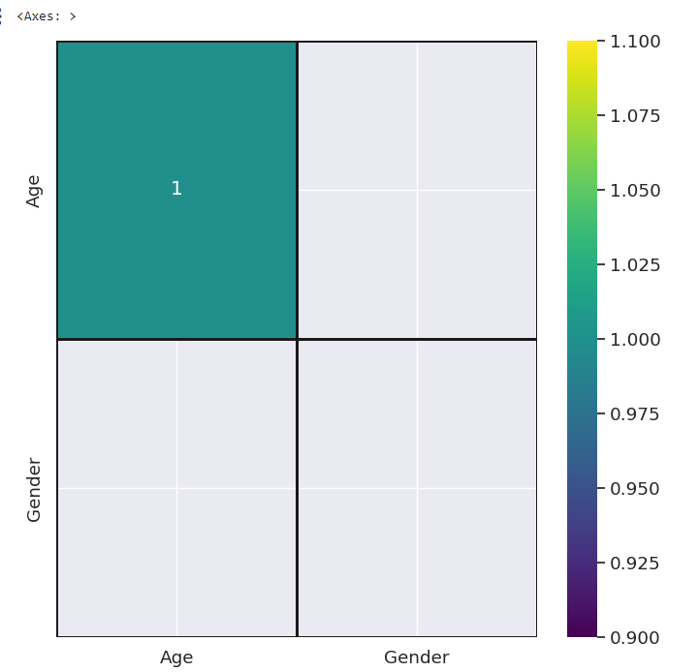
DATA VISULIZATION
the representation of data through use of common graphics, such as charts, plots, infographics and even animations. These visual displays of information communicate complex data relationships and data-driven insights in a way that is easy to understand. in this project we used bar chart, heat map, count map,distplot,jointplot
joint plot :
dist plot :
heat map :

Slide 7
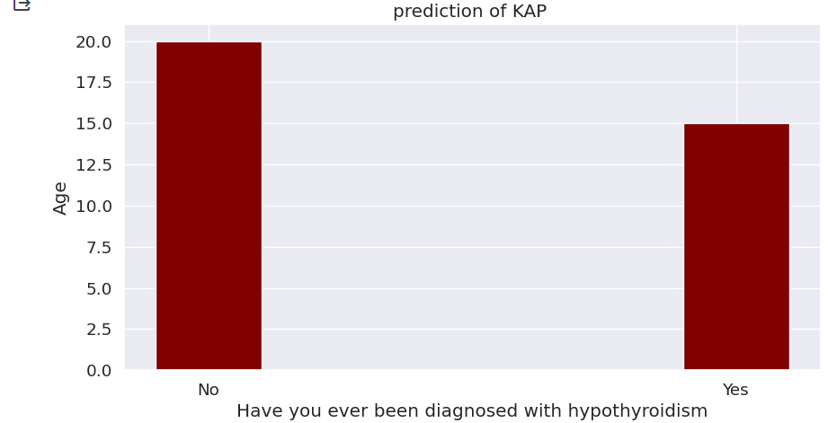
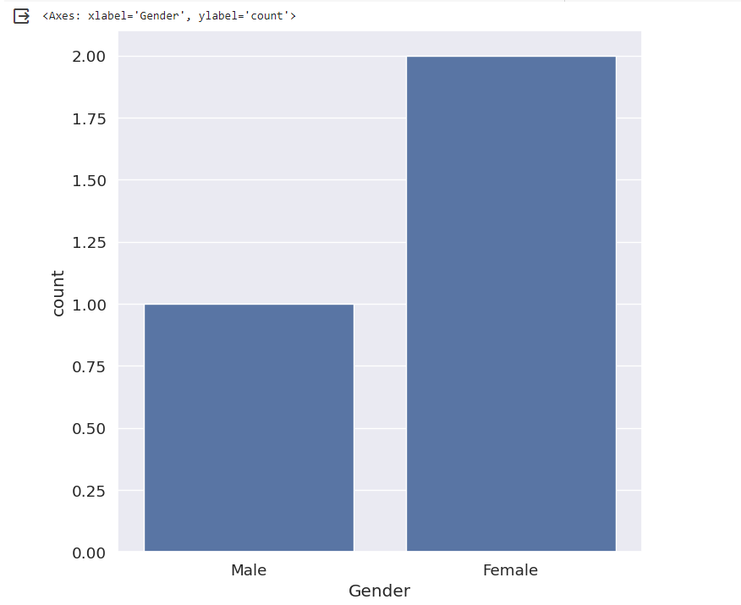
count plot :
bar plot :

Slide 8
METHODOLOGY :
input data
preprocessing
feature extraction
Use BERT to extract contextual embeddings for each word or token in the text data
loading the data
Tokenization,stop word removal,stemming,
lemmatization
model training
.
Split the data into training and validation sets.
Output
prediction
model evalution
Analyze the predicted KAP levels to gain insights into individuals' knowledge, attitudes, and practices regarding hypothyroidism.
Apply the selected model to new or unseen textual data to predict KAP levels related to hypothyroidism.
Evaluate the trained models on the validation set to assess their performance.

Slide 9
TYPES OF TECHNIQUES WE USED :
BERT ( Bidirectional Encoder Representation from Transformers) : is a powerful tool in natural language processinf that helps computers understand and process human language more effectively by capturing context from both directions of a sentence. LSTM (Long Short Term Memory) : is like a special brain for understanding and remembering words in sentences. it helps computers understand the meaning of words in context and remember important information for tasks like translation sentiment analysis, and text generation.
.

Slide 10
RESULTS :
BERT ( Bidirectional Encoder Representation from Transformers) :Validation Accuracy: 1.0
.

Slide 11
CONCLUSION:
we have learned a lot about the hypothyroidism and how people feel and know about it. We collected data by survey the people and we analyzes the data to see what people knew about it and how they felt about hypothyroidism. We preprocessed all the text we collected to make easier for the computer to understand. We turned the words into tokens,removed unnecessary stuff like punctuation,and made everything the same lowercase. After that, we imported some libraries and loaded a pre-trained BERT Tokenizier. This helped us understand the text even better. We split our data into training and validation sets and created data loaders to help the computer learn faster. Then we loaded a pre-trained BERT model and trained it on our data. After each training session, we checked how well it was doing on our validation set to make sure it was learning correctly. Lastly we had using about an LSTM model for time series forecasting, which is like predicting the future based on past patterns. By analyzing people’s knowledge and attitudes and using advanced techniques, we can help healthcare providers make better plans for managing hypothyroidism and improving patient outcomes .
.

Slide 12
THANK YOU

