Slide 1
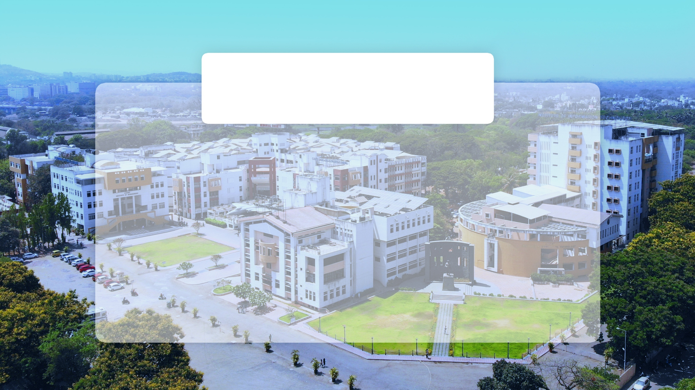

UNDER Water Quality Monitoring SENSORS
GroupID:0 Year: TE Shift: llnd Semester:06 A.Y.: 2020-2021
Project Group Members & Roll Numbers:
1]Ms. Sharvari kamble[42] Guided By: Ms. Anuradha Varal
2] Ms. Suvarna Pawar[52]
3] Ms. Komal Kamble [69]
4] Mr. Yash Mohite[68]
Department of Computer Engineering

Slide 2
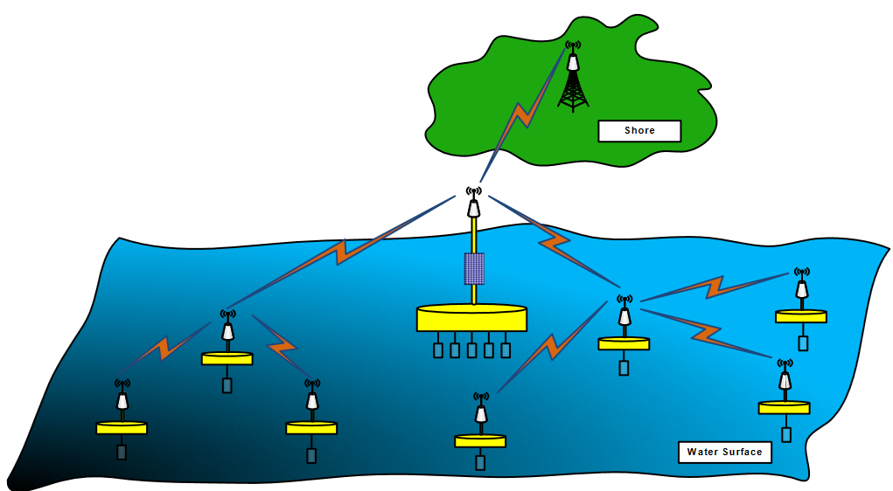
Project Goal:-
This project focuses on sea, river/lake water quality monitoring with inexpensive sensor nodes using hierarchical communication structure. Therefore, a large number of the sensor nodes can be deployed to cover a large monitoring area with enough density. The ultimate goal of this project is to implement a hierarchical water quality sensor network structure to reduce the cost of water quality sensor networks and increase the density of the sensor node deployment.

Slide 3
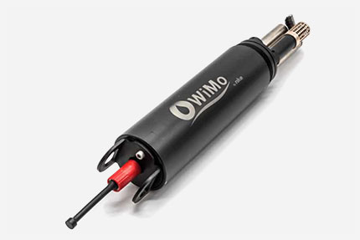
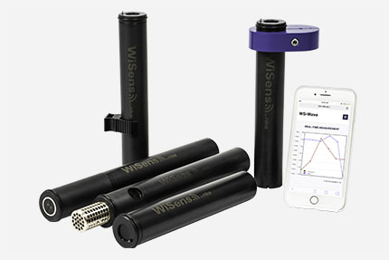
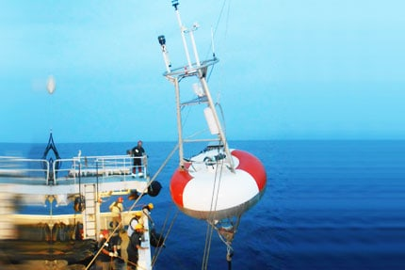
TYPES OF UNDERWATER MONITORING SENSORS.
Multiparameter probes
2)Underwater loggers
3)Specific parameters
Temperature and conductivity are measured by the CT sensor thanks to a thermistor and a 4 carbon electrodes cell. This sensor gives access to calculated parameters: salinity, specific conductivity, sound velocity, total dissolved solids or chlorides. The 3G/4G modem enables the WiMo multiparameter probe range to transmit its data using the deployed the 3G/4G networks
Instrumentation launched the most compact WiFi remote water-sensing loggers range on the market. Developped and designed by , these new autonomous data loggers allows a very high ease. So far, the WiSens range has been uses to measure temperature, pressure, conductivity, salinity, turbidity, acceleration and even tide and wave. Instrumentation will soon presents new parameters as dissolved oxygen.
parameters: • Density and absolute salinity: NOSS sensor • PCO2 concentration in seawater: pCO2 sensor • Sedimentology: ALTUS • Effort recorder: SF • Deep sea temperature measurement: S2T6000 DH-TI • Irradiance measurement: SPAR • Corrosivity sensors: SPCT, SCPC, AirCorr • Fishing sensors: SF, Hook Timers

Slide 4
How Sensors Can Measure Water Quality
Sensors can indicate water quality conditions for various applications. In particular, a water quality monitoring system can supply crucial data to researchers, operators and engineers for use in laboratory research, quality control, hydraulic model calibration, compliance and tracking shifts in the quality of a water system over a period time.
1)Residual Chlorine Sensor:- Determining residual chlorine in water treatment centers and distribution systems is essential and has been important as long as chlorine has been used to disinfect water.
2)Turbidity Sensor:- Turbidity sensors gauge suspended solids in water, normally by determining the amount of light that is able to pass through the water. These sensors are used in river and stream testing, wastewater measurements, drinking water treatment operations, settling ponds management, sediment transport study and laboratory testing.
3)Conductivity Sensor:- Conductivity testing is often conducted in industrial settings to obtain data on total ionic concentrations, such as the amount of dissolved compounds, in aqueous solutions. Common applications include water purification, clean in place (CIP) control, and measuring concentration amounts in solutions.
4)pH Sensor :- The pH of a solution, how acidic or basic it is, a major indicator of water quality. Sensors used to determine pH are usually a single electrode, typically made of glass and quite delicate. An electrode is typically attached to an analyzer that has an interface for data collection, calibration, and alerts.
5)ORP Sensor:- ORP sensors gauge the Oxygen-Reduction Potential of a water sample. Used in conjunction with a pH sensor, an ORP measurement can offer insight into the degree of oxidation/reduction reactions taking place in the solution. An ORP Sensor should be connected to an effective interface and software to gather data.

Slide 5






Water mathematical Quality
Water Quality Index Calculation
To measure water quality, WQI is used to be calculated using various parameters that significantly affect WQ
Where Nis the total number of parameters included in the Wi QI Qcalculations is the quality rating scale for each parameter calculated by equation (2) below,wi and is the unit weight for each parameter calculated by equation (3).
where K is the proportionality constant that can be calculated as follows:
Normalization METHOD is a normalization method used to normalize parameters by using the mean (μ) and standard deviation (σ) values of the tested data. It can be calculated as follows:

Slide 6
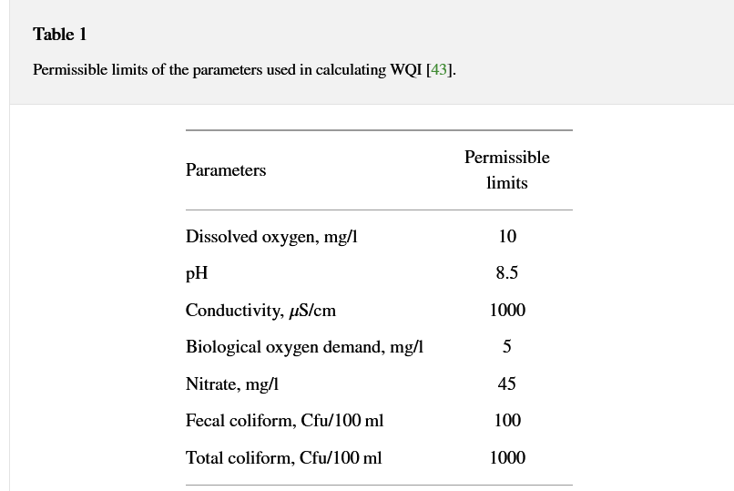


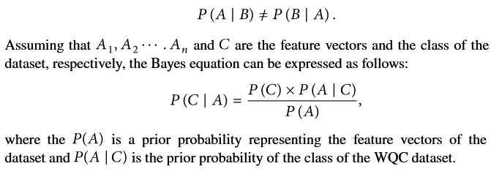
Prediction of Water Quality Classification
2.4.1. Support Vector Machine (SVM) Model
The SVM model was developed in 1995 by Corinna Cortes and Vapnik.
2.4.2. -Nearest Neighbor (K-NN) Model
The K-NN algorithm is a basic classification and regression method. It is used to find k the values that are close to values in the training dataset.
2.4.3. Naive Bayes Model

Slide 7
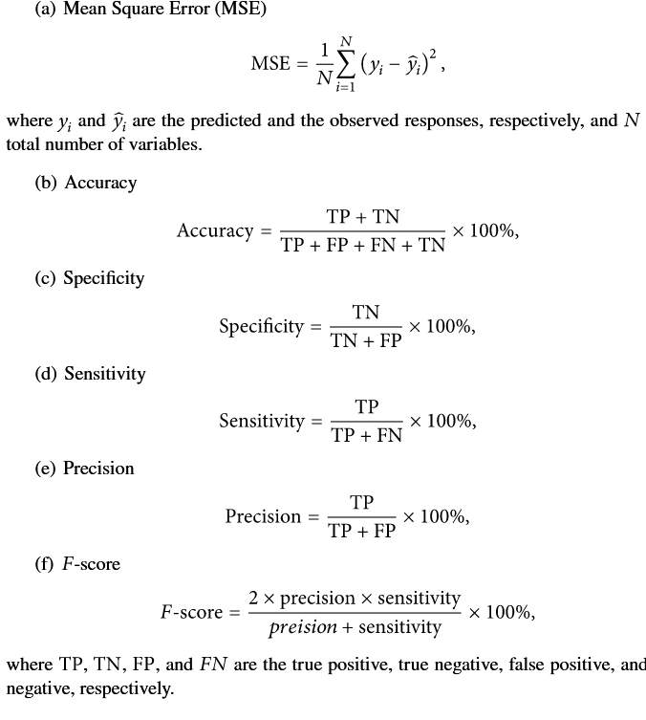

2.5. Performance Measurement
The statistical analysis, namely, mean square error (MSE), has been used to evaluate the robustness of the developed models to predict the WQI. However, the accuracy, specificity, sensitivity, precision, and
-score evaluation matrices were employed to evaluate the developed classification model to predict the WQC. The used statistical parameters were defined as follows:
2.6. Correlation Analysis
Pearson’s correlation coefficient approach is applied to analyze the correlation between the significant parameters of the dataset used for the prediction of the QWI values.
where:
: r:Pearson’s correlation coefficient approach
: x:input values in the first set of the training data
: n:input values of the second set of the training data
: y:total number of input variables

Slide 8
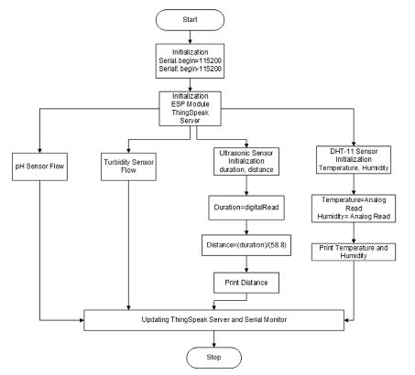
study WQI algorithm

Slide 9
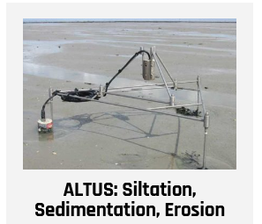
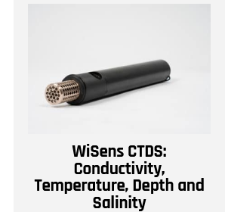
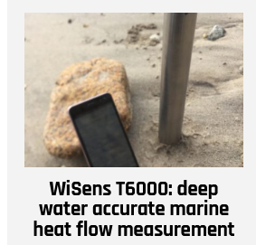
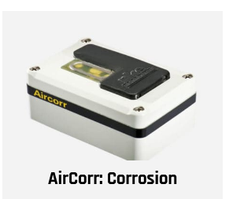
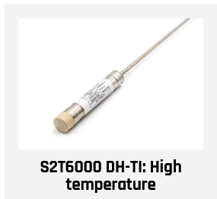
APPLICATIONS
Oceanographic studies & Environmental monitoring
Fishing & Oysterfarming
Lakes & Rivers
Deep sea
Corrosion & Immersed system behaviour
Lakes & Rivers

Slide 10
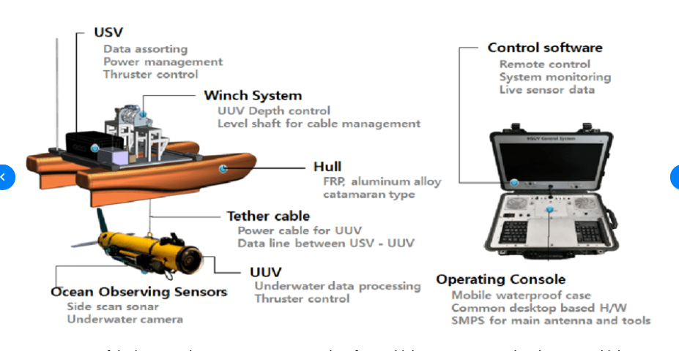
components/Architecture of underwater monitoring:-

Slide 11
Refrences:-
https://www.hindawi.com/journals/abb/2020/6659314/
https://www.google.com/url?sa=t&source=web&rct=j&url=https://www.nature.com/articles/s41598-017-12853-y&ved=2ahUKEwiYm6qq3t_wAhXP4XMBHdmXC0sQFjADegQIHRAC&usg=AOvVaw0oinXAu2ABeNvniZ_Q_j_j&cshid=1621770935595
https://www.azosensors.com/article.aspx?ArticleID=1444
https://www.google.com/url?sa=t&rct=j&q=&esrc=s&source=web&cd=&cad=rja&uact=8&ved=2ahUKEwiZgfmPueLwAhUOSX0KHbihDOUQFjACegQIFRAD&url=https%3A%2F%2Fnke-instrumentation.com%2Funderwater-monitoring-instruments%2F&usg=AOvVaw3VfE-jkaHJCoqjmYW8zqJo
Evaluate

Slide 12
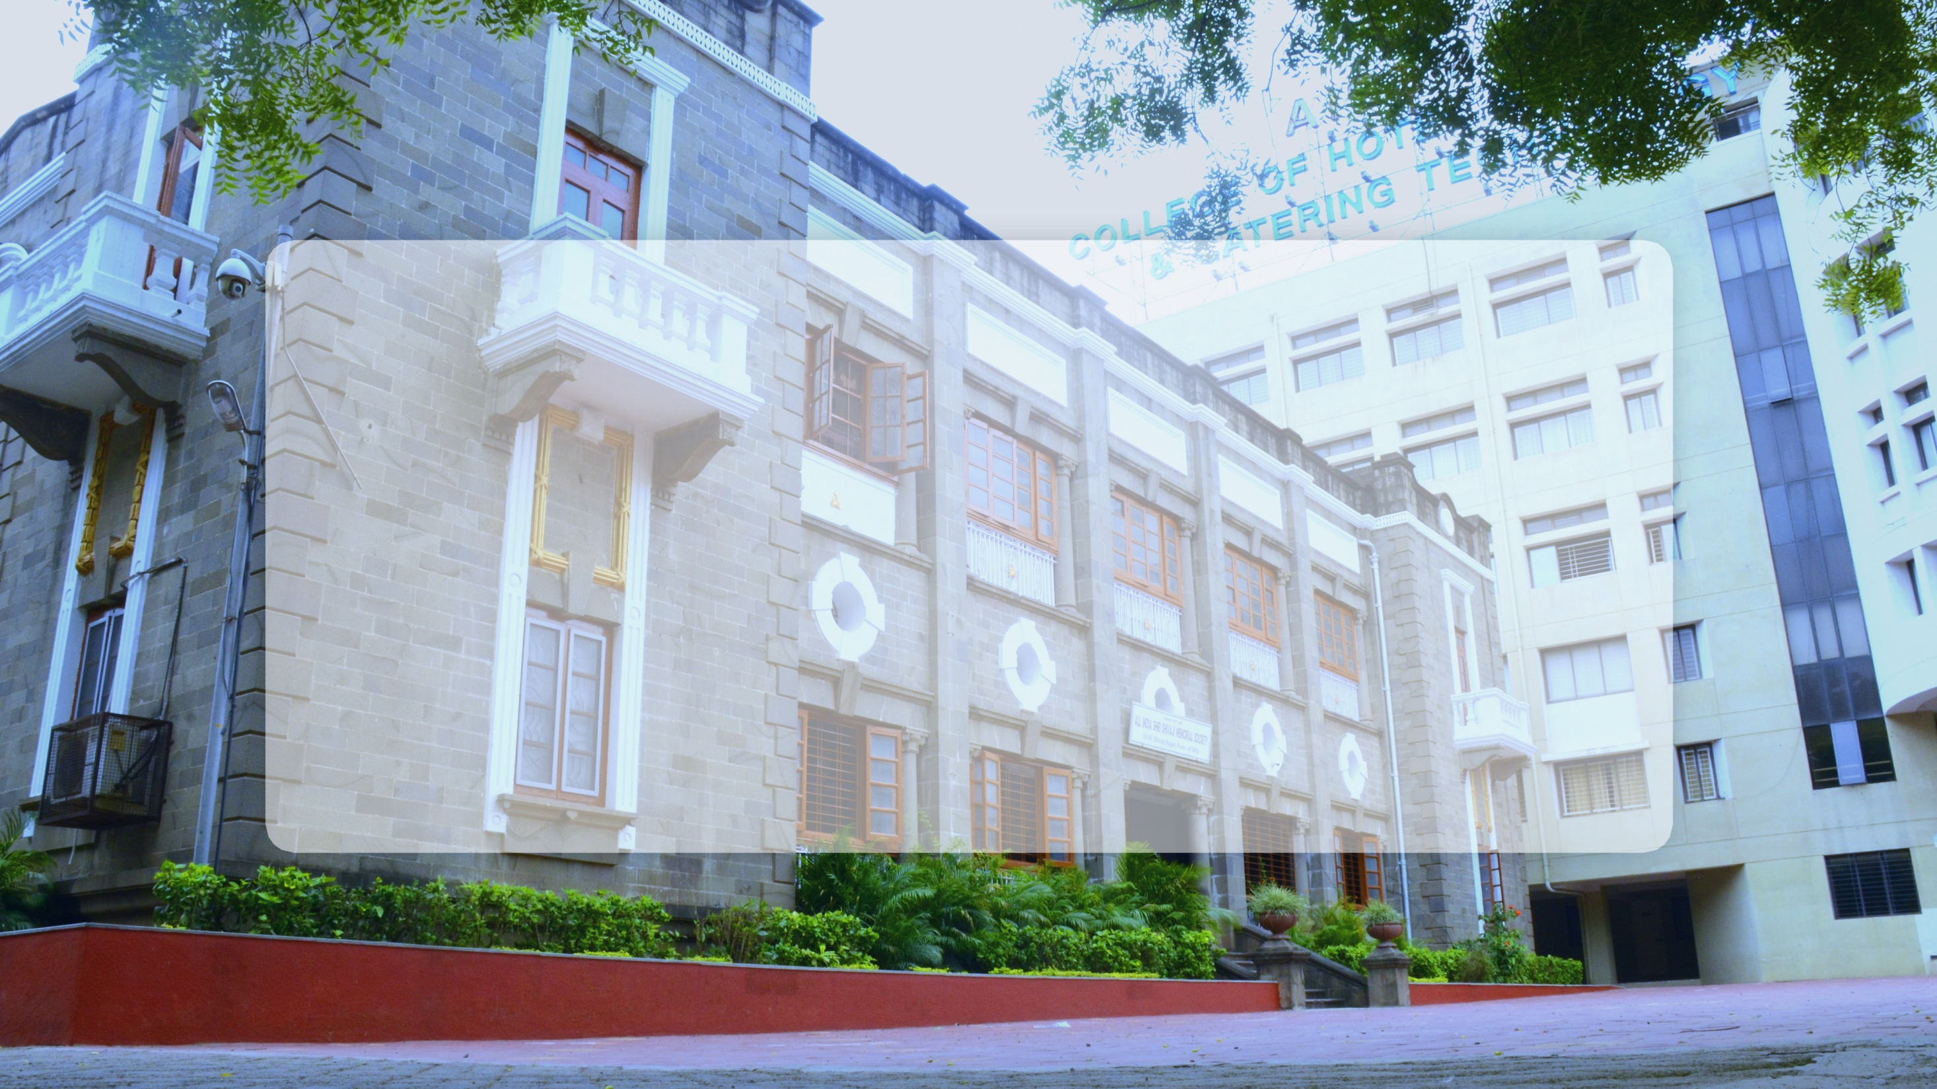
Thank You

