Slide 1

World Economic View
Sharvari Nagesh

Slide 2
Goals of the analysis
Data of Countries is analysed to find how the world economy is doing. The data is obtained from countries data. The focus areas of the analysis are:
GDP
Population
Life Expectancy
GDP Per Capita
Export/Import
Debt (External Debt / Public Debt)
Current account balance

Slide 3
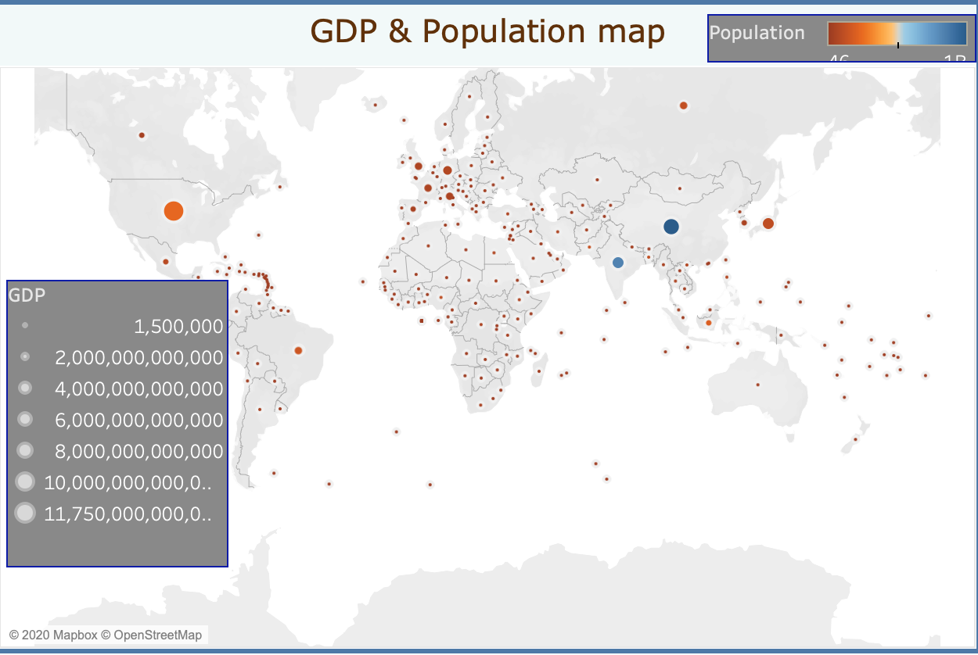
World Population Vs GDP
Biggest economies are : US, China, India, Japan, Germany, France & UK
Most populated countries are China and India

Slide 4
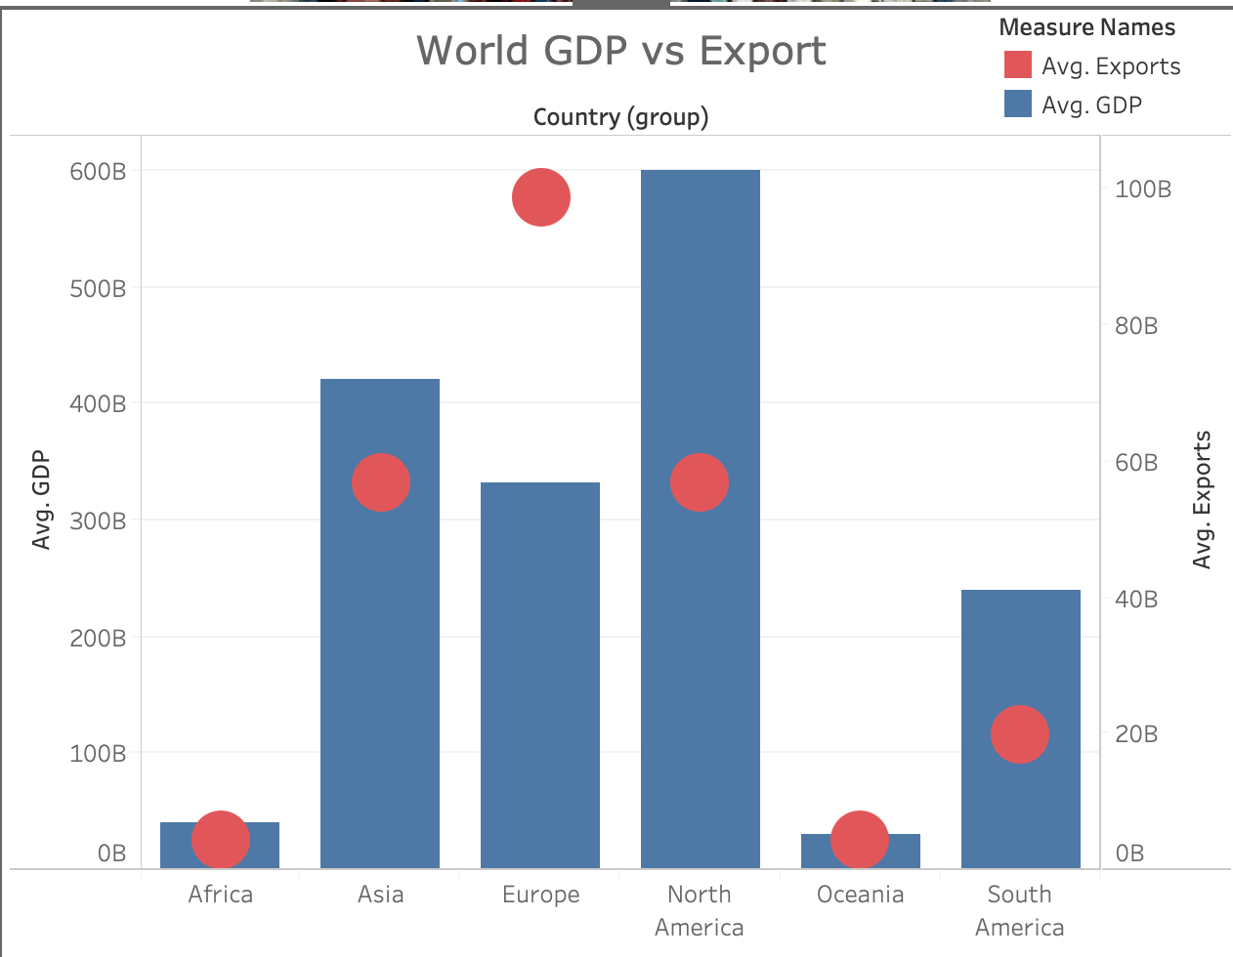
Continents GDP & Exports
North America followed by Asia have highest average GDP
Europe exports the most
African and Oceanic countries are the smallest GDPs and export the least

Slide 5
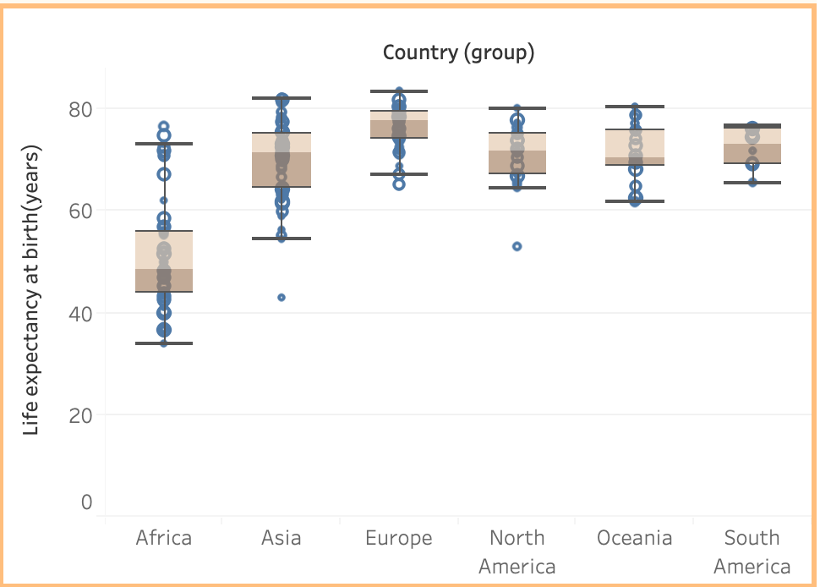

Continents’ Life expectancy
People from African countries live the shortest
Some of Asian countries also have people living a short life
European countries have very good life expectancy followed by North American countries

Slide 6
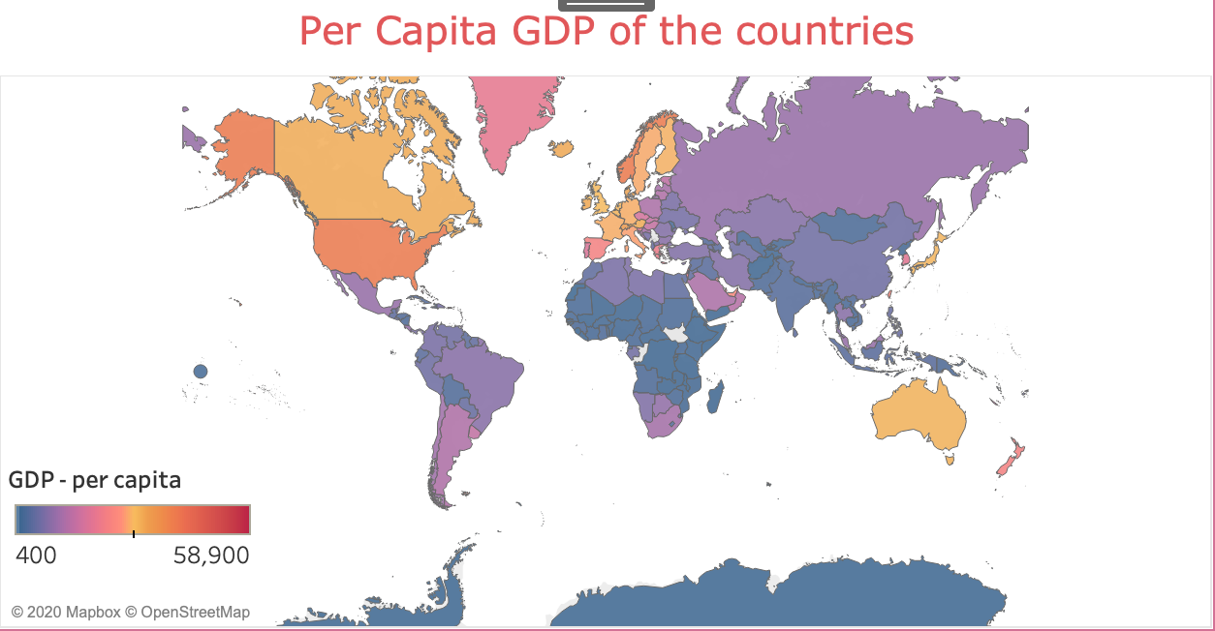
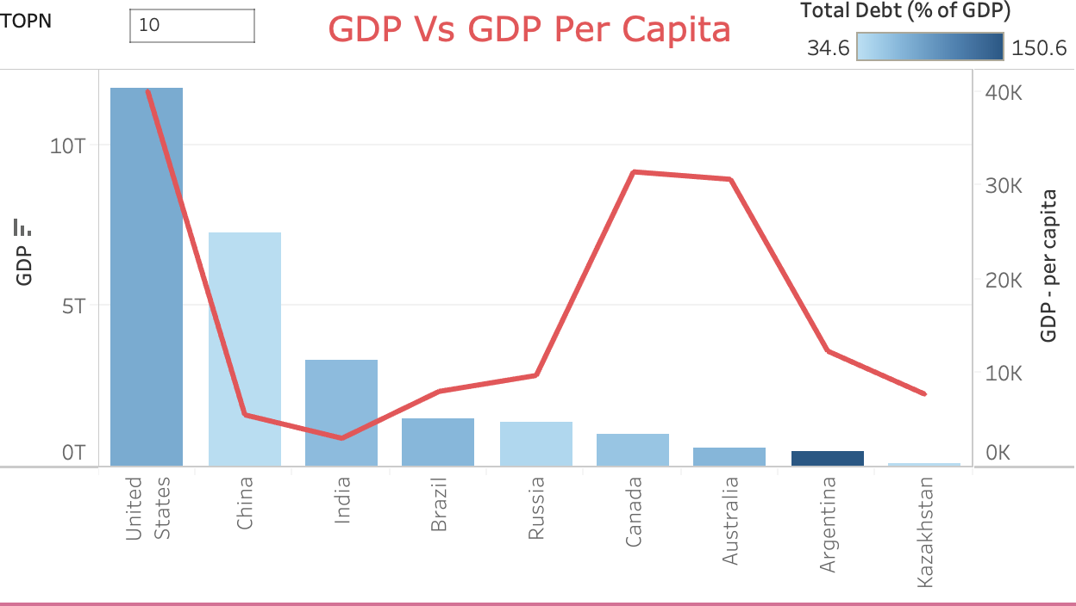
GDP Per Capita Vs GDP & Debt
United States has the highest per capita along with New zealand, Norway.
European countries and Australia has decent per capita income
Central African countries, Afghanistan followed by india, Pakistan among the lowest GDP Per capita countries
When we compare GDP to GDP Per capita, america, Canada, Australia have higher GDP Per capita
Interestingly some countries with higher GDP Per capita also have higher total debt

Slide 7
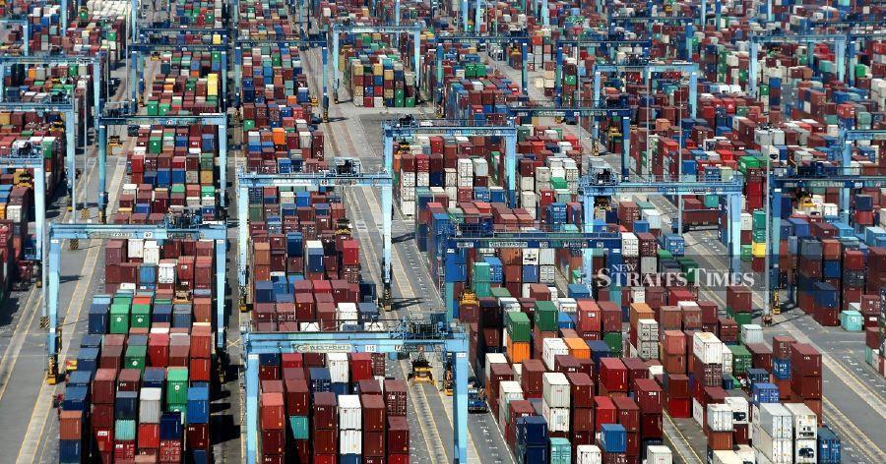
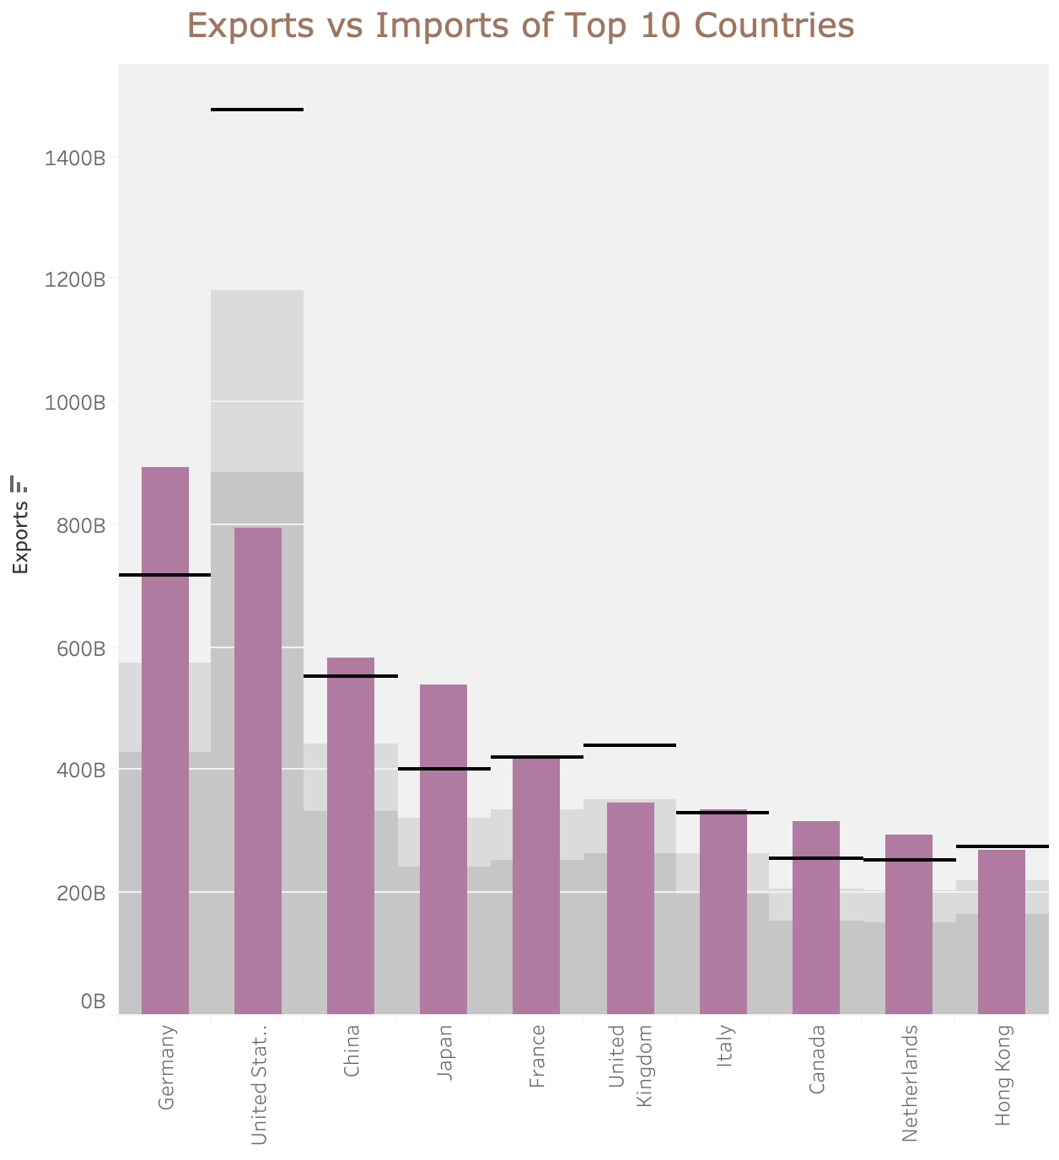
Export Vs Imports
Germany is the top exporting country in the world
America stands second followed by China and Japan.
America & UK imports much more than they export

Slide 8

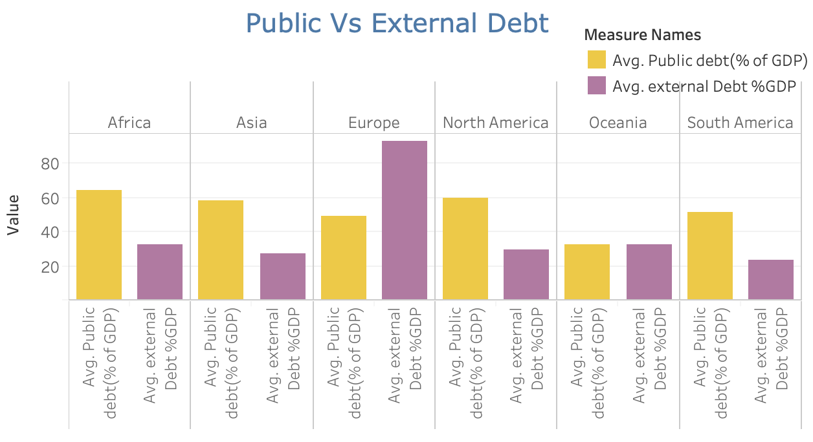
Debt
European countries have the highest external Debt
Countries in all other continents have higher public debt compared to external debt

Slide 9
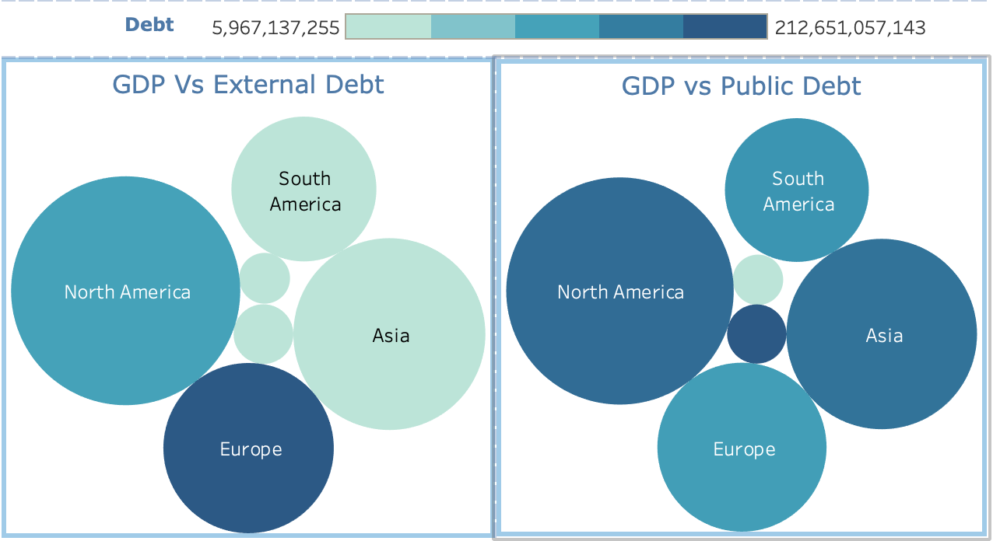
Debt
European countries have the highest external Debt % of GDP followed by North American countries
Africa has the highest public debt % of GDP followed by North America and Asian countries

Slide 10
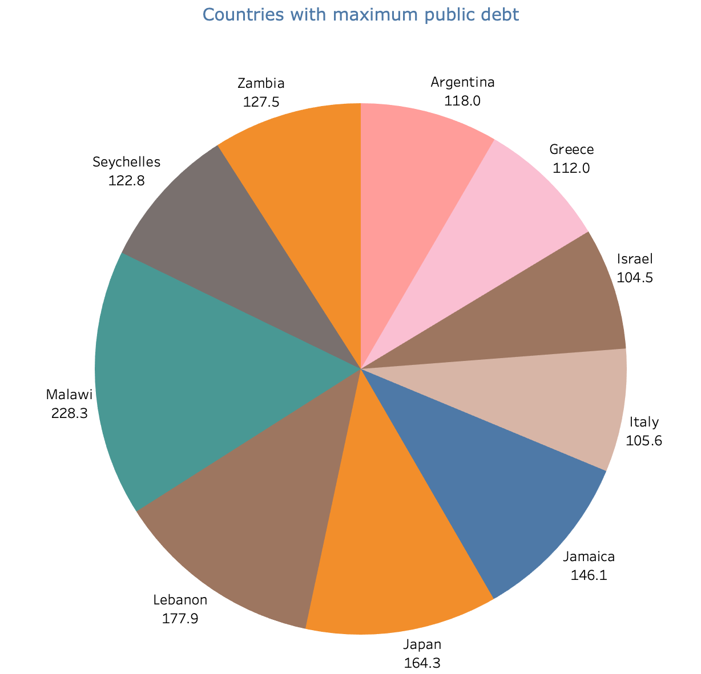
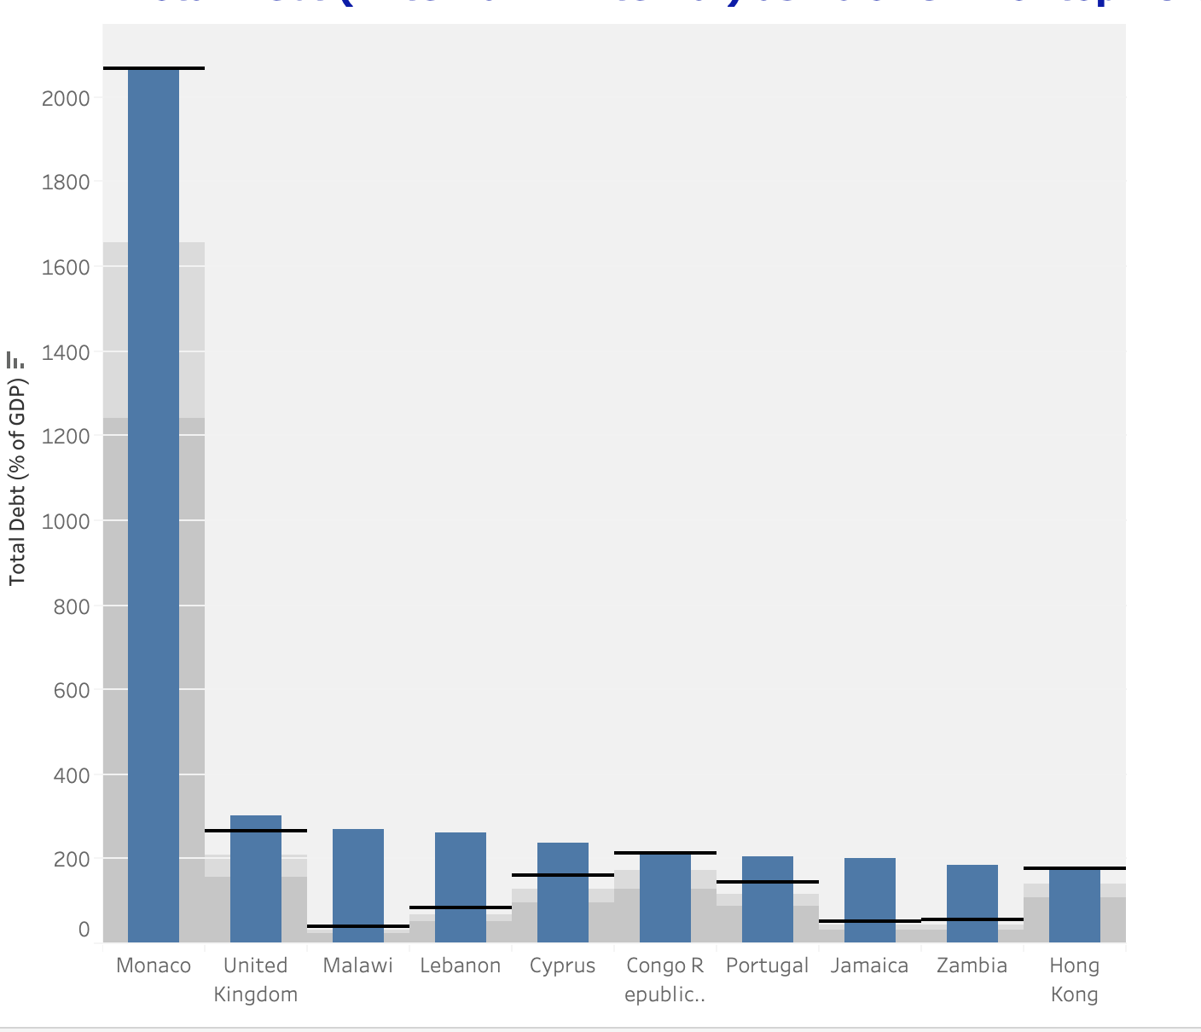
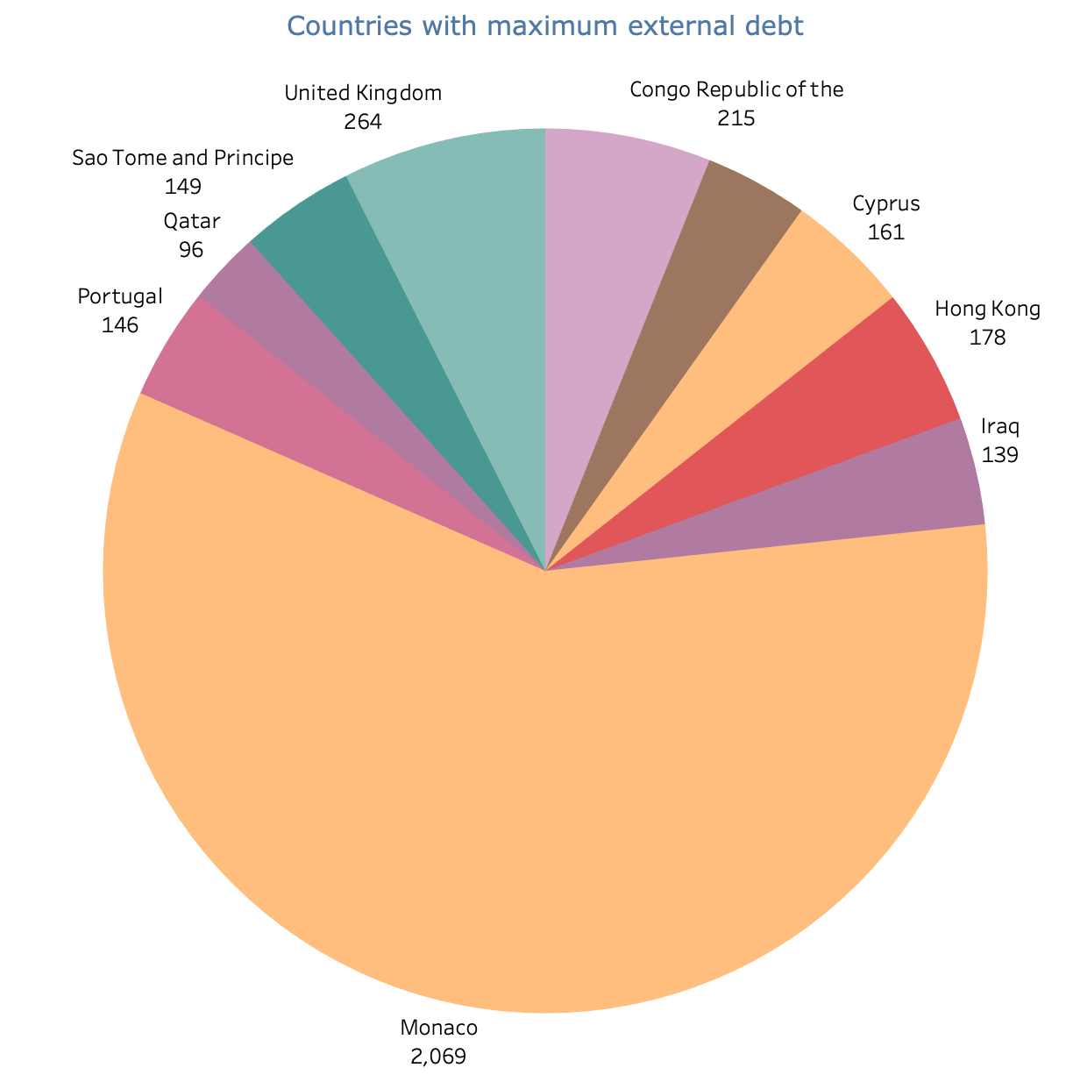
Debt of Individual countrieries
Monacco has the highest total debt which is mostly external debt followed by UK which also has a high percentage of external Debt to GDP
With 228% , Malavi has the highest %of public debt to GDP ratio

Slide 11
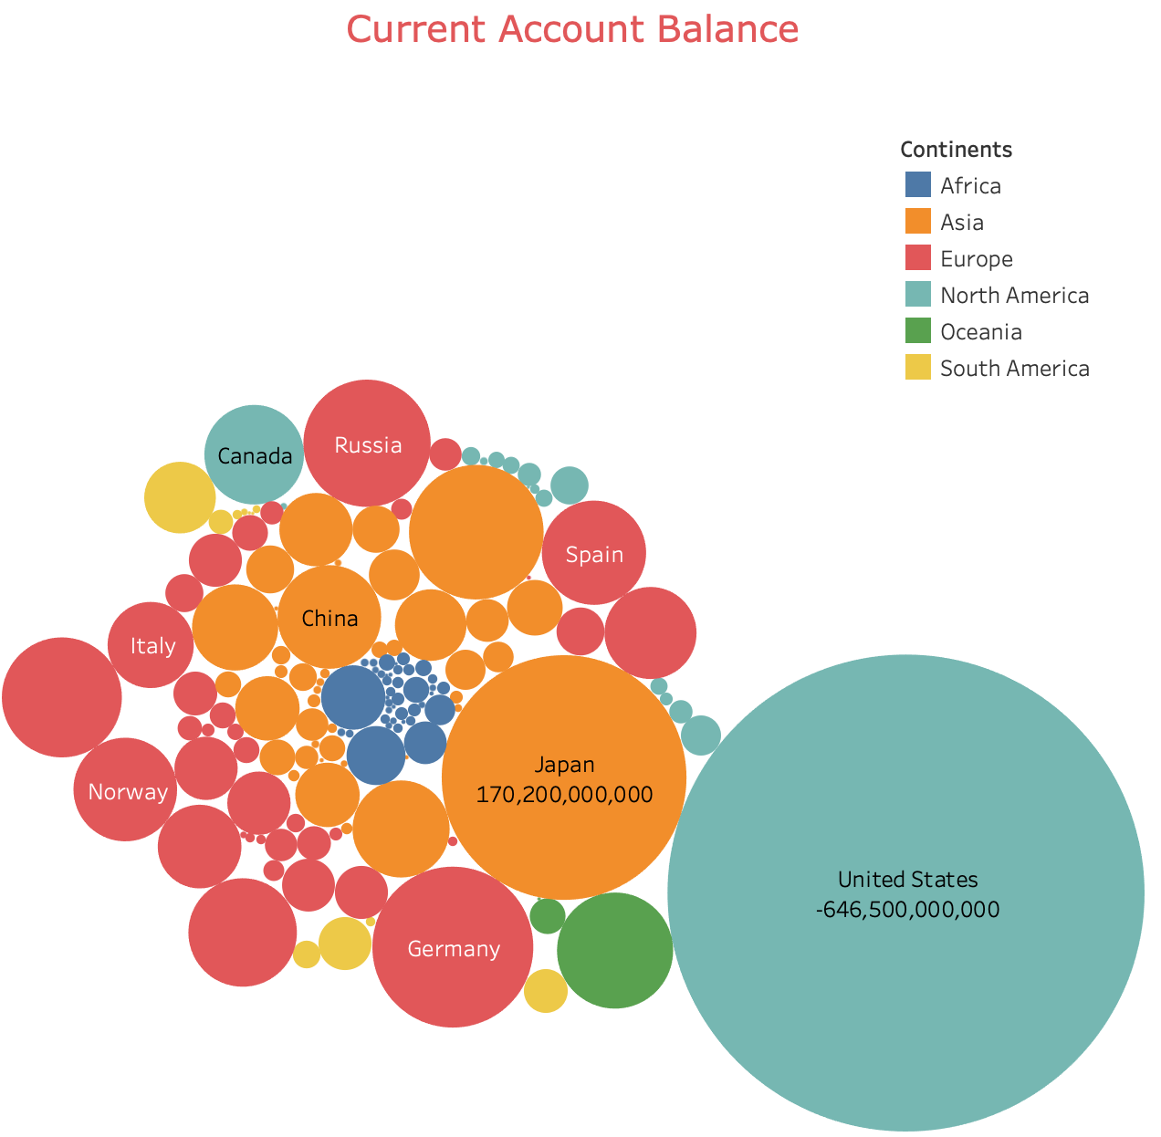
Current account balance
Current account balance is the trade balance + net income of a country
Uniterd states has the highest -ve current account balance followed by UK and Spain. These are the net borrowers of the world
Most of the emerging markets like Japan, India including Germany are net exports

Slide 12


