Slide 1

Legendary Pokemons ¶
Finding Legendary Pokemons - INSAID Machine Learning- Advanced Assignment
Sharvari Nagesh

Slide 2
Introduction
name: The English name of the Pokemon
japanese_name: The Original Japanese name of the Pokemon
pokedex_number: The entry number of the Pokemon in the National Pokedex
percentage_male: The percentage of the species that are male. Blank if the Pokemon is genderless.
type1: The Primary Type of the Pokemon
type2: The Secondary Type of the Pokemon
classification: The Classification of the Pokemon as described by the Sun and Moon Pokedex
height_m: Height of the Pokemon in metres
weight_kg: The Weight of the Pokemon in kilograms
capture_rate: Capture Rate of the Pokemon
base_egg_steps: The number of steps required to hatch an egg of the Pokemon
abilities: A stringified list of abilities that the Pokemon is capable of having
experience_growth: The Experience Growth of the Pokemon
base_happiness: Base Happiness of the Pokemon
against_?: Denote the amount of damage taken against an attack of a particular type
hp: The Base HP of the Pokemon
attack: The Base Attack of the Pokemon
defense: The Base Defense of the Pokemon
sp_attack: The Base Special Attack of the Pokemon
sp_defense: The Base Special Defense of the Pokemon
speed: The Base Speed of the Pokemon
generation: The numbered generation which the Pokemon was first introduced
is_legendary: Denotes if the Pokemon is legendary.
The requirement is to analyse pokemon data. Pokemons come in different shapes, sizes and with various capabilities. Only very few pokemons are considered legendary. Capturing a legendary pokemon is always difficult because of it's unique abilities. With the given data we need to predict if a pokemon is legendary or not. Available Columns are :

Slide 3
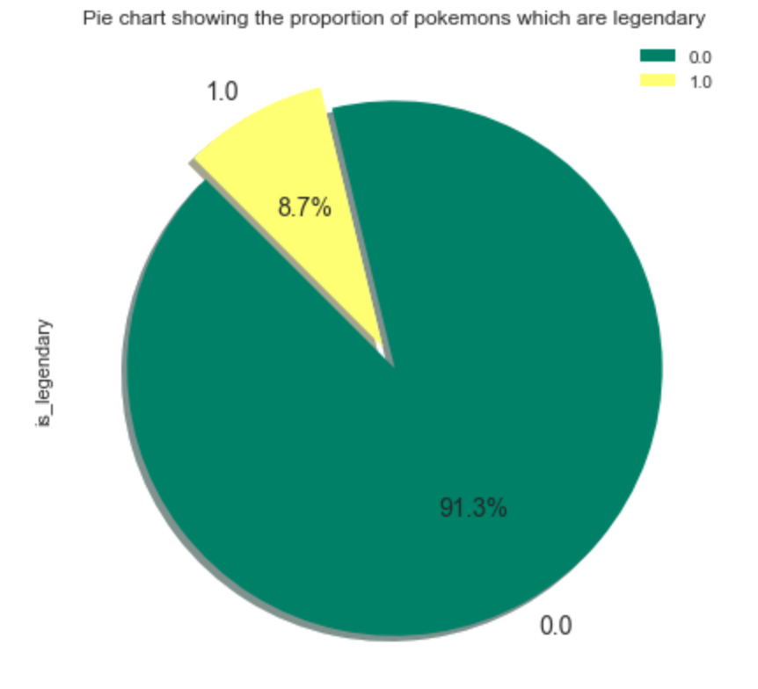
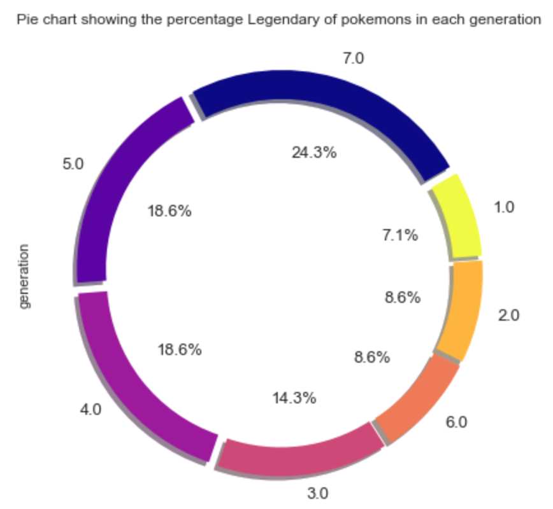
Legendary Pokemon Analysis:
8.7% of pokemons are legendary
Distribution of Legendary pokemon's show that it can be found in almost all generations. But are found more in 7,5 and 4th generations

Slide 4
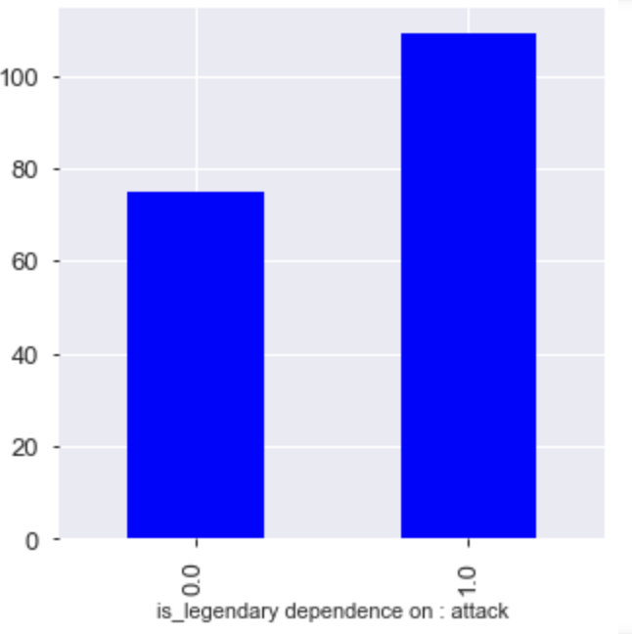
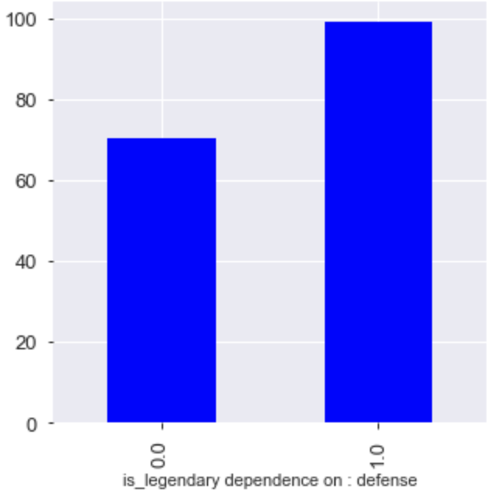
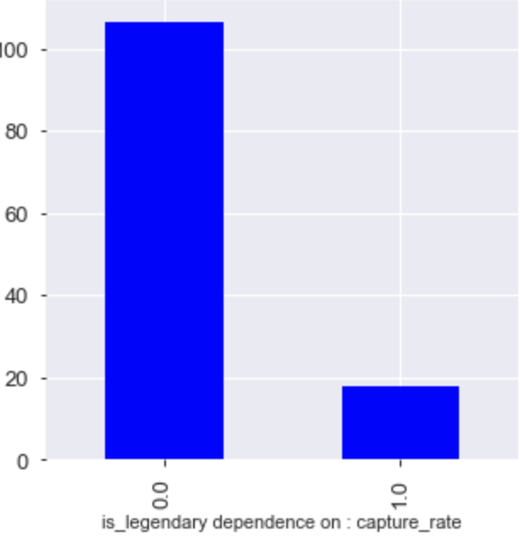
How are Legendary Pokemons different ?
Legendary pokemon’s 25% more attacking and nearly 30% better at defence
It is 80% more difficult to capture a legendary pokemon

Slide 5
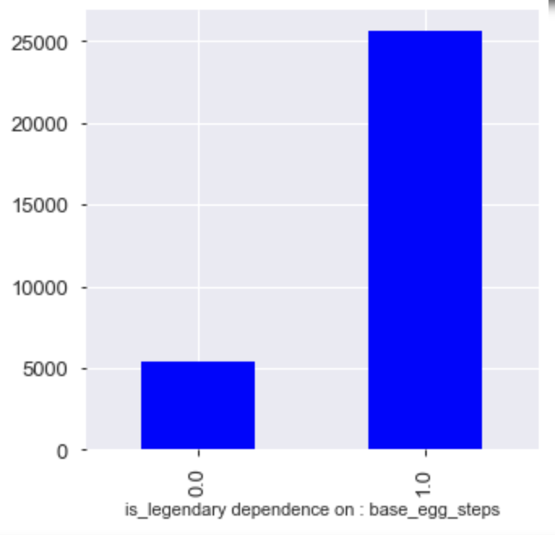
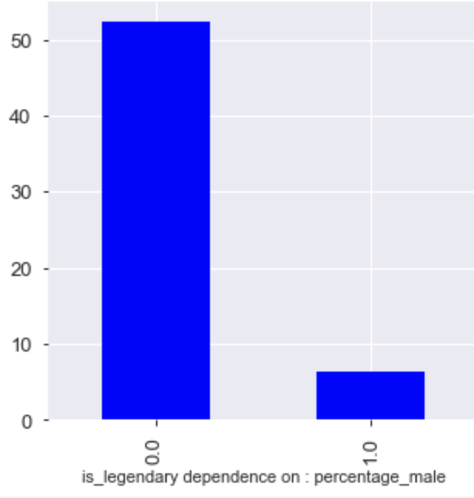
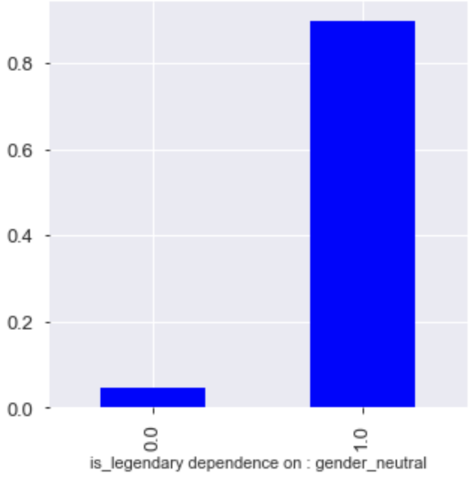
Continued ...
Base_egg_steps indicate the no. of steps needed to hatch a legendary pokemon. Legendary pokemon needs 5 times more steps to hatch than a normal pokemon
It is also noted that most of the legendary pokemons have very few males. And it is also observed that chances of a gender neutral pokemon being legendary is very high.

Slide 6
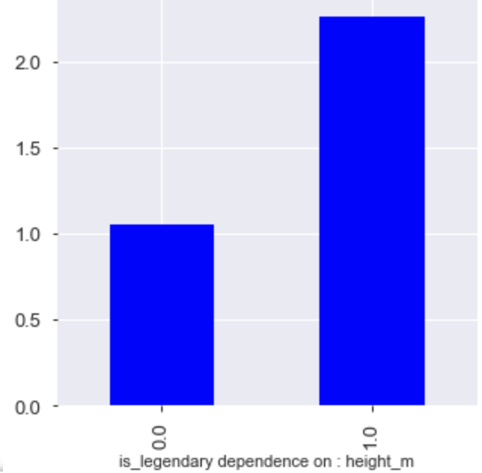
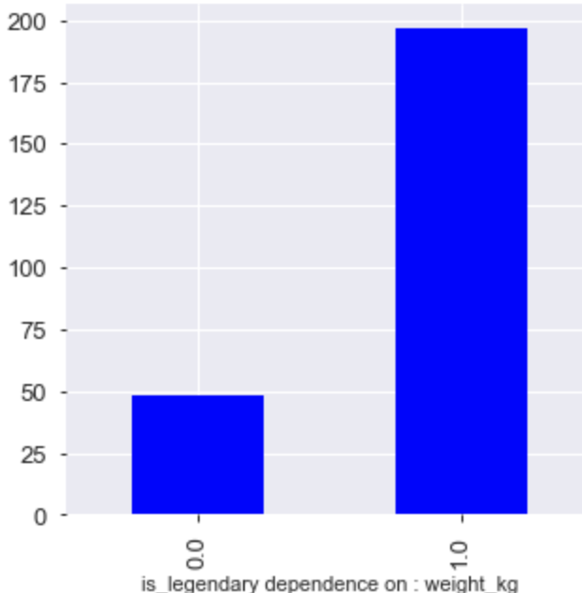
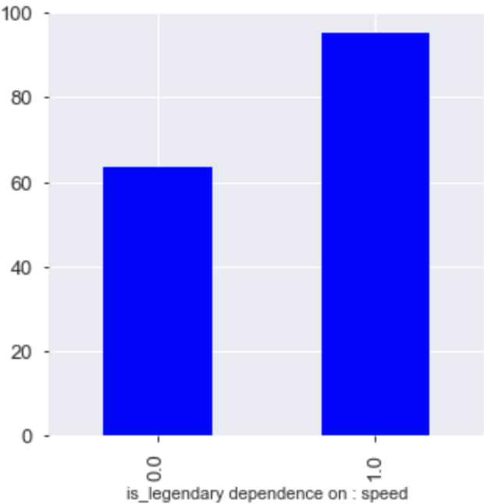
Continued ...
Legendary pokemons are taller, weight more and are faster than the normal pokemons

Slide 7
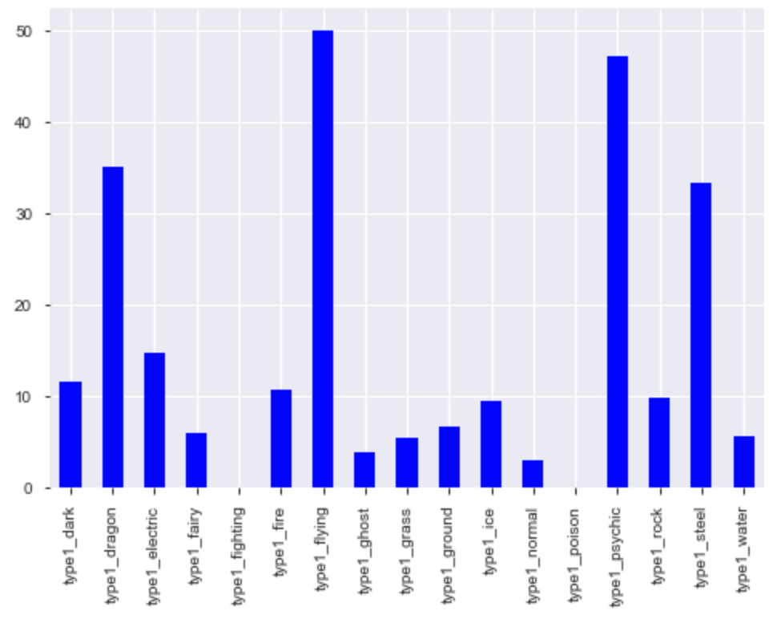
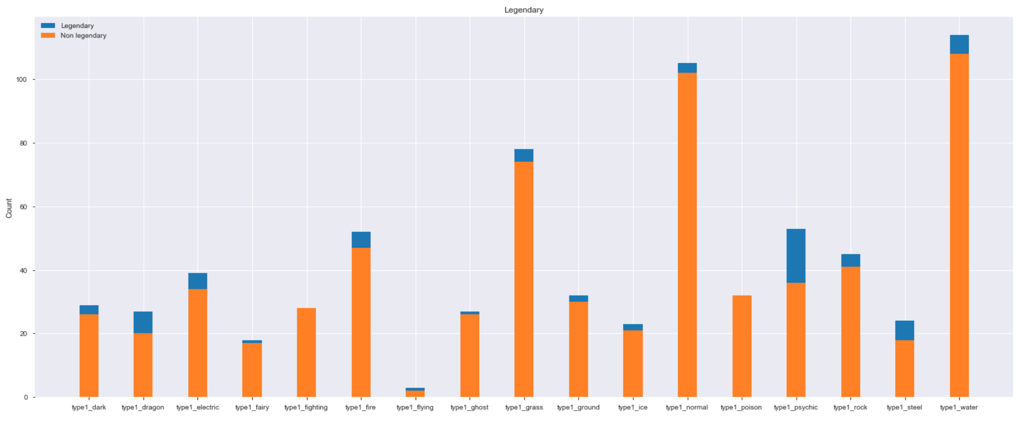
Types of legendary pokemon:
When we check percentage of legendary pokemon's in each type, we find that more percentage of legendary pokemons are mainly from flying, psychic, dragon and steel types.

Slide 8
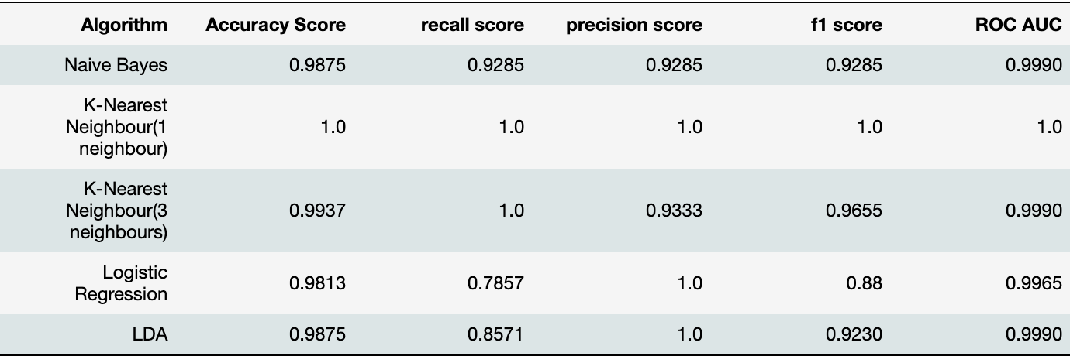
Comparing different algorithms for classification
K-Nearest algorithm(Both N=1 and 3) are giving very good results.
Naive bayes is the next best algorithm with accuracy and recall score.
LDA fares equally well as Naive bayes and is better at precision score.
Since our aim is to have a higher recall, K-nearest, Naive Bayes are best suited.

