Slide 1
UK‘s Energy Transition
(2020 – 2023)
24th september 2025

Slide 2
Introduction

Slide 3
Understanding the Data and Assumptions
Introduction
Only 3 year’s worth of complex data – No Covid to blame everything on.. ☹
Tried checking for Null/Missing values… Good news – Didn’t find any (as far as my knowledge goes).
Converted DateTime single column to Date, Time, Year and Month to make it easier for analysis in Dashboard.
Assumed that the columns for wind is the total amount of wind generated using wind as a source as it didn’t have any units of measurement.
Also tried to analyse the percentages of wind power generations by regions (Scotland, England and Wales/NI).
An interconnector is a big electricity cable that links the UK’s power grid to other countries, letting us import or export electricity as needed.

Slide 4
Purpose
Introduction
Understanding the Energy Mix: Insights about the fuels which generates electricity and their importance (renewables, gas, nuclear, etc.).
Highlight the Transition: How UK is shifting from fossil fuels (coal, gas, etc.) to renewable sources (wind, solar, etc.).
Assess Security and Sustainability: How current fuel mix balances reliability, affordability and net-zero targets.

Slide 5
Why It Matters?

Slide 6
The need of an hour…
Why it Matters?
Electricity is central to businesses, households and economies.
UK is on the journey to net-zero emissions by 2050.
Exploring fuel mix helps evaluate security, costs and carbon impact.

Slide 7
Key Metrics

Slide 8

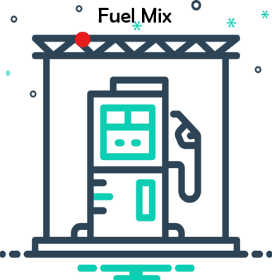
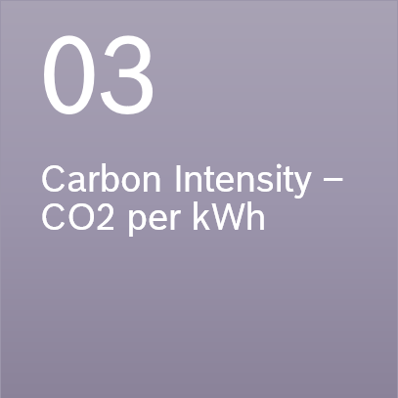


Key Metrics
Demand
02
Generation Mix - Sources (Gas, Nuclear, Renewable, Imports, etc.)

Slide 9
Demand Trends

Slide 10

Fun Fact
Demand Trends
In 2012, coal generated 40% of the UK’s electricity. By 2024, that number has dropped to less than 1% — and the UK is on track to close its last coal power stations completely.

Slide 11
Demand Trends
Seasonal Cycles
Gas Dominant but falling
Wind/Solar share growing
Imports play balancing role

Slide 12
Carbon Intensity

Slide 13
Carbon Intensity
Carbon Emissions per unit falling
Direct link to coal decline and renewables growth

Slide 14
Fossil Vs Renewable

Slide 15
Fossil Vs Renewable
Renewables offer 30%-50% of generation. Can see rise in renewable sources than fossil fuels over the period.
Fossil fuels are still needed during low wind/high-demand phase

Slide 16
Regional and Import Insights

Slide 17
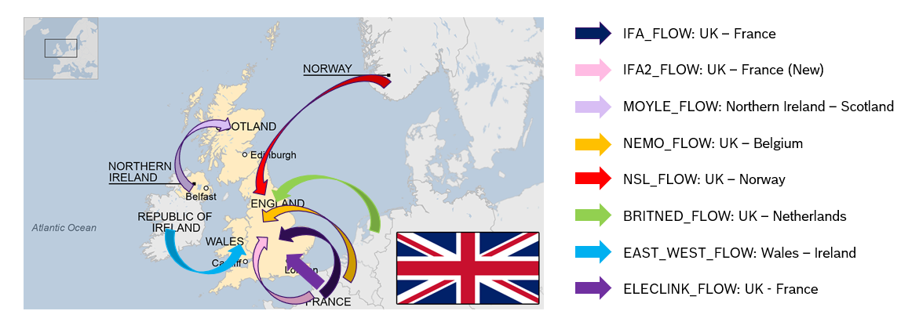
Regional and Import Insights
Scotland = Wind Powerhouse.
Interconnectors provide Security.

Slide 18
Strategic Recommendations

Slide 19
Strategic Recommendations
Accelerate/Invest in Renewable Deployment.
Expand Storage
Enhance Interconnectors
Monitor Carbon Intensity Live

Slide 20
Thank You!

