Slide 1

MSPM’S Deogiri Institute Of Engineering And Management Studies, Aurangabad Academic Year 2019-20 Department Of Computer Science And Engineering Subject:-Theory Of Computation Topic:-String Acceptability Submitted By Pratima More (36021) Sharvari Khamitkar (36022) Under The Guidance Of Dr. S. M. Chavan Asst. Prof. Department Of CSE (Deogiri Institute Of Engineering And Management Studies)

Slide 2
Contents:
Problem statement
Introduction
String acceptability
Example
Code
Output

Slide 3
Problem statement:
The string is accepted if it starts with 10 and ends with 01.
For e.g. 1001010101
101001

Slide 4
Introduction:
In automata theory, a branch of theoretical computer science, a deterministic finite automaton (DFA)—also known as deterministic finite state machine—is a finite state machine that accepts/rejects finite strings of symbols and only produces a unique computation (or run) of the automaton for each input string. 'Deterministic' refers to the uniqueness of the computation.

Slide 5
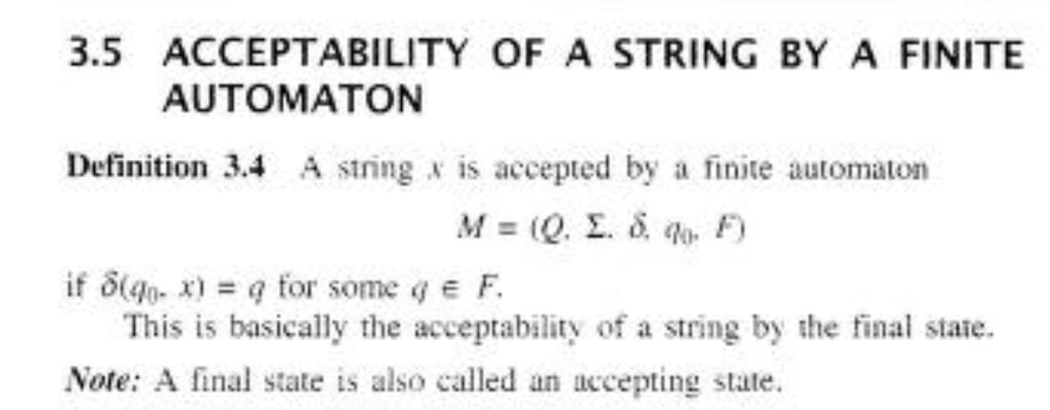
String acceptability :
The string is said to be accepted if it fulfills the condition given in the program.
If the strings starts from the initial state and ends at final state then that particular string is accepted.

Slide 6

Example:
Design a FA with ∑ = {0, 1} accepts those string which starts with 1 and ends with 0.
Solution:
The FA will have a start state q0 from which only the edge with input 1 will go to the next state.
In state q1, if we read 1, we will be in state q1, but if we read 0 at state q1, we will reach to state q2 which is the final state. In state q2, if we read either 0 or 1, we will go to q2 state or q1 state respectively. Note that if the input ends with 0, it will be in the final state.

Slide 7
Code for automata:
class DFA:
current_state = None;
def __init__(self, states, alphabet, transition_function, start_state, accept_states):
self.states = states;
self.alphabet = alphabet;
self.transition_function = transition_function;
self.start_state = start_state;
self.accept_states = accept_states;
self.current_state = start_state;
return;

Slide 8
def transition_to_state_with_input(self, input_value):
if ((self.current_state, input_value) not in self.transition_function.keys()):
self.current_state = None;
return;
self.current_state = self.transition_function[(self.current_state, input_value)];
return;
def in_accept_state(self):
return self.current_state in accept_states;
def go_to_initial_state(self):
self.current_state = self.start_state;
return;

Slide 9
def run_with_input_list(self, input_list):
self.go_to_initial_state();
for inp in input_list:
self.transition_to_state_with_input(inp);
continue;
return self.in_accept_state();
pass;
states = {0, 1, 2, 3};
alphabet = {'1','0'};

Slide 10
tf = dict();
tf[(0, '1')] = 1;
tf[(0, '0')] = 2;
tf[(0, '1')] = 3;
tf[(0, '0')] = 0;
tf[(1, '1')] = 1;
tf[(1, '0')] = 2;
tf[(1, '1')] = 3;
tf[(1, '0')] = 0;
tf[(2, '1')] = 1;
tf[(2, '0')] = 2;
tf[(2, '1')] = 3;
tf[(2, '0')] = 0;
tf[(3, '1')] = 1;
tf[(3, '0')] = 2;
tf[(3, '1')] = 3;
tf[(3, '0')] = 0;

Slide 11
start_state = 0;
accept_states = {2, 3};
d = DFA(states, alphabet, tf, start_state, accept_states);
inp_program = input('Enter the string:');
print (d.run_with_input_list(inp_program));

Slide 12
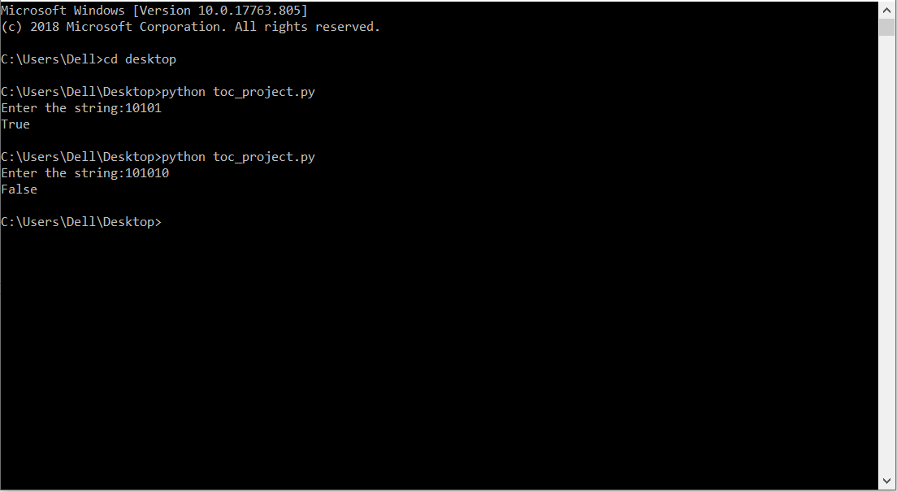
Output

Slide 13
Applications of Dfa:
As DFA have a rich background in terms of the mathematical theory underlying their development it has wide application that we are used our daily life directly or indirectly, some of them are as follows;
Protocol analysis
Text parsing,
Video game character behavior,
Security analysis,
CPU control units,
Natural language processing
Speech recognition, etc.

Slide 14
Conclusion:
1. Every DFA is NFA but not vice versa. 2. Both NFA and DFA have same power and each NFA can be translated
into a DFA. 3. There can be multiple final states in both DFA and NFA. 4. NFA is more of a theoretical concept. 5. DFA is used in Lexical Analysis in Compiler.

Slide 15
Thank you !!!!!!

