Slide 1
Snack Squad: a customizable snack ordering and delivery app
Akilesh J S
Sharvesh K
Koushik Balaji
Roshaun Infant
Tiruvikraman V

Slide 2
DESCRIPTION
Snack Squad is a customizable snack ordering and delivery application built using Android Jetpack Compose. It serves as a comprehensive platform for managing snack orders, providing real-time updates to users and administrators through an intuitive interface.
Core Components:
Room Database: A local database system that stores essential information including user profiles, snack items, orders, and transaction history. It enables seamless data persistence and retrieval through Data Access Objects (DAOs).
User Interface: Built entirely with Compose UI, the interface provides an intuitive e-commerce experience where users can browse snacks, add items to cart, and complete purchases. It features dynamic updating of cart contents and order status.
Architecture: The application follows a structured architecture where:
The Android app communicates with a Room Database through DAOs
Entities represent data models for snacks, orders, and user information
Data persistence is handled through dedicated database operations
Key Features:
User Registration and Authentication
Interactive Snack Catalog
Shopping Cart Management
Order Processing System
Admin Dashboard for Order Management
The application demonstrates modern Android development practices using:
Jetpack Compose for UI construction
Room Database for local data storage
DAO pattern for database operations
Entity management for data modeling
This system streamlines the snack ordering process by providing real-time updates to both customers and administrators while maintaining a reliable record of all transactions through the local Room database.

Slide 3
AdminActivity.kt:
package com.example.snackordering
import android.os.Bundle
import android.util.Log
import androidx.activity.ComponentActivity
import androidx.activity.compose.setContent
import androidx.compose.foundation.Image
import androidx.compose.foundation.layout.*
import androidx.compose.foundation.lazy.LazyColumn
import androidx.compose.foundation.lazy.LazyRow
import androidx.compose.foundation.lazy.items
import androidx.compose.material.MaterialTheme
import androidx.compose.material.Surface
import androidx.compose.material.Text
import androidx.compose.runtime.Composable
import androidx.compose.ui.Modifier
import androidx.compose.ui.graphics.Color
import androidx.compose.ui.layout.ContentScale
import androidx.compose.ui.res.painterResource
import androidx.compose.ui.unit.dp
import androidx.compose.ui.unit.sp
import com.example.snackordering.ui.theme.SnackOrderingTheme

Slide 4
class AdminActivity : ComponentActivity() {
private lateinit var orderDatabaseHelper: OrderDatabaseHelper
override fun onCreate(savedInstanceState: Bundle?) {
super.onCreate(savedInstanceState)
orderDatabaseHelper = OrderDatabaseHelper(this)
setContent {
SnackOrderingTheme {
// A surface container using the 'background' color from the theme
Surface(
modifier = Modifier.fillMaxSize(),
color = MaterialTheme.colors.background
) {
val data=orderDatabaseHelper.getAllOrders()
Log.d("kathir" ,data.toString())
val order = orderDatabaseHelper.getAllOrders()
ListListScopeSample(order)
}
}
}
}
}

Slide 5
LoginActivity.kt:
package com.example.snackordering
import android.content.Context
import android.content.Intent
import android.os.Bundle
import androidx.activity.ComponentActivity
import androidx.activity.compose.setContent
import androidx.compose.foundation.Image
import androidx.compose.foundation.layout.*
import androidx.compose.material.*
import androidx.compose.runtime.*
import androidx.compose.ui.Alignment
import androidx.compose.ui.Modifier
import androidx.compose.ui.graphics.Color
import androidx.compose.ui.layout.ContentScale
import androidx.compose.ui.res.painterResource
import androidx.compose.ui.text.font.FontFamily
import androidx.compose.ui.text.font.FontWeight
import androidx.compose.ui.text.input.PasswordVisualTransformation
import androidx.compose.ui.unit.dp
import androidx.compose.ui.unit.sp
import androidx.core.content.ContextCompat
import com.example.snackordering.ui.theme.SnackOrderingTheme

Slide 6
class LoginActivity : ComponentActivity() {
private lateinit var databaseHelper: UserDatabaseHelper
override fun onCreate(savedInstanceState: Bundle?) {
super.onCreate(savedInstanceState)
databaseHelper = UserDatabaseHelper(this)
setContent {
SnackOrderingTheme {
// A surface container using the 'background' color from the theme
Surface(
modifier = Modifier.fillMaxSize(),
color = MaterialTheme.colors.background
) {
LoginScreen(this, databaseHelper)
}
}
}
}
}

Slide 7
@Composable
fun LoginScreen(context: Context, databaseHelper: UserDatabaseHelper) {
Image(painterResource(id = R.drawable.login_screen), contentDescription = "",
alpha =0.3F,
contentScale = ContentScale.FillHeight,
)
var username by remember { mutableStateOf("") }
var password by remember { mutableStateOf("") }
var error by remember { mutableStateOf("") }
Column(
modifier = Modifier.fillMaxSize(),
horizontalAlignment = Alignment.CenterHorizontally,
verticalArrangement = Arrangement.Center
) {
Text("SNACK SQUAD APP",
fontSize = 40.sp,
fontWeight = FontWeight.Bold,
fontFamily = FontFamily.Monospace,
color = Color.Black
)

Slide 8
Text(
fontSize = 30.sp,
fontWeight = FontWeight.SemiBold,
fontFamily = FontFamily.SansSerif,
color = Color.Black,
text = " LOGIN "
)
Spacer(modifier = Modifier.height(10.dp))
TextField(
value = username,
onValueChange = { username = it },
label = { Text("Username") },
modifier = Modifier.padding(10.dp)
.width(280.dp)
)
TextField(
value = password,
onValueChange = { password = it },
label = { Text("Password") },
visualTransformation= PasswordVisualTransformation(),
modifier = Modifier.padding(10.dp)
.width(280.dp)
)
ontextCompat.startActivity(context, intent, null)
}

Slide 9
if (error.isNotEmpty()) {
Text(
text = error,
color = MaterialTheme.colors.error,
modifier = Modifier.padding(vertical = 16.dp)
)
}
Button(
onClick = {
if (username.isNotEmpty() && password.isNotEmpty()) {
val user = databaseHelper.getUserByUsername(username)
if (user != null && user.password == "admin") {
error = "Admin Successfully log in"
context.startActivity(
Intent(
context,
AdminActivity::class.java
)
)
}

Slide 10
else if (user != null && user.password == password) {
error = "User Successfully log in"
context.startActivity(
Intent(
context,
MainPage::class.java
)
)
}
else {
error = "Invalid username or password"
}
} else {
error = "Please fill all fields"
}
},
modifier = Modifier.padding(top = 16.dp)
) {
Text(text = "Login")
}
Row {
TextButton(onClick = {
context.startActivity(
Intent(
context,
MainActivity::class.java
)
)
}
)

Slide 11
{ Text(color = Color.Black, text = "Sign up") }
TextButton(onClick = {
})
{
Spacer(modifier = Modifier.width(60.dp))
Text(color = Color.Black, text = "Forget password?")
}
}
Spacer(modifier = Modifier.width(160.dp))
Text("Designed by",
fontSize = 16.sp,
fontWeight = FontWeight.ExtraBold,
fontFamily = FontFamily.Cursive,
color = Color.Black,
)
Text("KBMS",
fontSize = 16.sp,
fontWeight = FontWeight.ExtraBold,
fontFamily = FontFamily.Cursive,
color = Color.Cyan
)
}
}
private fun startMainPage(context: Context) {
val intent = Intent(context, MainPage::class.java)
ContextCompat.startActivity(context, intent, null)

Slide 12
MainPage.kt:
package com.example.snackordering
import android.annotation.SuppressLint
import android.content.Context
import android.os.Bundle
import androidx.activity.ComponentActivity
import androidx.activity.compose.setContent
import androidx.annotation.DrawableRes
import androidx.annotation.StringRes
import androidx.compose.foundation.Image
import androidx.compose.foundation.background
import androidx.compose.foundation.layout.*
import androidx.compose.foundation.shape.RoundedCornerShape
import androidx.compose.material.*
import androidx.compose.material.icons.Icons
import androidx.compose.material.icons.filled.*
import androidx.compose.runtime.Composable
import androidx.compose.ui.Alignment
import androidx.compose.ui.Modifier
import androidx.compose.ui.draw.clip
import androidx.compose.ui.graphics.Color
import androidx.compose.foundation.lazy.LazyColumn
import androidx.compose.foundation.lazy.items
import androidx.compose.material.Text
import androidx.compose.ui.unit.dp
import androidx.compose.ui.graphics.RectangleShape
import androidx.compose.ui.layout.ContentScale
import androidx.compose.ui.platform.LocalContext
import androidx.compose.ui.res.painterResource

Slide 13
import androidx.compose.ui.res.stringResource
import androidx.compose.ui.text.font.FontWeight
import androidx.compose.ui.unit.sp
import com.example.snackordering.ui.theme.SnackOrderingTheme
import android.content.Intent as Intent1
class MainPage : ComponentActivity() {
override fun onCreate(savedInstanceState: Bundle?) {
super.onCreate(savedInstanceState)
setContent {
SnackOrderingTheme {
// A surface container using the 'background' color from the theme
Surface(
modifier = Modifier.fillMaxSize(),
color = MaterialTheme.colors.background
) {
FinalView(this)
val context = LocalContext.current
//PopularFoodColumn(context)
}
}
}
}
}

Slide 14
@Composable
fun TopPart() {
Row(
modifier = Modifier
.fillMaxWidth()
.background(Color(0xffeceef0)), Arrangement.SpaceBetween
) {
Icon(
imageVector = Icons.Default.Add, contentDescription = "Menu Icon",
Modifier
.clip(RectangleShape)
.size(50.dp),
tint = Color.Black,
)
Column(horizontalAlignment = Alignment.CenterHorizontally) {
Text(text = "Location", style = MaterialTheme.typography.subtitle1, color = Color.Black)
Row {
Icon(
imageVector = Icons.Default.LocationOn,
contentDescription = "Location",
tint = Color.Gray,
)
Text(text = "Chennai" , color = Color.Red)
}

Slide 15
}
Icon(
imageVector = Icons.Default.Notifications, contentDescription = "Notification Icon",
Modifier
.size(45.dp),
tint = Color.Yellow
)
}
}
@Composable
fun CardPart() {
Card(modifier = Modifier.size(width = 310.dp, height = 150.dp), RoundedCornerShape(20.dp)) {
Row(modifier = Modifier.padding(10.dp), Arrangement.SpaceBetween) {
Column(verticalArrangement = Arrangement.spacedBy(12.dp)) {
Text(text = "Get Special Discounts")
Text(text = "up to 85%", style = MaterialTheme.typography.h5)
Button(onClick = {}, colors = ButtonDefaults.buttonColors(Color.DarkGray)) {
Text(text = "Claim voucher", color = MaterialTheme.colors.surface)
}
}
Image(
painter = painterResource(id = R.drawable.pasta),
contentDescription = "Food Image", Modifier.size(width = 100.dp, height = 200.dp)
)
}
}
}

Slide 16
@Composable
fun PopularFood(
@DrawableRes drawable: Int,
@StringRes text1: Int,
context: Context
) {
Card(
modifier = Modifier
.padding(top=20.dp, bottom = 20.dp, start = 65.dp)
.width(250.dp)
) {
Column(
verticalArrangement = Arrangement.Top,
horizontalAlignment = Alignment.CenterHorizontally
) {
Spacer(modifier = Modifier.padding(vertical = 5.dp))
Row(
modifier = Modifier
.fillMaxWidth(0.7f), Arrangement.End
) {
Icon(
imageVector = Icons.Default.Star,
contentDescription = "Star Icon",
tint = Color.Yellow
)
Text(text = "4.3", fontWeight = FontWeight.Black)

Slide 17
}
Image(
painter = painterResource(id = drawable),
contentDescription = "Food Image",
contentScale = ContentScale.Crop,
modifier = Modifier
.size(100.dp)
.clip(RectangleShape)
)
Text(text = stringResource(id = text1), fontWeight = FontWeight.Bold)
Row(modifier = Modifier.fillMaxWidth(0.7f), Arrangement.SpaceBetween) {
/*TODO Implement Prices for each card*/
Text(
text = "$50",
style = MaterialTheme.typography.h6,
fontWeight = FontWeight.Bold,
fontSize = 18.sp
)
IconButton(onClick = {
var no=FoodList.lastIndex
//Toast.
val intent = Intent1(context, TargetActivity::class.java)
context.startActivity(intent)

Slide 18
}) {
Icon(
imageVector = Icons.Default.ShoppingCart,
contentDescription = "shopping cart",
)
}
}
}
}
}
private val FoodList = listOf(
R.drawable.burger to R.string.burgers,
R.drawable.pack to R.string.pack,
R.drawable.salad to R.string.salad,
R.drawable.popcorn to R.string.popcorn
).map { DrawableStringPair(it.first, it.second) }
private data class DrawableStringPair(
@DrawableRes val drawable: Int,
@StringRes val text1: Int
)

Slide 19
@Composable
fun App(context: Context) {
Column(
modifier = Modifier
.fillMaxSize()
.background(Color(0xffeceef0))
.padding(10.dp),
verticalArrangement = Arrangement.Top,
horizontalAlignment = Alignment.CenterHorizontally
) {
Surface(modifier = Modifier, elevation = 5.dp) {
TopPart()
}
Spacer(modifier = Modifier.padding(10.dp))
CardPart()
Spacer(modifier = Modifier.padding(10.dp))
Row(modifier = Modifier.fillMaxWidth(), Arrangement.SpaceBetween) {
Text(text = "Popular Food", style = MaterialTheme.typography.h5, color = Color.Black)
Text(text = "view all", style = MaterialTheme.typography.subtitle1, color = Color.Black)
}
Spacer(modifier = Modifier.padding(10.dp))
PopularFoodColumn(context) // <- call the function with parentheses
}
}

Slide 20
@Composable
fun PopularFoodColumn(context: Context) {
LazyColumn(
modifier = Modifier.fillMaxSize(),
content = {
items(FoodList) { item ->
PopularFood(context = context,drawable = item.drawable, text1 = item.text1)
abstract class Context
}
},
verticalArrangement = Arrangement.spacedBy(16.dp))
}
@SuppressLint("UnusedMaterialScaffoldPaddingParameter")
@Composable
fun FinalView(mainPage: MainPage) {
SnackOrderingTheme {
Scaffold() {
val context = LocalContext.current
App(context)
}
}
}

Slide 21
Order.kt:
package com.example.snackordering
import androidx.room.ColumnInfo
import androidx.room.Entity
import androidx.room.PrimaryKey
@Entity(tableName = "order_table")
data class Order(
@PrimaryKey(autoGenerate = true) val id: Int?,
@ColumnInfo(name = "quantity") val quantity: String?,
@ColumnInfo(name = "address") val address: String?,
)

Slide 22
OrderDao.kt:
package com.example.snackordering
import androidx.room.*
@Dao
interface OrderDao {
@Query("SELECT * FROM order_table WHERE address= :address")
suspend fun getOrderByAddress(address: String): Order?
@Insert(onConflict = OnConflictStrategy.REPLACE)
suspend fun insertOrder(order: Order)
@Update
suspend fun updateOrder(order: Order)
@Delete
suspend fun deleteOrder(order: Order)
}

Slide 23
OrderDatabase.kt:
package com.example.snackordering
import android.content.Context
import androidx.room.Database
import androidx.room.Room
import androidx.room.RoomDatabase
@Database(entities = [Order::class], version = 1)
abstract class OrderDatabase : RoomDatabase() {
abstract fun orderDao(): OrderDao
companion object {
@Volatile
private var instance: OrderDatabase? = null
fun getDatabase(context: Context): OrderDatabase {
return instance ?: synchronized(this) {
val newInstance = Room.databaseBuilder(
context.applicationContext,
OrderDatabase::class.java,
"order_database"
).build()
instance = newInstance
newInstance
}
}
}

Slide 24
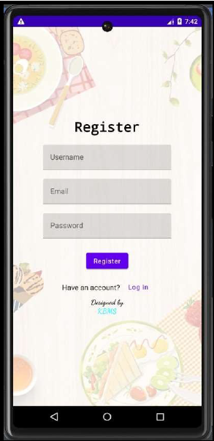
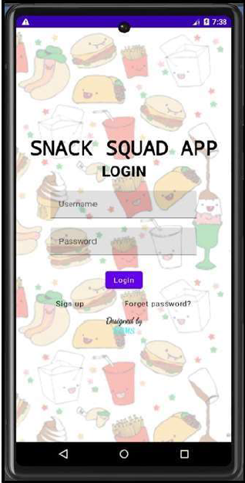
Register Page
Login Page

Slide 25
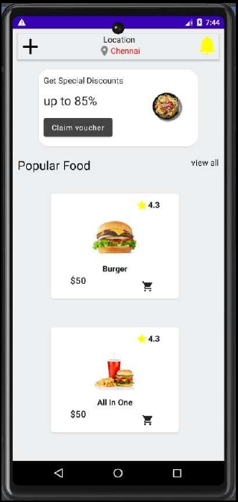
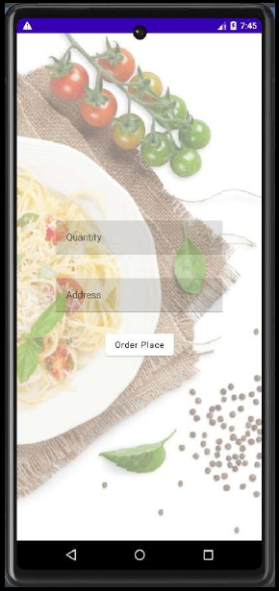
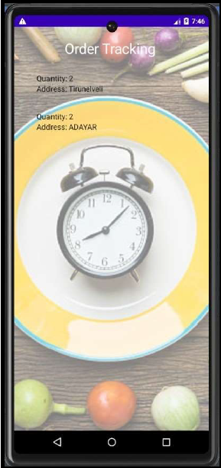
Main Page
Order page
Admin Page

