Slide 1


Internal Assessment
SHARVESH SUBHASH

Slide 2
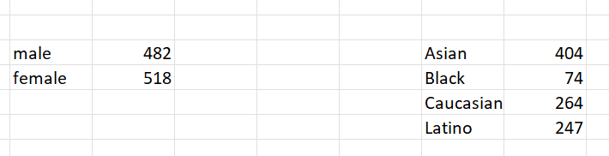
Q1
Clearly, there are more females than males
in the company. When it comes to ethnic
diversity, Asians dominate the crowd,
Followed by Caucasians, Latinos and Black.

Slide 3
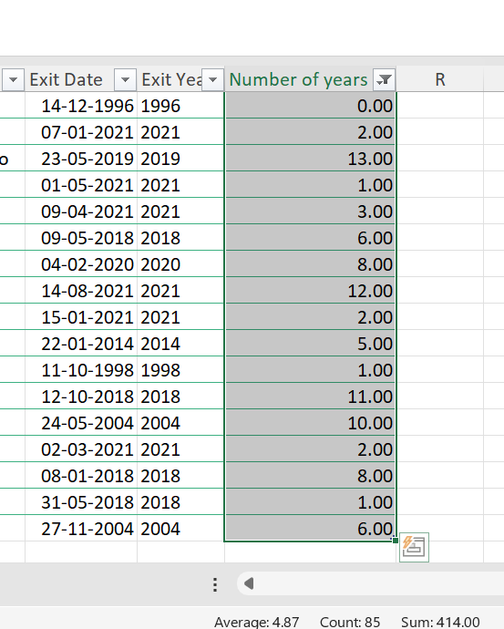
Q2
Clearly, 85 people have left the organization and the average
Tenure turns out to be 4.87~ 5 years.

Slide 4
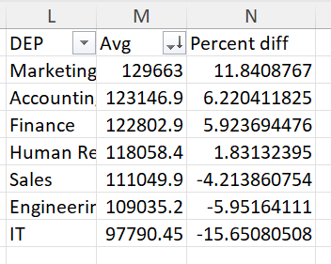
Q3
There is a significant difference in the average salaries across
the departments. The percentage difference from the average
Salary of any employee is displayed here. Clearly showing, IT
And Engineering department’s employees receive 15% lesser
than overall average salary of an employee in the company.
The employees from Marketing department
receive the highest average salaries.

Slide 5

Q4
Most of the employees are from the
USA, followed by China and then Brazil.

Slide 6
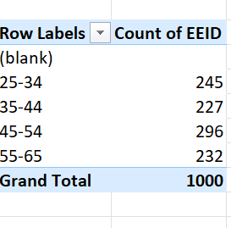
Q5
The most common age range of employees is 45-54, followed by 25-34 age
Range.

Slide 7
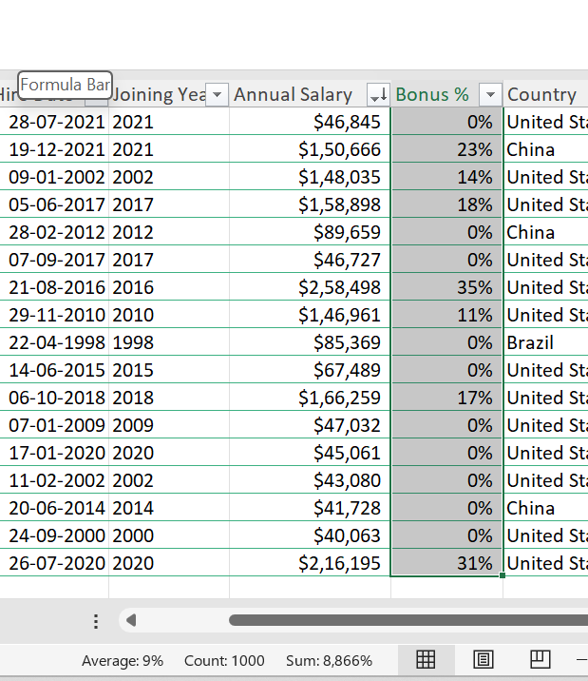
Q6
Clearly, average bonus percentage of all employees
is 9%

Slide 8
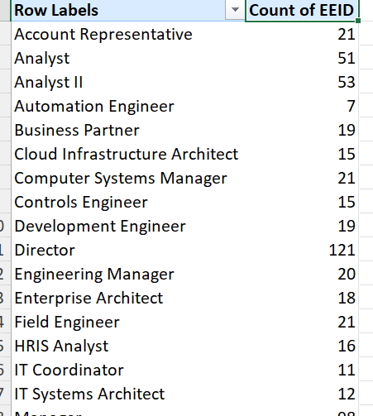
Q7
The most common is the Director job title.

Slide 9
Q8
There is no data to get inference on reasons for leaving

Slide 10
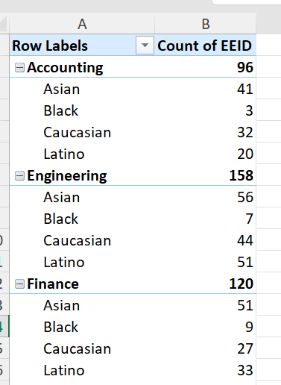
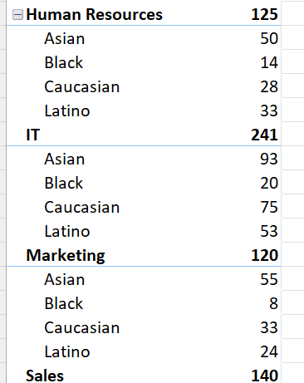
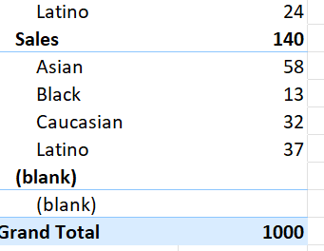
Q9
There is clearly good ethnic
Diversity in each department

Slide 11
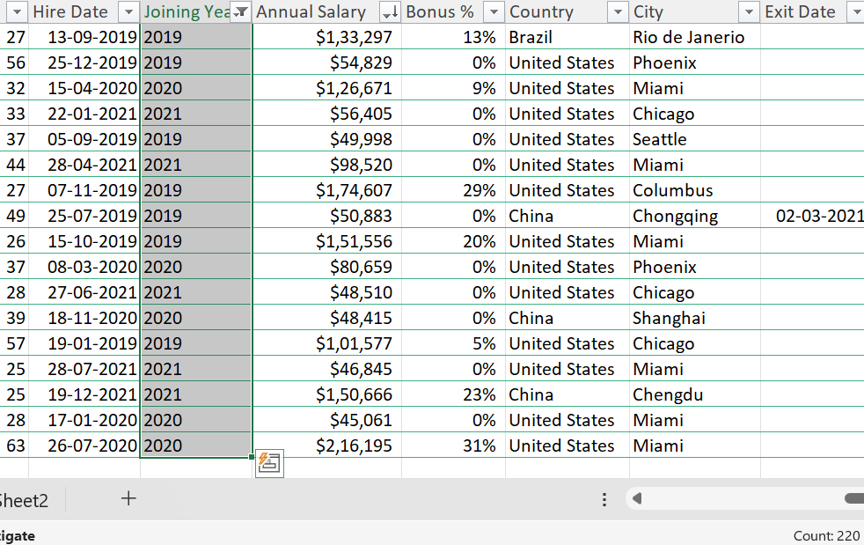
Q10
Clearly, there is quite a lot
Of hires in the last few years,
Around 220.

