Slide 1


Twitter Sentiment Analysis
For Brand Improvement
Team Name:
Tweetify ML
Team Members:
Parth D Patel (AU1841123)
Yash R Patel (AU1841125)
Kishan Patel (AU1841132)
Sharvil Patel (AU1841134)

Slide 2

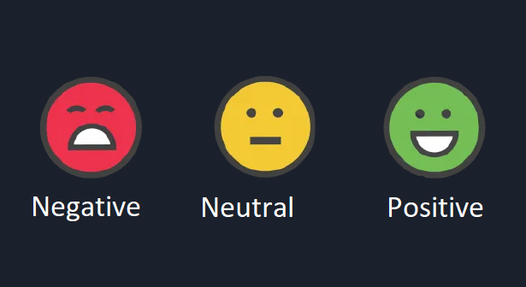
Introduction
TweetifyML = Twitter + ML
Twitter → Tweets ( public opinions / views) → brand sentiment analysis
Sentiment of Tweets :- Positive / Negative / Neutral
Tweets Fetched → Customer Feelings → Analysis → Trend Recognition → Brand Improvement

Slide 3
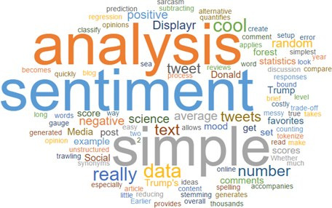
Problem Statement
Brands need to understand customers views for
New Product launches
Current issues
Response to campaigns
For politics
Views on statements
Government actions
Consistency and inconsistency
For public actions
Predicting potentially dangerous situations by analyzing social phenomena

Slide 4
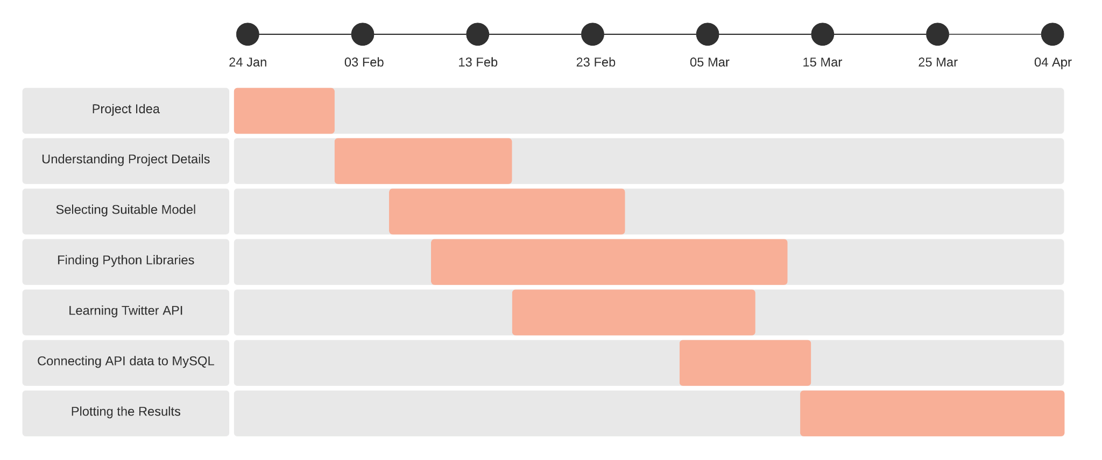
GANTT Chart

Slide 5
Existing body of work
Input (Keyword)
(Retrieving data using the twitter api )
Tweets Retrieval
(using Tweepy, MySQL, and Python.)
Data Pre-processing
(Using deEmogify and clean_tweet)
Sentiment in Graphical Representation
(using Plotly)
Classified Tweets
(Positive Tweets, Negative Tweets, Neutral Tweets)
Classification Algorithm
(Textblob - Naive Bayes)

Slide 6
Approach
Raw Tweets
Processed Tweets
Feature Extraction
Sentiment Prediction
Pre-Processing Steps:
Tokenization (N-grams)
Stop Words
Normalization
Encoding eg:
Bag of Words
TF-IDF
Machine Learning models:
Naive Bayes
A massive thank you to our fantastic carers-😁
#clapforcarers
[‘a’,’massive’,’thank’,’you’,’to’,’our’,’fantastic’,’carers’,’-’,😁 ,’#clapforcarers’]
[’massive’,’thank’,’you’,’to’,’our’,’fantastic’,’carers’,’-’, 😁,’#clapforcarers’]
[’massive’,’thank’,’you’’,’our’,’fantastic’,’carers’,’clapforcarers’]
Tokenization ( and Lowercase)
Remove some Stop words
Normalization

Slide 7
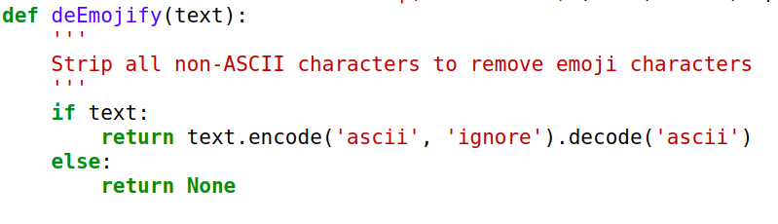
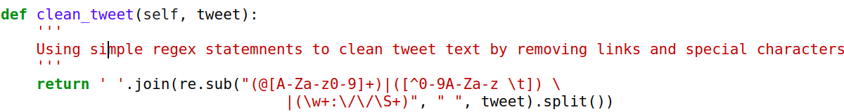
Approach
Data cleaning process to remove emojis and unwanted characters from the tweet

Slide 8
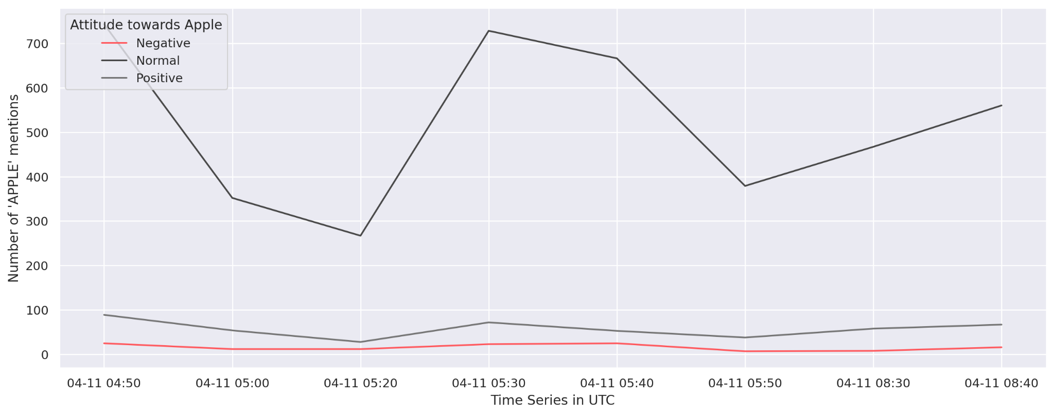
Final Results(1)
Plot showing the number of neutral (normal), positive and negative tweets for APPLE for the given time frame in UTC

Slide 9
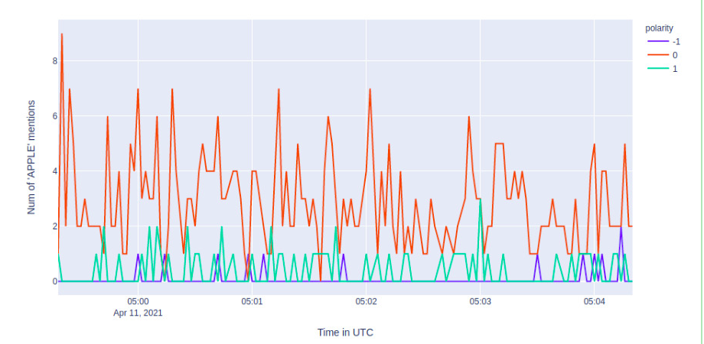
Final Results(2)
Plot showing the overall sentiment of APPLE.
Sentiment is defined by polarity
-1 -> negative
0 -> neutral / normal
1 -> positive
Using this graph we can find point where positive point were more than negative

Slide 10
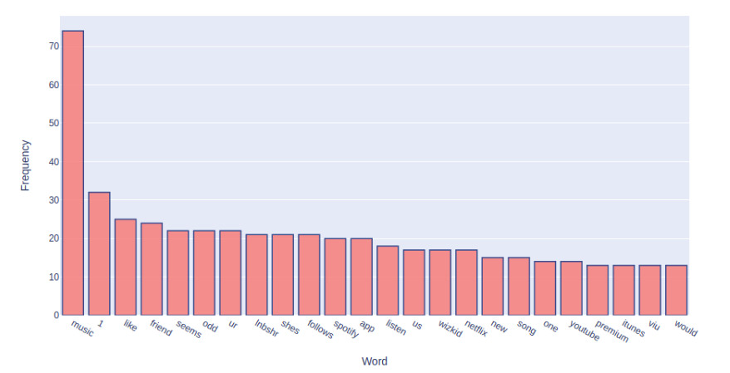
Final Results(3)
Shows frequencies of tokens (words ) which are repeated most number of times.

Slide 11
Conclusion
The first graph here showed the tweets being classified in three norms:- positive, negative or neutral.
The company here we tracked is ‘APPLE’ and the time zone is ‘UTC’
The values show in the graph were +1 for positive, 0 for neutral and -1 for negative.
Sentences may contain text or emotions or emoticons or expressions. Even though emotions look like a diagram, it represents some textual information.
We obtained classification of polarities of sentiments into positive , negative and neutral and prepared a plot using python module for data visualization.
At last we can conclude that we can analyze some prominent results for brands to know the customer side.

Slide 12
Role of each member in Project
 | Parth Patel | Yash Patel | Kishan Patel | Sharvil Patel
Literature Review | ✓ | ✓ | ✓ | ✓
Implementation | ✓ | ✓ | ✓
Documentation / Report |  |  | ✓ | ✓
Presentation | ✓ | ✓ | ✓ | ✓
Dataset Searching/Retrieving | ✓ | ✓ |  | ✓
Coding / Algorithmic Thinking | ✓ | ✓

Slide 13
References
https://cs.stanford.edu/people/alecmgo/papers/TwitterDistantSupervision09.pdf
http://static.googleusercontent.com/media/research.google.com/en//pubs/archive/36744.pdf
https://www.geeksforgeeks.org/twitter-sentiment-analysis-using-python/
http://help.sentiment140.com/for-students
https://web.stanford.edu/~cgpotts/papers/potts-salt20-negation.pdf
https://www.cs.cornell.edu/home/llee/omsa/omsa.pdf
https://towardsdatascience.com/twitter-sentiment-analysis-classification-using-nltk-python-fa912578614c
https://cse.iitk.ac.in/users/cs365/2015/_submissions/ajaysi/slides.pdf
https://docs.python.org/3.7/library/re.html
https://www.nltk.org/
https://textblob.readthedocs.io/en/dev/
https://github.com/yash982000/CSE523-Machine-Learning-TweetifyML

