Slide 1


Twitter Sentiment Analysis
For Brand Improvement
Team Name:
Tweetify ML
Team Members:
Parth D Patel (AU1841123)
Yash R Patel (AU1841125)
Kishan Patel (AU1841132)
Sharvil Patel (AU1841134)

Slide 2
Introduction
TweetifyML = Twitter + ML
Sentimental analysis is a method to identify an e text(text form of electronic data, such as comments, reviews and messages) to be positive or negative.
Sentimental analysis is also known as opinion mining eg (Analysing a product based on its reviews and comments).
This project addresses the problem of sentiment analysis in twitter; that is classifying tweets according to the sentiment expressed in them: positive, negative or neutral based on the views of the users and expresser their ideology, belief and interests in particular brand or person.
Analysing the public sentiment is important for many applications such as firms trying to find out the response of their products in the market, predicting political elections and predicting socioeconomic phenomena like stock exchange. The aim of this project is to develop a functional classifier for accurate and automatic sentiment classification of an unknown tweet stream.
Notes:
Sharvil

Slide 3
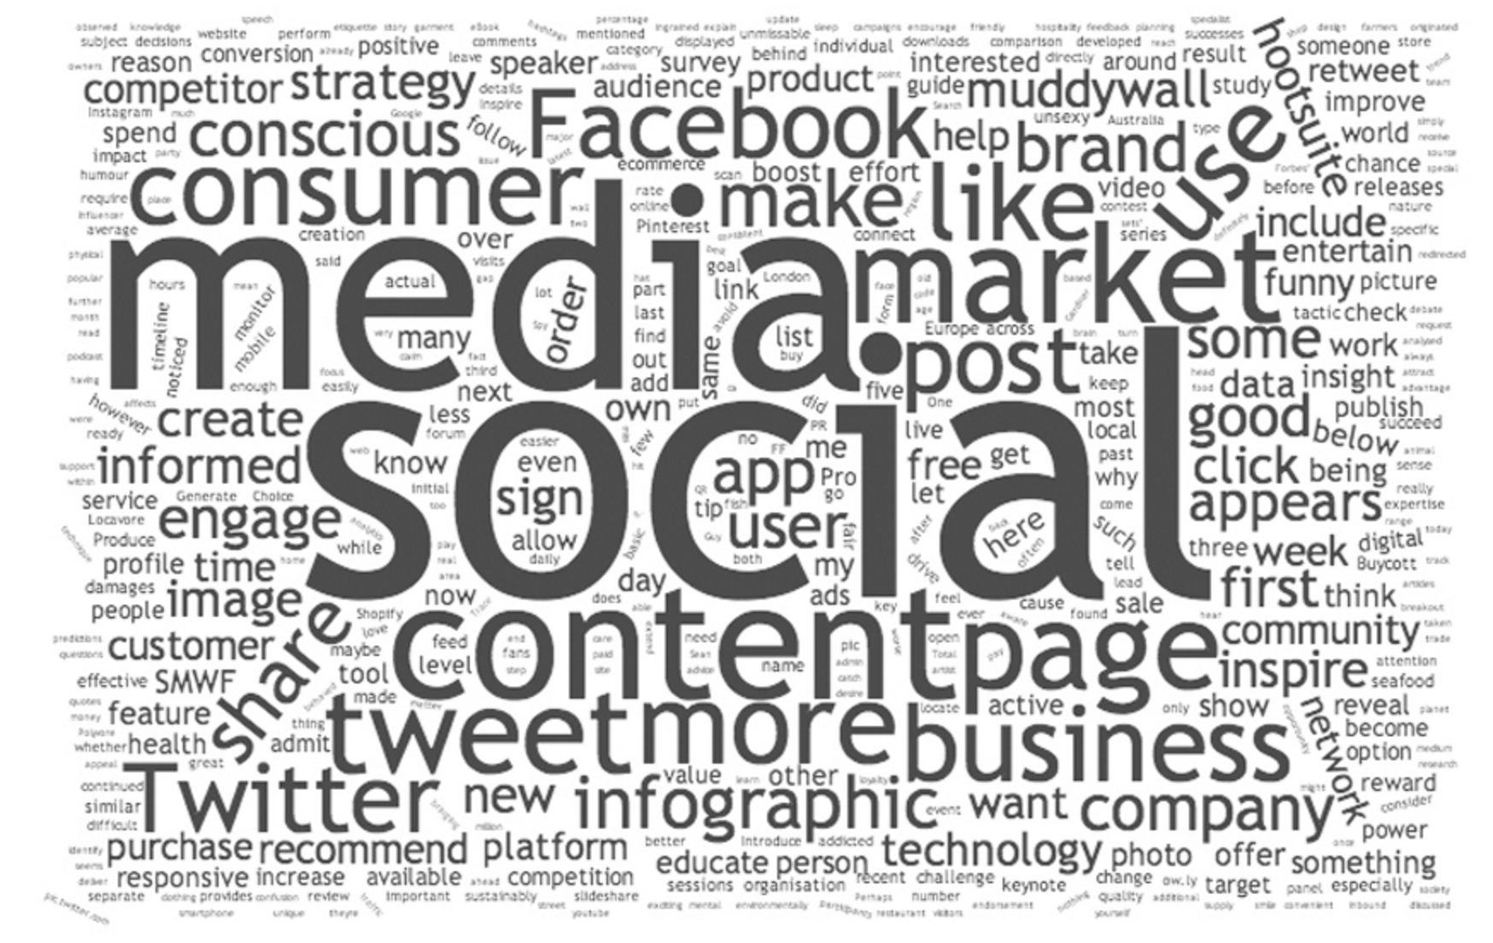
Problem Statement
Why Did We Use This??
The solution for evaluating Twitter data to perform better business decisions is to keep tracking all relevant Twitter content about a brand in real-time, perform analysis as topics or issues emerge, and detect anomaly with alert.
Business Strategies
By monitoring brand mentions on Twitter, brands could inform engagement and deliver better experiences for their customers across the world.
Trend Analysis
Identifying key emotional triggers.
Invaluable Marketing.
Notes:
Sharvil
1. Problem Definition
- Problem Statement
- Ideal Problem Solution
- Understanding and insight into the problem
- Technical requirements

Slide 4
Existing Body of Work
Existing techniques for sentiment analysis are : -
Naive Bayes
Maximum Entropy
Semantic Orientation
Ways for classification : -
Binary Classification - ( positive or negative)
3 - Tier - ( positive , negative and neutral)
5 -Tier -(extremely positive, positive, neutral, negative and extremely
Input (Keyword)
Tweets Retrieval
Data Pre-processing
Sentiment in Graphical Representation
Classified Tweets
Classification Algorithm
Notes:
Parth

Slide 5
Approach to Problem
Positive tweets
Negative tweets
Word features
Performing sentiment analysis on Twitter data involves five steps:
Gather relevant Twitter data from the Twitter API
Cleaning our data using pre-processing techniques
Create a sentiment analysis machine learning model
Analyze our Twitter data using the sentiment analysis model
Visualize the results of your Twitter sentiment analysis through Plotly, Dash. (Data Streaming)
Training set
Features extractor
Classifier
Features extractor
Tweet
Positive
Negative
Notes:
Yash
3. Data
needs to be
- diverse
- unbiased
- abundant
Steps
- Preparation
- Preprocessing
- Augmentation (if collected from multiple sources)
- Data Cleaning (if required)
- Data Normalisation

Slide 6
Approach to Problem (Contd.)
Create a TextBlob
Part-of-speech Tagging
Noun Phrase Extraction
Sentiment Analysis
Tokenization
Words Inflection and Lemmatization
WordNet Integration
WordLists
Spelling Correction
Get Word and Noun Phrase Frequencies
Parsing
n-grams
Get Start and End Indices of Sentences
Notes:
Yash
4. Model Implementation
- coding (your prefrable language however python is more suitable for ML)

Slide 7
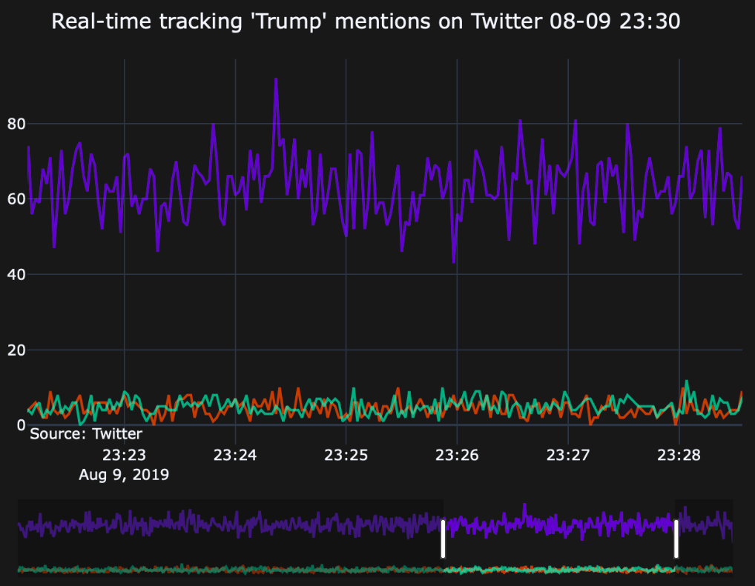
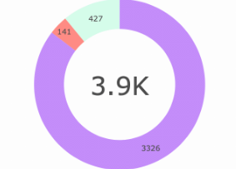
Initial Results
We tried our algorithm on a sample data set of around 2500 tweets and analyzed the result.
Twitter API allows around 50k to 5L Tweets to read from them.
Using uni-grams as features,
Accuracy of: Naïve Bayes Classifier – 76%
Maximum Entropy classifier – 75.4%
Support Vector Machines – 76.9%
Tech Stack: Python, Tweepy, Numpy, Pandas, Seaborn, Plotly, Dash, MySQL, RE, TextBlob, NLTK, HTML, CSS, Flask, JavaScript, React.js and Git
Notes:
Yash
5. Training
- Hyperparameters
- Training accuracy
- Validation accuracy
- Training Loss
- Validation Loss
- Underfitting
- Overfitting

Slide 8
Future Work
Bigrams, Trigrams and N-grams model on a bigger dataset with a good amount of accuracy.
Unstructured tweet texts may contain messy code and emoji characters
Semantics : - Federer beats Nadal :)
Hosting as a Web applications and if time permits can be converted to mobile based applications
Updating dictionary for new synonym and antonym of already existing words.
Some brands may take a long time to collection enough data to perform analysis on issue emerging since they target specific groups of people.
One of the main future work can be Sarcasm Detection
Sarcasm type related to twitter are :
Positive words with negative smiley
Negative words with positive smiley
Sarcasm related to facts which includes spoofs, sarcastic recreation etc.
Domain-specific tweets
Internationalization
Utilizing emoticon data in the test set
Notes:
Kishan
In future work, we will try to add bigrams, trigrams and N-grams means sequence of n-tokens in training dataset to get good amount of accuracy in analysing tweets.
We will try to get good accuracy in analysing sentiment for unstructured tweets which contains messy or random text and emoji characters.
Try to analyse tweets with semantics like Federer beats Nadal :) has mixed sentiments like this tweet has positive sentiment for federer as well as negative sentiment for nadal and the smiling emoji showing positive sentiment but it represents sarcasm.
We may host a web application for showing analysed data and will try to convert it for mobile based applications if time permits
We will update dictionary for new words and synonyms to existing words as it helps to increase the accuracy to analysing tweets with accurate sentiment prediction of a tweet.
Some brands may take a long time to analyze issues which makes the dataset bigger so they target only specific groups of people Suppose Facebook is mainly for middle aged to older people while in comparison Instagram has relatively younger audience as a target audience.
Now, one of the main future work will be detection of sarcasm in tweets.
Sarcasm type related to twitter are :
Positive words with negative smiley
Negative words with positive smiley
Sarcasm related to facts which includes spoofs, sarcastic recreation etc.
In addition to this we will try to analyse domain-specific tweets like sports or political domain, try to implement internationalization and utilize the emoticon data to analyse sentiments in tweets if time permits.
This is the distribution of work in our team.
6. Evaluation
- Confusion matrix (error matrix)
- Precision-Recall

Slide 9
Role of each member
 | Parth Patel | Yash Patel | Kishan Patel | Sharvil Patel
Literature Review | ✓ | ✓ | ✓ | ✓
Implementation | ✓ | ✓ | ✓
Documentation |  |  | ✓ | ✓
Presentation | ✓ | ✓ | ✓ | ✓
Algorithmic Thinking | ✓ | ✓ |  | ✓
Notes:
7. Parameter tuning and Inference
- Once hyperparameters are tuned and new values are selected, training and evaluation commence again.
- The process of parameter tuning is carried out until a suitable enough model is generated.
- Inference is a real-world test of our model

Slide 10
References
https://cs.stanford.edu/people/alecmgo/papers/TwitterDistantSupervision09.pdf
https://www.aclweb.org/anthology/P11-1016.pdf
http://static.googleusercontent.com/media/research.google.com/en//pubs/archive/36744.pdf
https://www.geeksforgeeks.org/twitter-sentiment-analysis-using-python/
http://help.sentiment140.com/for-students
https://web.stanford.edu/~cgpotts/papers/potts-salt20-negation.pdf
https://www.aclweb.org/anthology/P11-1016.pdf
https://dl.acm.org/doi/10.1561/1500000011
https://www.cs.cornell.edu/home/llee/omsa/omsa.pdf
https://towardsdatascience.com/twitter-sentiment-analysis-classification-using-nltk-python-fa912578614c
https://cse.iitk.ac.in/users/cs365/2015/_submissions/ajaysi/slides.pdf
B. Pang and L. Lee. Opinion mining and sentiment analysis. Foundations and Trends in Information Retrieval, 2(1-2):1–135, 2008.

