Slide 1

MOBILE PHONE DISCOVERY & RECOMMENDATIONS
ELYVEX
Better choices begin here.
Product walkthrough · October 2026
ELYVEX
01

Slide 2
ELYVEX at a glance
A phone discovery app that turns a large specification catalog into clear search, side-by-side comparison, and preference-based shortlists.
413
5
Top 5
CATALOG RECORDS
PERSONA PROFILES
RECOMMENDATION OUTPUT
From the supplied phone workbook.
Student, Creator, Gaming, Business, Senior.
With score breakdowns and missing-spec flags.
ELYVEX
02

Slide 3
The problem and who it's for
1
Many specs, one buying decision
Phone specifications are easy to list and hard to weigh against a person's budget and priorities.
2
A budget should filter before ranking
3
Unclear data should stay visible
Product framing · ELYVEX project brief
ELYVEX
03

Slide 4
Five personas, different priorities
Student
Creator
Gaming
Price-aware shortlist
Camera-focused picks
Memory & battery
Price 35 · Battery 20
Camera 35 · Storage 20
RAM 30 · Battery 20
Business Professional
Senior
Reliable daily use
Simple, readable choices
Rating 25 · Battery 25
Battery 25 · Display 15
ELYVEX
04

Slide 5
Key decisions
01
02
Filter over-budget phones first
Use the same catalog in every flow
03
04
Keep persona weights interpretable
Show missing specs; never guess
DATA INPUT · 413 phone records from the supplied workbook
ELYVEX
05

Slide 6
Product journey
Browse
Filter
Compare
Recommendations
Save profile
Browse the shared phone catalog
Filter by brand, category, budget, specs
Compare exactly two phones
Rank a top five by persona + budget
Save preferences to your profile
ELYVEX
06

Slide 7
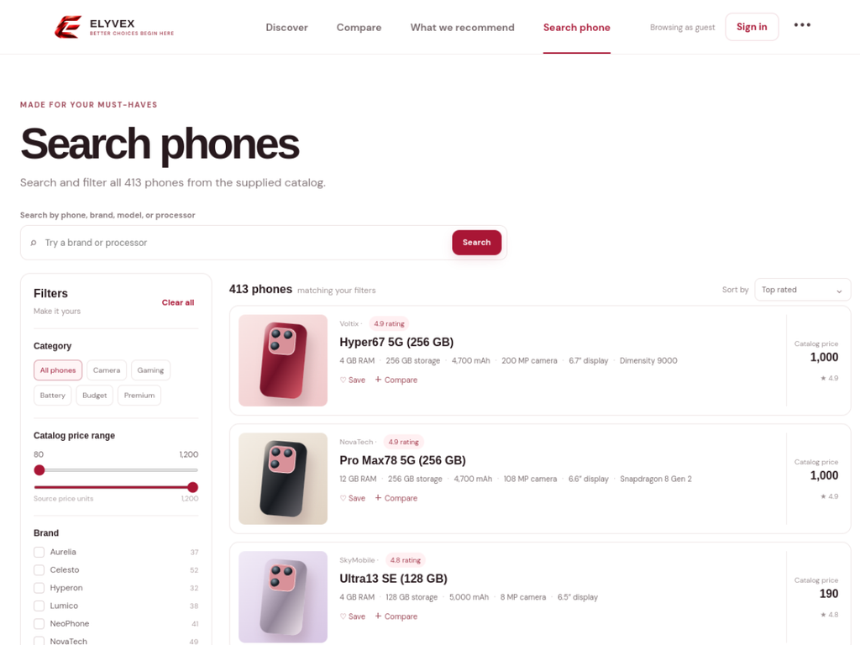
Live demo · discover & search
Brand
Budget
Camera
Battery
Search the catalog, filter by needs, and open a phone's details.
ELYVEX
07

Slide 8
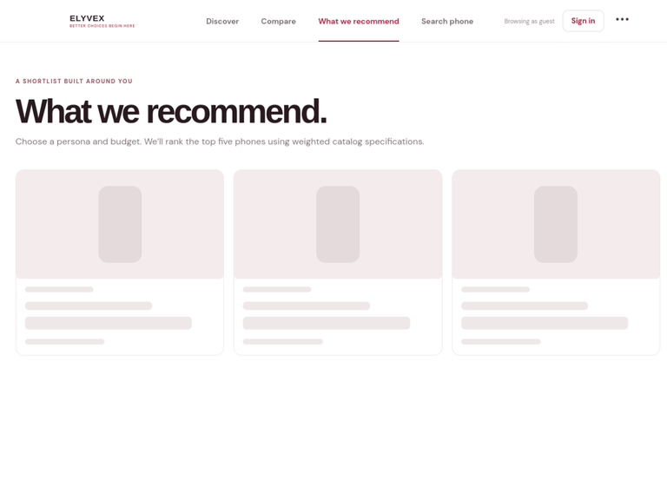
Live demo · personalized recommendations
YOU SET
ELYVEX RETURNS
Persona
Five weighted profiles
Max price
Above-budget phones excluded
Catalog specs
Normalized, then weighted
Missing spec
0 points; shown as missing
Shortlist
Ranked top five
ELYVEX
08

Slide 9
Recommendation scoring rules
Eligibility gate first; then a transparent persona-weighted score.
Budget gate
HARD FILTER
Normalize
CATALOG RANGE
Persona weights
SUM = 100
Missing specs
0 + FLAG
Rank results
TOP FIVE
score = Σ (normalized available spec × persona weight) · Price score is inverted; missing values are never inferred.
ELYVEX
09

Slide 10
Architecture & account data
Shared JSON catalog
TRUST & DATA
Profile: persona, budget, categories
Access: signed-in owner only
Guest picks: local browser storage
React + TypeScript UI
Firebase Auth + Firestore
FastAPI endpoints
ELYVEX
10

Slide 11
AI review, challenges & next steps
AI got wrong
How we caught it
It treated likely price/spec units as confirmed.
Checked every claim against the source workbook notes; currency and several units are unconfirmed.
Challenge
Improve next
Mixed field formats and no per-phone source links make verification harder.
Verify with sellers; add sources and freshness dates; test rankings with users.
ELYVEX
11

Slide 12
Clear priorities. Honest data. Better phone choices.
Questions?
LIVE DEMO · pj-1-five.vercel.app · Better choices begin here
ELYVEX
12

