Slide 1
E2E Testing with Cypress All in one testing tool

Slide 2
Contents
Overview 00
Cypress 01
Cypress vs Selenium 02
Cypress features 03
Framework 10
Cypress BDD 11
Cypress Dashboard 12
Cypress Test Recorder 13
CI/CD 20
Cypress Docker 21
OpenShift Cluster 22

Slide 3
What’s Cypress? Cypress is an e2e automation tool for any application that runs in the browser. It is open source, developer friendly, flake resistant and runs test much much faster. Tests are only written in Javascript language. cypress.io

Slide 4
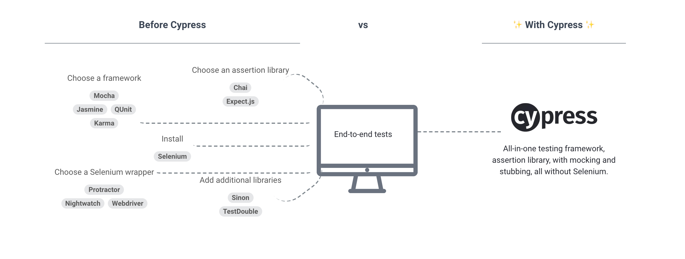
Cypress vs Selenium

Slide 5
Why Use Cypress?
Control over DOM
Can use jQuery method
Automatic waiting
Debugging
Selectors in Test Runner
Mocking capabilities
XHR Testing

Slide 6
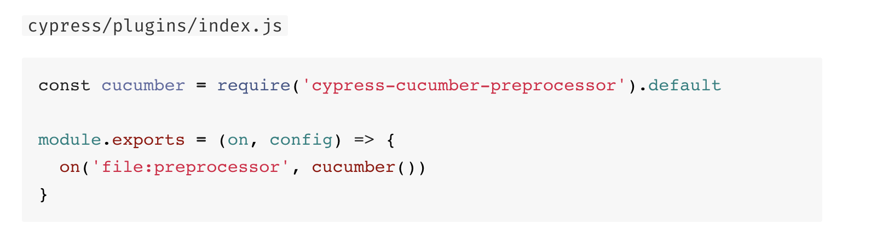

Cypress BDD using Cucumber
Using cypress-cucumber-preprocessor
Supports Mocha as well as Cucumber Hooks
npm install --save-dev cypress-cucumber-preprocessor

Slide 7
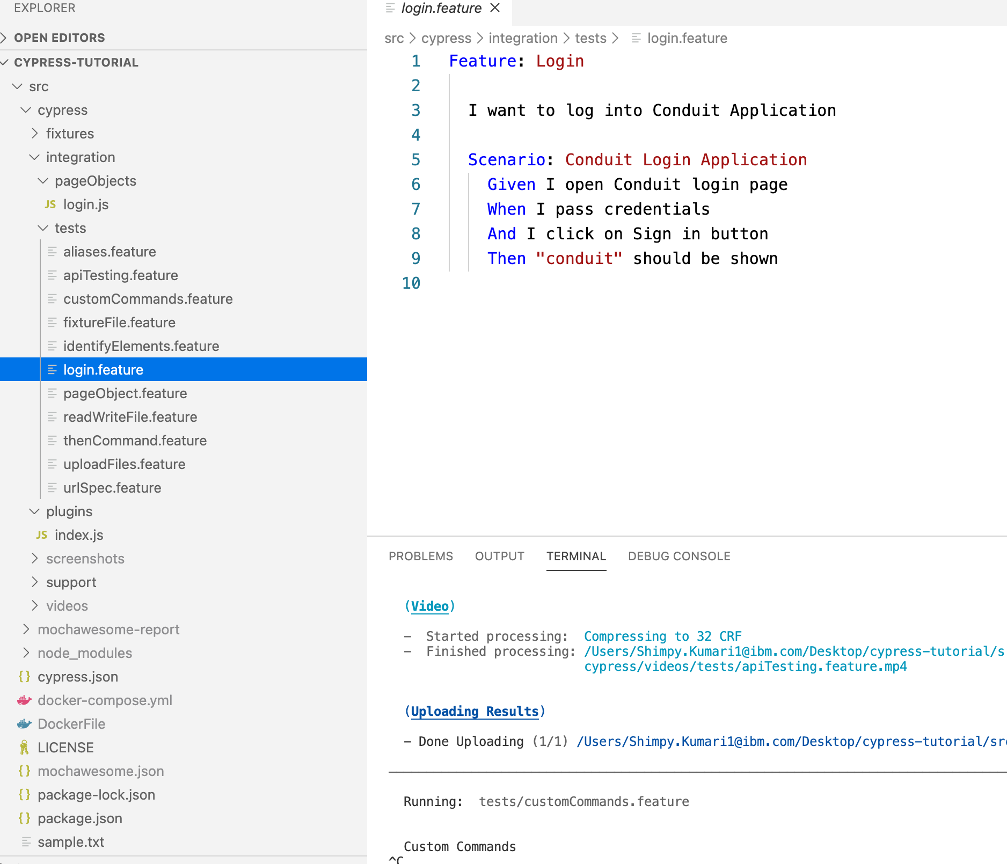
BDD Example

Slide 8
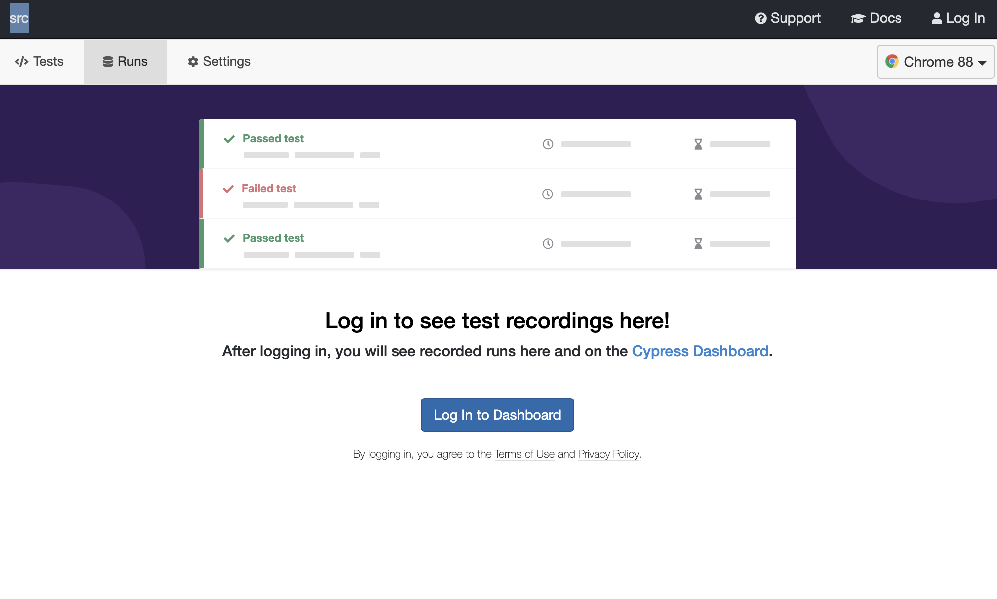
Cypress Test Runner

Slide 9
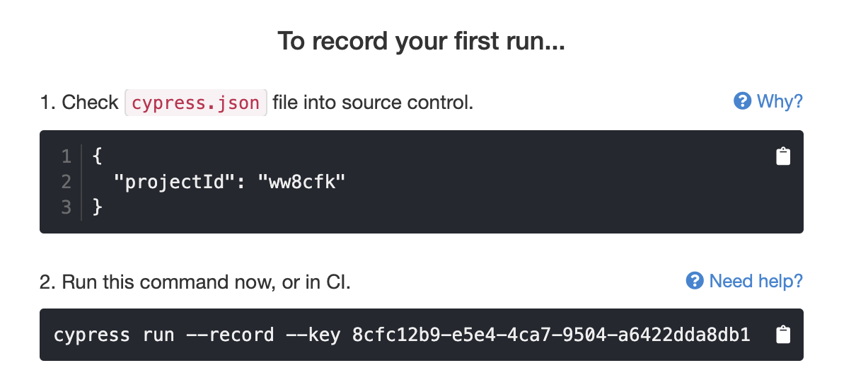
How to enable cypress dashboard?
Go to Cypress Test Runner -> Runs

Slide 10
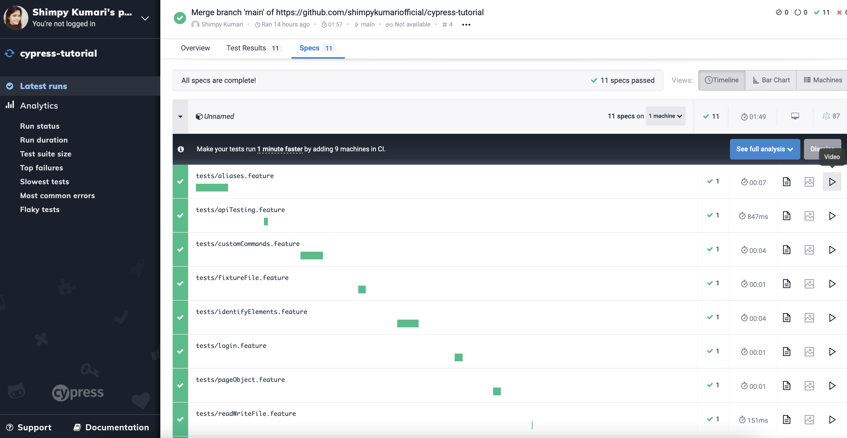
Cypress Dashboard

