Slide 1
Pharmacy Management System
Course ID : ITDC0201
Using C++ Object-Oriented Programming
Presented To : Ms. Kusum Bharti
Presented by: Shashank Gupta(24124104)
        Rishu Kesharwani(24124095)

Slide 2
Outline
• Motivation
• System Design
• OOP Concepts
• Workflow
• Demo Output
• Conclusion
• References

Slide 3
Motivation
• Manual pharmacy records are slow and error-prone
• Stock mismanagement → loss of sales
• Automation improves accuracy and speed

Slide 4
System Overview
• Stores medicine details
• Allows adding & updating stock
• Billing system with price calculation
• Extensible modular OOP structure

Slide 5
OOP Principles Applied
✅ Encapsulation — private data in classes
✅ Inheritance — Antibiotic, Painkiller from Medicine
✅ Polymorphism — showDetails() overridden
✅ Abstraction — Medicine as an abstract base class

Slide 6
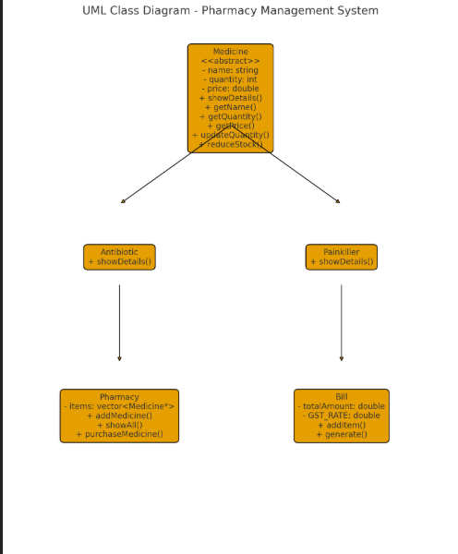
(Insert UML Diagram Here)
Medicine
↳ Antibiotic
↳ Painkiller
Pharmacy & Bill Controller

Slide 7
Workflow
1️⃣ Add Medicines
2️⃣ Display Inventory
3️⃣ User Purchases Product
4️⃣ Bill Generated
5️⃣ Stock Updated

Slide 8
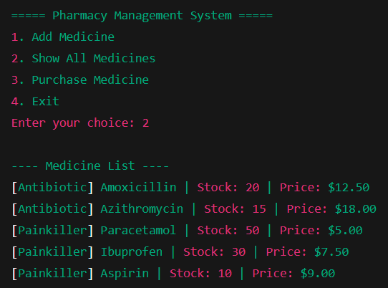
Sample Output
Console Output Example:
Add → Show → Bill
(Insert Screenshot Here)

Slide 9
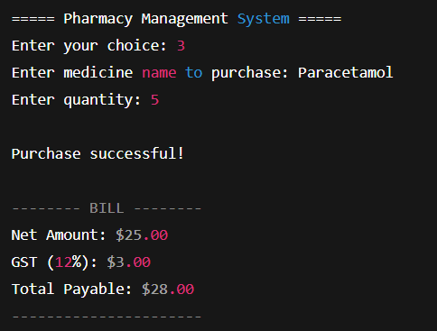
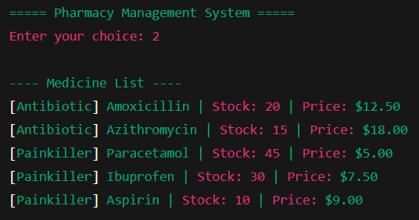

Slide 10
Future Enhancements
• File/database storage
• Medicine expiry monitoring
• Supplier & purchase history
• POS barcode scanning

Slide 11
Conclusion
• Fully automated basic pharmacy operations
• Demonstrates essential OOP principles in C++
• Highly scalable design

Slide 12
References
• C++ Standard Library Documentation
• Class lecture notes
• Object-Oriented Design best practices

