Slide 1

Project-1
NAME-Ambati Shasank Bhushan
Autonomous Street Light

Slide 2
Idea and Approach:
In a country with extensive road systems like India, street lights are a major part of this system but many roads in India are free of cars/bikes at night and even then the street lights remain switched on which is a major waste of electricity and some street lights are so poorly maintained that they stay on even in the day. To counter this problem we can use autonomous street light which work when it senses the day night cycle and senses when a car moves in front of it.

Slide 3
Components required:-
Arduino Uno-1
Breadboard-1
Ultrasonic Sensor-1
LDR resistor-1
Resistor(220 ohm)-1
Resistor(1kohm)-1
LED Yellow-1

Slide 4
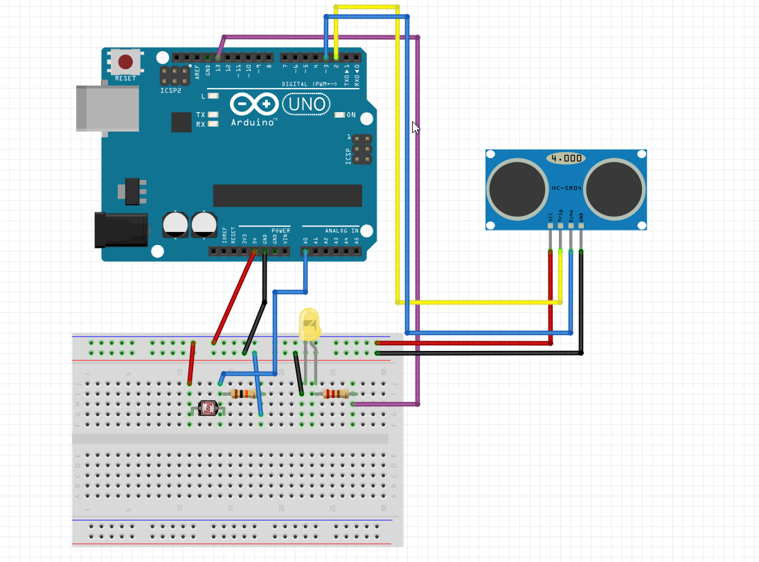
BREADBOARD VIEW of CIRCUIT

Slide 5
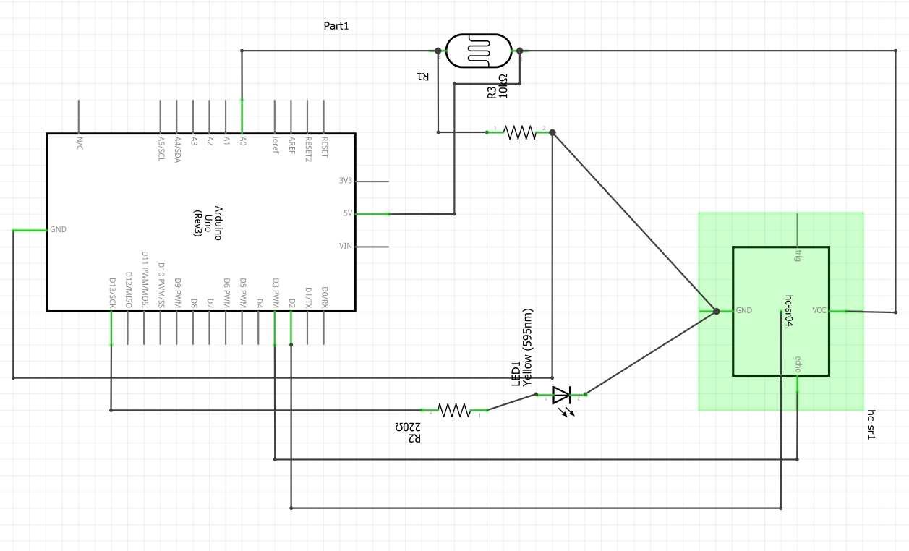
SCHEMATIC VIEW of CIRCUIT

Slide 6
Code:-
const int ledPin = 13;
const int ldrPin = A0;
#define echoPin 2
#define trigPin 3
long duration;
int distance;
void setup() {
Serial.begin(9600);
pinMode(trigPin,OUTPUT);
pinMode(echoPin,INPUT);
pinMode(ledPin, OUTPUT);
pinMode(ldrPin, INPUT);
}
Contd…….

Slide 7
void loop() {
int ldrStatus = analogRead(ldrPin);
if (ldrStatus <= 100) {
digitalWrite(trigPin,LOW);
delayMicroseconds(2);
digitalWrite(trigPin,HIGH);
delayMicroseconds(10);
digitalWrite(trigPin,LOW);
duration=pulseIn(echoPin,HIGH);
distance=(duration*0.034/2);
Serial.print("Distance : ");
Serial.print(distance);
Serial.println(" cm ");
delay(1000);
Contd…….

Slide 8
if(distance<=70)
{
digitalWrite(ledPin, HIGH);
Serial.print("Its DARK, Turn on the LED : ");
Serial.println(ldrStatus);
delayMicroseconds(10000);
}
else{
Serial.print("The car is far away, Turn off the LED : ");
Serial.println(ldrStatus);
digitalWrite(ledPin, LOW);
}
}
else {
digitalWrite(ledPin, LOW);
Serial.print("Its BRIGHT, Turn off the LED : ");
Serial.println(ldrStatus);
delayMicroseconds(10000);
}
}

Slide 9
TAKEAWAY and RESOURCES:-
This task has made me learn countless new things such as sensors, Circuits, Arduino boards, Pseudo code writing, etc,. When an automated street light is put infront of us the first thing that comes to mind is a street light that switches on its own during night time without someone pushing the button but that isn’t an efficient way of power utilisation as some roads are rarely used on nights so the street lights there are not used at all that is a waste of power consumption and it can be minimised by using a sensory module that detects a car passing by to switch on the street light and once the car passes by the street itself switches off, this way even if the road is barely used keeping street lights there is viable as energy consumption there is less
Software used for circuit making:- Fritzing
Websites used for references:-
https://create.arduino.cc/projecthub/tarantula3/using-an-ldr-sensor-with-arduino-807b1c
https://www.arduino.cc/en/Tutorial/BuiltInExamples/Blink
https://create.arduino.cc/projecthub/abdularbi17/ultrasonic-sensor-hc-sr04-with-arduino-tutorial-327ff6

Slide 10
THANK YOU

