Slide 1

SRM INSTITUTE OF SCIENCE AND TECHNOLOGY Ramapuram, Chennai – 600 089 DEPARTMENT OF COMPUTER SCIENCE AND ENGINEERING
18CSP107L-MINOR PROJECT
Resume Screening using Machine Learning and Natural Language Processing
BATCH NUMBER :AI_A2
Team Members | Supervisor
Konduru Sri Abhinaya (RA2111026020030) L Shasank Chowdary (RA2111026020036) Charanya R (RA2111026020047) | Ms. Angeline R, AP/CSE

Slide 2
Agenda
Abstract
Scope and Motivation
Introduction
Literature Survey
Objective
Problem Statement
Proposed Work
Work Flow Diagram
Novel idea
Modules
Module Description
Software & Hardware Requirements
Implementation
Results and Discussion
Conclusion
Future Work
References
Outcome : Status of Paper Submissions

Slide 3
ABSTRACT
In today's competitive job market, organizations face the challenge of efficiently screening a large volume of resumes to identify the most qualified candidates for job openings.
Manual screening of resumes is a laborious and time-consuming process that often leads to inefficiencies and biases in candidate selection.
This project addresses these challenges by leveraging machine learning and natural language processing techniques to develop an automated resume screening system.
The significance of the project lies in its potential to revolutionize the recruitment process, making it more efficient, objective, and scalable.
By automating tedious tasks associated with resume screening, organizations can focus their resources on evaluating top candidates, leading to better hiring decisions and improved organizational performance.

Slide 4
SCOPE AND MOTIVATION
The scope of this project includes the development of a scalable and robust resume screening system capable of handling diverse resume formats and categories.
The system will utilize state-of-the-art machine learning models trained on a labeled dataset of resumes to perform accurate classification.
The system will be designed to process and analyze resumes submitted for job openings, categorizing them based on predefined criteria such as skills, experience, and qualifications.

Slide 5
INTRODUCTION
Companies employ resume screening, which is similar to a preliminary review of job applications, to sift through a large number of resumes and identify the top candidates for their open positions.
By doing this, they ensure that the correct personnel are chosen for the task and save time. Resume screening, whether carried out by humans or algorithms, is crucial for locating the most eligible applicants as soon as possible.
a novel resume screening method based on TF-IDF word representation and K-Nearest Neighbors (KNN) One-vs-Rest classification.
Our approach uses natural language processing (NLP) to extract valuable information from unstructured resume text, and the KNN One-vs-Rest classifier uses job eligibility criteria to classify resumes into predetermined groups.
Furthermore, by measuring a word's significance in a resume in relation to the entire corpus, TF-IDF word representation improves feature extraction and increases classification accuracy.

Slide 6
LITERATURE SURVEY
TITLE & YEAR | AUTHOR | METHODOLOGY | CONCLUSION
Resume Shortlisting Using NLP(2024) | Dr. Ambareesh S, Nikhil Kumar Thakur, Ujjwal Bhattarai, Saurav Kumar Yadav, Jay Nath Thakur, Amrit Kumar Mahato | The core steps in the system include parsing resume to text, performing NLP creating a NER model and using NER model to calculate P, R and F score to generate final score to sort resume based on final score. | Natural Language processing (NLP) based resume shortlisting research has shown great potential for accelerating the hiring process.
Resume Ranking and Shortlisting with DistilBERT and XLM(2024) | Anuska Mukherjee, Umme Salma M | It utilizes distilBERT model and the XLM (Cross-lingual Language Model). To refine our approach further, two types of metrics for resume ranking, such as Cosine similarity score and Spatial Euclidean distance, are used, and the results are compared | It has a test accuracy of 95%

Slide 7
LITERATURE SURVEY
TITLE & YEAR | AUTHOR | METHODOLOGY | CONCLUSION
Resume Screening–Testing For Data Stability(2024) | Asim Wahedna, Adit Vakil, Somil Shah, Vishakha V. Kelkar and Ishan Shrivastava | NLP techniques used for resume parsing, such as Named Entity Recognition, along with the various machine learning algorithms used for screening resumes, such as cosine Similarity. | This model provides upto 74%.
Resume Classification Using ML Techniques(2023) | B.Surendiran, Tejus Paturu, Harsha Vardhan Chirumamilla, Maruprolu Naga Raju Reddy | To find the best possible solution, different ML techniques like Decision Tree, Random Forest, KNN, Support Vector are researched and the most accurate one is chosen. | Random forest classifiers gave the highest accuracy (91%).

Slide 8
LITERATURE SURVEY
TITLE & YEAR | AUTHOR | METHODOLOGY | CONCLUSION
Resume Classification using Elite Bag-of-Words Approach(2023) | Muskan Sharma, Gargi Choudhary, Seba Susan | It utilizes a recently introduced text vectorization technique called Elite bag-of-words for the vectorization of resumes. To implement this method, words in each class are ranked based on their occurring frequency and then applied max entropy partitioning (MEP) to derive the top-ranked significant keywords in each class. | The best performing was observed to be the elite key words which gave highest test accuracy of 62.6%.
2Q-Learning Scheme for Resume Screening(2023) | Bhoomika SP, Likhitha S, Chandana H S, Kavya S A, Bhargavi K | This paper uses a 2Q-Learning-based approach enriched with natural language processing capability to accurately evaluate resumes. The 2Q-Learning approach involves the selection or rejection of resumes by comparing the resume with the skills or requirements mentioned in the job description by recruiter. | Accuracy: 72%

Slide 9
LITERATURE SURVEY
TITLE & YEAR | AUTHOR | METHODOLOGY | CONCLUSION
Automated Resume Screener using Natural Language Processing(NLP)(2022) | Tumula Mani Harsha,Gangaraju Sai Moukthika, Dudipalli Siva Sai, Mannuru Naga Rajeswari Pravallika, Satish Anamalamudi, MuraliKrishna Enduri | This paper discusses about one such process which is very efficient in performing Resume screening. It includes Natural Language Processing (NLP), an automated Machine Learning Algorithm for screening the resumes. | A user interface was developed.
Resume Screening using NLP and LSTM(2022) | S Bharadwaj, Rudra Varun2, Potukuchi Sreeram Aditya, Macherla Nikhil, G.Charles Babu | This project intends to develop an application that will categorize CVs according to the skills they contain into various job options. This system worked on NLP and LSTM. | In the future, it can be upgraded such that the system does 90% of the selection process of resumes.

Slide 10
LITERATURE SURVEY
TITLE & YEAR | AUTHOR | METHODOLOGY | CONCLUSION
Screening and Ranking Resumes using Stacked Model(2021) | Rasika Ransing, Akshaya Mohan | This system makes use of Machine Learning algorithms such as KNN, Linear SVC, and XGBoost. | Accuracy: Linear SVC: 83% KNN : 72% XG Boost: 85%
Resume Scanning and Emotion Recognition System based on Machine Learning Algorithms(2020) | Vishruth R G, Sunitha R, Varuna K S, Varshini N, Prasad B Honnavalli | This project comprises three modules: Resume scanning, Chatbot implementation, and Emotion Recognition | 66% accuracy of prediction efficiency was accomplished.

Slide 11
OBJECTIVES
The primary objective of this project is to develop an automated resume screening system using machine learning and natural language processing (NLP) techniques.
The system aims to streamline the recruitment process by:
Automating the screening of resumes submitted for job openings.
Extracting relevant features from resumes, such as skills and experience.
Categorizing resumes into predefined classes or categories based on extracted features.
Providing an intuitive user interface for recruiters to interact with the system.

Slide 12
PROBLEM STATEMENT
The employment procedure that is too labor-intensive and prone to mistakes due to the volume of resumes it cannot process.
For businesses looking for effective candidate selection procedures in the cutthroat job market of today, the amount of incoming resumes presents a major obstacle.
Conventional manual resume screening techniques are frequently time-consuming, biased, and difficult. However, there is a potential chance to efficiently streamline this procedure with the advent of Natural Language Processing (NLP) techniques and machine learning algorithms.
Some of the problems that have arisen include the challenges of extracting relevant profiles from a large number of resumes, the requirement for a more efficient and standardized screening process, and the need for a solution that minimizes manual processing while ensuring accurate candidate selection based on job descriptions.
DEPARTMENT OF COMPUTER SCIENCE AND ENGINEERING - Artificial Intelligence and Machine Learning

Slide 13
PROPOSED WORK
Block Diagram
Novel Idea
Modules
Module description
DEPARTMENT OF COMPUTER SCIENCE AND ENGINEERING - Artificial Intelligence and Machine Learning

Slide 14
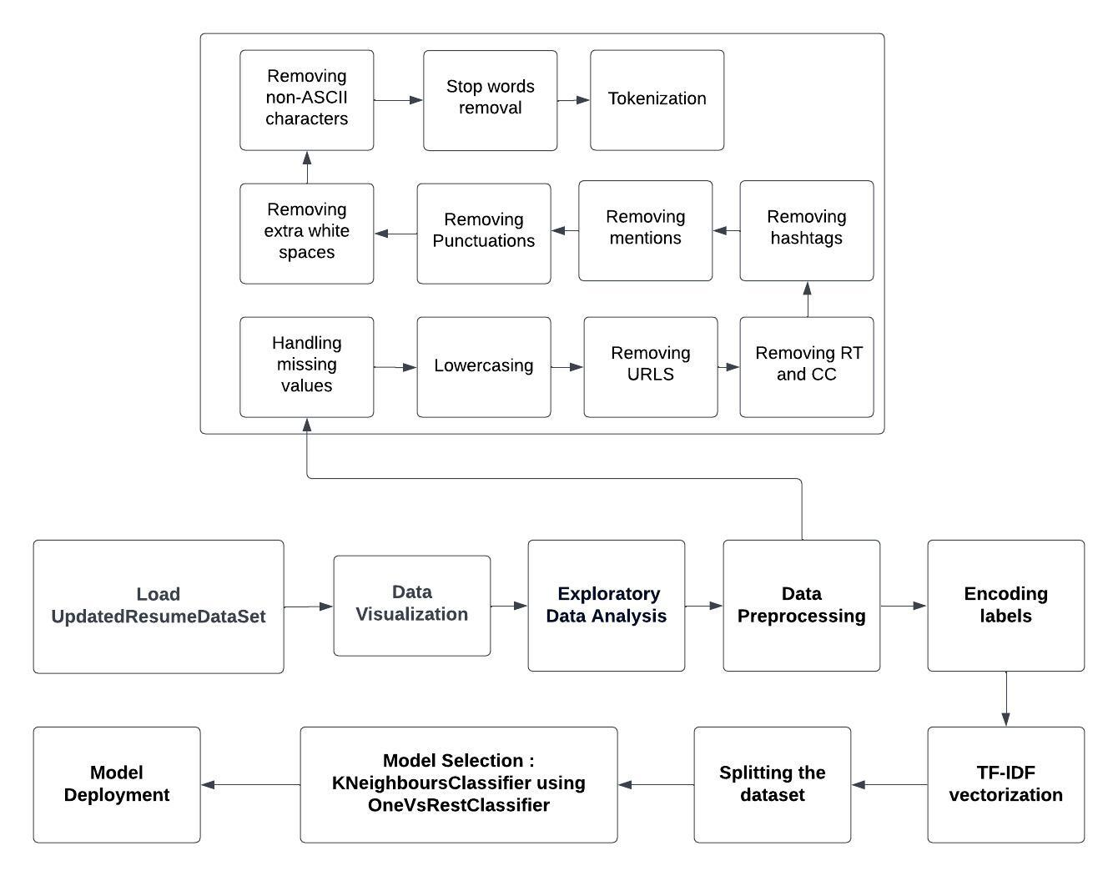
BLOCK DIAGRAM OF THE PROPOSED SYSTEM

Slide 15
NOVEL IDEA
The goal of the project is to incorporate a self-learning mechanism into the automated resume screening system.
The aim of this project is to address the limitations of the existing system by automating the resume screening process using machine learning and NLP techniques.
By leveraging advanced algorithms and models, the system will analyze and classify resumes accurately, enabling recruiters to focus their efforts on evaluating top candidates.
Advantages:
Improved recruitment efficiency
Reduced manual effort and labor costs
Objective and consistent screening process
Scalable and capable of handling large volumes of resumes
Enhanced candidate selection based on predefined criteria

Slide 16
MODULES
Data Loading
Data Visualization
Exploratory Data Analysis
Data Preprocessing
Encoding labels
TF-IDF vectorization
Splitting the dataset
Model Selection
Model Deployment

Slide 17
MODULE DESCRIPTION
Data Loading: This is the first step where the text data is loaded from its source. This could be from a file, database, or API.
Data Visualization: This step involves creating visualizations of the data to help explore and understand the data. This could be helpful in identifying patterns or trends.
Exploratory Data Analysis: This is a data analysis technique that involves investigating the characteristics of the data. This can help in understanding the data better and making informed decisions about the next steps in the text processing pipeline.
Data Preprocessing:The process begins by defining a function cleanResume that utilizes regular expressions to systematically eliminate various types of unwanted text. Specifically, the function removes URLs, occurrences of "RT" and "cc", hashtags, and mentions (indicated by '@'). Additionally, it strips away all punctuation marks and non-ASCII characters, ensuring that only standard textual content remains. Furthermore, the function condenses multiple spaces into a single space to maintain uniform spacing.

Slide 18
MODULE DESCRIPTION
Encoding Labels: This converts the textual tokens into numerical representation. This is a crucial step for machine learning models as they can only process numerical data. There are various encoding techniques, such as one-hot encoding or word embedding.
TF-IDF Vectorization: TF-IDF is used for featurization.The acronym TF-IDF stands for Term Frequency - Inverse Document Frequency, wherein we create a word frequency map or dictionary where each word is mapped to its corresponding frequency, and multiply this frequency by a weight that represents how rare this keyword is across all documents. TF-IDF is a modified version of the original Term Frequency (TF) wherein, in addition to the basic functionalities of the TF an added benefit is there - it aims to focus more on those frequently occurring keywords that do not occur commonly in all documents.
Splitting the dataset: This step involves splitting the data into training and testing sets. The training set is used to train the machine learning model, and the testing set is used to evaluate the performance of the model.

Slide 19
MODULE DESCRIPTION
Model Selection: This step involves choosing a machine learning model that is suitable for the text processing task. There are various machine learning models that can be used for text processing tasks, such as sentiment analysis, topic modeling, or machine translation. The OneVsRestClassifier with K-Nearest Neighbours (KNN) is a multiclass classification approach that trains KNN classifiers separately for each class. In this technique, each classifier separates one class from all others, presenting the issue as binary classification. During prediction, the classifiers work together to identify the class of a new data point by choosing the class with the greatest confidence score from each binary classifier. This approach takes use of the simplicity of KNN and extends it to multiclass classification by successfully merging several binary judgements.
Model Deployment: This step involves deploying the trained model to production. This means making the model available to use for real-world tasks.

Slide 20
SOFTWARE & HARDWARE REQUIREMENTS
Software Requirements:
Programming Language: Python
Development Environment: Juypter Notebook or Juypterlab
Python Libraries: pandas, numpy, string, nltk, matplotlib, seaborn, sklearn, re, wordcloud.
Hardware Requirements:
Processor: 11th Gen Intel(R) Core(TM) i5-1135G7 @ 2.40GHz 2.42 GHz
Installed RAM: 8.00 GB (7.74 GB usable)
System type: 64-bit operating system, x64-based processor 3.3.2

Slide 21
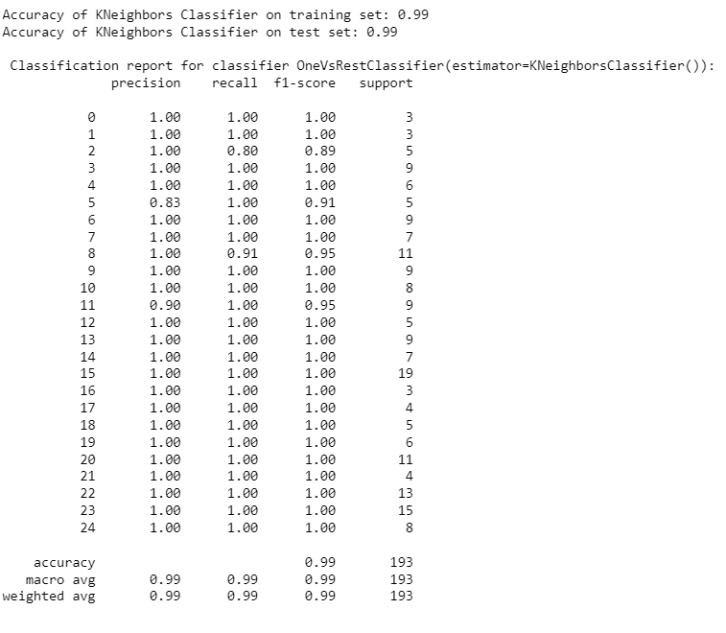
RESULT
The performance metrics for a K-Neighbors Classifier utilizing the OneVsRestClassifier approach, in Fig 5., as measured for a resume screening assignment achieves an astounding 99% accuracy, demonstrating outstanding generalization. The complete classification report contains precision, recall, and F1-scores for each of the 25 resume categories, with the majority of categories receiving perfect scores (1.00) on all metrics. Categories with minor variances, such as category 2 (precision: 1.00)

Slide 22
CONCLUSION
In order to automate the procedure and boost productivity, we created a machine learning model for resume screening in this project. We trained a OneVsRestClassifier utilizing a K-NeighborsClassifier base estimator on TF-IDF features extracted from cleaned resume text following extensive data exploration, preprocessing, and feature engineering.The model demonstrated strong generalization performance, achieving 99% accuracy on the test set. The model was able to correctly identify resumes across many classes. By implementing this model in actual resume screening procedures, one may guarantee uniform candidate evaluation, minimize manual labor, and streamline operations.Scalability is made possible by automation, which enables businesses to manage high resume quantities effectively while upholding quality standards.

Slide 23
FUTURE WORK
Future advancements to the resume screening model will include hyperparameter tuning, research into advanced algorithms and ensemble approaches, and the use of complex text embeddings. Scalability and real-time processing through cloud integration, continuous learning, and ethical concerns will all help to strengthen and fair the model. These innovations will ensure high accuracy, simplify recruiting procedures, and respond to changing market trends.

Slide 24
References
[1] B.Surendiran, Tejus Paturu, Harsha Vardhan Chirumamilla, Maruprolu Naga Raju Reddy. Resume Classification Using ML Techniques, 2023.
[2] Anuska Mukherjee, Umme Salma M. Resume Ranking and Shortlisting with DistilBERT and XLM, 2024.
[3] Asim Wahedna, Adit Vakil, Somil Shah, Vishakha V. Kelkar and Ishan Shrivastava. Resume Screening–Testing For Data Stability, 2024.
[4] Dr. Ambareesh S, Nikhil Kumar Thakur, Ujjwal Bhattarai, Saurav Kumar Yadav, Jay Nath Thakur, Amrit Kumar Mahato. Resume Shortlisting Using NLP, 2024.
[5] Muskan Sharma, Gargi Choudhary, Seba Susan. Resume Classification using Elite Bag-of-Words Approach, 2023.
[6] Bhoomika SP, Likhitha S, Chandana H S, Kavya S A, Bhargavi K. 2Q-Learning Scheme for Resume Screening, 2023.
[7] Tumula Mani Harsha,Gangaraju Sai Moukthika, Dudipalli Siva Sai, Mannuru Naga Rajeswari Pravallika, Satish Anamalamudi, MuraliKrishna Enduri. Automated Resume Screener using Natural Language Processing(NLP), 2022.
[8] S Bharadwaj, Rudra Varun2, Potukuchi Sreeram Aditya, Macherla Nikhil, G.Charles Babu. Resume Screening using NLP and LSTM, 2022.
[9] Rasika Ransing, Akshaya Mohan. Screening and Ranking Resumes using Stacked Model, 2021.
[10] Vishruth R G, Sunitha R, Varuna K S, Varshini N, Prasad B Honnavalli. Resume Scanning and Emotion Recognition System based on Machine Learning Algorithms, 2020.
[11] Sujit Amin, Nikita Jayakar, Sonia Sunny, Pheba Babu, M.Kiruthika, Ambarish Gurjar. Web Application for Screening Resume, 2019.

Slide 25
References
[12] Rishabh Bathija et al. SVM, Weighted KNN, and KNN are compared for resume screening, 2023.
[13] M.F.Mridha, et al. Evaluation Job Overviews: Using CNN and ML, 2021.
[14] Rajath V , Riza Tanaz Fareed , Sharadadevi Kaganurmath. Resume Classification and Ranking using KNN and Cosine Similarity, 2021.
[15] Tejaswini K, Umadevi V, Shashank M Kadiwal, Sanjay Revanna. Design and development of machine learning based resume ranking system, 2022.
[16] Prasanna Parasurama and João Sedoc. Gendered Information in Resumes and its Role in Algorithmic and Human Hiring Bias. Proceedings, 2022.
[17] Suhas. H. E and Manjunath. A E. Differential Hiring using a Combination of NER and Word Embedding, 2020.
[18] Pradeep Kumar Roy, Sarabjeet Singh Chowdhary, Rocky Bhatia. A Machine Learning approach for automation of Resume Recommendation system, 2020.
[19] Bhushan Kinge, Shrinivas Mandhare, Pranali Chavan, S. M. Chaware, Resume Screening using Machine Learning and NLP: A proposed System, 2022.
[20] D. Jagan Mohan Reddy, S. Regella and S. R. Seelam. Recruitment Prediction using Machine Learning, 2020.

Slide 26
STATUS OF PAPER SUBMISSIONS
CONFERENCE TITLE | STATUS
ETMDIT 2024 | Submitted for Review
SoCTA | Submitted for Review
Com IT Con | Received Notification of Acceptance
IcoICI | Submission Rejected
DELCON 2024 | Submission Rejected
SSITCON 2024 | Submission Rejected
Taylor and Francis Journal | Paper Accepted
ICIEI 24 | Received Acceptance Letter

