Slide 1
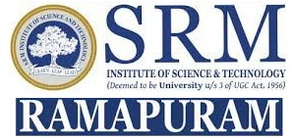
SRM INSTITUTE OF SCIENCE AND TECHNOLOGY Ramapuram, Chennai – 600 089 DEPARTMENT OF COMPUTER SCIENCE AND ENGINEERING
18CSP107L-MINOR PROJECT
Resume Screening using Machine Learning and Natural Language Processing
BATCH NUMBER :AI_A2
Team Members | Supervisor
Konduru Sri Abhinaya (RA2111026020030) L Shasank Chowdary (RA2111026020036) Charanya R (RA2111026020047) | Ms. Angeline R, AP/CSE

Slide 2
Agenda
Abstract
Literature survey
Scope and Motivation
Objectives
Novel idea
Block diagram of proposed system
Tools to be used
Applications
References (Base paper to be included)

Slide 3
ABSTRACT
In today's competitive job market, organizations face the challenge of efficiently screening a large volume of resumes to identify the most qualified candidates for job openings.
Manual screening of resumes is a laborious and time-consuming process that often leads to inefficiencies and biases in candidate selection.
This project addresses these challenges by leveraging machine learning and natural language processing techniques to develop an automated resume screening system.
The significance of the project lies in its potential to revolutionize the recruitment process, making it more efficient, objective, and scalable.
By automating tedious tasks associated with resume screening, organizations can focus their resources on evaluating top candidates, leading to better hiring decisions and improved organizational performance.

Slide 4
LITERATURE SURVEY
TITLE & YEAR | AUTHOR | METHODOLOGY | CONCLUSION
Resume Shortlisting Using NLP(2024) | Dr. Ambareesh S, Nikhil Kumar Thakur, Ujjwal Bhattarai, Saurav Kumar Yadav, Jay Nath Thakur, Amrit Kumar Mahato | The core steps in the system include parsing resume to text, performing NLP creating a NER model and using NER model to calculate P, R and F score to generate final score to sort resume based on final score. | Natural Language processing (NLP) based resume shortlisting research has shown great potential for accelerating the hiring process.
Resume Ranking and Shortlisting with DistilBERT and XLM(2024) | Anuska Mukherjee, Umme Salma M | It utilizes distilBERT model and the XLM (Cross-lingual Language Model). To refine our approach further, two types of metrics for resume ranking, such as Cosine similarity score and Spatial Euclidean distance, are used, and the results are compared | It has a test accuracy of 95%

Slide 5
LITERATURE SURVEY
TITLE & YEAR | AUTHOR | METHODOLOGY | CONCLUSION
Resume Classification Using ML Techniques(2023) | B.Surendiran, Tejus Paturu, Harsha Vardhan Chirumamilla, Maruprolu Naga Raju Reddy | To find the best possible solution, different ML techniques like Decision Tree, Random Forest, KNN, Support Vector are researched and the most accurate one is chosen. | Random forest classifiers gave the highest accuracy (91%).
Resume Screening–Testing For Data Stability(2024) | Asim Wahedna, Adit Vakil, Somil Shah, Vishakha V. Kelkar and Ishan Shrivastava | NLP techniques used for resume parsing, such as Named Entity Recognition, along with the various machine learning algorithms used for screening resumes, such as cosine similarity. | This model provides upto 74%.

Slide 6
LITERATURE SURVEY
TITLE & YEAR | AUTHOR | METHODOLOGY | CONCLUSION
Resume Classification using Elite Bag-of-Words Approach(2023) | Muskan Sharma, Gargi Choudhary, Seba Susan | It utilizes a recently introduced text vectorization technique called Elite bag-of-words for the vectorization of resumes. To implement this method, words in each class are ranked based on their occurring frequency and then applied max entropy partitioning (MEP) to derive the top-ranked significant keywords in each class. | The best performing was observed to be the elite key words which gave highest test accuracy of 62.6%.
2Q-Learning Scheme for Resume Screening(2023) | Bhoomika SP, Likhitha S, Chandana H S, Kavya S A, Bhargavi K | This paper uses a 2Q-Learning-based approach enriched with natural language processing capability to accurately evaluate resumes. The 2Q-Learning approach involves the selection or rejection of resumes by comparing the resume with the skills or requirements mentioned in the job description by recruiter. | Accuracy: 72%

Slide 7
LITERATURE SURVEY
TITLE & YEAR | AUTHOR | METHODOLOGY | CONCLUSION
Automated Resume Screener using Natural Language Processing(NLP)(2022) | Tumula Mani Harsha,Gangaraju Sai Moukthika, Dudipalli Siva Sai, Mannuru Naga Rajeswari Pravallika, Satish Anamalamudi, MuraliKrishna Enduri | This paper discusses about one such process which is very efficient in performing Resume screening. It includes Natural Language Processing (NLP), an automated Machine Learning Algorithm for screening the resumes. | A user interface was developed.
Resume Screening using NLP and LSTM(2022) | S Bharadwaj, Rudra Varun2, Potukuchi Sreeram Aditya, Macherla Nikhil, G.Charles Babu | This project intends to develop an application that will categorize CVs according to the skills they contain into various job options. This system worked on NLP and LSTM. | In the future, it can be upgraded such that the system does 90% of the selection process of resumes.

Slide 8
LITERATURE SURVEY
TITLE & YEAR | AUTHOR | METHODOLOGY | CONCLUSION
Screening and Ranking Resumes using Stacked Model(2021) | Rasika Ransing, Akshaya Mohan | This system makes use of Machine Learning algorithms such as KNN, Linear SVC, and XGBoost. | Accuracy: Linear SVC: 83% KNN : 72% XG Boost: 85%
Resume Scanning and Emotion Recognition System based on Machine Learning Algorithms(2020) | Vishruth R G, Sunitha R, Varuna K S, Varshini N, Prasad B Honnavalli | This project comprises three modules: Resume scanning, Chatbot implementation, and Emotion Recognition | 66% accuracy of prediction efficiency was accomplished.

Slide 9
SCOPE AND MOTIVATION
The scope of this project includes the development of a scalable and robust resume screening system capable of handling diverse resume formats and categories.
The system will utilize state-of-the-art machine learning models trained on a labeled dataset of resumes to perform accurate classification.
The system will be designed to process and analyze resumes submitted for job openings, categorizing them based on predefined criteria such as skills, experience, and qualifications.

Slide 10
OBJECTIVES
The primary objective of this project is to develop an automated resume screening system using machine learning and natural language processing (NLP) techniques.
The system aims to streamline the recruitment process by:
Automating the screening of resumes submitted for job openings.
Extracting relevant features from resumes, such as skills and experience.
Categorizing resumes into predefined classes or categories based on extracted features.
Providing an intuitive user interface for recruiters to interact with the system.

Slide 11
NOVEL IDEA
A novel idea for the project could be to incorporate a self-learning mechanism into the automated resume screening system.
The novel idea of this project is to address the limitations of the existing system by automating the resume screening process using machine learning and NLP techniques.
By leveraging advanced algorithms and models, the system will analyze and classify resumes accurately, enabling recruiters to focus their efforts on evaluating top candidates.
Advantages:
Improved recruitment efficiency
Reduced manual effort and labor costs
Objective and consistent screening process
Scalable and capable of handling large volumes of resumes
Enhanced candidate selection based on predefined criteria

Slide 12
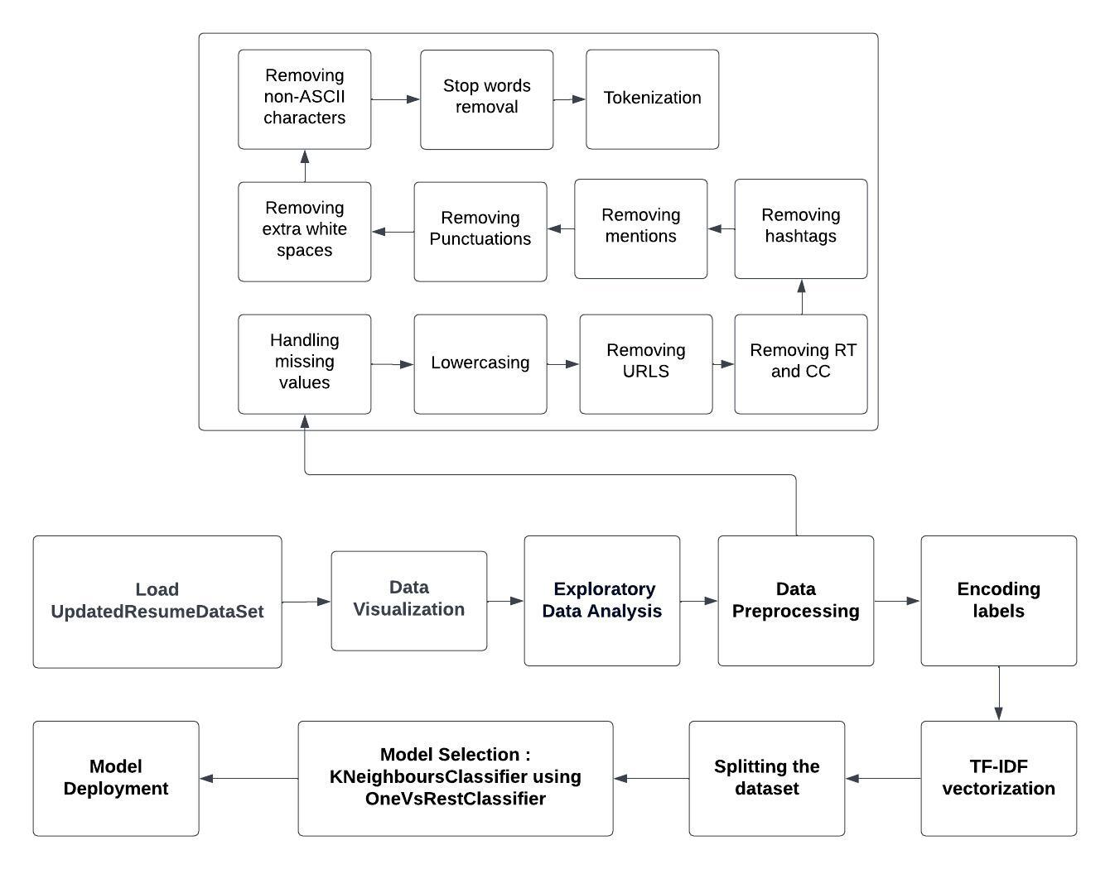
BLOCK DIAGRAM OF THE PROPOSED SYSTEM

Slide 13
TOOLS TO BE USED
Python: The primary programming language used for data manipulation, analysis, and machine learning model implementation.
Libraries Used:
Pandas: A Python library for data manipulation and analysis, used for loading, preprocessing, and analyzing the resume dataset.
NumPy: A Python library for numerical computing, used for handling arrays and matrices, particularly for operations related to machine learning models.
Matplotlib: A Python library for creating static, interactive, and animated visualizations, used for data visualization, such as plotting histograms and countplots.
Scikit-learn (sklearn): A machine learning library in Python, used for implementing various machine learning algorithms, preprocessing techniques, and model evaluation metrics.

Slide 14
Regular Expressions (re): A module in Python used for pattern matching and text manipulation, particularly for cleaning and preprocessing text data.
TfidfVectorizer: A class in the scikit-learn library used for converting text documents to numerical feature vectors using the TF-IDF (Term Frequency-Inverse Document Frequency) weighting scheme.
KNeighborsClassifier: A class in the scikit-learn library used for implementing the K-Nearest Neighbors algorithm, particularly for classification tasks.
Seaborn: A Python data visualization library based on Matplotlib, used for creating more visually appealing and informative statistical graphics.
NLTK: Natural Language Toolkit is a Python library used for natural language processing tasks such as tokenization, parsing, and sentiment analysis.
Wordcloud: A word cloud is a visual representation of text data where the size of each word corresponds to its frequency in the given text.

Slide 15
APPLICATIONS
The automated resume screening project has several potential applications across various industries and sectors. Here are some key applications:
Recruitment and HR Management
Job Portals and Recruitment Platforms
Talent Acquisition and Talent Management
High-Volume Recruitment
Internship and Entry-Level Hiring
Freelance Hiring
Government and Public Sector Recruitment

Slide 16
References
[1] B.Surendiran, Tejus Paturu, Harsha Vardhan Chirumamilla, Maruprolu Naga Raju Reddy. Resume Classification Using ML Techniques, 2023.
[2] Anuska Mukherjee, Umme Salma M. Resume Ranking and Shortlisting with DistilBERT and XLM, 2024.
[3] Asim Wahedna, Adit Vakil, Somil Shah, Vishakha V. Kelkar and Ishan Shrivastava. Resume Screening–Testing For Data Stability, 2024.
[4] Dr. Ambareesh S, Nikhil Kumar Thakur, Ujjwal Bhattarai, Saurav Kumar Yadav, Jay Nath Thakur, Amrit Kumar Mahato. Resume Shortlisting Using NLP, 2024.
[5] Muskan Sharma, Gargi Choudhary, Seba Susan. Resume Classification using Elite Bag-of-Words Approach, 2023.
[6] Bhoomika SP, Likhitha S, Chandana H S, Kavya S A, Bhargavi K. 2Q-Learning Scheme for Resume Screening, 2023.
[7] Tumula Mani Harsha,Gangaraju Sai Moukthika, Dudipalli Siva Sai, Mannuru Naga Rajeswari Pravallika, Satish Anamalamudi, MuraliKrishna Enduri. Automated Resume Screener using Natural Language Processing(NLP), 2022.
[8] S Bharadwaj, Rudra Varun2, Potukuchi Sreeram Aditya, Macherla Nikhil, G.Charles Babu. Resume Screening using NLP and LSTM, 2022.
[9] Rasika Ransing, Akshaya Mohan. Screening and Ranking Resumes using Stacked Model, 2021.
[10] Vishruth R G, Sunitha R, Varuna K S, Varshini N, Prasad B Honnavalli. Resume Scanning and Emotion Recognition System based on Machine Learning Algorithms, 2020.
[11] Sujit Amin, Nikita Jayakar, Sonia Sunny, Pheba Babu, M.Kiruthika, Ambarish Gurjar. Web Application for Screening Resume, 2019.

Slide 17
References
[12] Rishabh Bathija et al. SVM, Weighted KNN, and KNN are compared for resume screening, 2023.
[13] M.F.Mridha, et al. Evaluation Job Overviews: Using CNN and ML, 2021.
[14] Rajath V , Riza Tanaz Fareed , Sharadadevi Kaganurmath. Resume Classification and Ranking using KNN and Cosine Similarity, 2021.
[15] Tejaswini K, Umadevi V, Shashank M Kadiwal, Sanjay Revanna. Design and development of machine learning based resume ranking system, 2022.
[16] Prasanna Parasurama and João Sedoc. Gendered Information in Resumes and its Role in Algorithmic and Human Hiring Bias. Proceedings, 2022.
[17] Suhas. H. E and Manjunath. A E. Differential Hiring using a Combination of NER and Word Embedding, 2020.
[18] Pradeep Kumar Roy, Sarabjeet Singh Chowdhary, Rocky Bhatia. A Machine Learning approach for automation of Resume Recommendation system, 2020.
[19] Bhushan Kinge, Shrinivas Mandhare, Pranali Chavan, S. M. Chaware, Resume Screening using Machine Learning and NLP: A proposed System, 2022.
[20] D. Jagan Mohan Reddy, S. Regella and S. R. Seelam. Recruitment Prediction using Machine Learning, 2020.

