Slide 1
Large Multimedia File Transfer
(Project no - 2)
Advanced Computer Networks
CSN-503

Slide 2
Group - 8
Group Members :-
Bhanu Pratap - 17114019
Sasi Kiran Bhimavarapu - 17114021
Goddu Vishal - 17114034
Jaynil Jaiswal - 17114040
Ommi Akash - 17114053
Shashank Kashyap - 17114070
Vishnuteja - 17114031

Slide 3
Introduction
Problem Statement : Develop an application which can share large-sized multimedia files transfer between two nodes on the same network using socket programming. Further optimize the application using multithreading to run faster for larger files.
Why use Multithreading over Single threading ?
Perform quantitative analysis on the impact of multithreading in the file transfer.

Slide 4
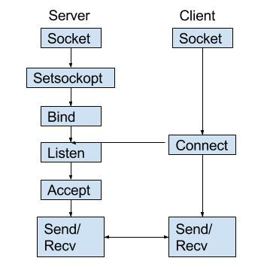
Socket Programming

Slide 5
Socket Programming
BIND - This method is used to bind server to a specific ip address and port, this enables server to ‘listen’ to request on this pair of ip address and port number.
LISTEN - This method marks the socket as a passive socket, i.e., it will be used to accept incoming request over binded ip-address and port.
ACCEPT - This method is used by a server to accept a connection request from a client. When a connection is available, the socket created is ready for use to read data from the process that requested the connection.

Slide 6
Socket Programming
CONNECT - This method is used by the client to connect to the already listening server, this attempts to establish a connection between two sockets.
SEND - This is a low-level method, basically a syscall. It can send less no. of bytes than requested but returns the no. of bytes sent.
SENDALL - This is a high-level Python-only method that sends the entire buffer you pass or throws an exception. We are using this since we are using blocking sockets.
RECV - This method is used to receive a specific amount of bytes of data. Used by both client and server.

Slide 7
Multithreading
Multithreading is basically the process of splitting a task into multiple parallel tasks and each parallel task is run on its own thread.
The advantage of multithreading is fragmenting our primary task into smaller subtasks that can be run parallely, which results in considerable decrease in the processing time.
Similarly, in our implementation each thread transfers a chunk of data from the client to the server and once all the data has been received by the server it merges these chunks and put together our received media.
So usually increasing the threads results in increase in performance, but context-switch-overhead, which also increases with increasing threads, limits the multithreading.

Slide 8
Thread in Python
Python has a ‘Thread’ class which represents an activity that is run in a separate thread of control.
__init__() is invoked when a thread object is created.
This thread’s activity is started by calling start() method of Thread class.
This invokes the run() method in a separate thread of control.
join() method where other threads can call a thread’s join() method. This blocks the calling thread until the thread whose join() method is called is terminated.

Slide 9
Explaining the code

Slide 10
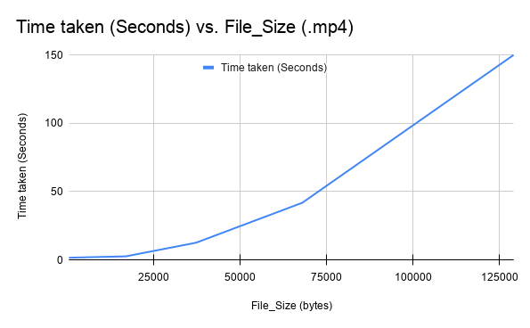
Analysis
Time(seconds) vs File Size(bytes)

Slide 11
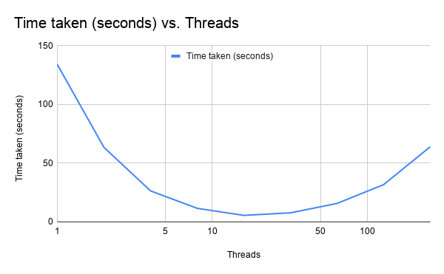
Analysis
Time(seconds) vs # of Threads

Slide 12
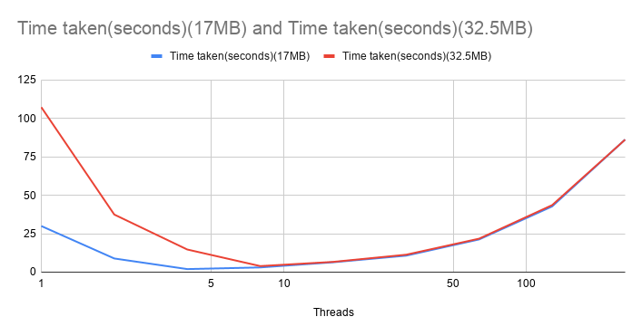
Analysis
Time taken (36.4MB) vs Time taken (17MB)

Slide 13
Thank You

