Slide 1
Bootstrapping Implementation
April 4, 2016

Slide 2
Bootstrapping – Quick Review
Scoring
Candidate Patterns
Candidate Patterns +
Scores
Promote
Patterns
Corpus
Search
Relations
Entity Labeled
Docs
Patterns
Corpus
Search
Promote Entities
Candidate
Relations + Scores
Candidate Relations
Scoring

Slide 3

Bootstrapping – Quick Review Now with User Feedback
Scoring
Candidate Patterns
Candidate Patterns +
Scores
Promote
Patterns
Corpus
Search
Relations
Entity Labeled
Docs
Patterns
Corpus
Search
Promote Entities
Candidate
Relations + Scores
Candidate Relations
Scoring
I can help with entities too!!

Slide 4
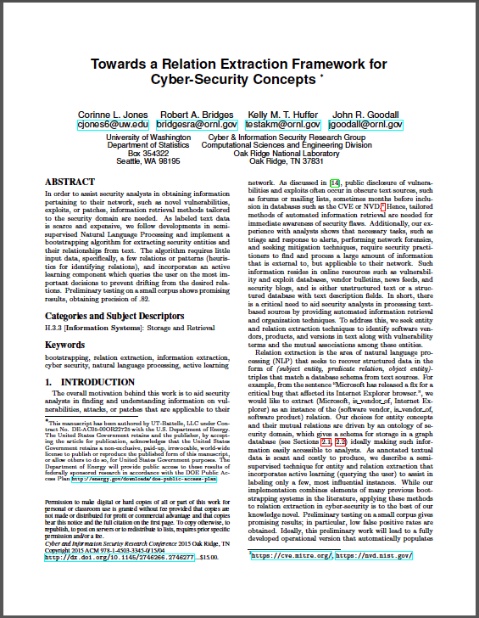
Bootstrapping – Quick Review
We wrote a short paper for CISRC 2015 on cyber relation bootstrapping
And won Runner-Up Best Short Paper

Slide 5
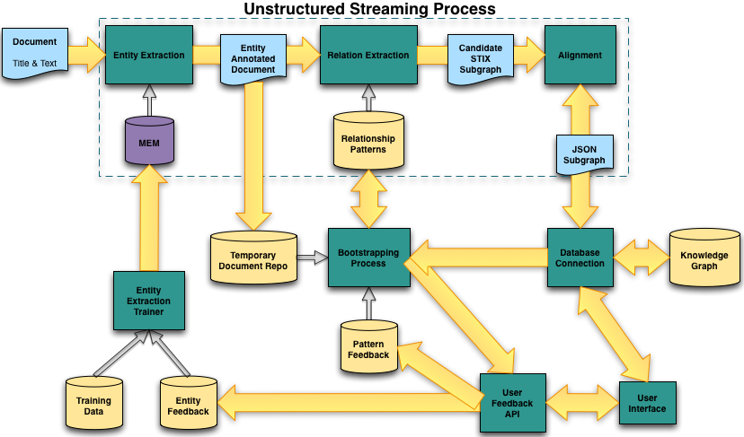
Overview
5

Slide 6
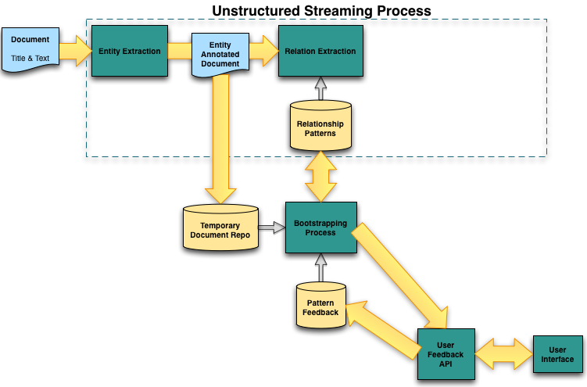
Bootstrapping
6

Slide 7
Bootstrapping
Entity extraction process annotates document with cyber labels
Document is passed to relation extraction in streaming process & stored in a temporary repository
Bootstrapping is offline process that utilizes the documents in the temporary repo
7

Slide 8
User Feedback
Scores of candidate patterns determine what to ask user
Query user on relationships
Is hasVulnerability a relationship between Internet Explorer & cross-site scripting?
Query user on entities
Is Microsoft a software vendor?
8

Slide 9
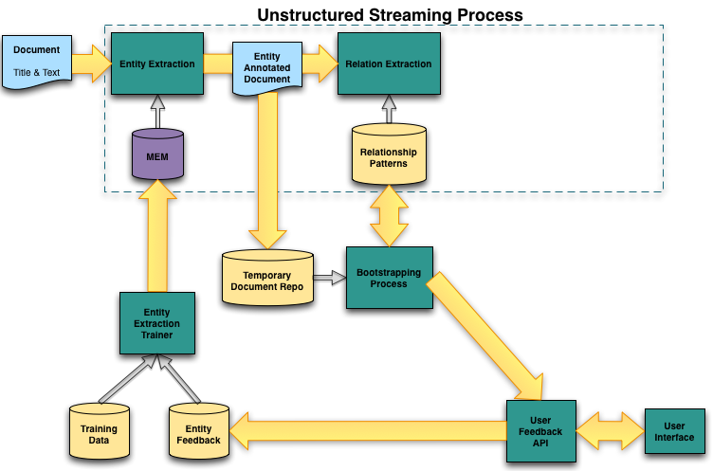
User Feedback
9

Slide 10
Questions?
10

