Slide 1
A Bootstrapping Approach for Extracting Cyber-Security Entities & Relations
Stucco, September 2014
Robert A. Bridges, PhD

Slide 2
Previous Stucco-NLP Work
Began with Entity Extraction
Goal Identify and Classify Entities in text
Two Approaches
Supervised Learning - MEM / Averaged Perceptron
Semi-Supervised Learning – PACE Bootstrapping

Slide 3
Previous Stucco-NLP Work
Supervised Approach (Bobby & Corinne)
Auto-labeled NVD, MS-Bulletin, Metasploit
Gazetteer look-ups (match strings in text)
From structured information
From relevant terms list (hand assembled)
Heuristics (patterns for identifying entities)
Auto-labeled corpus used as training data for MEM
Results:
Exhibited surprisingly good accuracy when trained and tested on NVD text
Precision, Recall, Accuracy all above 97%
Need better results on dissimilar text
Aliases aren’t identifiable
Notes:
Method works really well in the presence of lots of training data, but
1. Not portable to different writing styles
2. Can’t identify aliases
e.g. I.E. and IE and Internet Explorer

Slide 4
New Supervised Learning Research
Varied the training data
Contacted Joshi et. al authors (UMBC)
They shared a small hand labeled corpus
Similar entities labeled
Has a few blogs labeled!
Also CVE descriptions, MS Bulletin Descriptions
Retrained on Mixed Training Set (Kelly)
Tested on 10 labeled security blogs

Slide 5
New Supervised Learning Research (Kelly)
Test 1 Training Set
50 out of 15,192 auto-labeled NVD entries
50 out of 256 auto-labeled Microsoft Security Bulletins
50 out of 356 auto-labeled Metasploit entries
Test 2 Training Set (added some of Joshi et al.’s docs)
Training Set 1 Plus:
20 Adobe Security Bulletins
20 security blog posts
58 CVE entries
50 Microsoft Security Bulletins
Testing Set
10 security blogs

Slide 6
New Supervised Learning Research
Results
F1 = Harmonic Average (P,R) = =
 | Precision | Recall | F1 | Accuracy - % of testing set labeled
Test 1 | 0.3663 | 0.4791 | 0.4152 | 0.9386 - 0.9520 = -0.0134
Test 2 | 0.6795 | 0.5300 | 0.5955 | 0.9751 - 0.9640 = 0.0111

Slide 7
Semi-Supervised Learning (Bootstrapping)
Goal is to proto-type a bootstrapping algorithm for relation extraction
Relation
A triple [(entity_1, entity_type_1) , predicate, (entity_2, entity_type_2)]
Example - [ (Microsoft, SW_vendor), is_vendor, (Internet Explorer, SW_product)]
Entity types and relationships match the ontology
Patterns
A heuristic or rule that identifies a relation
Example sentence:
“Microsoft’s Internet Explorer browser versions 7 & 8 …”
Example pattern for in_vendor relation:
[SW_vendor , “ ’s ”, SW_product]

Slide 8
Previous Stucco-NLP Work: Bootstrapping Bootstrapping Main Idea
Scoring
Candidate Patterns
Candidate Patterns +
Scores
Promote
Patterns
Corpus
Search
Entities
Docs
Patterns
Corpus
Search
Promote Entities
Candidate
Entities + Scores
Candidate Entities
Scoring

Slide 9
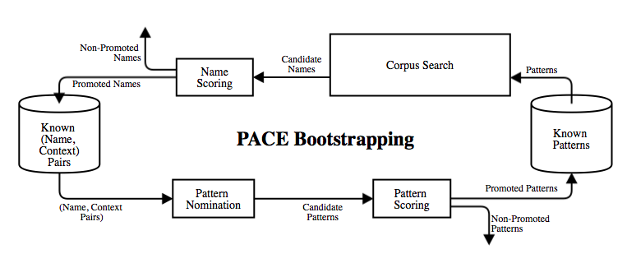
Previous Stucco-NLP Work
PACE Bootstrapping (Bobby, Nikki, Mike)
Input:
Corpus of documents
Seed Patterns (Heuristics for learning entities)
Seed Entities

Slide 10
Previous Stucco-NLP Work
PACE Bootstrapping (Bobby & Nikki)
Input:
Corpus of documents
Seed Patterns (heuristics for identifying entities)
Seed Entities
Output
List of Patterns
List of Entities
Novel Ideas:
Store context with entities
More stringent pattern nomination
patterns nominated by comparing context
Omits one corpus search
Cost: changes the scoring method

Slide 11
Goal: Bootstrapping for Relation Extraction
Prototype algorithm that extracts relations and entities
[(entitiy1, entity_type1), relation, (entity2, entity_type2)]
Strengthen Entity Extraction through this process
Supervised approach struggles to identify aliases “IE”, “Internet Explorer”
Incorporate constraints from ontology into the learning process
See [Carlson et al. “Coupled Semi-Supervised …” 2010]
Include a user interactive component (active learning)
See [Jones et al. “Learning to Extract ..” 2005] & [Carlson et al. “Active Learning ..” 2010]
Adds parse tree patterns
Discards irrelevant documents before “too much” processing
Stores context with known instances for pattern nomination (like PACE)

Slide 12
Bootstrapping Preprocessing
World Wide Web
KrebsOnSecurity.com
Stanford.edu
Team-Cymru.org
Freebase.com
Core NLP
Entity List
(with aliases)
Core NLP
Goose
Docs
Docs
-Tokenized
-POS-tagged
Docs
-Tokenized
-POS-tagged
-Entities Labeled
Relevant Docs
-Tokenized
-POS-tagged
-Entities Labeled
Relevant Docs
-Tokenized
-POS-tagged
-Entities Labeled
-Parse Trees
URL
List
Auto-Labeling
Heuristics
Logistic Regression

Slide 13
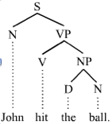
NLP Concept: Parse Tree
Parse Tree:
Example
(S,[ N(John), VP( V[hit], NP[D(the),N(ball) ] ) ] )
By definition, there is a unique path between two nodes in a tree.
Gives a pattern for identifying relationships by the path between entities:
Example parse tree path:
[John, N, S, VP, NP, N, ball]
Notes:
Way to map a sentence a tree (graph theory) that represents the dependencies and syntactic structure.

Slide 14
Bootstrapping Details: Documents
62 news articles, blogs, and updates from
Security Intelligence
Computer World
Threat Post
Microsoft Bulletin
Krebs on Security
Schreier’s Blog
Ars Technica
Malware Bytes
And others

Slide 15
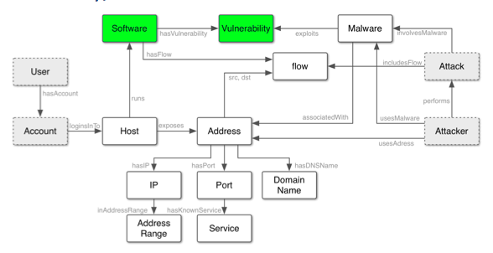
Bootstrapping Details: Relations
We target the Software & Vulnerability nodes of the ontology.
Relations
Vendor_of
Version_of
Not_version_of
CVE_ID_of_software
CVE_ID_relevant_term
MS_ID_of_software
MS_ID_relevant_term
Relevant_term_of_software
Software_symbol

Slide 16
Bootstrapping Details: Patterns
Type 1 – Words / Parts-of-speech between entities
[entity_type_1, word_1, …, word_n, entity_type_2]
[entity_type_1, POS_1, …, POS_n, entity_type_2]
Type 2 - Contiguous words between entities
[entity_type_1, * , (word_1, … , word_n), *, entity_type_2]
[entity_type_1, * , (POS_1, … , POS_n), *, entity_type_2]
Type 3 – Parse Tree Paths
[entity_type_1, path-through-parse-tree, entity_type_2]

Slide 17
Bootstrapping Details: Scoring
Scoring from Basilisk Method
denotes number of unique promoted relations identified by
denotes the number of unique occurrences of
Main Idea: Patterns that match lots of known relations, but don’t occur elsewhere get high scores
is the number of patterns matching
Main Idea: Relations nominated by patterns that have a high success rate get the highest score
See [Riloff et al., “A Bootstrapping…” 2002] & [& Carlson et al. “Active learning…” 2010]
Notes:
Patterns get high score if they 1. promote a lot of known relations, and 2. only occur w/ promoted relations – this weeds out common phrases that occur a lot,
Relations get a high score not by being identified by a lot of patterns, but by being identified by patterns that match many other relations.

Slide 18
Bootstrapping Details: Active Learning User Query
After scoring, the top N-percentile of candidates is presented to the user.
N is a pre-specified input
“Yes” or “No” Question
Answers increase / decrease the candidates score by 1000
Any candidates with score greater then α (pre-set threshold) are promoted.
Notice: the highest scoring patterns are the ones that will nominated the most relations, so these are the ones to have the user validate.

Slide 19
Active Learning User Query Example
Is the following pattern valid for the given pattern type? Type 'y' for 'yes', 'n' for 'no', or 'd' for 'don't know'.
Pattern type: VENDOR_OF
Pattern: NNP NP NP NP NNP (parse tree path)
The following relations were extracted by this pattern:
Microsoft SharePoint
Microsoft Excel
Microsoft Word
Adobe Flash
Adobe Shockwave
Adobe Acrobat

Slide 20
Bootstrapping Idea
Scoring
Candidate Patterns +
Scores
Candidate Patterns
Promote
Patterns
Corpus
Search
Relations
Docs
Patterns
Corpus
Search
Promote Relations
Candidate
Relations + Scores
Candidate
Relations
Scoring

Slide 21

Bootstrapping Implementation
Corpus Search + Scoring
Candidate Patterns
Corpus Search
Candidate Patterns +
Scores
Candidate
Pattern Instances
Relations
Docs
Entities Labeled
Promote Relations
Candidate Patterns +
Updated
Scores
Candidate Pattern Instances
Candidate
Relations + Scores
New
Entities Labeled
Promote
Patterns
Candidate
Relations + Scores
Patterns
Filter Pattern Instances & Nominate Relations
Candidate Pattern Instances

Slide 22
Bootstrapping for Relation Extraction (Corinne)
✔Prototype algorithm that extracts relations and entities
[(entitiy1, entity_type1), relation, (entity2, entity_type2)]
Examples
[ (Microsoft, SW_vendor), is_vendor, (Internet Explorer, SW_product)]
✔Identifies and disambiguates alternate aliases
For example, “IE”, “Internet Explorer”
✔Incorporates constraints from ontology into the learning process
✔Includes an user interactive component (active learning)
✔Has a relevance classifier for documents
✔Adds parse tree patterns
✔Stores context with known instances for pattern nomination (like PACE)

Slide 23
Next Steps
Need to test Entity Extraction accuracy from Corinne’s Bootstrapping
Corinne’s Bootstrapping performs entity extraction by matching
Lists of entities from Freebase
Heuristics from our Auto-labeling work
Need to incorporate the previous entity extraction with this bootstrapping approach.
Need to incorporate bootstrapping into the Stucco pipeline
Perform User Study
Record accuracy and performance (time to finish) of relation extraction by
User alone
User interacting with bootstrapping
Bootstrapping alone
Publish

Slide 24
Questions?
Robert A. Bridges
bridgesra@ornl.gov

Slide 25
Preprocessing Components
Goose – Open source tool for grabbing text from a URL
CoreNLP – Stanford’s open source NLP software
Tokenize – programmatically identify word boundaries, sentence boundaries
Part-of-speech tags applied
Parse Tree – a tree representing the sentence’s dependencies and syntactic structure
Freebase – Open knowledge base
Includes software products, vendors & aliases
Used for entity identification
Logistic Regression – Machine Learning Classifier
Input: # of entities in a document
Output: binary (relevant or non-relevant)
Used for relevancy classification

Slide 26
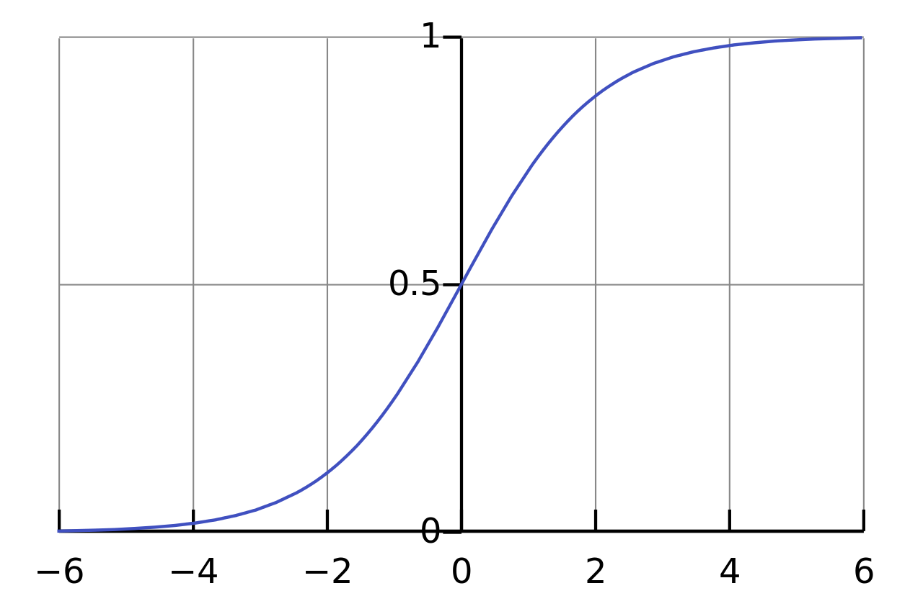
Logistic Regression
Training data
feature vector, with binary label
Cost Function
Minimize cost to learn weights,
New data , then interpreted as probability the label is 1.
Fix a threshold,
Label 1 if
Logistic Function

Slide 27
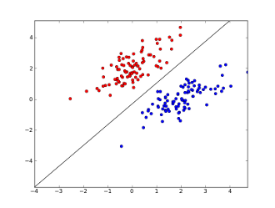
Logistic Regression
Training data
feature vector, with binary label
Cost Function
Minimize cost to learn weights,
New data , then interpreted as probability the label is 1.
Fix a threshold,
Label 1 if
Linear Decision Boundary

