Slide 1
Future Work in Natural Language Processing
April 4, 2016

Slide 2
Bootstrapping – Quick Review
Scoring
Candidate Patterns
Candidate Patterns +
Scores
Promote
Patterns
Corpus
Search
Relations
Entity Labeled
Docs
Patterns
Corpus
Search
Promote Entities
Candidate
Relations + Scores
Candidate Relations
Scoring

Slide 3

Bootstrapping – Quick Review Now with User Feedback
Scoring
Candidate Patterns
Candidate Patterns +
Scores
Promote
Patterns
Corpus
Search
Relations
Entity Labeled
Docs
Patterns
Corpus
Search
Promote Entities
Candidate
Relations + Scores
Candidate Relations
Scoring
I can help with entities too!!

Slide 4
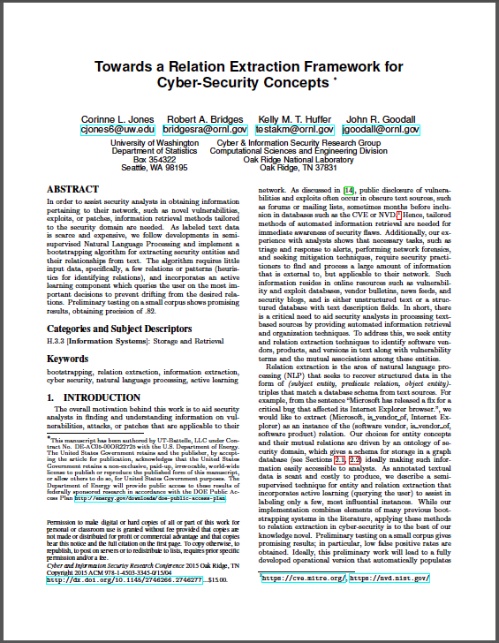
Bootstrapping – Quick Review
We wrote a short paper for CISRC 2015 on cyber relation bootstrapping
And won Runner-Up Best Short Paper

Slide 5
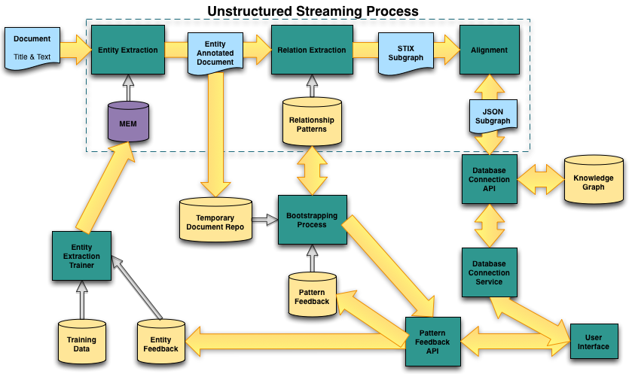
Overview
5

Slide 6
Bootstrapping
Entity extraction process annotates document with cyber labels
Document is passed to relation extraction in streaming process & stored in a temporary repository
Bootstrapping is offline process that utilizes the documents in the temporary repo
6

Slide 7
User Feedback
Pattern/relation scores and threshold determines what to ask user
Query user on relationships
Is Microsoft software_vendor_of Windows?
Query user on entities
Is Microsoft a software_vendor?
7

Slide 8
User Feedback
Relationship responses are stored, then added to set of patterns used by streaming pipeline
Entity responses are stored, then used with the training data as periodic retraining of the averaged perceptron
8

Slide 9
Questions?
9

