Slide 1
PACE: Pattern Accurate Computationally Efficient Bootstrapping
Bootstrapping for Timely Discovery of Cyber-Security Concepts
Robert A. Bridges & Nikki McNeil
Co-authors: Mike Iannacone, Bogdan Czejdo, Nick Perez, John Goodall
Acknowledgement
This project is funded by the U.S. Department of Homeland Security (DHS) Science & Technology Directorate, the Dutch National Cyber Security Centre, and the Defence Research and Development Canada (DRDC) pursuant to the Agreement between the Government of the United States of America and the Government of Canada for Cooperation in Science and Technology for Critical Infrastructure Protection and Border Security. DHS sponsored the production of this material under DOE Contract Number DE-AC05-00OR22725 for the management and operation of Oak Ridge National Laboratory. This material represents the position of the authors and not necessarily that of the sponsors.
Notes:
ORNL, UMBC, summer internship, PACE – bootstrapping technique for entity extraction - NLP

Slide 2
Motivation (Big Picture / Overall Goal)
Situational awareness for network security
Understand everything in an environment necessary for critical decision making.
Endogenous Data (internal to the network e.g. log files, software configuration)
Exogenous Data (external to the network, mainly on web e.g. blacklists, vulnerability databases, exploits)
Approach (Big Picture / Overall Goal)
STUCCO Project
Populate a graph database to Gather, Correlate, and later Display necessary data

Slide 3
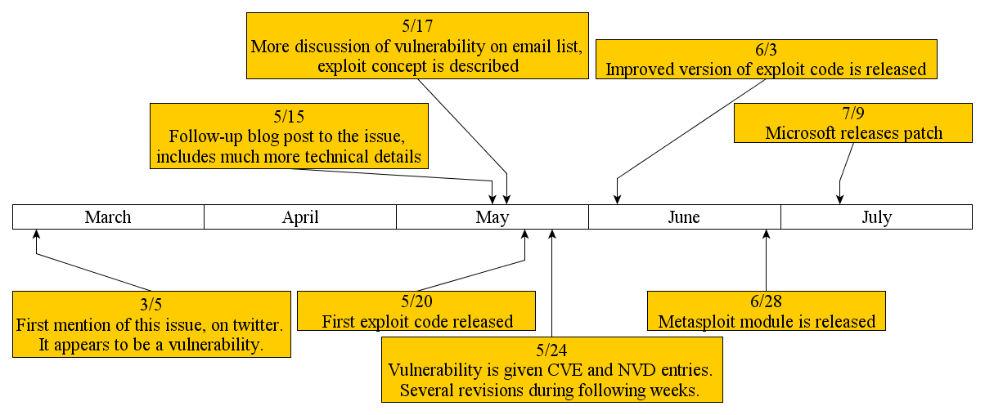
Need: Natural Language Processing in Cyber Security
Timely cyber-security info often appears in text first
Motivating Example
Disclosure of a vulnerability and exploit

Slide 4
Approach: Current Work = Entity Extraction
Goal: identify and classify concepts referenced in text
Software Names, Vendors, Versions
(Windows, Safari, Apple, 1.2.1 …)
Vulnerabilities and effects
(XSS, Privileged Escalation, Remote Code Execution, … )
Exploits / Malware
Supervised Learning
Constrained by availability of annotated data
Semi-Supervised Learning (Bootstrapping)
Use a small set of known examples and heuristics to iteratively learn more

Slide 5
General NLP Bootstrapping
Initialization:
Entity Instances
Example Instance: “Abraham Lincoln”, President
Example Instance: “Privilege Escalation”, Vulnerability Potential Effect
Patterns = Heuristics for identifying instances of an entity
Example Pattern: “_____ was inaugurated” is a pattern for identifying President Names.
Example Pattern: “allow attacker to _____” is a pattern for identifying Vulnerability Potential Effects
Corpus
Un-annotated,
Traditionally very large (millions of documents)

Slide 6
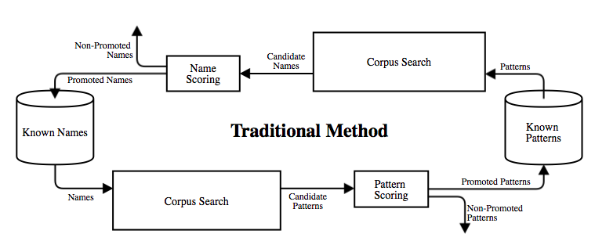
General NLP Bootstrapping

Slide 7
Common Limitations of Bootstrapping
Drift
Learning spurious results gives compounding errors
Common Mitigations
Very Restrictive Pattern Nomination
Extremely Large Corpus
Brin (’98)- 5 million documents (cut from 24 million for time constraints)
Agichtein et al (’00) More than 300,000
Pantel et al (‘04) More than 15 GB
Carlson (’10 a) 1 million webpages + 5 billion sentences from 500 million webpages

Slide 8
PACE: Pattern Accurate Computationally Efficient Bootstrapping
Store [Entity, Context] – pairs (rather than just entities)
Context is a 5 word prefix and 5 word suffix
Example
Sentence: “The 16th President of the United States, Abraham Lincoln, led the Union to victory in the Civil War.”
Context Prefix = “16th president of the United States”
Entity = “Abraham Lincoln”
Context Suffix = “led the Union to victory”
Example
Sentence: “… that could allow attackers to inject arbitrary code and execute rogue commands on…”
Context Prefix = “that could allow attackers to”
Entity = “inject arbitrary code”
Context Suffix = “and execute rogue commands on”

Slide 9
PACE Pattern Nomination
Compare two [Entity, Context] – pairs.
Create patterns from the longest matching prefix, suffix, or entity strings.
Example:
Gives new pattern: “allows attacker to _____ ”
Prefix | Vuln. Effect Entity | Suffix
could possibly allow attacker to | gain privilege escalation | by borrowing techniques from other
that would allow attacker to | execute rogue commands | on a DHCP server or

Slide 10
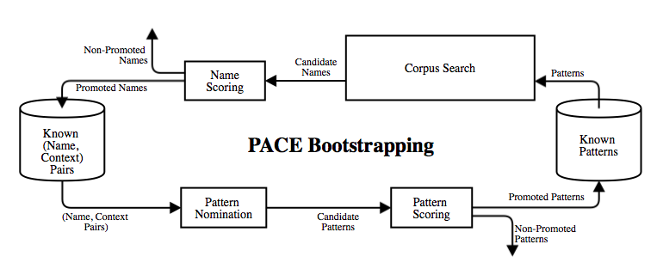
PACE Bootstrapping
Input
[Entity, Context] – pairs (rather than just entities)
Patterns
Corpus

Slide 11
PACE Scoring
Basilisk Scoring is used. Research (Carlson et.al. ‘10) shows Basilisk is best.
Entity Scoring:
Candidate Entity
Let be the patterns
matching a given candidate
entity and the number
known entities previously
matched.
Score( ) =
Pattern Scoring
Candidate Pattern
Score is the number of times
the pattern appeared in the
[Entity, Context] - pairs

Slide 12
Preliminary PACE Test
NLTK used for tokenization, stemming, omitting stopwords
Seed [Entity, Context]-Pairs and Patterns manually extracted from 10 documents (news articles, forums, blogs)
Four entity types are identified:
Exploit Effect
Software Name
Vulnerability Potential Effect
Vulnerability Category
Corpus of 7 different news articles
Bootstrapping iterated until nothing extracted (6 cycles)

Slide 13
PACE Results
Entities
21 entity name phrases learned
19 accurate
2 inaccurate
Patterns
23 patterns learned
3 extracted inaccurate entities (too general)
14 accurate but learned no new entities (too specific / corpus too small)
6 were both accurate and succeeded in finding new entities
Precision = .90
Recall = .12
We need more seeds!

Slide 14
PACE vs Brin Pattern Test
Previous bootstrapping methods relied on a large corpus with very restrictive patterns
Our hope is the new pattern nomination from known [Entity, Context]-Pairs will facilitate greater recall and smaller corpora via less stringent but more accurate pattern nomination
To test this, we employed one of Brin’s restrictions on pattern nomination:
Patterns must only occur with one entity name per document to be nominated.
The same test yielded no learned results

Slide 15
PACE Advantages & Differences
More accurate pattern nomination
Patterns are only nominated from known (or learned) [Entity, Context] - Pairs
Example: “exploit” refers to a specific type of software, but is also used in many unrelated contexts. Nominating patterns from every occurrence of the token can lead to spurious results.
Circumvents a corpus search
More efficient in the case of a large corpus (a traditional problem)
May not be more efficient if known [entity, context]-pairs set is large
Many previous bootstrapping attempts rely on a huge corpus with very strict pattern nomination to inhibit drift (but also recall).
We’d like to label each occurrence of an entity in a single document

Slide 16
PACE Advantages / Differences
Traditional Bootstrapping
PACE Bootstrapping
Corpus is extremely large
Necessary
Pattern nomination
search entire corpus for any occurrence of known entity
Only very specific patterns nominated (to reduce drift)
Goal = list creation (not usually concerned with recall)
Hope to use small or large corpus effectively
Pattern Nomination
Comparison of pairs of entities in known context
Pattern Nomination is less strict
Goal = labeling

Slide 17
Entity Extraction Challenges Imposed by the Cyber-Security Domain
Alternate meaning of terms
Examples: “exploit”, “application”, “host” have loaded meaning in our context, but occur elsewhere quite often.
Relatively complicated entity names
Names, dates, places often are distinguishable by their syntactic structure
Our entities are often short phrases
Mitigation is to extract short phrases (useful to a human, but often hard to match in other text)
Inaccuracies in source documents
Example: Erroneous, synonymous use of “malware” and “exploit”
Example: “virus” used as a blanket term for any malware.

Slide 18
Conclusions
We exhibited the need for NLP in Cyber-Security
Provide a new Bootstrapping algorithm, PACE, that
Stores context with entities
More accurate pattern nomination
Exchanges a corpus search for comparing pairs of known entity contexts
Uses bootstrapping for labeling task
Identified domain specific difficulties of entity extraction
Future Work
Test PACE on larger data set
More robust patterns (syntactic information)
Tweak PACE to accommodate relation extraction

