Slide 1
STUCCO
Situation & Threat Understanding by Correlating Contextual Observations
Notes:
Main idea is that cyber data (e.g. ids alert or a firewall log) is information impoverished, and to put such events in context and really understand them security analysts

Slide 2
STUCCO: Project Overview
Goal: Provide Situational Awareness for understanding (and protecting) a computer network
Need: Data is diverse in nature and location, therefore, time consuming to find and digest
Means: Collect, correlate, and make accessible diverse data to enable decision making
Endogenous Data
Software (internal config.+ CPE)
Hardware (internal config)
Flows (Hone, Argus)
Firewall logs
Snort alerts
Authorization logs
Exogenous Data
Malware
Exploits (Metasploit)
Vulnerabilities (NVD, CVE)
Geographic IP address (GeoIP)
Blacklists
Info from unstructured text

Slide 3
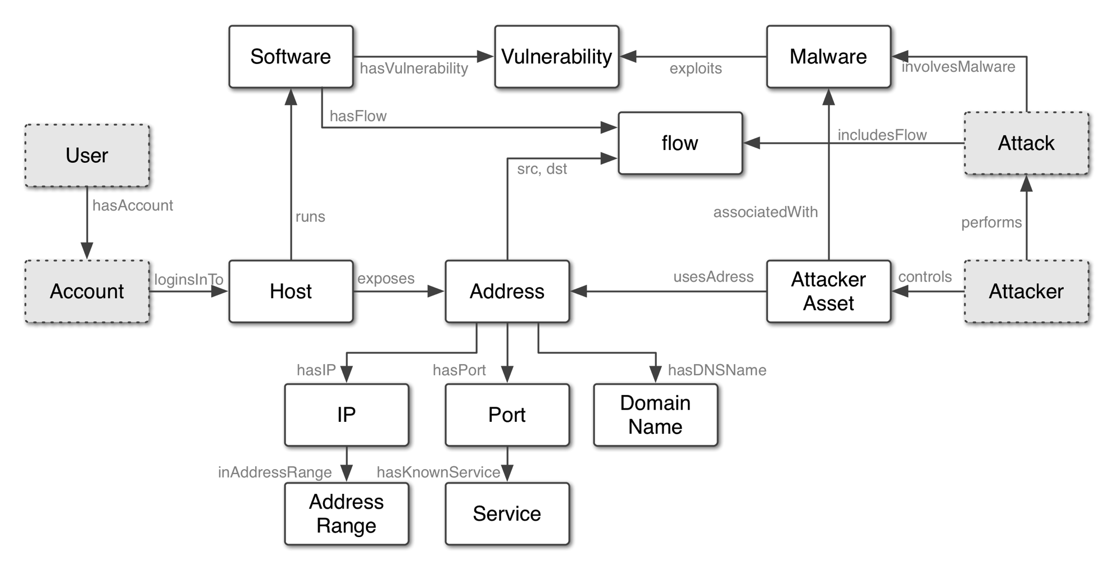
Approach
Ontology of domain concepts informs a
Graph database to be instantiated with data
Notes:
Advantages of graph database
Queries faster than relational
Natural fits relationships of data/ concepts

Slide 4
Key Components
Continuous collection and processing of data from endogenous and exogenous sources
Domain Specific Language for parsing and extracting domain concepts and relationships from structured data
Natural Language Processing for extracting domain concepts from text
Alignment methods for instantiating the knowledge graph
API for accessing the graph
Visualizations for exploring the graph to derive context
Continuous collection and processing of data from endogenous and exogenous sources
Domain Specific Language for parsing and extracting domain concepts and relationships from structured data
Natural Language Processing for extracting domain concepts from text
Alignment methods for instantiating the knowledge graph
API for accessing the graph
Visualizations for exploring the graph to derive context

Slide 5
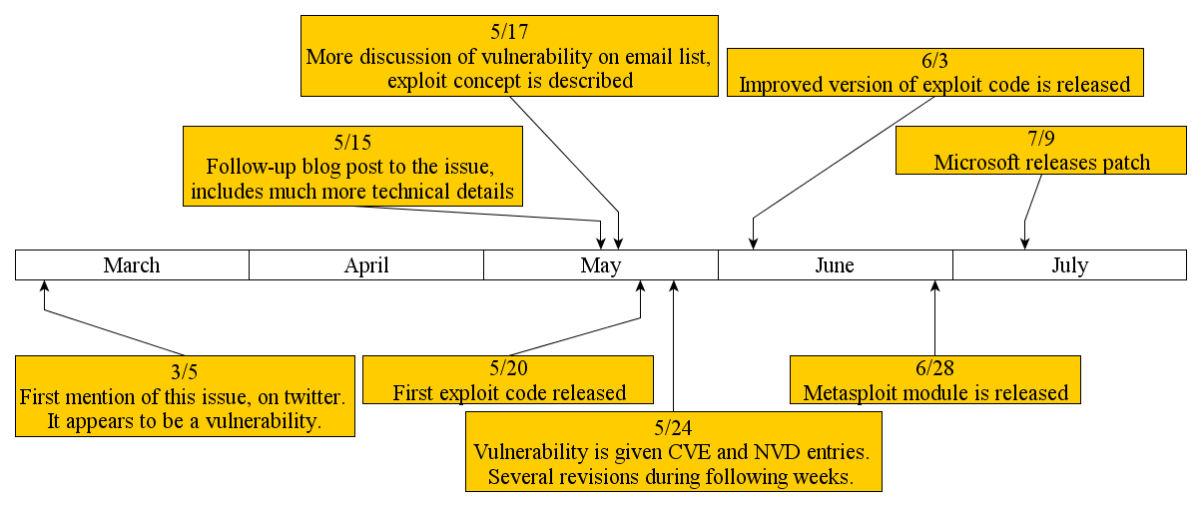
Enter Natural Language Processing
Want to automatically identify and extract important information from text
Compelling example
Notes:
Immediate

Slide 6
Entity Extraction
Automatically Identifying & Classifying Concepts in Text
Example
Input:
Output
Microsoft Internet Explorer 6 & 7 does not properly handle objects in memory, which allows remote attackers to execute arbitrary code by accessing a deleted object, aka “OnReadyStateChange Remote Code Execution Vulnerability”.
Microsoft Internet Explorer 6 & 7 does not properly handle objects in memory, which allows remote attackers to execute arbitrary code by accessing a deleted object, aka “OnReadyStateChange Remote Code Execution Vulnerability”.
sw.vendor
sw.product
sw.versions
Vuln.relevant
Vuln.relevant
Vuln.relevant
Vuln.relevant

Slide 7
Entity Extraction Approach
Use Supervised Entity Extraction to identify and classify concepts of interest.
“Automatically” created a training corpus with security-related labels
Used a Maximum Entropy Model with history-based features
Averaged Perceptron for training
Greedy Tagging
Use semi-supervised techniques (Bootstrapping)
Under development
Theme: NLP Machine Learning is thoroughly developed. Now, how to deploy these techniques to specialize applications?

Slide 8
“Auto-labeling”: Creating a Training Corpus
Example: National Vulnerability Database (NVD) record with annotated description
ID #: CVE-2012-0678
Description: Cross-Site Scripting (XSS) vulnerability in Apple Safari before 6.0 allows remote attackers to inject arbitrary web script or HTML via a feed :// URL.
Software Vendor: Apple
Software Application: Safari
Versions Affected: 1.0.0, : : : , 5.1.7
CWE Type: Cross-Site Scripting
...

Slide 9
“Auto-Labeling”: Creating a Training Corpus
Example: National Vulnerability Database (NVD) record with annotated description
ID #: CVE-2012-0678
Description: Cross-Site Scripting (XSS) vulnerability in Apple Safari before 6.0 allows remote attackers to inject arbitrary web script or HTML via a feed :// URL.
Software Vendor: Apple
Software Application: Safari
Versions Affected: 1.0.0, … , 5.1.7
CWE Type: Cross-Site Scripting
...
Vuln.relevant
Sw.vendor
Sw.product
Sw.version
Vuln.relevant
Vuln.relevant

Slide 10
Auto-Labeled Corpus Stats
Over 850,000 words
Results on a random subsample:
Precision = #(correctly labeled) / #(labeled)
Precision is the probability something was correctly labeled given it was labeled.
Recall = #(correctly labeled)/ #(should be labeled)
Recall is the probability something was correctly labeled given it should have been
F1 = Harmonic Mean (P,R) = 1/ave(1/P, 1/R) = 2PR/(R+P)
 | P | R | F1
NVD | .99 | .80 | .89
MS-Bulletin | .99 | .75 | .87
Metasploit | .95 | .54 | .69

Slide 11
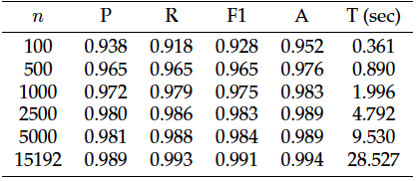
Performance Results
NVD Results
5-fold repeated subsampling
80/20% train/test sets
n = # NVD text descriptions
OpenNLP implementation results given
Time is “clock-time” on Macbook 2.3Ghz I7, 8GB, 256GB flash

Slide 12

STUCCO Conclusion
Main Idea: Building a tool to collect, correlate, and make accessible diverse data to enable decision making
Team
John Goodall, PI
Michael Iannacone, CoPI
Kelly Testa, CoPI
Robert A. Bridges CoPI
Acknowledgements:
This material is based on research sponsored by: the Department of Homeland Security (DHS) Science and Technology Directorate, Cyber Security Division (DHS S\&T/CSD) via BAA 11-02; the Department of National Defence of Canada, Defence Research and Development Canada (DRDC); the Dutch Ministry of Security and Justice; and the Department of Energy (DOE).}\blfootnote{The views and conclusions contained herein are those of the authors and should not be interpreted as necessarily representing the official policies or endorsements, either expressed or implied, of: the Department of Homeland Security; the Department of Energy; the U.S. Government; the Department of National Defence of Canada, Defence Research and Development Canada (DRDC); or the Dutch Ministry of Security and Justice.

