Slide 1
New Techniques for Entity Extraction of Cyber Security Concepts
Acknowledgements:
This material is based on research sponsored by: the Department of Homeland Security (DHS) Science and Technology Directorate, Cyber Security Division (DHS S\&T/CSD) via BAA 11-02; the Department of National Defence of Canada, Defence Research and Development Canada (DRDC); the Dutch Ministry of Security and Justice; and the Department of Energy (DOE).}\blfootnote{The views and conclusions contained herein are those of the authors and should not be interpreted as necessarily representing the official policies or endorsements, either expressed or implied, of: the Department of Homeland Security; the Department of Energy; the U.S. Government; the Department of National Defence of Canada, Defence Research and Development Canada (DRDC); or the Dutch Ministry of Security and Justice.
Notes:
Goal is to present research on using NLP to extract cyber security concepts from text

Slide 2
Project Overview: STUCCO
Situation & Threat Understanding by Correlating Contextual Observations
Goal: Provide Situational Awareness for understanding (and protecting) a computer network
Need: Data is diverse in nature and location, therefore, time consuming to find and digest
Means: Collect, correlate, and make accessible diverse data to enable decision making
Endogenous Data
Software (internal config.+ CPE)
Hardware (internal config)
Flows (Hone, Argus)
Firewall logs
Snort alerts
Authorization logs
Exogenous Data
Malware
Exploits (Metasploit)
Vulnerabilities (NVD, CVE)
Geographic IP address (GeoIP)
Blacklists
Info from unstructured text

Slide 3
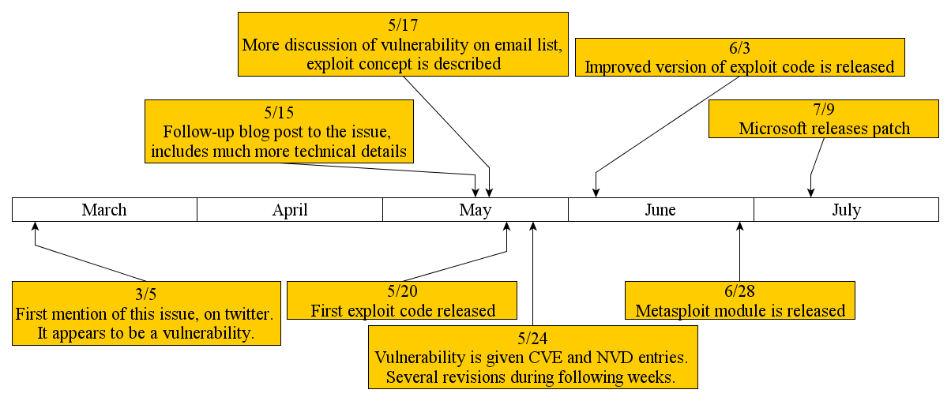
Enter Natural Language Processing
Want to automatically identify and extract important information from text
Compelling example: Timeline of disclosure of a vulnerability

Slide 4
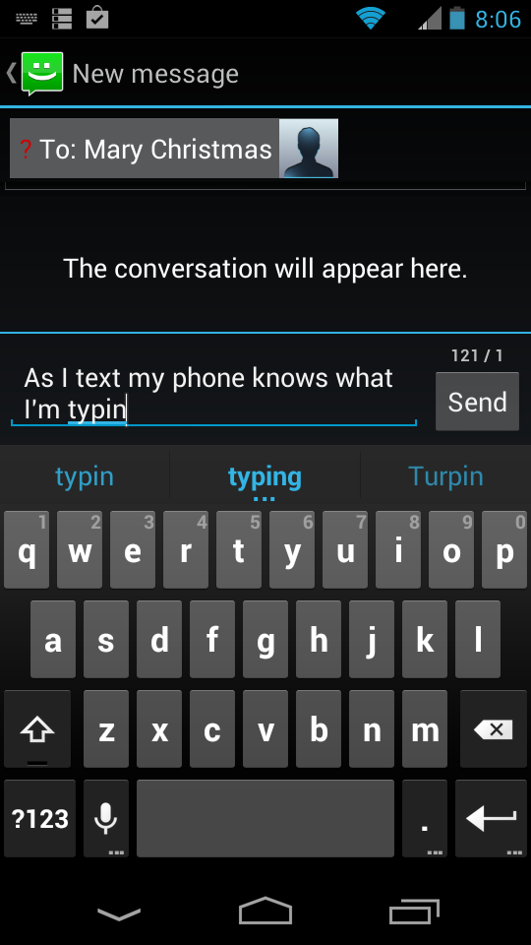
Natural Language Processing (NLP) “Where Machine Learning meets Linguistics”
Use heuristic rules, probability, & computational tools to understand human language
Computational Linguistics = Natural Language Processing (in my vernacular they are the same)
Examples
Machine Translation
Language Modeling
Information Extraction
Part of Speech Tagging
Parse Trees
Topic Modeling
Text Summarization
Sentiment Analysis
…

Slide 5
Our Approach
Use supervised Entity Extraction to identify and classify concepts of interest.
“Automatically” created a training corpus with security-related labels
Used a Maximum Entropy Model with history-based features
Averaged Perceptron for training
Greedy Tagging
Use semi-supervised techniques
Not discussed today
Theme: NLP Machine Learning is thoroughly developed for some tasks. Now, how to deploy these techniques to specialized applications?

Slide 6
Entity Extraction
Automatically Identifying & Classifying Concepts in Text
Also known as “Named Entity Recognition”
Example
Input
Output
George Washington’s ancestors were from Sulgrave, England; his great-grandfather, John Washington, had emigrated to Virginia in 1657.
George Washington’s ancestors were from Sulgrave, England; his great-grandfather, John Washington, had emigrated to Virginia in 1657.
person
place
person
place
date

Slide 7
Entity Extraction
Automatically Identifying & Classifying Concepts in Text
Example
Input:
Output
Microsoft Internet Explorer 6 & 7 does not properly handle objects in memory, which allows remote attackers to execute arbitrary code by accessing a deleted object, aka “OnReadyStateChange Remote Code Execution Vulnerability”.
Microsoft Internet Explorer 6 & 7 does not properly handle objects in memory, which allows remote attackers to execute arbitrary code by accessing a deleted object, aka “OnReadyStateChange Remote Code Execution Vulnerability”.
sw.vendor
sw.product
sw.versions
Vuln.relevant
Vuln.relevant
Vuln.relevant
Vuln.relevant

Slide 8
(Supervised) Sequential Labeling Problem Generalization & Formalization
Given a fixed vocabulary,
Given a fixed set of labels,
Given a training set
Each a sentence, so
Each a tag sequence, so
Must produce a function which takes in a sentence and outputs labels (or tags)
Security Domain Labels
Sw.product
Sw.vendor
Sw.version
Sw.language
Sw.symbol
Vuln.relevant
Vuln.name
O – (No label)

Slide 9
Sequential Labeling Solution Probabilistic Modeling
Pick probability model
Estimate using training data
Set
In other words, for sentence , choose the sequence of labels that is most likely.
Problem – No training data exists for many specialized applications!

Slide 10
“Auto-labeling”: Creating a Training Corpus
Method
Found structured sources (databases) with related text.
Used structured fields to label identical strings in related text
Heuristic rules to label entities in text
Created a gazetteer of “relevant vulnerability terms”
Common Weakness Enumeration (CWE) categorizes vulnerabilities. Most frequent phrases in vulnerability descriptions were hand-picked and labeled.
Sources
National Vulnerability Database (NVD)
Microsoft Bulletin
Metasploit Module

Slide 11
“Auto-labeling”: Creating a Training Corpus
Example: National Vulnerability Database (NVD) record with annotated description
ID #: CVE-2012-0678
Description: Cross-Site Scripting (XSS) vulnerability in Apple Safari before 6.0 allows remote attackers to inject arbitrary web script or HTML via a feed :// URL.
Software Vendor: Apple
Software Application: Safari
Versions Affected: 1.0.0, … , 5.1.7
CWE Type: Cross-Site Scripting
...

Slide 12
“Auto-Labeling”: Creating a Training Corpus
Example: National Vulnerability Database (NVD) record with annotated description
ID #: CVE-2012-0678
Description: Cross-Site Scripting (XSS) vulnerability in Apple Safari before 6.0 allows remote attackers to inject arbitrary web script or HTML via a feed :// URL.
Software Vendor: Apple
Software Application: Safari
Versions Affected: 1.0.0, … , 5.1.7
CWE Type: Cross-Site Scripting
...
Vuln.relevant
Sw.vendor
Sw.product
Sw.version
Vuln.relevant
Vuln.relevant

Slide 13
Auto-Labeled Corpus
Publicly Available
https://github.com/stucco/auto-labeled-corpus
Over 850,000 Words Labeled
Accuracy results on random sample
 | Precision | Recall | F1
NVD | .99 | .80 | .89
MS-Bulletin | .99 | .75 | .866
Metasploit | .95 | .54 | .69

Slide 14
“Auto-Labeling”: Creating a Training Corpus
Total List of Domain Specific Labels
Sw.product
Sw.vendor
Sw.version
Sw.language
Sw.symbol
Vuln.relevant
Vuln.name
O – (No label)
Also used “IOB” tags to mark multiple term entities.
Example:
“… Internet Explorer was …”
“… Internet Explorer was …”
“… Internet Explorer was ...”
B
I
O
(First, IOB labels identify entities)
B
sw.product
I
sw.product
O
(Next, domain labels classify entities)

Slide 15
Similar to “Auto-Labeling” Papers
Bellare et al 2007
Use BibTeX to segment corresponding citations
Seymore et al 1999
Use BibTeX entries to label headers of papers
Craven & Kumlien 1999
Sentence related to a database
Label a sentence as positive or negative

Slide 16
Supervised Entity Extraction Techniques
We used History Based Maximum Entropy Model
Trained with Averaged Perceptron
Greedy Labeling
Models | Type | Training Time | Performance
Hidden Markov Model | Generative | Fast | Least Accurate
History-Based Maximum Entropy Model | Discriminative | Medium | Medium
Global Maximum Entropy Model (Conditional Random Field) | Discriminative | Slow | Most Accurate

Slide 17
Feature Functions
Vuln. Relevant O O Vendor Software ??
Cross-Site Scripting (XSS) vulnerability in Apple Safari 6 allows remote attackers …
Create feature functions, e.g.
For each “history” , and current label, we get a binary feature vector

Slide 18
IOB Labels
Used NLTK to apply part-of-speech tags
Features:
Unigram features for
Previous 2, current, and following 1 word
Previous 2, current, and following 1 part-of-speech tag
Previous 2 and current IOB-tag
Bigram features for
Previous 2 IOB-tags
Previous IOB-tag & current word
Previous part-of-speech tag & current word
Regular Expressions for identifying
1nitial digit, inter1or digit, snake_case, camelCase, Initial capital, & punctuation!
Used on previous 2, current, and following 2 words

Slide 19
Domain Labels
Used NLTK to apply part-of-speech tags
Used MEM for IOB tags
Features:
Unigram features for
Previous 2, current, following 1 word
Previous 2, current and following 1 part-of-speech tag
Previous 2 and current IOB-tag
Previous 2 domain labels
Bigram features for
Previous 2 domain labels
Previous domain label & current word
Previous IOB-tag & current word
Previous part-of-speech tag & current word
Gazetteer features for
Sw.product
Sw.vendor
Regular Expressions for identifying
1nitial digit, inter1or digit, snake_case, camelCase, Initial capital, & punctuation!
Used on previous 2, current, and following 2 words

Slide 20
Cook-Up a Probability from Feature Vectors
Called a “Maximum Entropy Model” (MEM), also a “Log-Linear Model”
If features only depend on current and previous labels, it’s “History Based”.
HMM can be realized from MEM by choosing features that only depend on the current word, and the previous labels.

Slide 21
MEM Tagging & Training
Choose Features, e.g.
Define
How to learn the parameters ?
Averaged Perceptron
How to tag a sentence?
Greedy (word by word) Tagging

Slide 22
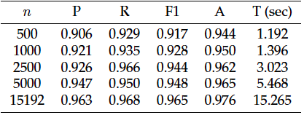
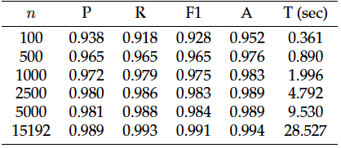
Performance
IOB Results
Results:
5-fold repeated subsampling
80/20% train/test sets
n = # NVD text descriptions
OpenNLP implementation results given
Time is “clock-time” on Macbook 2.3Ghz I7, 8GB, 256GB flash
NVD Results

Slide 23
Some Results from Literature
Joshi et. al 2013
Almost same problem
Hand-labeled corpus
CRF (global model)
Precision | Recall | F1
.837 | .764 | .799

Slide 24
Thank You!
Website with training corpus and machine learning code:
https://github.com/stucco/auto-labeled-corpus
Collaborators:
Corinne Jones (PSU Intern)
Mike Iannacone
Kelly Testa
John Goodall (PI)
Funding
DHS
Questions?
Contact
Robert A. Bridges, PhD
bridgesra@ornl.gov
Oak Ridge National Laboratory

Slide 25
Why is It Called “Maximum Entropy”?
Want to only bias probability model by the observations in training data.
Definition: Given a discrete probability distribution, , the Entropy is
Maximizing entropy ensures the probability mass is spread evenly (unbiased)
Idea: Maximize entropy in the presence of constraints given by observed features (Lagrange Multiplier Problem).
Result:
Notes:
EXAMPLE: 6 sided die, 100 rolls, only know 50 of them were 3! How to make a probability distribution? Def. Want p(3)=.5, and want p(j)=1/10 for other 5 sides.

Slide 26
Training History Based Models How to Learn Parameters
Maximum Likelihood Estimation (MLE)
Choose most likely in light of training data
In practice, maximize
Easy to prove is concave
Use gradient ascent methods, e.g. LBFGS
, the log of the prior is the “regularization term”
The first, linear term is
where the name
“Log Linear Model”
originates
Medium computational
speed

Slide 27
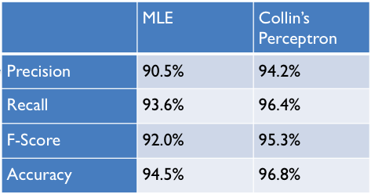
MLE and Perceptron Results
Our tests with labels “1” and “0”s
Both were slow, not as accurate as Ave. Perceptron

Slide 28
Decoding with History Based Models How to Tag a Sentence
Direct Search:
For a sentence of length n, , and m labels, , then finding the “best” tag sequence is
Greedy Decoding:
Choose the most likely , then the most likely , …
Not guaranteed to give the most likely total sequence!
Viterbi Decoding: Recovers “best” tag sequence in (for histories of length k)
Dynamic programming trick: store calculated probabilities at each word.
Then “walk” backward though sentence to construct the sequence

Slide 29
Training History Based Models How to Learn Parameters
MLE
Perceptron:
Initiate
Iterate through training set
At example tag using current . Say given tag is .
If keep unchanged, & go to next training example.
If replace with
Guaranteed to converge in case of linearly separable data
Averaged Perceptron:
Run the “vanilla” perceptron
Keep track of each intermediate and how many correct labels each provides
Return the weighted average vector

