Slide 1


RESTAURANT RECOMMENDATION SYSTEM
Bharath Reddy Sarabuddula - 70073991
Shashaank Reddy Dondapaati -700740721
Jyothi Sai Rajesh Kunapareddy - 700742325

Slide 2
ROLES/RESPONSIBILITIES AND CONTRIBUTION OF THE PROJECT
Researching the data and Identification of proper data set as well as working on documentation – Bharath Reddy Sarabuddula
Choosing the proper machine learning model which helps us to predict the most accurate prediction result – Shashaank Reddy Donadapaati
Contribution to coding and verifying the best accuracy of predicted model – Jyothi Sai Rajesh Kunapareddy

Slide 3

MOTIVATION
We are continually impressed by the restaurants' ability to maintain their high standards in the face of such innovative rivalry.
Since Bengaluru is one of these cities, with more than 12,000 restaurants serving dishes from all over the world, the primary goal of analyzing the Zomato dataset is to get a fair idea about the factors affecting the establishment of various types of restaurants at various locations in Bengaluru, as well as an aggregate rating of each restaurant.

Slide 4

OBJECTIVES
Examine and investigate the dataset.
The representation of the datasets.
Rating prediction of the restaurant.
A sentiment analysis of the dataset's reviews
System for recommending restaurants using keywords

Slide 5
PROBLEM STATEMENT
It is always difficult to find the restaurant in some areas like Bangalore.
It is also difficult predict the rating of the rating based on the area.
So, we need a machine learning approach to find a good restaurant and rating using some keywords.

Slide 6

PROPOSED SOLUTION
We are going first predict the rating of the restaurant using regression we used the following regression algorithms
Linear Regression
Decision Tree Regression
Random Forest Regression
Extra Tree Regression

Slide 7

PROPOSED SOLUTION
Next, we are building a model to get recommendation list as per the given keyword.
Term Inverse Frequency Document Frequency

Slide 8
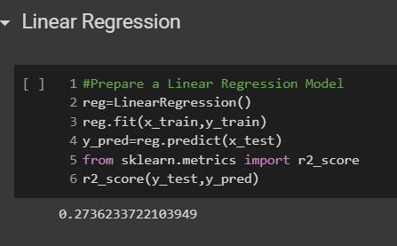
RESULTS: LINEAR REGRESSION

Slide 9
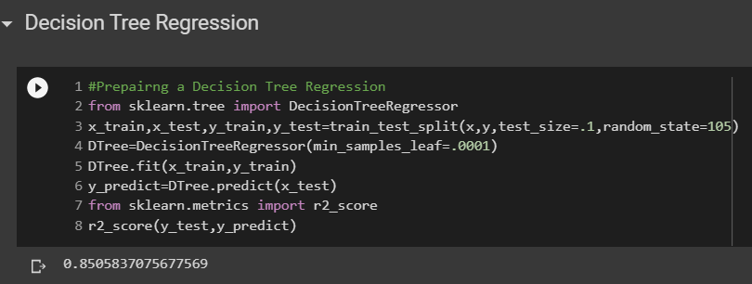
RESULTS: DECISION TREE REGRESSION

Slide 10
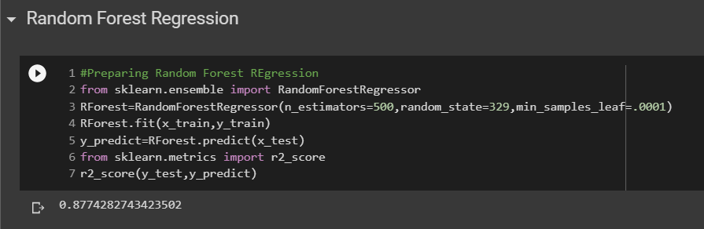
RESULTS: RANDOM FOREST REGRESSION

Slide 11
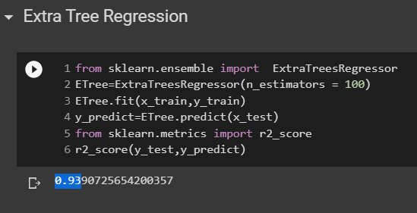
EXTRA TREE REGRESSION

Slide 12
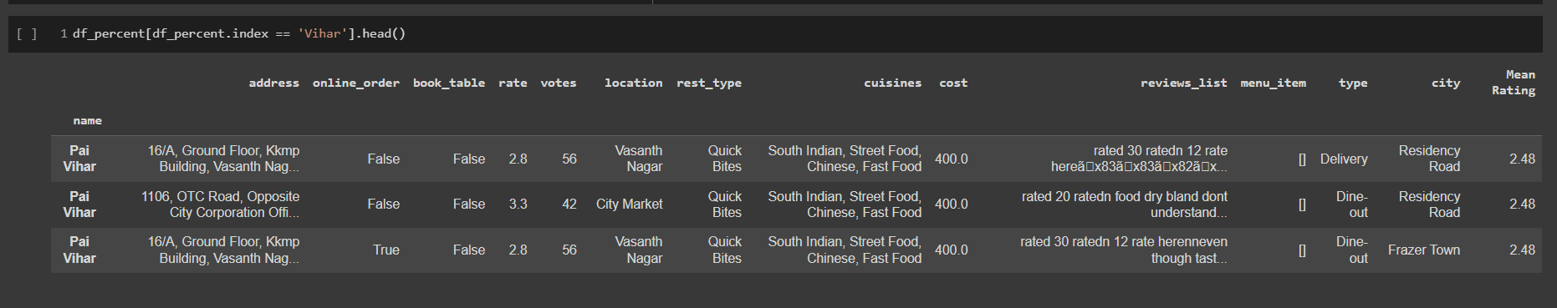
Results: Restaurant Recommendation

