Slide 1
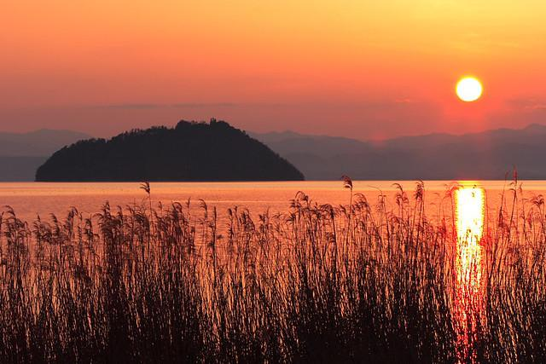
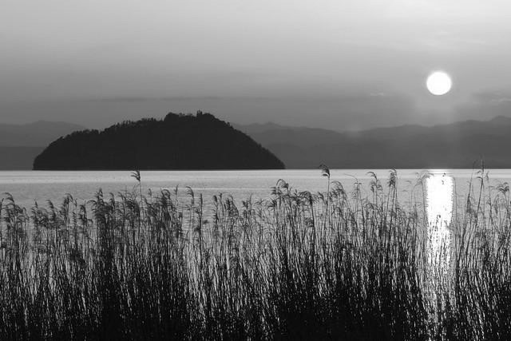
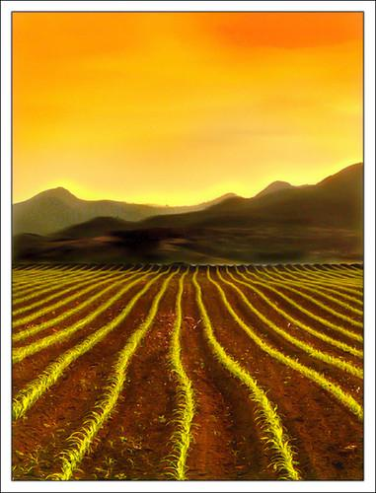
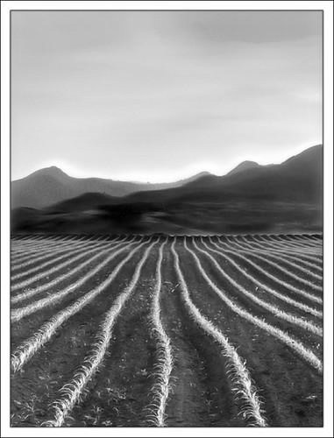
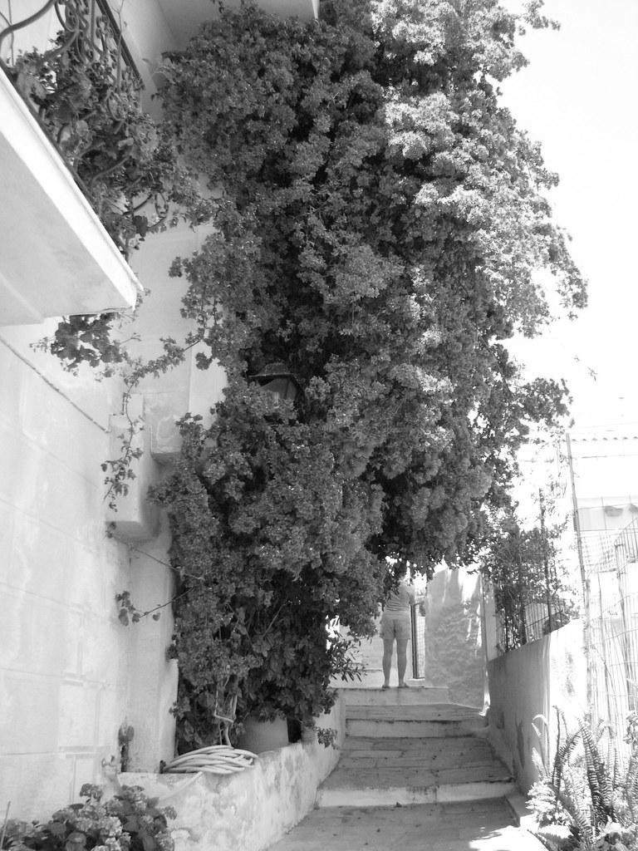
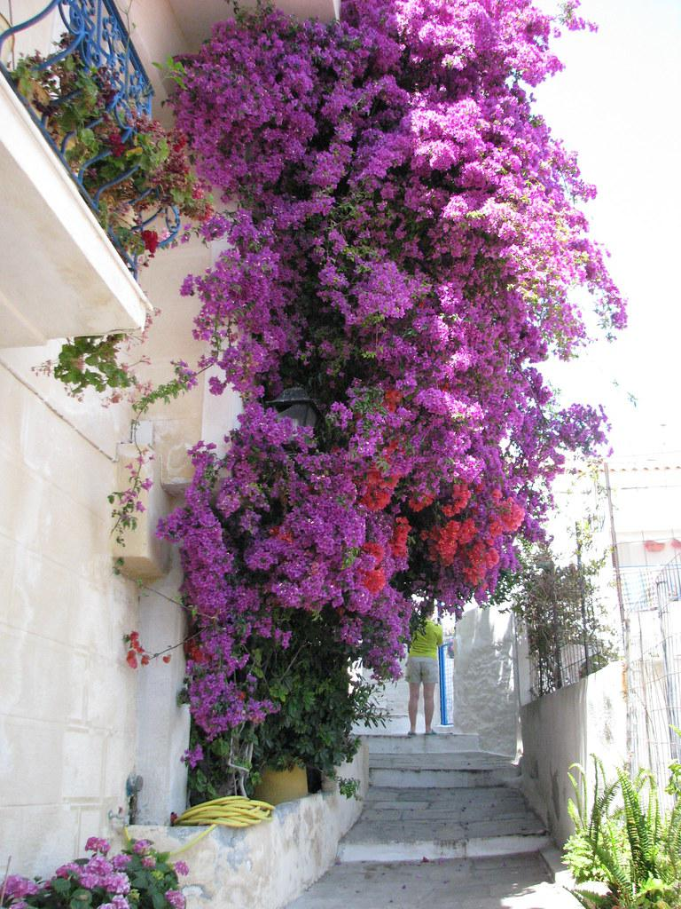
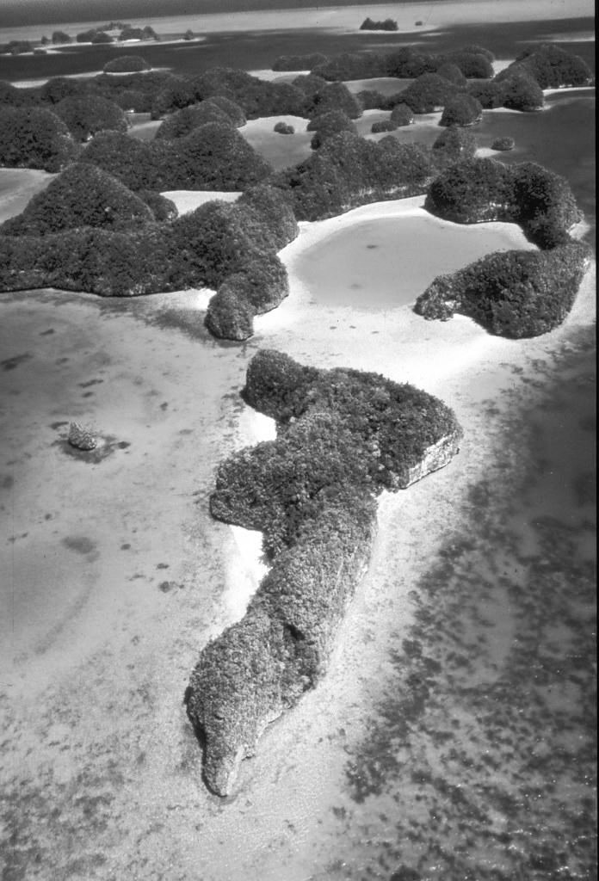
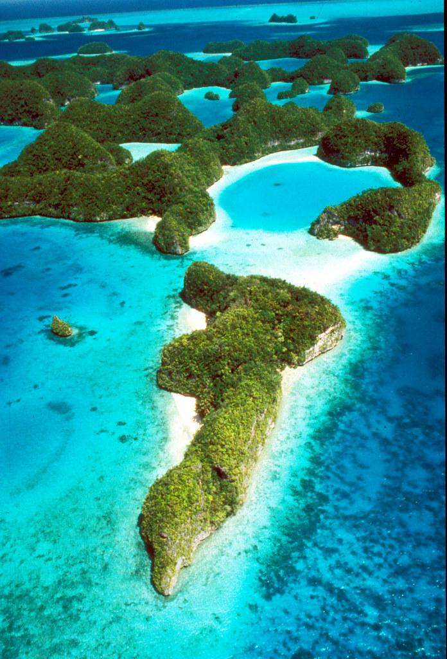
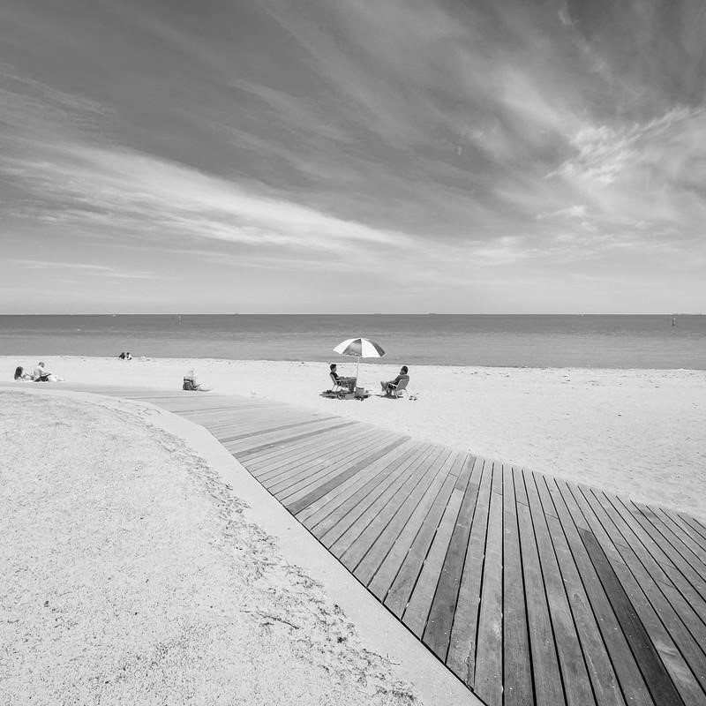
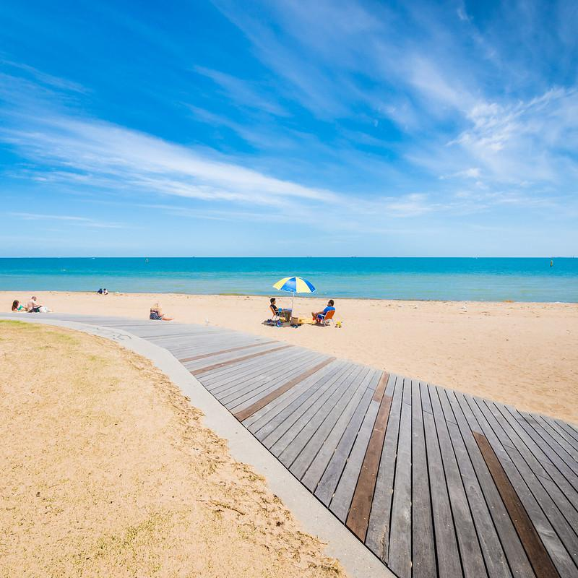

Slide 2
IMAGE COLORIZATION USING TRANSFER LEARNING
FINAL PROJECT PRESENTATION
FOR
COMPUTER VISION (CS0029)
Presented by:
Shashank (M11115809)
Megha Dey Sarkar(M11115811)

Slide 3
PROJECT BACKGROUND
Image colorization is a captivating task that adds color to grayscale images, enhancing visual appeal.
From media to medical, image colorization is an attractive and investigated image processing practice.
Traditional colorization methods have limitations in accuracy and efficiency, often requiring manual intervention.
Transfer learning uses pre-trained models, improves image colorization by leveraging knowledge and features learned from large color image datasets.

Slide 4
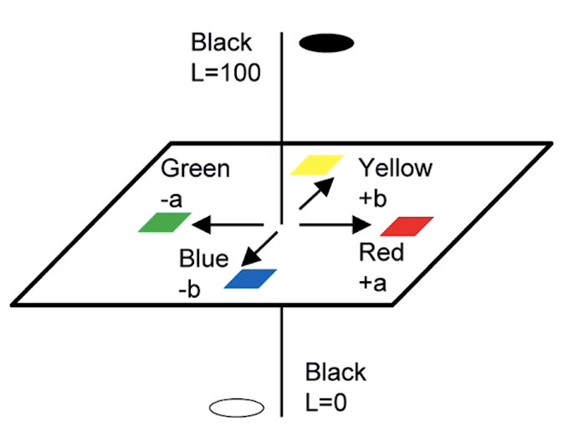
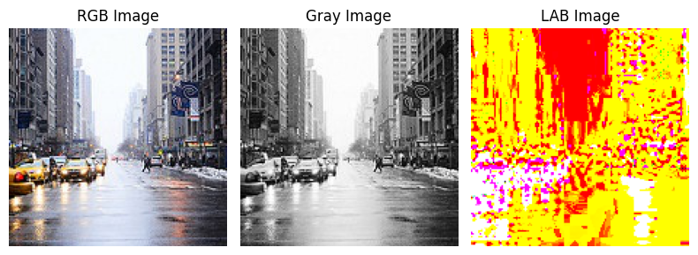
IMPLEMENTATION (IMAGE FORMAT)
Dataset consists of 7000+ colorful landscape images.
LAB color space is one of the complete color space.
3 color axis - L for lightness, a&b for other color positions.
Unlike other color space, very little correlation between three components.
Fig: Image in RGB format converted to Gray and LAB format

Slide 5
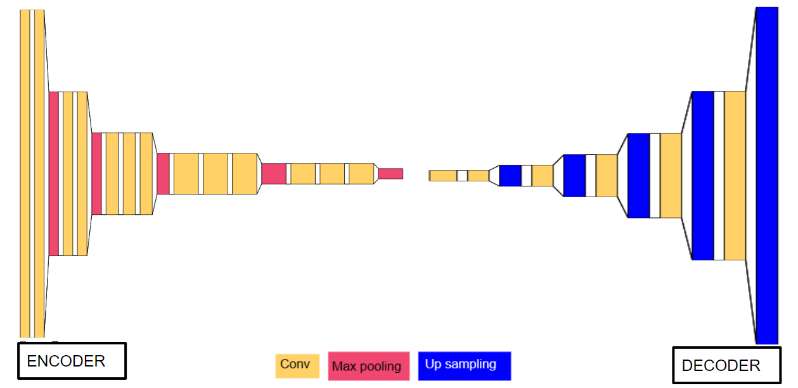

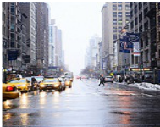
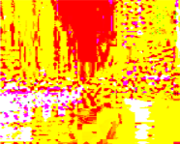
IMPLEMENTATION (STEPS)
LOAD TRAINING IMAGES
CREATE A SEQUENTIAL MODEL
PREPROCESS TEST IMAGES
PREDICT
INITIALIZE VGG16 MODEL
CHECK THE SUMMARY
RESCALE IMAGES
COMPILE THE MODEL
CONVERT RGB TO LAB
EVALUATE THE MODEL
SAVE AND LOAD THE MODEL

Slide 6
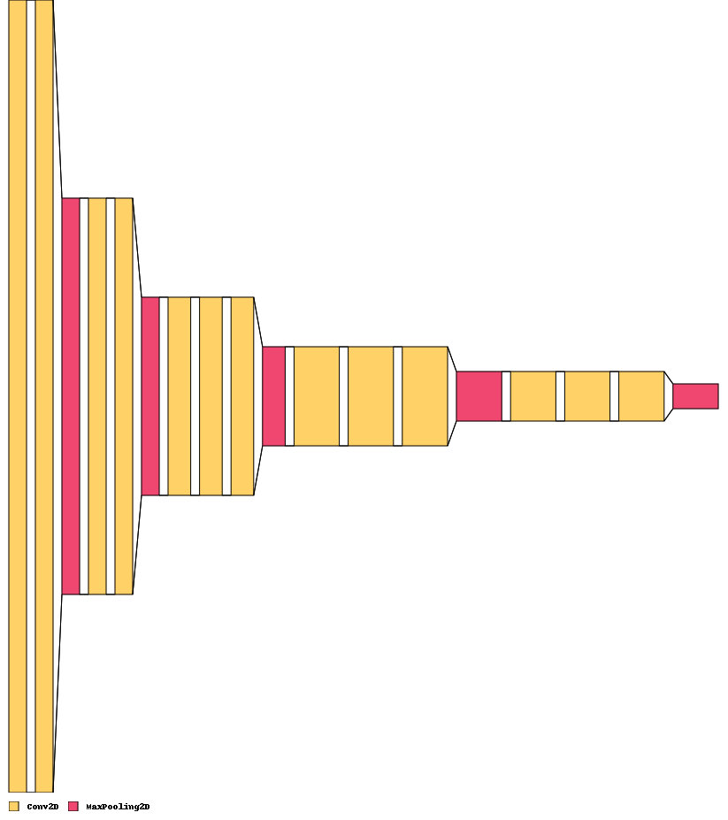
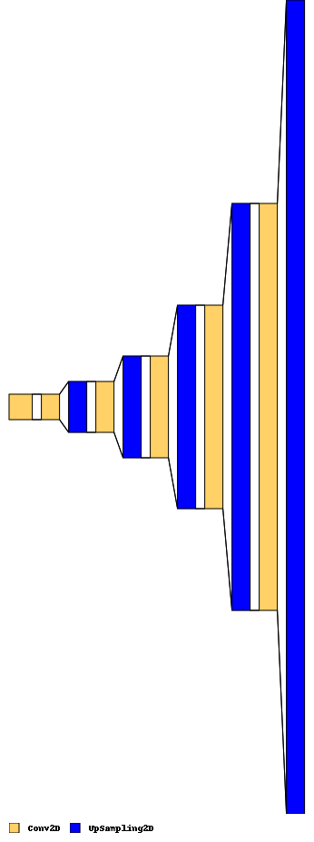

ARCHITECTURE
I/P SHAPE - 224*224*3
O/P SHAPE- 224*224*2
O/P SHAPE - 7*7*512
O/P SHAPE - 14*14*512
O/P SHAPE - 7*7*256
O/P SHAPE - 112*112* 64
O/P SHAPE - 56*56*16
ENCODER
DECODER

Slide 7
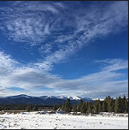
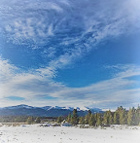
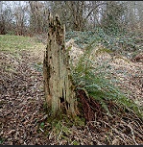
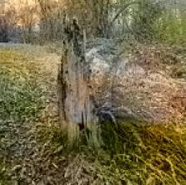
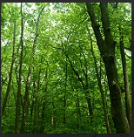
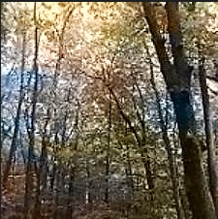
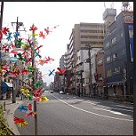
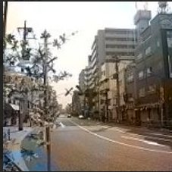
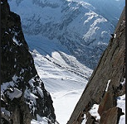
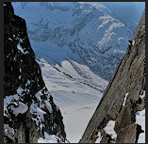
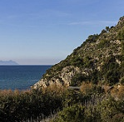
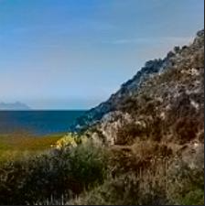
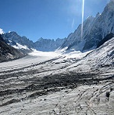
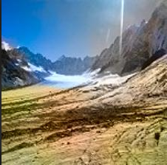
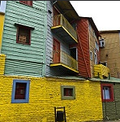
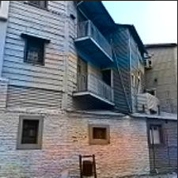
EXPERIMENT RESULTS
Good Results | Modest Results | Ambiguous Results | Failed results
Original
Generated
Original
Generated
Original
Generated
Original
Generated

Slide 8
EVALUATION METRICS
PSNR(Peak Signal to Noise Ratio): The ratio is used as a quality measurement between the original and a compressed image.
SSIM (Structural Similarity Index Measure): A perceptual metric that quantifies image quality degradation.
NO. OF TRAINING IMAGES | NO. OF EPOCHS RUN | TRAINING ACCURACY | AVERAGE SSIM | AVERAGE PSNR
700 | 200 | 84.99% | 0.944 | 25.448
700 | 500 | 86.99% | 0.927 | 25.448
*1000 | 500 | 87.32% | 0.924 | 22.994

Slide 9
CHALLENGES FACED
Variation in Image Content:
Ambiguity in colorizing objects like trees due to color variations and textures.
Ensuring consistent and realistic colorization across diverse image types.
Handling Large-Scale Colorization:
Computationally intensive and time-consuming process.
Constraints on training with large datasets and limited training epochs due to system limitations.
Bias Towards Sepia Colors:
The model tends to favor "sepia" colors more than other colors in the colorization process.
Identifying the exact cause behind this bias and finding ways to mitigate it is crucial for achieving more balanced and accurate colorization results.

Slide 10
CONCLUSION AND FUTURE WORK
The objective of effectively converting a grayscale image into a colored image is achieved using a convolutional neural network.
The model seems to be favouring the ‘sepia’ colors more than other colors. Finding the precise cause of this is a wise course of action.
Using Generative Adversarial model over the existing model might generate better colorization.

Slide 11
THANK YOU!!!

